Slide 1
PBIS Team Training 4A
Problem Behavior Definitions & Discipline Policies (TFI 1.5 & 1.6)
Thank you to Midwest PBIS Network, Mid-Atlantic PBIS Network, Missouri Schoolwide PBS, Virginia Dept of Ed PBIS, and other National Partners for their contributions

Slide 2
Learning Expectations
EXPECTATION | BEHAVIOR
Be Responsible | Make yourself comfortable Take care of your needs (water, food, restroom, etc.) Action plan to implement what you are learning Follow through on your action items
Be Respectful | Turn cell phones off or to “vibrate” Listen attentively while others are speaking Have only the training materials up on your computer/tablet/phone
Be Engaged | Ask what you need to know to understand and contribute Contribute to the group by sharing relevant information and ideas
Notes:
2

Slide 3
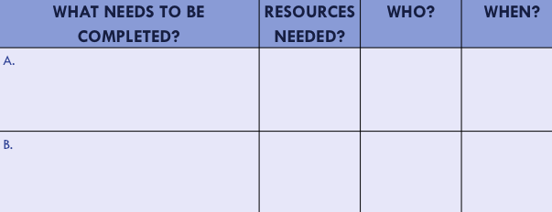
Organization of Modules
Content:
Aligned to TFI Items 1.1 – 1.15 and Classroom Management Practices
Activities/Team Time: Activities for Fluency
Self-Assessment:
Tiered Fidelity Inventory
Action Planning: Applying the core content to your school
Notes:
These are the icons that you will see throughout the training and will serve as a guide and a prompt to the content of each slide.

Slide 4
Tier 1: Professional Learning Roadmap
TFI Sub-Scale: Team
TFI 1.1 | Team Composition
TFI 1.2 | Team Operating Procedures
TFI Sub-Scale: Evaluation
TFI 1.12 | Discipline Data
TFI 1.13 | Data-based Decision Making
TFI 1.14 | Fidelity Data
TFI 1.15 | Annual Evaluation
TFI Sub-Scale: Implementation
TFI 1.3 | Behavioral Expectations
TFI 1.4 | Teaching Expectations
TFI 1.5 | Problem Behavior Definitions
TFI 1.6 | Discipline Policies
TFI 1.7 | Professional Development
TFI 1.8 | Classroom Procedures
TFI 1.9 | Feedback and Acknowledgement
TFI 1.10 | Faculty Involvement
TFI 1.11 | Student/Family/Community Involvement

Slide 5
TFI 1.5 & 1.6 Purpose & Outcomes
Purpose:
Prepare and plan for facilitating implementation of effective discipline procedures
Outcomes:
1.5 Problem Behavior Definitions:
School has clear definitions for behaviors that interfere with academic and social success and a clear policy/ procedure (e.g., flowchart) for addressing office-managed versus staff-managed problems
1.6 Discipline Policies:
School policies and procedures describe and emphasize proactive, instructive, and/or restorative approaches to student behavior that are implemented consistently

Slide 6
Definition
Disciplinary policies and practices are part of a cohesive behavior support system within a school. Discipline is a complementary system to expectations and acknowledgements.
Effective discipline includes opportunities for students to LEARN and PRACTICE appropriate behaviors through an instructional approach.

Slide 7
Rationale for Discipline Definitions and Policies
Clearly defined procedures support consistency with responding to behavioral infractions. Consistency creates the conditions for increased structure, feelings of safety, and a positive learning environment.
Differentiating between behaviors addressed in the classroom, versus those addressed by administration, can:
improve consistency within the classroom
provide more meaningful information for problem solving
increase instructional minutes
free up administrative time spent on discipline.
Notes:
Effective discipline procedures ultimately: increase consistency in the building, increase the collection of and problem solving with meaningful data, and to increase instructional minutes and keep students engaged in learning.

Slide 8
Responsibility for Behaviors
Behavioral Examples
Classroom-managed (minor) | Office-managed (major)
Involve opportunities for teachable moments and minimizing interruption to instruction | Involve school and student physical and emotional safety
Notes:
Involve school and student physical and emotional safety -Behaviors that significantly violate rights of others, put others at risk or harm

Slide 9
Classroom or Office Managed?
Tardy to class?
Not prepared?
Aggressive Language?
Electronic Devices?
Touching?
Gambling?
Dress code?
Chronic minors?
Notes:
Opportunity for group participation

Slide 10
How does your school/district differentiate between classroom and office managed behaviors?
Notes:
Turn and Talk
Then large group talk

Slide 11
Defining Behaviors
The SWIS developers have definitions for problem behaviors that can be used by anyone.
The definitions are clear, observable, and can be measureable.

Slide 12
Minor Examples (develop by SWIS)
See Workbook Pages 30 - 31
Notes:
These are our starting points

Slide 13
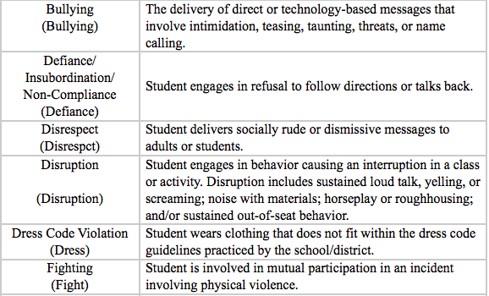
Major Examples (developed by SWIS)
See Workbook Pages 30 - 31
Notes:
These are our starting points for Major offenses

Slide 14
“T-Chart” School Example
Teacher Managed Behavior (Minor)
Attendance/Tardy – Inform parents on effect on academic performance
Profanity directed at student
Gum chewing
Homework
No supplies
Tattling
Non-compliance
Name calling
Lying
Minor stealing
Cheating
Dress Code Violations
Minor Harassment
Disrespect
Disruption
Defiance
Office Managed Behavior (Major)
Attendance/Tardy
Vandalism
Substances
Weapons
Profanity directed at Adults
Fighting
Verbal/Physical intimidation
Major stealing
Cutting school
Wanderers
Gang Related Activity
Chronic Dress Code Violation
Harassment (including sexual)
Disrespect
Disruption
Defiance

Slide 15
“T-Chart” School Example
Teacher Managed Behavior (Minor)
Attendance/Tardy – Inform parents on effect on academic performance
Profanity directed at student
Gum chewing
Homework
No supplies
Tattling
Non-compliance
Name calling
Lying
Minor stealing
Cheating
Dress Code Violations
Minor Harassment
Disrespect
Disruption
Defiance
Office Managed Behavior (Major)
Attendance/Tardy
Vandalism
Substances
Weapons
Profanity directed at Adults
Fighting
Verbal/Physical intimidation
Major stealing
Cutting school
Wanderers
Gang Related Activity
Chronic Dress Code Violation
Harassment (including sexual)
Disrespect
Disruption
Defiance
What about these examples?

Slide 16
Example of a School Reviewing their Major ODR Data
Infraction | Notes
Disruption | Refusal to do work, throw paper
Disruption | Refusal to do work, cry, pout, stomp
Disruption | Off task, refusal
Disruption | Arguing with teacher
Disruption | Prohibited teaching and learning
Disruption | Playing, throwing water
Disruption | Off task
Disruption | Throwing paper, yelling, hitting, crawling
Disruption | Following directions, playing, off task
Disruption | Not following directions
Notes:
Here is actual school data from an elementary school. These are the behaviors reported on the Office Referrals. The staff looked at the referrals and determined which behaviors could be handled in the classroom and which behaviors needed to be referred to the principal.
The result was commitment and ownership from colleagues and teachers.

Slide 17
Analysis of Data on Disruption:
What does Disruption look like and sound like?
Classroom-managed | Office-managed
Refusal to do work | Disruption escalated into a physical or verbal confrontation
Argue with the teacher | Minor actions repeated to the point of an “un-teachable” learning environment
Calling out
Tapping pencil/objects
Talking to others
Unnecessary movement (out of seat/fidgeting)
Touching others
Notes:
What are some minor and major examples of the behavior described?
Is there a point in the scenario in which the behavior might be considered minor? Is there a point when it crosses the line and might be considered major?
Have you considered what is developmentally appropriate, culturally responsive, gender responsive, special needs?
When does a recurring teacher-managed behavior (minor) become an administrator-managed (major) behavior?
How many minor incidents of the same behavior warrant administrative action?
How do you factor in minor incidents with multiple teachers?
How do you factor in the timeframe in which the minor incidents occur?
Lessons learned…
Establish a system for collecting, monitoring, and analyzing minor incidents
Define decision rules to design supports, not as a “gotcha” or a 3 strikes you’re out!

Slide 18
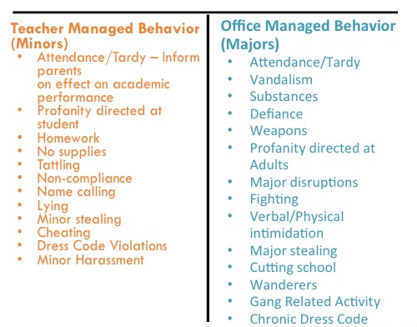
Completing T-charts with Staff
T Chart for All Behaviors
Workbook: TFI 1.5, 1.6 Activities 1 & 2
List all Minor Behaviors (Classroom managed) on one side
List all Major Behaviors (Office managed) on the other side
Finalize the list and definitions
Provide additional examples for any behaviors that are listed as both Minor and Major.

Slide 19
“When everyone handles infractions with instructional correction procedures, students learn that what happens when they misbehave is procedure not personal.”
~Bob Algozzine

Slide 20
How Do You Respond?
Notes:
https://www.youtube.com/watch?v=Oq8nYgnE93Y - 1:54

Slide 21
Why Focus on a Continuum of Strategies to Respond to Inappropriate Behavior?
What is the single most commonly used but least effective method for addressing
undesirable behavior?
The single most commonly used but least effective method for addressing undesirable behavior is to verbally scold and berate a student
(Albetro & Troutman, 2006).
Notes:
Even when we have clearly defined rules and routines and give high rates of positive feedback we know some students will still demonstrate inappropriate or undesirable behavior.
When misbehavior happens, correcting students is not bad or wrong- in fact, consistently responding to inappropriate behavior is essential. Correctives are a problem only if they exceed the rate of positives.
However….(Read Slide)
The teacher who yells or berates is, in effect, saying to the student this is how an adult reacts and copes with undesirable behaviors in an environment (Alberto & Troutman, 2006).
This is not the model we want to provide for students.

Slide 22
Consistency is key, not severity
It is less important what the consequence is, than that something is reliably done.
How staff respond or what consequence is used is less important than the certainty that something will be done, even something relatively brief such as redirection or re-teaching.
Notes:
When students passing in the hallways see that all educators consistently stop students to address even small violations of procedures, they will quickly bring their behavior in line.
Give teams time to think of a current problem or a previous problem where staff are not responding consistently or where staff did increase consistency with response and that contributed to a decrease in that behavior.

Slide 23
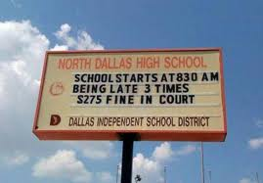
School Sign
Notes:
When students passing in the hallways see that all educators consistently stop students to address even small violations of procedures, they will quickly bring their behavior in line.
Give teams time to think of a current problem or a previous problem where staff are not responding consistently or where staff did increase consistency with response and that contributed to a decrease in that behavior.
It is less important what the consequence is, than that something is reliably done.
How staff respond or what consequence is used is less important than the certainty that something will be done, even something relatively brief such as redirection or re-teaching.

Slide 24
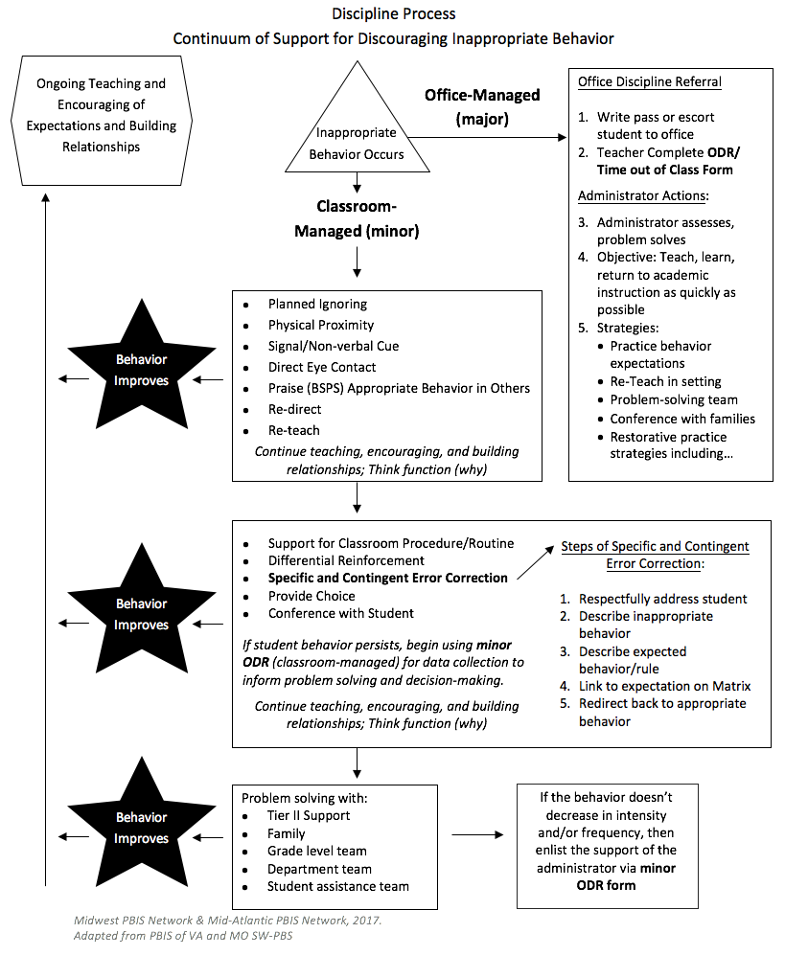
Where do you document the process and practices for how staff prevent and respond to problem behaviors?
SAMPLE
Notes:
This will be addressed more completely through classroom behavior systems- EBPs, problem solving, responding/error correction and preventing

Slide 25
Develop a Continuum of Strategies to Respond to Inappropriate Behavior
Planned Ignoring
Physical Proximity
Signal/ Non-Verbal Cue
Direct Eye Contact
Praise (BSPS) the Appropriate Behavior in Others
Redirect
Support for Procedure/Routine
Re-teach
Differential Reinforcement
Specific and Contingent Error Correction
Provide Choice
Conference with Student

Slide 26
Definitions of Strategies
If time permits, discuss these definitions from the next two slides with your shoulder partner, and consider if 1)if any should be included on your school’s discipline flowchart, and 2) PD required to ensure all staff implement those strategies with fidelity
Planned Ignoring | Ignore student behaviors when their motivation is attention, and continue instruction without stopping
Physical Proximity | Using teacher proximity to communicate teacher awareness, caring, and concern
Signal/Non-Verbal Cue | Teacher gestures to prompt a desired behavior, response, or adherence to a classroom procedure and routine.
Direct Eye Contact | The ”teacher look” to get attention and non-verbally prompt a student
Praise (BSPS) the Appropriate Behavior in Others | Identify the correct behavior in another student or group, and use behavior specific praise to remind all students of the rule/expectation.
Redirect | Restate the desired behavior as described on the teaching matrix

Slide 27
Definitions of Strategies (con’t)
Support for Procedures/ Routine | Identify and install a classroom routine to prevent the problem behavior. Provide a booster for a routine already in place.
Re-teach | State and demonstrate the matrix behavior. Have the student demonstrate. Provide immediate feedback.
Differential Reinforcement | Reinforcing one behavior and not another. For example reinforce the positive behavior while ignoring the student’s inappropriate behavior.
Specific and Content Error Correction | Specific directions that prompt or alert the student to stop the undesired behavior and to engage in the desired behavior
Provide Choice | Give choice to accomplish task in another location, about the order of task completion, using alternate supplies to complete the task or for a different type of activity that accomplishes the same instructional objective. Choices should lead to the same outcome.
Conference with Student | Describe the problem. Describe the alternative behavior. Tell why the alternative is better. Practice. Provide feedback.

Slide 28
Specific and Contingent Error Correction Definition
Error correction is an informative statement provided by a teacher or other adult following the occurrence of an undesired behavior.
It is:
Contingent - occurs immediately after the undesired behavior
Specific - tells the learner exactly what they are doing incorrectly and what they should do differently in the future
Brief- after redirecting back to appropriate behavior, move on.

Slide 29
Goals of Specific and Contingent Error Correction
Interrupt the problem behavior and engage the students in the expected behavior
Ensure the students exhibit the expected behavior in future occurrences of similar situations
Avoid escalation of the problem behavior (Colvin, 2010)

Slide 30
Error Correction: Non-Examples…
How many times do I have to tell you to work quietly?
Didn’t I just tell you to get your work done?
Why are you talking when I’m talking?
Do you want me to send you to the office?
What’s going to happen if I call your mother?
What do you think you’re doing?
Don’t you think you should be using your time better?
Notes:
How often have we heard or used these types of statements? (Read Slide)
Although meant to deter misbehavior these types of statements are often very reinforcing to students… why do you think? (gives adult attention)
Questioning students about their behavior is ineffective. You don’t want an answer, you want compliance. Questioning gives attention to the inappropriate behavior.
Our goal instead is to increase the likelihood of appropriate behavior. We do this by teaching and acknowledging what we want students to do instead…and on occasion by providing consistent, respectful responses to misbehavior.
(Newcomer, 2008)

Slide 31
Set the tone
Responses to inappropriate behaviors are always: 1. Calm 2. Consistent 3. Brief 4. Immediate 5. Respectful
I’ve come to a frightening conclusion that I am the decisive element in the classroom. It’s my personal approach that creates the climate. It’s my daily mood that makes the weather. As a teacher, I possess a tremendous power to make a child’s life miserable or joyous. I can be a tool for torture or an instrument of inspiration. I can humiliate or humor, hurt or heal. In all situations, it is my response that decides whether a crisis will be escalated or de-escalated and a child humanized or dehumanized.
~Haim Ginott

Slide 32
Steps to Specific and Contingent Error Correction:
Describe inappropriate behavior
Respectfully address student
Describe expected behavior/rule
Link to expectation on Matrix
Redirect back to appropriate behavior
Practice: Come up an a sample Error Correction statement that includes all steps above and is brief!
Notes:
Ask participants to make an error correction statement to share with the whole group. Are all components included? Is it brief? Is it linked to rule and expectation on the Matrix?

Slide 33
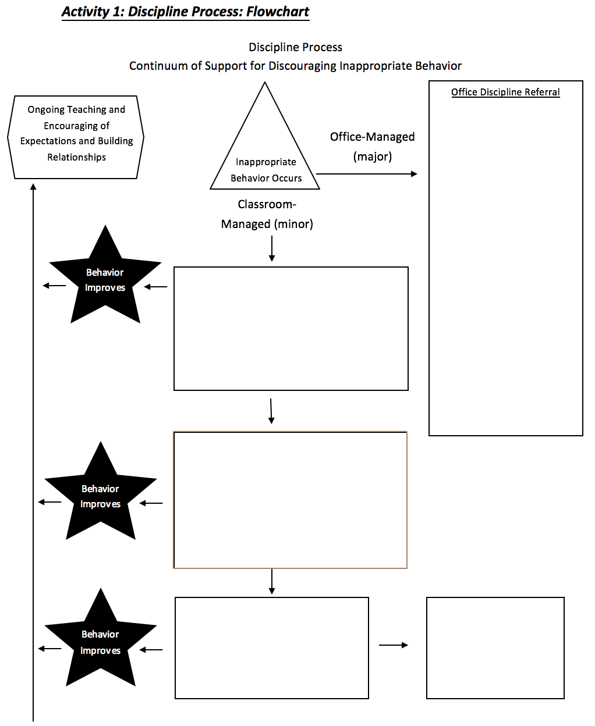
Add a Continuum of Strategies to your Discipline Flowchart
Workbook: TFI 1.5, 1.6 Activity 3
What effective strategies are currently in place for responding to a minor/teacher managed behavior problems in your school?
Identify your continuum of strategies
Include prevention strategies
Include re-teaching and other classroom management practices
Add your continuum to the flowchart to document the process for responding to behavior.
Avoid “3 minors equals a major” logic
What about minors?
Notes:
NOTES
This is a sample flowchart for discipline procedures.
We have pre-populated with practices. Your end goal for this module is to create a complete flow chart or narrative of the discipline procedures at your school.
We are going to go step by step to do that.
ENGAGE:
Ask the participants
1- Do you have one already? What does it look like? Do people use it?
2- What would the impact of having a flowchart be your building? Would it make it easier or harder for teachers to navigate discipline procedures?
To operationalize this system, you will need to: 1) define what constitutes major or office-managed behavior, 2) know strategies to respond to minor or staff-managed behaviors, and 3) develop related data gathering tools. (Adapted from Colvin, 2007, pp. 65-66).

Slide 34
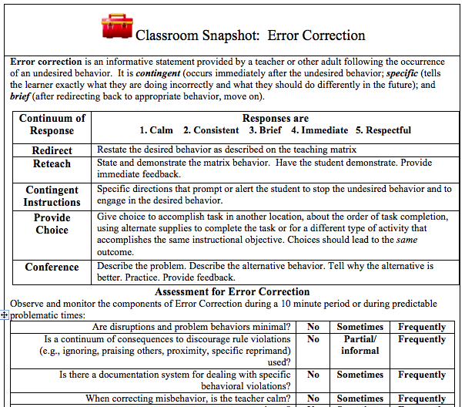
Classroom Management Module on: Continuum of Strategies to Respond to Inappropriate Behavior

Slide 35
What is the purpose of the office discipline referral form?
Is it used as an intervention?
Is it used to collect data?
Notes:
Fields on data collection-odr
Minor collection tool fields
Procedures for odrs and minors
PD for staff protocol

Slide 36
What happens if a student needs to be referred to the office?
Sample
Do you complete an office referral electronically?
Do you complete an office referral on paper?
What is the procedure for getting a student to the office (call to office, student goes to the office)?
What’s the administrator’s disposition and is it communicated to referring teachers?
Office Procedures for Discipline Referral
Write pass or escort student to office
Teacher Complete Time out of Class Form
Administrator assesses, problem solves
Objective: Teach, learn, return to academic instruction as quickly as possible
Strategies:
Practice behavior expectations
Re-Teach in setting
Problem-solving team
Conference with families
Restorative practice strategies including…

Slide 37
Considerations for Consequences
Workbook TFI 1.5, 1.6, Activity 4
Workbook TFI 1.5, 1.6, Activity 5
In small groups, read and discuss the statements on considerations for consequences in your workbook.
Discuss with the full table how your team can use this activity with all staff
Review the examples of alternatives to suspension.
Identify alternatives in place at your school to add to your discipline flowchart.
Peterson, R. L. (2005). Ten alternatives to suspension. Impact: Feature Issue on Fostering Success in School and Beyond for Students With Emotional/Behavioral Disorders, 18(2).
https://ici.umn.edu/products/impact/182/over5.html
Notes:
Direct participants to the workbook. There are two sections with guiding questions for alternatives to suspension and general guidelines for responding to behavior.

Slide 38
Add a process for Major Discipline Referrals to your Discipline Flowchart
What practices are in place for how school administration responds to a major discipline referral?
Identify your office process and practices
Include prevention strategies
Include re-teaching and other educational approaches to discipline
Add your process for Major ODRs to the flowchart
Office Procedures and Practices
Workbook: TFI 1.5, 1.6 Activity 7
Notes:
NOTES
This is a sample flowchart for discipline procedures.
We have pre-populated with practices. Your end goal for this module is to create a complete flow chart or narrative of the discipline procedures at your school.
We are going to go step by step to do that.
ENGAGE:
Ask the participants
1- Do you have one already? What does it look like? Do people use it?
2- What would the impact of having a flowchart be your building? Would it make it easier or harder for teachers to navigate discipline procedures?
To operationalize this system, you will need to: 1) define what constitutes major or office-managed behavior, 2) know strategies to respond to minor or staff-managed behaviors, and 3) develop related data gathering tools. (Adapted from Colvin, 2007, pp. 65-66).

Slide 39
Do your data collection tools have all the information to make data-informed decisions?
Student’s Name
Date
Time of Incident
Location of Incident
Student’s Teacher
Student’s Grade Level
Referring Staff
Others Involved
Problem Behavior
Possible Motivation
What was happening before the behavior (antecedent)?
Possible consequences
Administrative Decision
Other Comments
Workbook: TFI 1.5, 1.6 Activitiy 6
Notes:
Ask why would these data fields be useful for collecting and making intentional intervention decisions around discipline?
This is the type of info you need to implement with fidelity. The type of data to work smarter around behavior

Slide 40
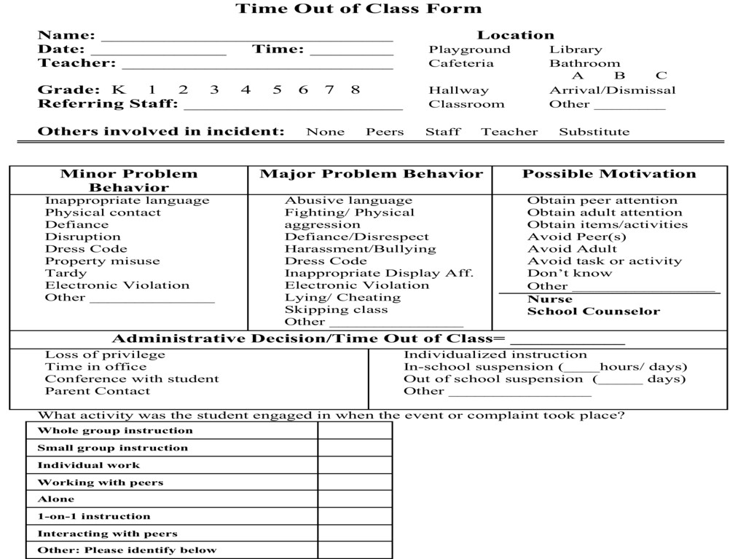
Time Out of Class Form
Sample
Notes:
UPDDATE: Page #
Because ORDs are for documenting and problem solving we need to include all of this info.
Purpose of the Form = “to provide and eventually accumulate information” – from which decisions can be made about interventions

Slide 41
Your Referral Form
Does it collect all of the info needed?
Does everyone know where to find them?
Does everyone know how to fill them out?
Just the facts
No previous info (yesterday, a week ago, etc.)
No opinions

Slide 42
Create Your Office Referral Form
Workbook: TFI 1.5, 1.6 Activity 7
Review “Constructing your Office Referral” resource in the workbook
Review sample data collection tools for office-managed (major)
Review your current office discipline referral and identify data fields to add
Identify when and how you will provide support staff to use data collection tools
Notes:
A time to reflect and talk among teams. These are a few prompts for dialogue and planning. Direct participants to dialogue about where they are with the process of revising data collection forms, creating data collection forms for classroom managed, supporting staff to use them, etc.

Slide 43
TFI 1.5 & 1.6 Problem Behavior Definitions & Discipline Policies
SELF-ASSESSMENT
Complete TFI item(s)
Assess additional action items at end of module
ACTION PLANNING
Add action items to Action plan
Plan for PD
Add to your Staff Presentation PPT

Slide 44
TFI Self-Assessment
TFI Features | Possible Sources | Criteria
1.5 Problem Behavior Definitions: School has clear definitions for behaviors that interfere with academic and social success and a clear policy/ procedure (e.g., flowchart) for addressing office-managed versus staff-managed problems | • Staff handbook • Student handbook • School policy • Discipline flowchart | 0 = No clear definitions exist, and procedures to manage problems are not clearly documented 1 = Definitions and procedures exist but are not clear and/or not organized by staff- versus office-managed problems 2 = Definitions and procedures for managing problems are clearly defined, documented, trained, and shared with families
1.6 Discipline Policies: School policies and procedures describe and emphasize proactive, instructive, and/or restorative approaches to student behavior that are implemented consistently | • Discipline policy • Student handbook • Code of conduct • Informal administrator interview | 0 = No process for teaching staff is in place 1 = Process is informal/unwritten, not part of professional development calendar, and/or does not include all staff or all 4 core Tier I practices 2 = Formal process for teaching all staff all aspects of Tier I system, including all 4 core Tier I practices
1.8 Classroom Procedures: Tier I features (school-wide expectations, routines, acknowledgements, in-class continuum of consequences) are implemented within classrooms and consistent with school-wide systems. | • Staff handbook • Informal walkthroughs • Progress monitoring • Individual classroom data | 0 = Classrooms are not implementing Tier I 1 = Classrooms are informally implementing Tier I but no formal system exists 2 = Classrooms are formally implementing all core Tier I features, consistent with school-wide expectations
Notes:
Teams should complete this self assessment and use the results to determine action planning steps on Workbook page 11.

Slide 45
Reflection
Identify action items below needed for full implementation
Add action items to the Action Plan in your workbook
Add completed items and artifacts to the PPT Overview for your school
TFI | Action Item (Not In Place; Partially; Fully In Place ->) | NI | PI | FI
1.5 | Engage staff in facilitated process to define behaviors and differentiate between office-managed and classroom-managed behavioral examples
1.5 | Create a narrative and/or flowchart to establish discipline procedures
1.5 | Develop data collection forms for office-managed and classroom-managed behavioral examples and plan for training staff
1.5 | Ensure data form fields exist for meaningful decision-making
1.5 | Define a continuum of appropriate instructional responses to office-managed and classroom-managed behavioral examples
1.6 | Identify school policies and procedures that describe and emphasize proactive, instructive, and/or restorative approaches to student behavior that are implemented consistently.
1.8 | Procedures exist for tracking classroom behavior problems
1.8 | Classrooms have a range of interventions for problem behavior that are documented and consistently delivered.

Slide 46
Appreciation is given to the following for their contributions to this Professional Learning:

