Slide 1
PBIS Team Training 4C
PBIS in the Classroom (TFI 1.8)
Responding to Behavior (TFI 1.6)
Notes:
Updated October 2019

Slide 2
Tier 1: Professional Learning Roadmap
TFI Sub-Scale: Team
TFI 1.1 | Team Composition
TFI 1.2 | Team Operating Procedures
TFI Sub-Scale: Evaluation
TFI 1.12 | Discipline Data
TFI 1.13 | Data-based Decision Making
TFI 1.14 | Fidelity Data
TFI 1.15 | Annual Evaluation
TFI Sub-Scale: Implementation
TFI 1.3 | Behavioral Expectations
TFI 1.4 | Teaching Expectations
TFI 1.5 | Problem Behavior Definitions
TFI 1.6 | Discipline Policies
TFI 1.7 | Professional Development
TFI 1.8 | Classroom Procedures
TFI 1.9 | Feedback and Acknowledgement
TFI 1.10 | Faculty Involvement
TFI 1.11 | Student/Family/Community Involvement
6 Classroom Management Practices
1 | Physical Environment
2 | Classroom Teaching Matrix (Expectations, Routines and Procedures)
3 | Active Supervision
4 | Encouraging Appropriate Behavior
5 | Continuum of Response Strategies for Inappropriate Behaviors
6 | Engagement and Opportunities to Respond

Slide 3
Learning Expectations
EXPECTATION | BEHAVIOR
Be Responsible | Make yourself comfortable Take care of your needs (water, food, restroom, etc.) Action plan to implement what you are learning Follow through on your action items
Be Respectful | Turn cell phones off or to “vibrate” Listen attentively while others are speaking Have only the training materials up on your computer/tablet/phone
Be Engaged | Ask what you need to know to understand and contribute Contribute to the group by sharing relevant information and ideas
Notes:
3

Slide 4
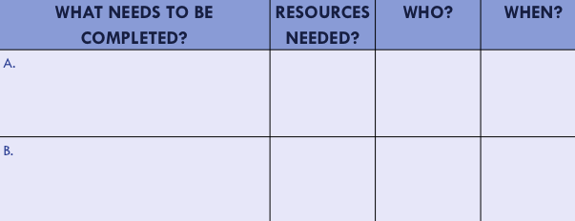
Organization of Modules
Content:
Aligned to TFI Items 1.1 – 1.15 and Classroom Management Practices
Activities/Team Time: Activities for Fluency
Self-Assessment:
Tiered Fidelity Inventory
Action Planning: Applying the core content to your school
Notes:
These are the icons that you will see throughout the training and will serve as a guide and a prompt to the content of each slide.

Slide 5
How Do You Respond?
Notes:
https://www.youtube.com/watch?v=Oq8nYgnE93Y - 1:54

Slide 6
Research Based Behavior Principles
Behavior is learned.
Behavior can be changed.
Lasting behavioral change is more likely with positive rather than punitive techniques.
No student should be intentionally or unintentionally humiliated or belittled.

Slide 7
2 Minute Chat
At your table, discuss which one of the behavioral principles on the previous slide you would anticipate is the hardest
for your staff to embrace.

Slide 8
Classroom Management Practices
6 Classroom Practices
Physical environment
Classroom Teaching Matrix (Expectations, Rules, Routines)
Active Supervision
Encouraging Appropriate Behavior
Direct instruction of expectations, rules, routines
Preventative Prompts
Specific Praise for Behavior
Individual Reinforcers
Class-Wide Group Contingency
Continuum of Response Strategies for Inappropriate Behaviors
Praise other students/groups
Specific Error Correction
Etc.
6. Engagement & Opportunities to Respond
Purpose:
Identify actions for a school-wide team to improve the quality of classroom management throughout the school
Outcomes:
Tier I features are implemented within classrooms and are consistent with school-wide systems. (TFI 1.8)
Rev 3-16-19. Midwest PBIS Network. Developed through the ongoing research and shared knowledge of many partners, including the National TA Center on PBIS, Midwest PBIS Network, Mid-Atlantic PBIS Network, Missouri PBIS, Lincoln Public Schools, Brandi Simonsen (UConn) & Diane Myers (Texas Women’s University).
Notes:
These are the 6 Classroom Management Practices that research has shown has a positive impact on students.
We want your teachers to have effective strategies that they are all using consistently. Tier I features are implemented within classrooms and are consistent with school-wide systems.
(The classroom is a critical aspect of Tier I training and includes 8 key components. These strategies maximize classroom management to allow for instructional time and less teacher stress!

Slide 9
Encouraging Appropriate Behavior
A set of strategies that encourage appropriate behavior by instructing what is expected, communicating positive examples, giving specific feedback, and motivating students with reinforcers designed to promote a growth mindset and community inclusion.
Rev 7-24-19
Notes:
Welcome to the webinar on encouraging appropriate behavior. We will explore a set of strategies that encourage appropriate behavior by instruction what is expected, communicating positive examples, giving specific feedback, and motivating students with reinforcers designated to promote a growth mindset and community inclusion. Let’s get started!

Slide 10
Class and School-wide Strategies to Encourage Appropriate Behavior
Teach Behavior/ Routines
A written plan/schedule for teaching and practicing expectations, rules, or procedures
Preventative Prompts
Prompting expected behavior just prior to when it is needed. “Before we transition to group work, remember showing respect looks like…”
Behavior Specific Praise
“Diane, Awesome! You are showing Listening to the speaker by leaning in, that's being respectful.”
Individual Reinforcers
Tiger tokens, bulldog bucks, table points, etc.
Group Contingencies
After 20 Tiger Tokens are earned among the group, everyone gets a 5-10 min social reward
Notes:
Let’s explore the continuum of class and school-wide strategies to encourage appropriate behavior.
-First we need to make sure to teach behavior and routines. This means that we have a written plan or schedule for teaching and practicing expectations, rules, or procedures.
-Next we need to be using preventative prompts. This involves prompting the expected behavior just prior to when it is needed. For example “Before we transition to group work, remember showing respect looks like quietly putting our previous work away, getting our necessary materials ready, and quietly moving to our assigned group”
-We need to be giving behavior specific praise at a rate of 4 praise to 1 correction. An example is “Joel, Thank you for keeping your eyes on the speaker, that is showing respect!”
-Pairing behavior specific praise with individual reinforcers like tiger tokens/bulldog bucks or table points gives the extra focus on acknowledging the student for expected behavior.
-Finally, using group contingencies where you acknowledge the whole class or groups in the class by giving points or tokens so that students can earn a 5-10 minute social reward helps to reinforce expected behavior.

Slide 11
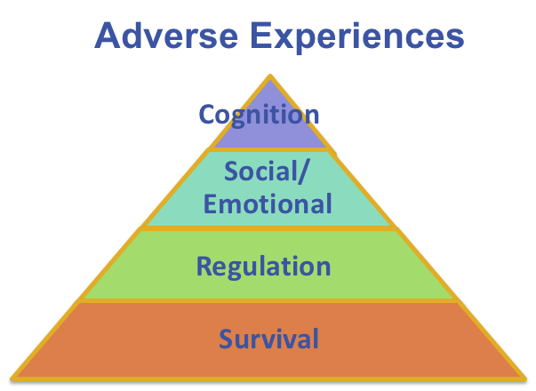
These Strategies to Encourage Appropriate Behavior are also trauma informed because
These strategies (Behavior lesson plans, preventative prompts, specific praise, individual reinforcers, and group contingencies) teach and increase use of desired social-emotional competencies (e.g.: sense of self, emotional regulation) often underdeveloped in students impacted by trauma.
Specific Praise also:
Building positive sense of self for student
Teaches new skills
Allows for sense of control
Promotes brain development
Creates predictability
Group Contingencies also:
Establish and maintain expectations and positive climate
Provides limit setting and predictability
Strengthen sense of community in classroom
Increases dosage of behavior specific praise
Recommended ratio of BSPS for students with trauma even higher - at least 6:1
Notes:
As with all the practices, we want to explore how encouraging appropriate behavior is trauma informed. These practices teach and increase the use of desired social emotional competencies that are often underdeveloped in students impacted by trauma. Specific praise helps build a positive sense of self for student, teach new skills, allows for a sense of control, promotes brain development, and creates predictability.
Group contingencies can establish and maintain expectations and positive climate, provide limit setting and predictability, strengthen the sense of community in the classroom, and increase dosage of behavior specific praise.
Remember that students need behavior specific praise at a rate of 4 to 1 and students who have experienced trauma need an even higher rate of 6 to 1.

Slide 12
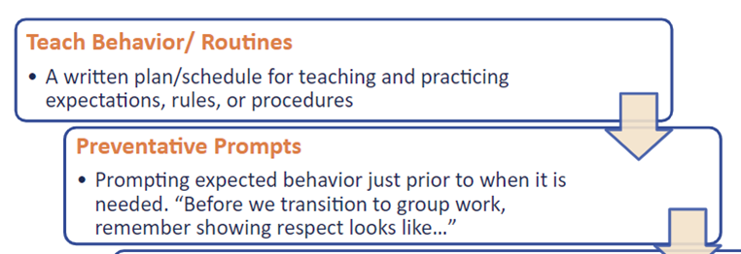
Teach and prompt
Remember to include the following in your teaching plan:
Introduce the expectation during a neutral time and provide a rationale
Embed rules into daily lessons and activities
Post the rules (with large font) and refer to it often
Model what the expectation looks like and discuss non-examples
Practice with the students and provide specific feedback
Acknowledge students who demonstrate the expected behavior
Prompt, pre-correct and review as often as necessary
DEFINE
(TELL)
Simplify
ADJUST
(RETEACH)
For
efficiency
MODEL
(SHOW)
MONITOR
PRACTICE
In setting
Notes:
Let’s explore teaching classroom expectations and rules and prompting students to set them up for success. We need to teach the expectation or rule, model or show what it looks like, have students practice in the setting, then we monitor and adjust or reteach is and as needed. Some things to remember are that we want to introduce the expectation during a neutral time and provide a rationale as to the why. Embed the rules into daily lessons and activities. Have the rules posted and refer or point to them often throughout the day. Model what the expectations look like and discuss non-examples. Be careful with having students practice non-examples, they don’t need any helpful ideas for misbehavior ☺ Practice, practice, practice and provide behavior specific praise OR specific corrective feedback to students. Prompt, pre-corr4ect and review as often as necessary!

Slide 13
Quickest Way to Change Behavior in Anyone is to…
Point out what they’re
doing right!
Research indicates that you
can improve behavior
by 80% just by pointing out
what someone is doing
correctly.
Laura Riffel, OSEP
Notes:
When we (adults) change/shift our focus from giving most of our attention to misbehavior to acknowledging positive behaviors, we create the conditions for behavior to change. (Sprick,& Garrison, 2008) Let’s flip this and follow the research, you can improve behavior by 80% just by pointing out what someone is doing correctly. Think about an example in your life where this is true.

Slide 14
Rationale for Using Behavior Specific Praise
Create positive climate, interactions, rapport, and relationships with students by focusing the adults and students on positive social behaviors and actions.
It makes that behavior more likely to occur in the future, and is one of the most powerful tools for shaping or changing behavior.
Spending time on acknowledgements focus the attention on positive behaviors, minimizes attention to negative behaviors, and reinforces a growth mindset toward learning
It increases instructional time, and minimizes time students are out of the classroom.
Decreases inappropriate behavior and therefore, reduces the need for correction.
Enhances understanding of self, and helps build internal focus of control.
Every time any adult interacts with any student, it is an instructional moment.
(Cameron, 2002; Cameron & Pierce, 1994, 2001;
Cameron, Banko, & Pierce, 2001)
Notes:
Take a minute to review the rationale for using behavior specific praise, what is your favorite? Remember that EVERY time any adult interacts with any student, it is an instructional moment!

Slide 15
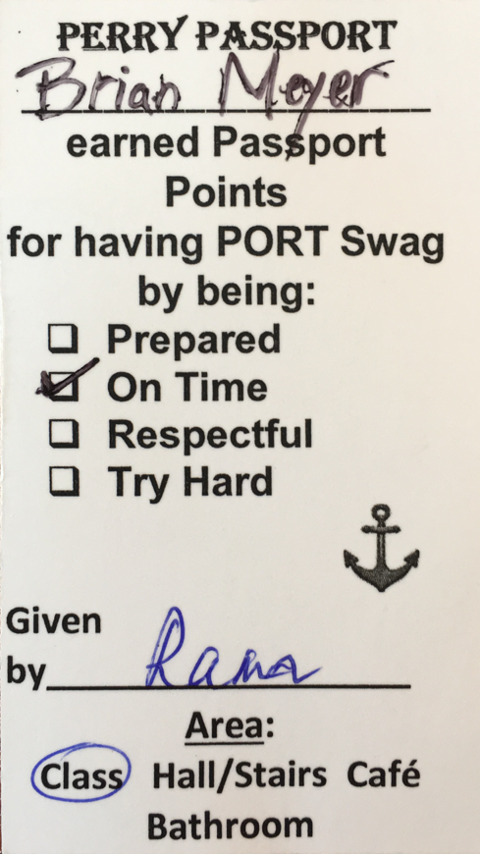
Examples of individual reinforcers
Tangible Reward, delivered with Behavior Specific Praise
Teacher digital entry form of tangibles given:
Efficient reward drawings,
Fidelity progress monitoring,
Tier 1 Data-based decision making.
Remember: Digital tokens, given without specific praise, do not teach or shape behavior
Shared courtesy of: Perry High School Pittsburgh, PA
Notes:
Remember that the physical token or ticket is a reminder to staff to give the acknowledgement. Some schools have also started using digital acknowledgements. Teachers can quickly and easily give students a digital “ticket” but also need to pair that with the actual verbal praise!. In this example, Perry High School in Pittsburgh PA gives positive acknowledgement which results in being able to have access to a student lounge once they obtain a certain number of PORT swag.

Slide 16
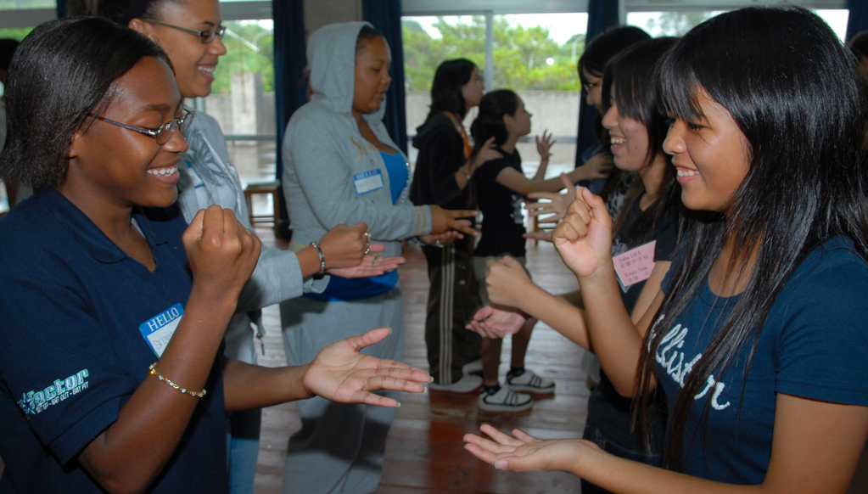
Examples of group contingencies
Examples of Group Contingencies
What is it?
Identify target behavior (positive example)
Set collective goal for group celebration.
Layer larger/less-frequent rewards on top for bigger celebrations.
Whole Classroom Example:
After 10 “PAWs” are earned by individuals within the group for Be Respectful by Using Kind Words, everyone gets a 5-10 min social reward.
Small Groups Example:
Table points are earned for demonstrating Responsibility by Staying on Task. First group to earn 5 points picks the reward for the whole class.
Why?
Keeps a focus on growth mindset.
Use the benefits of social rewards to emphasize desired behaviors, build relationships, and build community.
School-wide Example:
Once 150 “PAWs” are earned school-wide for Be Respectful, PE teachers will lead the whole community in a before-school yoga session in the yard.
Talk it out
Tips:
Get student input on a menu of short/long term rewards in advance.
Everyone is included in group celebrations
Once earned, acknowledgements/rewards are never taken away
Address inappropriate behaviors using continuum of strategies
Deliver reward as quickly as possible.
Notes:
Take a minute to review what school wide and classroom group contingencies are all about. Check out the whole class, small group, and school wide examples. Make sure to get student input on your menu of acknowledgements, and that EVERYONE is involved in the group celebrations, no exclusions! Once earned, don’t take away! Address inappropriate behavior by using a continuum of strategies and deliver rewards as quickly as possible.

Slide 17
Reflecting on your Classroom Management System
Pro-active or reactive?
Does your system include teaching, pre-correcting, subtle re-directs before consequence?
Does your system include re-teaching as part of consequence?
Does your system acknowledge students when they are displaying appropriate behaviors?
Do you take acknowledgments away once they are earned?
Does your system publicly shame students for negative behavior?

Slide 18
Encouraging Appropriate Behavior - Turn & Talk
With your team, pinpoint 2 key learnings about Encouraging Appropriate Behavior that need to be brought back to your entire staff.

Slide 19
Classroom Management Practices
6 Classroom Practices
Physical environment
Classroom Teaching Matrix (Expectations, Rules, Routines)
Active Supervision
Encouraging Appropriate Behavior
Direct instruction of expectations, rules, routines
Preventative Prompts
Specific Praise for Behavior
Individual Reinforcers
Class-Wide Group Contingency
Continuum of Response Strategies for Inappropriate Behaviors
Praise other students/groups
Specific Error Correction
Etc.
6. Engagement & Opportunities to Respond
Purpose:
Identify actions for a school-wide team to improve the quality of classroom management throughout the school
Outcomes:
Tier I features are implemented within classrooms and are consistent with school-wide systems. (TFI 1.8)
Rev 3-16-19. Midwest PBIS Network. Developed through the ongoing research and shared knowledge of many partners, including the National TA Center on PBIS, Midwest PBIS Network, Mid-Atlantic PBIS Network, Missouri PBIS, Lincoln Public Schools, Brandi Simonsen (UConn) & Diane Myers (Texas Women’s University).
Notes:
These are the 6 Classroom Management Practices that research has shown has a positive impact on students.
We want your teachers to have effective strategies that they are all using consistently. Tier I features are implemented within classrooms and are consistent with school-wide systems.
(The classroom is a critical aspect of Tier I training and includes 8 key components. These strategies maximize classroom management to allow for instructional time and less teacher stress!

Slide 20
Rationale for Using a Continuum of Strategies to Respond to Inappropriate Behavior
Highly effective teachers have a toolkit of respectful strategies that diminish the frequency, intensity, and/or duration of inappropriate behaviors.
A continuum is necessary because no single strategy is effective for all students or all behaviors.
Strategies should recognize the function of the behavior and be applied with a growth mindset toward student development.
Notes:
The rationale for using a continuum of responses are that we need to have a tool kit to diminish the frequency, intensity, and duration of inappropriate behavior. There is also no single strategy that works for all students all the time. We must also start to think about function of the behavior as we use strategies with individual or groups of students.

Slide 21
Continuum of Responses for Inappropriate Behaviors is also trauma informed because
Empower students and teach resiliency skills
Replace learned responses with appropriate behavior
Helps students regulate their emotions
Supports regulate, relate, and reason
Notes:
As with all of the practices, we want to connect this set of responses/practices back to how they are trauma informed. Primarily, we need to consider Regulate - Relate - Reason --- concept to keep in mind that someone who is dysregulated is not accessing the higher part of their brain. We must help them first regulate, then relate to them and then reason.
Your continuum of response should be supporting students to regulate, relate and then reason.
Borrowing your cortex ---- when a student is in state of arousal, stay calm and allow them to borrow your regulation. Example of student with box cutter and adult responding by sitting down in hallway with the student vs allowing her feeling of unsafe arouse her and escalate his arousal.
Be there, be consistent. Be there each and everyday and during moments of arousal.

Slide 22
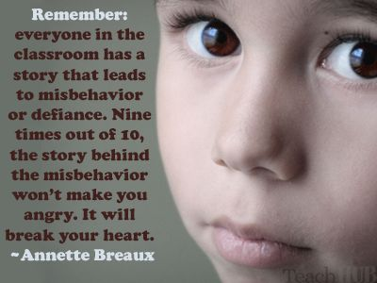
Remember
Notes:
Presenter, ask participants to pause and read this quote.

Slide 23
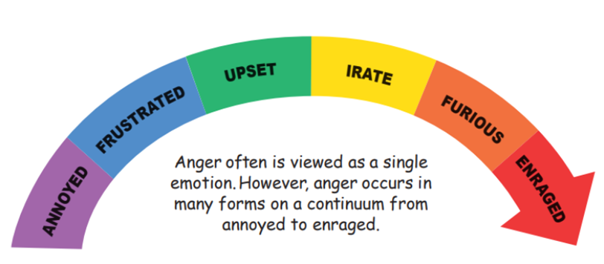
Developing a Continuum of Response
Just like emotions have a continuum, we need to have a continuum to responding to behaviors

Slide 24
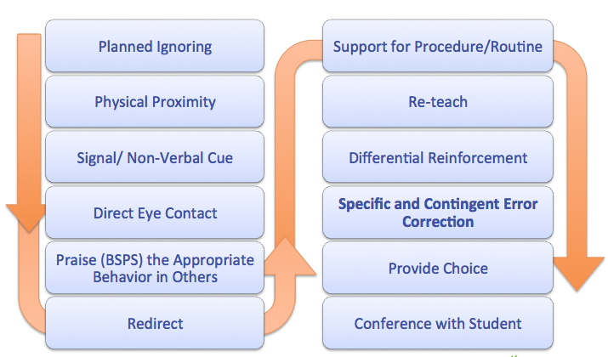
Use a Continuum of Strategies to Respond to Behavioral Errors
Notes:
This is just a suggestion. Teachers need to develop their own remembering that re-teaching and positive response should be the focus

Slide 25
Definitions of Strategies
Planned Ignoring | Ignore student behaviors when their motivation is attention, and continue instruction without stopping
Physical Proximity | Using teacher proximity to communicate teacher awareness, caring, and concern
Direct Eye Contact | The ”teacher look” to get attention and non-verbally prompt a student
Signal/Non-Verbal Cue | Teacher gestures to prompt a desired behavior, response, or adherence to a classroom procedure and routine.
Praise (BSPS) the Appropriate Behavior in Others | Identify the correct behavior in another student or group, and use behavior specific praise to remind all students of the rule/expectation.
Redirect | Restate the desired behavior as described on the teaching matrix

Slide 26
Definitions of Strategies (con’t)
Support for Procedures/ Routine | Identify and install a classroom routine to prevent the problem behavior. Provide a booster for a routine already in place.
Re-teach | State and demonstrate the matrix behavior. Have the student demonstrate. Provide immediate feedback.
Differential Reinforcement | Reinforcing one behavior and not another. For example reinforce the positive behavior while ignoring the student’s inappropriate behavior.
Specific and Content Error Correction | Specific directions that prompt or alert the student to stop the undesired behavior and to engage in the desired behavior
Provide Choice | Give choice to accomplish task in another location, about the order of task completion, using alternate supplies to complete the task or for a different type of activity that accomplishes the same instructional objective. Choices should lead to the same outcome.
Conference with Student | Describe the problem. Describe the alternative behavior. Tell why the alternative is better. Practice. Provide feedback.

Slide 27
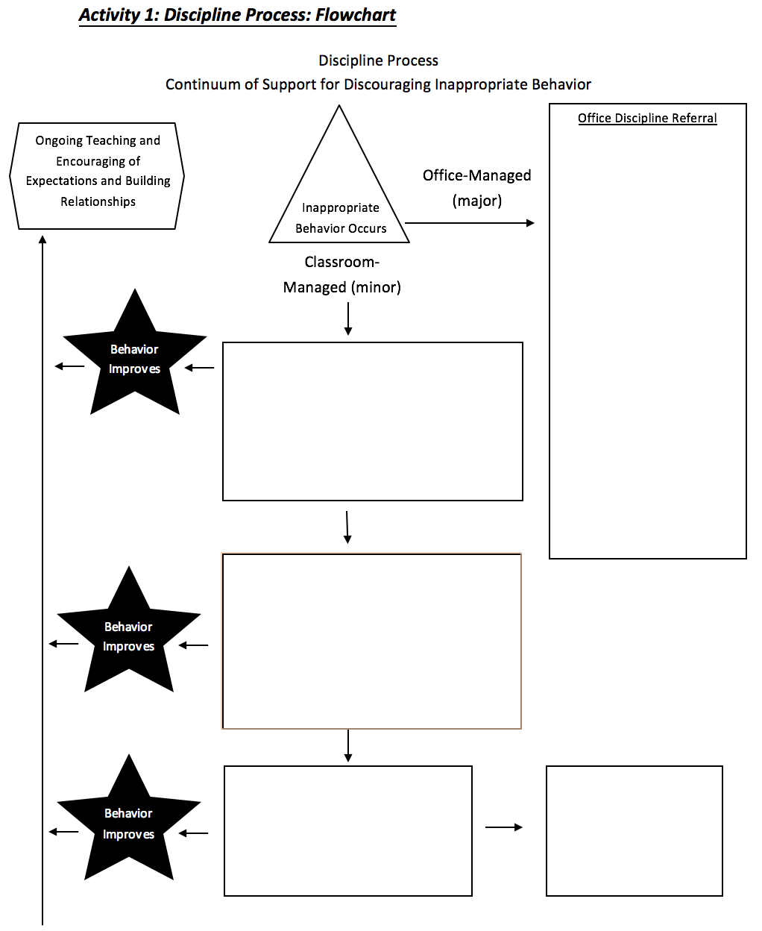
Consider a Continuum of Strategies to your Discipline Flowchart
What effective strategies are currently in place for responding to a minor/teacher managed behavior problems in your school?
Identify your continuum of strategies
Include prevention strategies
Include re-teaching and other classroom management practices
Add your continuum to the flowchart to document the process for responding to behavior.
Avoid “3 minors equals a major” logic
When do staff complete a minor ODR form?
Workbook Activity 3 (p.34)
Notes:
NOTES
This is a sample flowchart for discipline procedures.
We have pre-populated with practices. Your end goal for this module is to create a complete flow chart or narrative of the discipline procedures at your school.
We are going to go step by step to do that.
ENGAGE:
Ask the participants
1- Do you have one already? What does it look like? Do people use it?
2- What would the impact of having a flowchart be your building? Would it make it easier or harder for teachers to navigate discipline procedures?
To operationalize this system, you will need to: 1) define what constitutes major or office-managed behavior, 2) know strategies to respond to minor or staff-managed behaviors, and 3) develop related data gathering tools. (Adapted from Colvin, 2007, pp. 65-66).

Slide 28
Planning -
Continuum of Strategies
Discuss the definitions from the previous two slides with a shoulder partner, and consider:
If any should be included on your school’s discipline flowchart (write these down on a post-it)
What PD is required to ensure all staff implement those strategies with fidelity?
3) Come back as a whole team to discuss your post-its

Slide 29
Specific and Contingent Error Correction Definition
Error correction is an informative statement provided by a teacher or other adult following the occurrence of an undesired behavior.
It is contingent (occurs immediately after the undesired behavior); specific (tells the learner exactly what they are doing incorrectly and what they should do differently in the future); and brief (after redirecting back to appropriate behavior, move on).
Notes:
Let’s dig into specific and contingent error correction. Error correction is an informative statement provided by the teacher or another adult following the occurrence of an undesired behavior. It happens immediately after the undesired behavior and is specific and brief.

Slide 30
Error Correction: Non-Examples…
How many times do I have to tell you to work quietly?
Didn’t I just tell you to get your work done?
Why are you talking when I’m talking?
Do you want me to send you to the office?
What’s going to happen if I call your mother?
What do you think you’re doing?
Don’t you think you should be using your time better?
Notes:
How often have we heard or used these types of statements? (Read Slide)
Although meant to deter misbehavior these types of statements are often very reinforcing to students… why do you think? (gives adult attention)
Questioning students about their behavior is ineffective. You don’t want an answer, you want compliance. Questioning gives attention to the inappropriate behavior.
Our goal instead is to increase the likelihood of appropriate behavior. We do this by teaching and acknowledging what we want students to do instead…and on occasion by providing consistent, respectful responses to misbehavior.
(Newcomer, 2008)

Slide 31
Set the tone
Responses to inappropriate behaviors are always: 1. Calm 2. Consistent 3. Brief 4. Immediate 5. Respectful
I’ve come to a frightening conclusion that I am the decisive element in the classroom. It’s my personal approach that creates the climate. It’s my daily mood that makes the weather. As a teacher, I possess a tremendous power to make a child’s life miserable or joyous. I can be a tool for torture or an instrument of inspiration. I can humiliate or humor, hurt or heal. In all situations, it is my response that decides whether a crisis will be escalated or de-escalated and a child humanized or dehumanized.
~Haim Ginott

Slide 32
Steps to Specific and Contingent Error Correction:
1 minute or less!
Example: “Joe [privately and with sincere voice tone], I saw that you were talking to your neighbor during independent work time. The expectation during independent time is focus on your own work which is Doing Your Best. Go ahead and start on your work again, and I’ll stop by to catch you doing your best.”
1. Respectfully address student
2. Describe inappropriate behavior
3. Describe expected behavior/rule
4. Link to school-wide expectation on Matrix
5. End with encouragement
Your Turn!
Give a sample Error Correction statement that includes these steps and is brief!
Notes:
Let’s break it down to 5 steps:
Respectfully address the student
Describe the inappropriate behavior
Describe the expected behavior or rule
Link to the school wide expectation on the matrix
End with Encouragement.
Read the example and then turn to your shoulder partner and practice pretending that they have been shopping on line instead of listening to the webinar ☺

Slide 33
Classroom Management Practices
6 Classroom Practices
Physical environment
Classroom Teaching Matrix (Expectations, Rules, Routines)
Active Supervision
Encouraging Appropriate Behavior
Direct instruction of expectations, rules, routines
Preventative Prompts
Specific Praise for Behavior
Individual Reinforcers
Class-Wide Group Contingency
Continuum of Response Strategies for Inappropriate Behaviors
Praise other students/groups
Specific Error Correction
Etc.
6. Engagement & Opportunities to Respond
Purpose:
Identify actions for a school-wide team to improve the quality of classroom management throughout the school
Outcomes:
Tier I features are implemented within classrooms and are consistent with school-wide systems. (TFI 1.8)
Rev 3-16-19. Midwest PBIS Network. Developed through the ongoing research and shared knowledge of many partners, including the National TA Center on PBIS, Midwest PBIS Network, Mid-Atlantic PBIS Network, Missouri PBIS, Lincoln Public Schools, Brandi Simonsen (UConn) & Diane Myers (Texas Women’s University).
Notes:
These are the 6 Classroom Management Practices that research has shown has a positive impact on students.
We want your teachers to have effective strategies that they are all using consistently. Tier I features are implemented within classrooms and are consistent with school-wide systems.
(The classroom is a critical aspect of Tier I training and includes 8 key components. These strategies maximize classroom management to allow for instructional time and less teacher stress!

Slide 34
Increase Academic Engagement
Use of Multiple Opportunities To Respond (OTR) includes strategies to increase all students being engaged in the content simultaneously through various group engagement strategies.
Examples of group engagement strategies: think, pair, share; response boards; choral response, computer programs (e.g. Kahoot); small group work; etc.
Notes:
We all know how important it is to have students be academically engaged! The use of MULTIPLE opportunities to respond includes strategies for all students to be engaged simultaneously through various strategies. Examples include: think/pair/share, response boards, choral response, computer programs like Kahoot, and small group work.

Slide 35
Rationales for Increasing Academic Opportunities to Respond
Research indicates that using high rates of OTRs during instruction results in increases in accurate academic responses and desired behaviors and decreases in undesired behaviors.
The more students spend involved in learning activities, the more they learn.
Additionally, increased rates of responding and the subsequent improved learning tend to increase the amount of material that can be covered.
When teachers increase their rates of opportunities to respond, student on-task behavior and correct responses increase while disruptive behavior decreases.
Shown to improve reading and math performance.
Provides continual feedback for the teacher on student learning and the effectiveness of teaching strategies.
(Barbetta, Heron, & Howard, 1993; Carnine, 1976; Heward, 1994; Sutherland, Alder, & Gunter, 2003; Sutherland & Wehby, 2001; West & Sloane, 1986).
Notes:
The rationale for increasing academic opportunities to respond include the more students spend involved in learning activities, the more they learn. Increased rates of responding can increase the amount of material to be covered. When teachers increase their opportunities to respond, students on task behavior and correct responses increase while disruptive behavior decreases! WIN WIN!!! Increased OTR is shown to improve reading and math performance and it provides continual feedback for the teacher on student learning and on the effectiveness of his/her teaching strategies.

Slide 36
Engagement & Multiple Opportunities to Respond is also trauma informed because
Differentiated response supports all students to engage in ways comfortable
Facilitating frequent opportunities for students to respond provides time to process or apply what students are learning, allowing neural networks to be strengthened. (Craig, S.E., 2016)
Notes:
As with all of the strategies, we want to point out how engagement and OTR is trauma informed. Giving students the opportunity to differentiate their response helps engage students in ways that are comfortable. It also allows the student time to process and apply what they are learning, allowing neural networks to be strengthened.

Slide 37
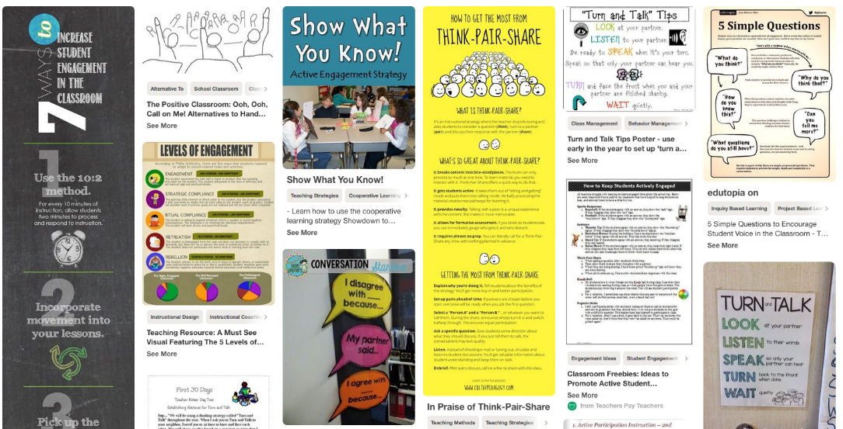
Provide Multiple Opportunities to Respond
Individual
Partner
Group
Using Technology
Classic Non Example
Notes:
https://www.youtube.com/watch?v=yUjhSBjxuXA (Could start at 52 seconds in if you want) 2 minutes

Slide 38
Guidelines for Response Rates
Teacher talk should be no more than 40-50% of instructional time.
New material: a minimum of 4-6 responses per minute with 80% accuracy.
Review of previously learned material: 8-12 responses per minute with 90% accuracy.
(Council for Exceptional Children, 1987; Reinke, Herman & Stormont, 2013)
Notes:
Let’s think about these percentages:
Teacher talk should be no more than 40-50% of instructional time!
When covering new material: a minimum of 4-6 responses PER MINUTE with 80% accuracy,
When reviewing previously learned material, 8-12 responses PER MINUTE with 90% accuracy!
That is a LOT of OTR!!!

Slide 39
Example of Opportunities to Respond
This scenario demonstrates the practice of providing numerous opportunities to respond and engage students.
Shortly after science class started, the teacher announced, “We have a small block of ice and the same size block of butter. Tell your neighbor which one would melt first.” A few seconds later the teacher said, “Please write down in one sentence an explanation for your answer.” A few minutes later, the teacher told the students to share with their neighbor what they had written. Shortly thereafter, the teacher called on one student to tell the class her answer. The teacher then asked students to give a thumb down if anyone disagreed, and so on. (Colvin, 2009, p.48)
Notes:
If time, this example could be used as an activity. Once it has been read, the participants can point out the various Opportunities to Respond the teacher has given the students.

Slide 40
Opportunities to Respond
Turn & Talk
What are the Opportunities to Respond in this scenario?
Shortly after science class started, the teacher announced, “We have a small block of ice and the same size block of butter. Tell your neighbor which one would melt first.” A few seconds later the teacher said, “Please write down in one sentence an explanation for your answer.” A few minutes later, the teacher told the students to share with their neighbor what they had written. Shortly thereafter, the teacher called on one student to tell the class her answer. The teacher then asked students to give a thumb down if anyone disagreed, and so on. (Colvin, 2009, p.48)
Choral Response
Individual or small group questioning
Response Cards
Signaling
Non-verbal response
Technology
Wait/think time
Notes:
If time, this example could be used as an activity. Once it has been read, the participants can point out the various Opportunities to Respond the teacher has given the students.

Slide 41
Provide Professional Development
It is critical to create a safe and nurturing climate for teachers to improve their skills.
When school leadership provides the resources staff need to adapt to improve their classroom management skills, the process progresses more smoothly.
Based on the work of Marzano, Waters, McNulty (2005)

Slide 42
Shifting to Positive Behavior Support
We know what evidence based classroom management practices look like.
We have a science to support implementation.
We have tools to describe and illustrate what implementing evidence based classroom management “looks like.”
So, what are we waiting for?

Slide 43
Team Time
Refer to pages ______ in workbook
Think about the second 3 components of classroom PBIS we have discussed:
Encouraging Appropriate Behavior, Continuum of Response, Opportunities to Respond
Use the workbook to find activities to support your work:
Encouraging Behavior methods
Continuum of Response in your Flowchart
Professional Development for Staff
Begin thinking about how you will bring this at your school.
Notes:
The following slides are EXAMPLES for teams to look at; trainers do not need to go through them but you can reference they are there for information/exploration.

Slide 44
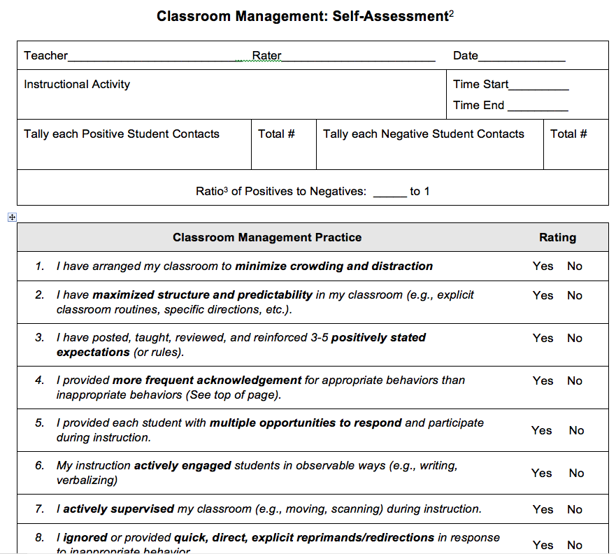
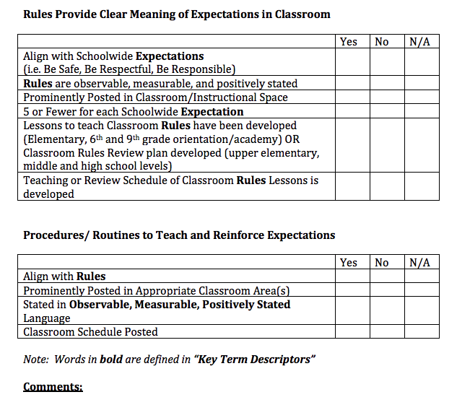
Activity
Explore these tools.
How could these tools help you plan classroom management professional development activities based on the results?
What other tools and resources are available at your site to support staff?
Workbook page(s) ______
Self Assessment & Walk through Tools
http://www.laspdg.org/files/Classroom%20Walkthrough%20Examples.pdf

Slide 45
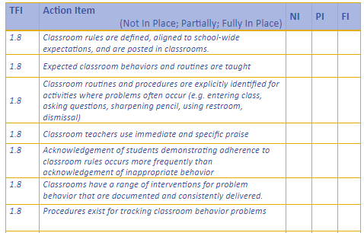
Reflection

Slide 46
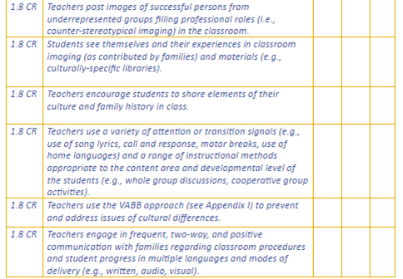
Reflection

Slide 47
Resources
National Website
http://www.pbis.org/school/pbis-in-the-classroom
Midwest PBIS – Classroom Modules
http://www.midwestpbis.org/materials/classroom-management
Florida PBIS Classroom Coaching
http://www.livebinders.com/play/play?id=2295063
Mid-Atlantic PBIS http://www.midatlanticpbis.org/materials-1/classroom
Additional Classroom Resources – Tim Lewis
https://www.pbis.org/resource/192/classroom-checklists-effective-classroom-plan-environmental-inventory-checklist
Supporting and Responding to Classroom Behavior Tool
http://www.pbis.org/resource/1016/supporting-and-responding-to-behavior

Slide 48
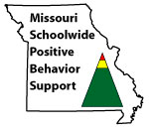
Appreciation is given to the following for their contributions to this Professional Learning:

