Slide 1
PBIS Team Training 5A Non-Classroom
Notes:
Updated January 2020

Slide 2
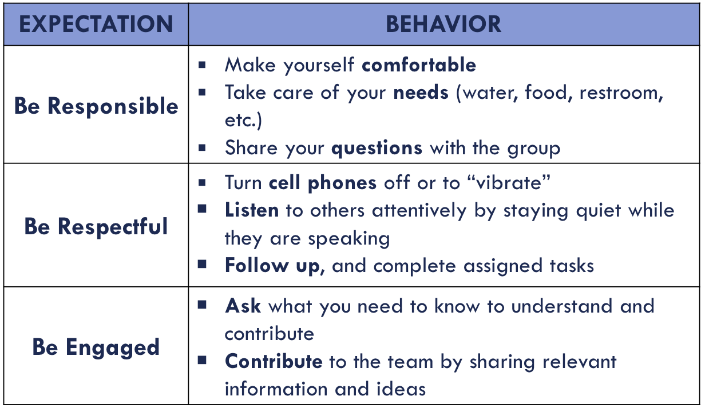
Learning Expectations

Slide 3
Tier 1: Professional Learning Roadmap
TFI Sub-Scale: Team
TFI 1.1 | Team Composition
TFI 1.2 | Team Operating Procedures
TFI Sub-Scale: Evaluation
TFI 1.12 | Discipline Data
TFI 1.13 | Data-based Decision Making
TFI 1.14 | Fidelity Data
TFI 1.15 | Annual Evaluation
TFI Sub-Scale: Implementation
TFI 1.3 | Behavioral Expectations
TFI 1.4 | Teaching Expectations
TFI 1.5 | Problem Behavior Definitions
TFI 1.6 | Discipline Policies
TFI 1.7 | Professional Development
TFI 1.8 | Classroom Procedures
TFI 1.9 | Feedback and Acknowledgement
TFI 1.10 | Faculty Involvement
TFI 1.11 | Student/Family/Community Involvement
Notes:
Non Classroom is not a TFI question, but we find that a lot of ODR’s come these areas because they tend to be unstructured.

Slide 4
SWPBS Subsystems
School-wide
Classroom
Family
Non-classroom
Student
Notes:
*
Have audience callout some non-classroom areas
Review the School-wide system’s key components and emphasize this morning’s portion of the training focuses on non-classroom settings. Point out that most will assume behavioral issues are generated from the classroom. However, we have learned student behavioral concerns are often generated in unstructured areas of the building.

Slide 5
Non-Classroom
Positive expectations & routines taught & encouraged
Active supervision by all staff
Scan, move, interact
Pre-corrections & reminders
Positive reinforcement

Slide 6
Non-classroom areas
What is the non-classroom area in your building that causes the biggest disruption to learning in your class?
Notes:
1 minute turn and talk

Slide 7
Purposes
Development and implementation of a formal, consistent, and continuous system of SW-PBIS in non-classroom settings.
To review critical features & essential practices of active supervision.
Notes:
Point out the key feature of improving student behavior in non-classroom settings is to involve all school personnel in Active Supervision, emphasizing ALL school staff.
*

Slide 8
Outcomes
Teams will update their action plan to include a method, materials, personnel etc. needed to train staff on the use of Active Supervision.

Slide 9
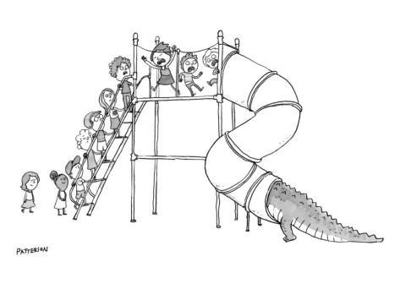
Using Data – Elementary School
An elementary school principal found that over 45% of their behavioral incident reports were coming from the playground.

Slide 10
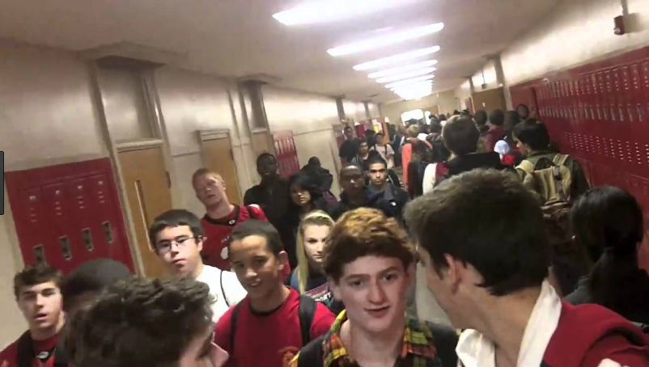
Using Data – High School
High school assistant principal reports that over 2/3 of behavior
incident reports come from “four corners.”

Slide 11
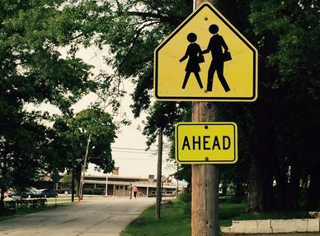
Using Data – Middle School
A middle school secretary reported that she was getting at least one neighborhood complaint daily about student behavior on & off school grounds.
Notes:
*

Slide 12
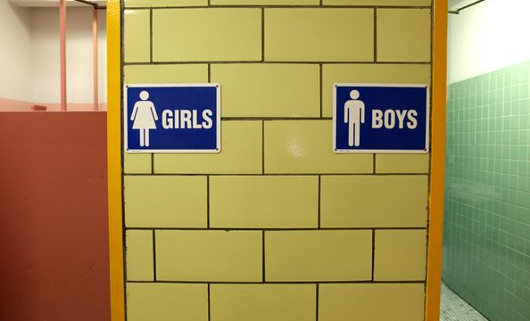
Using Data – Health Office
High school nurse lamented that “too many students were asking to use her restroom during class transitions.”
Notes:
*

Slide 13
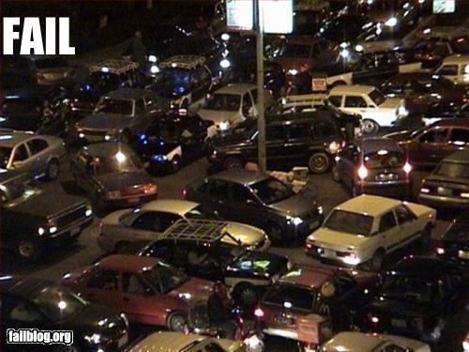
Using Data – Parking Lot
At least 2 times/month, police are called to settle arguments by parents & their children in parking lot
Notes:
*

Slide 14
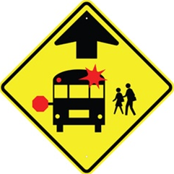
Using Data - Bus
Over 50% of referrals occurring on “buses” during daily transitions.
Notes:
Often bus referrals are more prevalent in elementary and middle schools than they are in the high schools.
*

Slide 15
Non-classroom Settings
Particular times or places where supervision is emphasized:
Cafeteria, hallways, playgrounds, bathrooms, buses, parking lots, study halls, media center, assemblies, sporting events, dances
Wherever instruction is not available as behavior management tool
Notes:
*

Slide 16
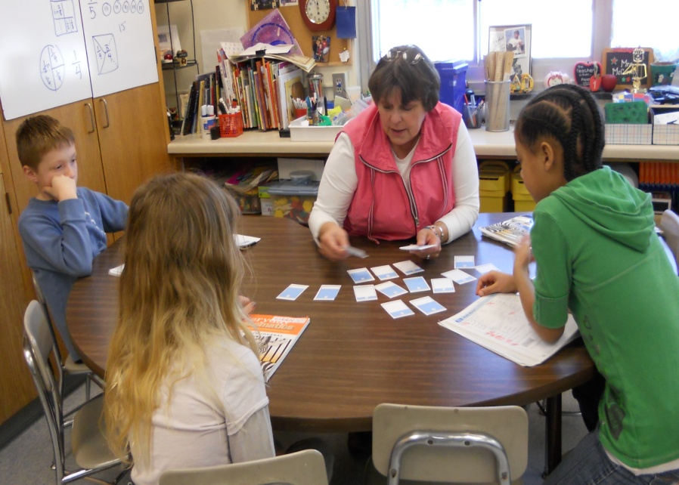
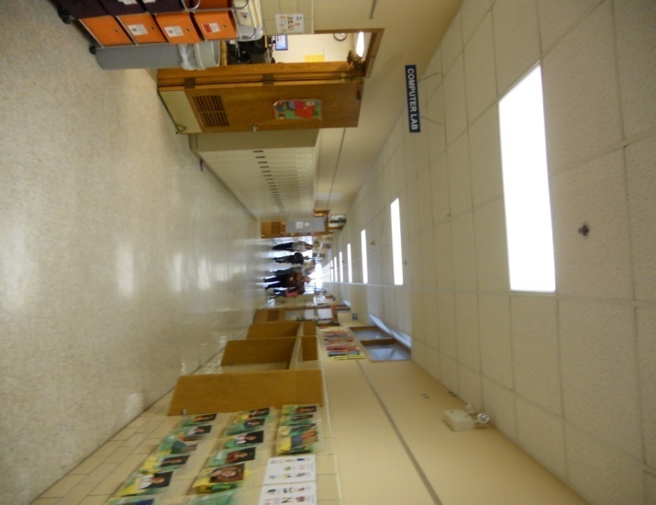
Classroom v. Non-classroom
Classroom
Teacher directed
Instructionally focused
Small # of predictable students
Non-classroom
Student focused
Social focus
Large # of unpredictable students
Notes:
*

Slide 17
5 Minute Activity
Pick 1 problematic non-classroom setting you have experienced
Identify 2-3 features of problem
Identify 2-3 possible solutions
Report (<1 min.) main features of your example

Slide 18
Social Competence & Academic Achievement
Positive
Behavior
Support
OUTCOMES
SYSTEMS
Supporting
Decision
Making
Supporting
Staff Behavior
DATA
PRACTICES
Supporting
Student Behavior
Notes:
*

Slide 19
SYSTEMS FEATURES
School-wide implementation
All staff
Direct teaching 1st day/week
Regular review, practice, & positive reinforcement
Team-based identification, implementation, & evaluation
Data-based decision making
Notes:
*

Slide 20
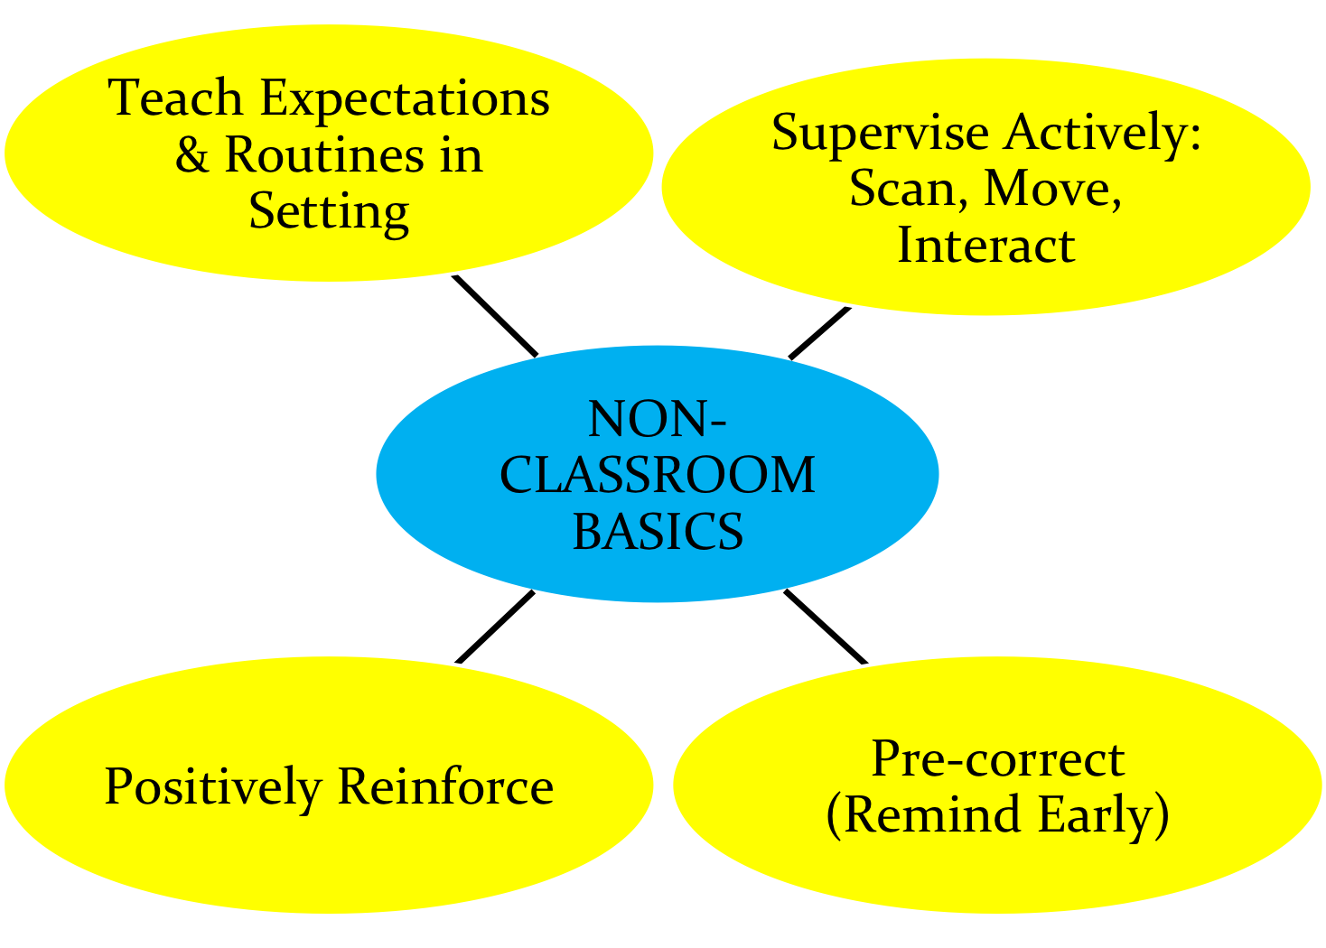
Non-Classroom Basics
What, where, when, who, how at YOUR school?
Notes:
Turn and talk - teaching expectations, discuss pre-correction before moving off this slide. Point out that active supervision and positive reinforcement go hand in hand.

Slide 21
Identify Expectations
Physical Environment
Routine Expectations
Staff Behavior
Student Behavior

Slide 22
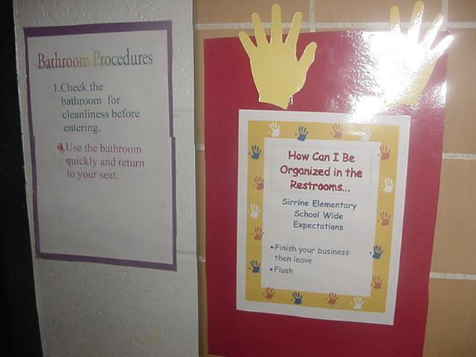
Expected behaviors are visible
Notes:
*

Slide 23
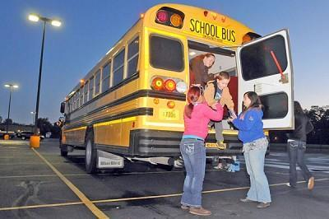
Teach Expectations in the Setting
Notes:
Point out that many PBIS schools – particularly at the elementary level – use a checkoff system where expectations are taught in each setting by different staff – and students have their list “checked off” for each non-classroom setting.
*

Slide 24
Lesson
TEACH - Overview of the lesson: “Today we are going to talk about how ‘we are kind, responsible, and safe in the restroom.”
Show the Teaching Poster of Expectations with pictures and walk through the expectations.
Discuss the details of the expectations with students.
MODEL – Adults demonstrate examples of not following expectations.
Choose a couple of students to “show” examples of following the expectations.
Discussion. “Tell me what Kind, Responsible, and Safe look like, feel like, or sound like in the restroom.”
PRACTICE
Have all students line up outside the restroom, and two at a time come into the restroom to show the following of the restroom expectations with an adult monitoring.
Debrief with students any questions. “Are there any questions you have about being Kind, responsible, and safe behavior in the restroom?”

Slide 25
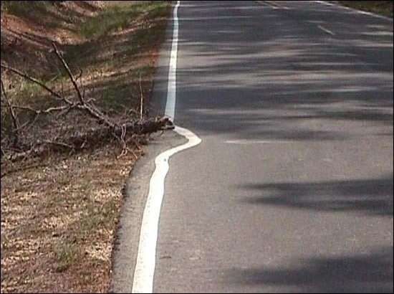
Why does everyone need to be involved?
Staff outnumbered
Unified Front/Same page
Adult presence
Prompts desired behavior
Deters problem behavior
“Being a good citizen”
Contribute to school climate
“Not my job”
Notes:
*

Slide 26
1. At least 4 positives for each negative student contact?
Contextually, developmentally, culturally appropriate
Genuine, efficient, effective
Specific, meaningful
Varied in type and form

Slide 27
“Good morning, class!”
Teachers report that when students are greeted by an adult in morning, it takes less time to complete morning routines & get first lesson started.
Notes:
*

Slide 28
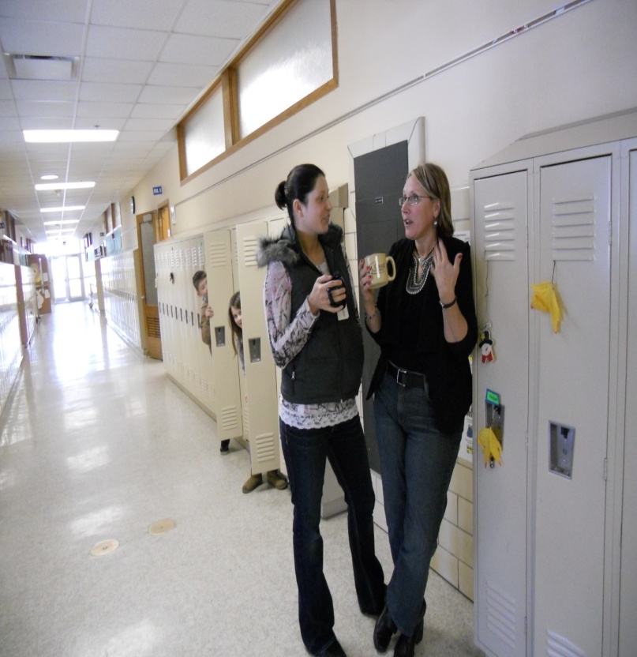
2. Did I move continuously throughout the area?
Obvious
Positive
Interactive
Unpredictable

Slide 29
3. Did I scan frequently?
Head up
Make Eye Contact
Open Body Posture
Head/Body orientation
Varied type/form
Predictable vs Unpredictable

Slide 30
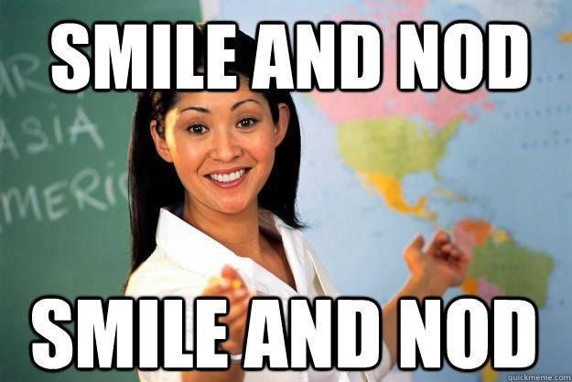
4. Positive Interactions with most students?
Contextually, developmentally, culturally appropriate
Genuine, efficient, effective
Specific, meaningful
Varied in type and form

Slide 31
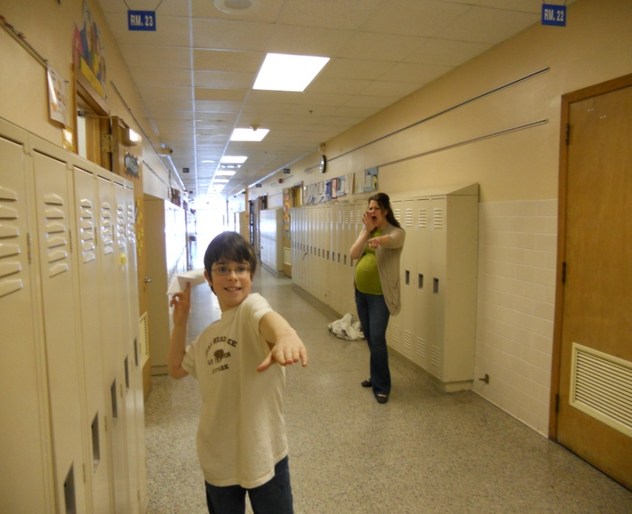
5. Did I handle minor rule violations efficiently?
Quickly
Privately
Culturally, contextually and developmentally appropriate
Neutral, Business-like
Reinforce rule-following
Notes:
Culturally, contextually developmentally appropriate

Slide 32
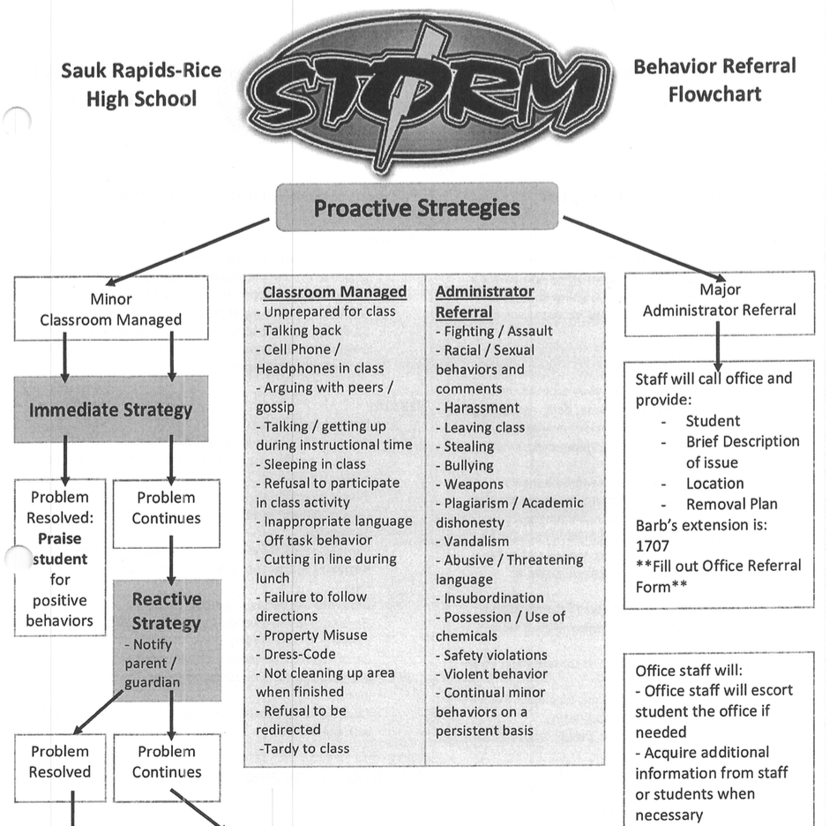
6. Follow SW procedures for major rule violations?
Calm and businesslike
Follow procedure
Disengage if escalation
Pre-correct for next occurrence
Look for opportunity to reinforce

Slide 33
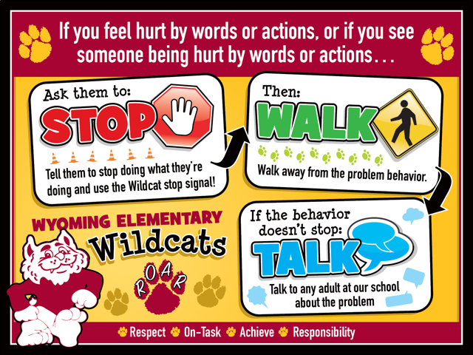
Stop, Walk and Talk

Slide 34
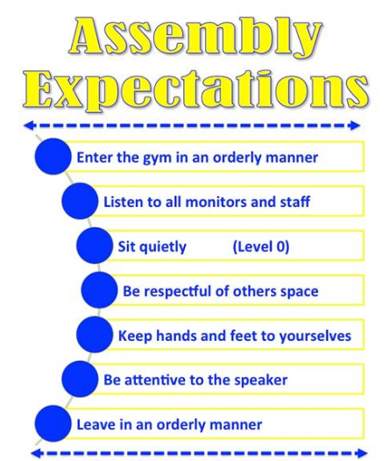
7. Fluent with SW positive expectations?
Positively stated and visible
Taught directly across contexts
Context specific behavioral examples
Frequently acknowledged
Culturally and contextually appropriate

Slide 35
Behavior Matrix
Notes:
Local Elem. example

Slide 36
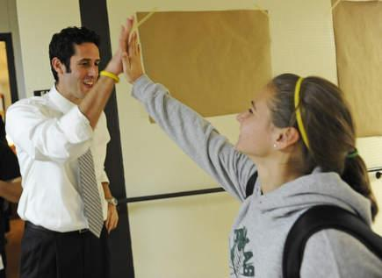
8. Positively acknowledge at least 5 different students in setting?

Slide 37
Active Supervision –Video!
Notes:
Active supervision was also covered in classroom. This just reiterates the need for active supervision in ALL areas
Possible Videos:
**please note we have already used the Princeton video in the classroom section
Systematic Supervision MS 2:13 - https://www.youtube.com/watch?v=95YA8mfY-2c
Systematic Supervision HS 2:14 - https://www.youtube.com/watch?v=rCqIzeU-0hQ&t=14s
Systematic Supervision Elem- 2:07 - https://www.youtube.com/watch?v=5JB2xSf-S58 LINK is not working
*

Slide 38
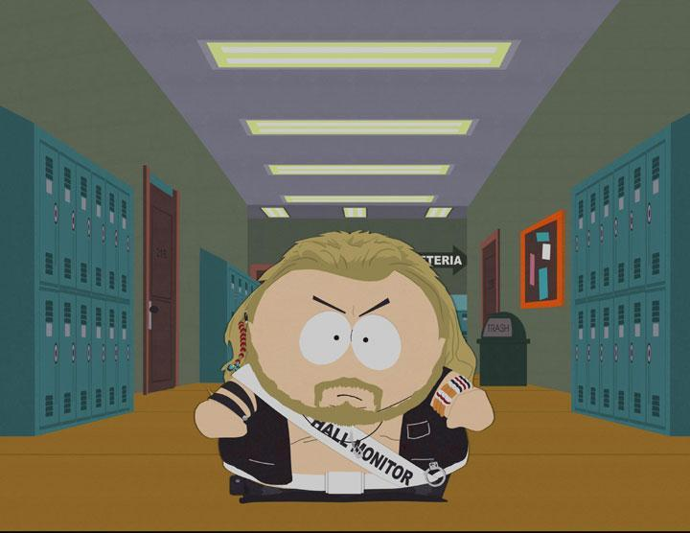
Basics
“Active Supervision:
Self-Assessment”
Notes:
*

Slide 39
Non-Classroom Management: Self-Assessment
Name______________________________ |  | Date_____________
Setting □ Hallway □ Entrance □ Cafeteria □ Playground □ Other_______________ |  | Time Start_________ Time End _________
Tally each Positive Student Contacts | Total # | Ratio of Positives to Negatives: _____: 1
Tally each Negative Student Contacts | Total #
Notes:
This is a tool they can use at their site- don’t spend too much time on this
*

Slide 40
Supervision Self-Assessment
Did I have at least 4 positive for 1 negative student contacts? | Yes No
2. Did I move throughout the area I was supervising? | Yes No
3. Did I frequently scan the area I was supervising? | Yes No
4. Did I positively interact with most of the students in the area? | Yes No
5. Did I handle most minor rule violations quickly and quietly? | Yes No
6. Did I follow school procedures for handling major rule violations? | Yes No
7. Do I know our school-wide expectations (positively stated rules)? | Yes No
8. Did I positively acknowledge at least 5 different students for displaying our school-wide expectations? | Yes No
Overall active supervision score: 7-8 “yes” = “Super Supervision” 5-6 “yes” = “So-So Supervision” <5 “yes” = “Improvement Needed” | # Yes______
Notes:
*

Slide 41
Purpose of the Self-Assessment
Determine the extent effective non-classroom management practices are in place.
Teach best practices.
Develop an action plan for enhancing or maintaining practices – what, when, how, by when?
Evaluate impact of changes in practice.
Can be completed as a self-assessment or by an observer.

Slide 42
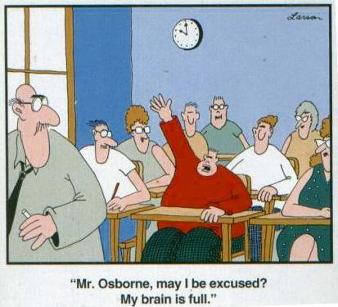
Time for planning!

Slide 43
Action Plan:
Discuss teaching/re-teaching expectations in non-classroom settings.
Active Supervision
Who needs training?
What non-classroom settings should be the focus in your school?

Slide 44
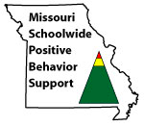
Appreciation is given to the following for their contributions to this Professional Learning:

Slide 45
Vulnerable Decision Points from National ODR Data
Subjective problem behavior
Defiance, disrespect, disruption
Major vs. minor
Non-classroom areas
Hallways
Afternoons
Ambiguity
Lack of Contact
Fatigue
Notes:
These slides should not be covered now- please SKIP this slide
Remember the vulnerable decision points?
As implicit bias occurs most often during vulnerable decision points, it’s important to identify them.
Here is what the research it telling us about vulnerable decision points. They occur:
When the problem behavior requires a subjective assessment, such defiance or disrespect or disruption. Or in determining if the behavior is a major or minor infraction. These behaviors introduce ambiguity, and thus are more influenced by implicit bias.
Behaviors occurring in non-classroom areas, such as the hallway. The difficulty here is a lack of relationship between the adult and student. When we don’t know the student, our bias more heavily influences our judgements.
Finally, in the afternoon, when teachers are more tired.

Slide 46
Two-Step Neutralizing Routine for Staff:
When you see problem behavior, stop and ask yourself:
1. Is this a vulnerable decision point?
Situation
Decision state
2. Is the behavior cultural or is it a behavioral error?
STOP
Notes:
This slide should not be covered now- please SKIP this slide
How can we neutralize the influence of our implicit biases?
By pausing, much as we did when diffusing power struggles, and giving ourselves to time to ask these 2 questions.

Slide 47
Hallway Expectations
HS Level
Notes:
https://www.youtube.com/watch?v=65eDkEjkQU8 2:04

