Slide 1
PBIS Training Day 6 5-Point Intervention Approach For Enhancing Equity
Notes:
Updated January 2020

Slide 2
Trainer Notes: Trainer Reflection
Things to keep in mind when preparing for this training.
**The Trainer presenting this content & Lead Trainer for the region should have a conversation about this content prior to training.
Discussions around equity and bias can be very uncomfortable. Own this upfront and own your own bias or state your vulnerability with the content.
Be sure to incorporate not only examples by racial disparities, but also any vulnerable group: socio-economic status, special education, LGBTQ
Be open and honest with your experiences and state as many examples (positive or constructive) that you can, in order to keep audience engaged and to “keep it real.”
It is important to review the 5-Point Intervention Approach Guide before training on this content.
Please ask questions if any of the content is unclear.

Slide 3
Trainer Notes: Points to make to teams during the training
This is not a bias training. We want to share resources and practices that can be incorporated into your PBIS work around disproportionality and equity in education. We want to encourage this work to be done as one and not as separate silos of work.
Each and every school is in their own place with this work. We understand and value that. Listening with an open mind and without judgement is crucial.
The goal is to introduce you to resources that will advance the equity in school discipline. You can use the resources as they fit to your context.
This content will give you resources for going back and training your staff in order to continue progress in this work.
This work is never-ending. It’s all about being educated and informed to make the best systems for ALL.

Slide 4
Tier 1: Professional Learning Roadmap
TFI Sub-Scale: Team
TFI 1.1 | Team Composition
TFI 1.2 | Team Operating Procedures
TFI Sub-Scale: Evaluation
TFI 1.12 | Discipline Data
TFI 1.13 | Data-based Decision Making
TFI 1.14 | Fidelity Data
TFI 1.15 | Annual Evaluation
TFI Sub-Scale: Implementation
TFI 1.3 | Behavioral Expectations
TFI 1.4 | Teaching Expectations
TFI 1.5 | Problem Behavior Definitions
TFI 1.6 | Discipline Policies
TFI 1.7 | Professional Development
TFI 1.8 | Classroom Procedures
TFI 1.9 | Feedback and Acknowledgement
TFI 1.10 | Faculty Involvement
TFI 1.11 | Student/Family/Community Involvement

Slide 5
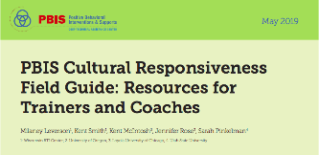
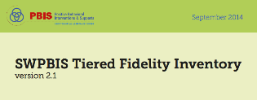
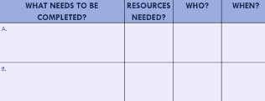
Organization of Modules
Content:
Aligned to TFI Items 1.1 – 1.15
Activities/Team Time: Activities for Fluency
Culturally Responsive:
Aligning culturally responsive practices to the core components of SWPBIS
Self-Assessment:
Tiered Fidelity Inventory
Action Planning: Applying the core content to your school
Notes:
MOVE UP
These are the icons that you will see throughout the training and will serve as a guide and a prompt to the content of each slide.
Change

Slide 6
A few assumptions:
We are aware of the extent of disproportionality
We are committed to enhancing equity in school discipline
The work is uncomfortable
There are a wide range of approaches that could work to enhance equity

Slide 7
Four Agreements
Stay Engaged
Speak Your Truth
Experience Discomfort
Expect and Accept Non-Closure
Adapted from Glenn E. Singleton & Curtis Linton, Courageous Conversations about Race: A Field Guide for Achieving Equity in Schools. 2006. pp.58-65. Thousand Oaks, CA: Corwin.
Notes:
Having discussions around equity can be difficult whether it is just within the team or at your school. Using these four agreements can help with those conversations.

Slide 8
Which SWPBIS Features are Most Related to Equity? (Tobin & Vincent, 2011)
Examined change in Black-White Relative Risk Index for suspensions in 46 schools:
Two key predictors of decreased disproportionality:
Regular use of data for decision making
Implementation of classroom SWPBIS systems
Relevant Factors Identified Elsewhere:
Expected Behaviors Defined Clearly
Expected Behaviors Acknowledged Regularly
Transitions are Efficient and Orderly

Slide 9
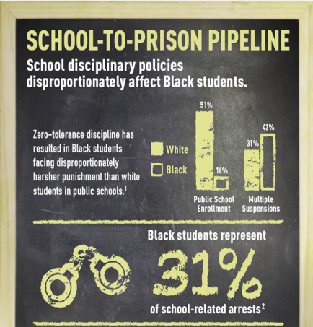
Disproportionality
Disproportionality can be understood as when a group is over- or underrepresented in a category differently than what we might expect for that group.
Overrepresentation
Identification for Special Education
Receiving office discipline referrals
Receiving a school suspension or expulsion
Underrepresentation
Identification for Talented and Gifted classes
Identification for Advanced Placement classes

Slide 10
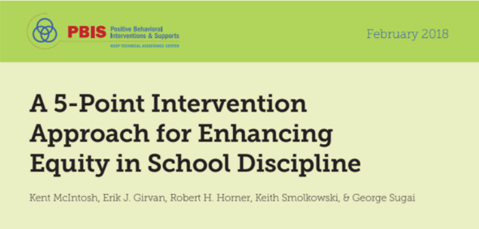
5 - Point Intervention Approach
Notes:
Guide published in February of 2018 by the Technical Assistance Center in Oregon. The guide give school teams 5 succinct strategies for enhancing equity in school discipline. We will inform you on these 5 strategies. It will be your team’s job to decide where you are at as a school and what information needs to be brought back for further inquiry and PD.

Slide 11
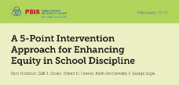
5 - Point Intervention Approach
We will come back to this.
Collect, use, and report disaggregate discipline data.
Implement a behavior framework that is preventative, multi-tiered, and culturally responsive.
Use engaging academic instruction to reduce the opportunity (achievement) gap.
Develop policies with accountability for disciplinary equity.
Teach strategies to neutralize implicit bias.
Notes:
We will come back to #1 at the end of the content. Time will be given to work through disaggregating your data.

Slide 12
5 - Point Intervention Approach
Collect, use, and report disaggregate discipline data.
Implement a behavior framework that is preventative, multi-tiered, and culturally responsive.
Use engaging academic instruction to reduce the opportunity (achievement) gap.
Develop policies with accountability for disciplinary equity.
Teach strategies to neutralize implicit bias.

Slide 13
Implement a behavior framework that is preventative, multi-tiered, and culturally responsive.
PBIS is particularly relevant for 3 reasons:
Focus on clear, consistent, and positive social culture reduces ambiguity for all.
Clear discipline definitions and procedures can reduce ambiguity in discipline decisions, reducing implicit bias.
Focus on instructional approaches to discipline can keep students in the classroom learning.

Slide 14
5 - Point Intervention Approach
Collect, use, and report disaggregate discipline data.
Implement a behavior framework that is preventative, multi-tiered, and culturally responsive.
Use engaging academic instruction to reduce the opportunity (achievement) gap.
Develop policies with accountability for disciplinary equity.
Teach strategies to neutralize implicit bias.

Slide 15
Use engaging academic instruction to reduce the opportunity (achievement) gap.
An evidence based definition of engaging instructions includes:
1. Using explicit instruction
2. Building and priming background knowledge
3. Increasing opportunities to respond
4. Providing performance feedback
(Chaparro, Nese, & McIntosh, 2015; Hattie, 2009)

Slide 16
5 - Point Intervention Approach
Collect, use, and report disaggregate discipline data.
Implement a behavior framework that is preventative, multi-tiered, and culturally responsive.
Use engaging academic instruction to reduce the opportunity (achievement) gap.
Develop policies with accountability for disciplinary equity.
Teach strategies to neutralize implicit bias.

Slide 17
Develop policies with accountability for disciplinary equity.
Policies should encompass clear steps to achieve equity.
Clear, actionable procedures for enhancing equity
i.e. remove harmful practices, data collection, hiring preferences, professional development
Hiring practices should include preference to individuals committed to educational equity.
Inclusion of racial and disability disciplinary equity outcomes into administrator & teacher evaluation processes.
Review the “Key Elements of Policies to Address Discipline Disproportionality: A Guide for District and School Teams”

Slide 18
5 - Point Intervention Approach
Collect, use, and report disaggregate discipline data.
Implement a behavior framework that is preventative, multi-tiered, and culturally responsive.
Use engaging academic instruction to reduce the opportunity (achievement) gap.
Develop policies with accountability for disciplinary equity.
Teach strategies to neutralize implicit bias.
Notes:
The 5-point intervention approach does a great job of laying out 5 concrete steps schools can take to promote equity in school discipline. We are going to first examine bias and vulnerable decision points and how this impacts our ability to stay neutral in discipline situations.

Slide 19
Teach strategies to neutralize implicit bias.
Assumptions about Bias
We can generally agree that a student’s color, race, economic status, disability, etc. should not fate negative outcomes.
Discussing equity can be uncomfortable.
Creating discomfort without providing effective strategies for equity is not productive.
In discussing equity and taking proactive steps, we will make mistakes.

Slide 20
Teach strategies to neutralize implicit bias.
Explicit Bias (conscious bias)
Pattern: Consistent discipline disproportionality across all situations.
Implications:
Strong school & district policies
Strong accountability for changes
Regular review and reporting of data
Implicit Bias (unconscious bias)
Pattern: Peaks & Valleys of discipline disproportionality depending on situations.
Implications:
Clarify discipline policies
Provide strategies for decision making

Slide 21
Teach strategies to neutralize implicit bias.
In specific situations, implicit (unconscious) bias is more likely to influence decision making. These are referred to as Vulnerable Decision Points (VDPs)
Subjective (ambiguity) behavior is prone to biased decision making
(Defiance, Disrespect, Disruption)
Using a self-review routine prior to making a disciplinary decision may neutralize effects.
Am I hungry, tired, out of typical context, etc.
Using “If-Then” statements can be effective
If a student is disrespectful, then handle it after class.

Slide 22
5 - Point Intervention Approach
As a team, take out copies of the 5-Point Intervention or look it up online.
Dig deeper into points 2-5.
Develop an action plan for 2-3 next steps your school site can explore as you continue to enhance equity in discipline.

Slide 23
5 - Point Intervention Approach
Collect, use, and report disaggregate discipline data.
Implement a behavior framework that is preventative, multi-tiered, and culturally responsive.
Use engaging academic instruction to reduce the opportunity (achievement) gap.
Develop policies with accountability for disciplinary equity.
Teach strategies to neutralize implicit bias.

Slide 24
5 - Point Intervention Approach
Collect, use, and report disaggregate discipline data.
Notes:
We are going to go through some “Simple Napkin Math” to start the conversation about disaggregating data.

Slide 25
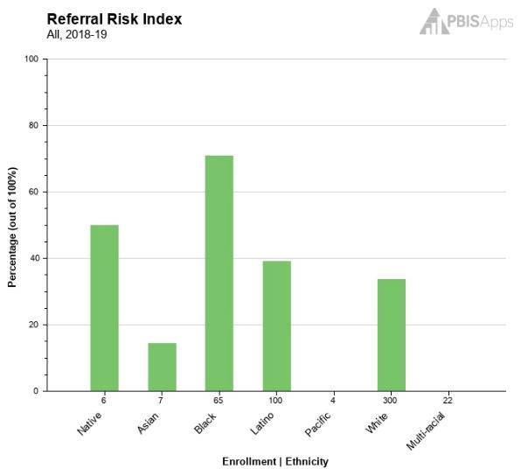
Collect, use, and report disaggregated discipline data
Yes, data can seem overwhelming & scary.
Use Simple Napkin Math to get started.
Ask yourself:
What are we going to look at?
What information are we looking to find?
Notes:
How many schools have SWIS?
If you have SWIS, this simple math is done for you with your ethnicity reports.

Slide 26
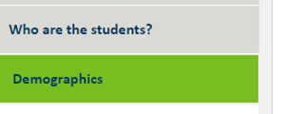
Collect, use, and report disaggregated discipline data
Example: We want to know if we have disproportionate discipline data.
Look up your school report card at: https://rc.education.state.mn.us
Go to “Who are the students?” on the left
Check out your demographics

Slide 27
Collect, use, and report disaggregated discipline data
4. Pull up your discipline data.
5. Compare % of office referrals by demographic to the overall % of each demographic in your school.
6. Think. Reflect. Respond.
Think. What is this data telling us?
Reflect. From what this data is telling us, what are our next steps?
Respond. Set out 2-3 action steps based on your findings.

Slide 28
Back to the start…
A few assumptions:
We are aware of the extent of disproportionality
We are committed to enhancing equity in school discipline
The work is uncomfortable
There are a wide range of approaches that could work to enhance equity

Slide 29
The following slides are resources for your continued work
Notes:
Trainer - you do not need to go through all of the following slides of resources, but just make sure the teams see they are available.

Slide 30
Pbis.org National resource center

Slide 31
Equity and PBIS

Slide 32
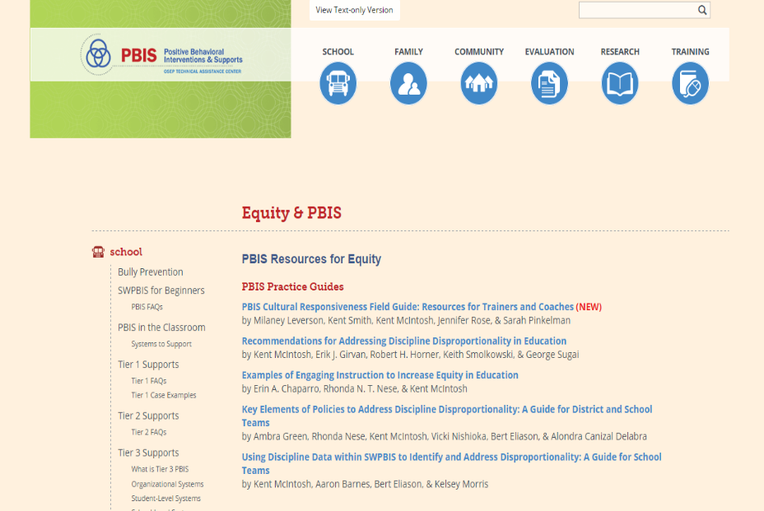
PBIS practice guides

Slide 33
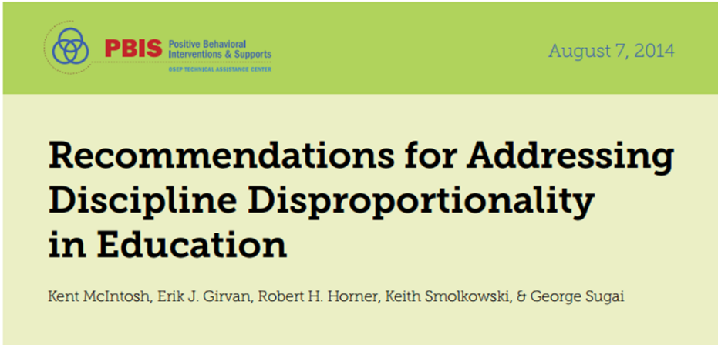
Recommendation for addressing disproportionality

Slide 34
Using data to identify and address disproportionality

Slide 35
Intervention Approach

Slide 36
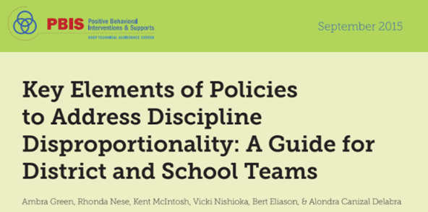
Key elements of policies
1. Specific Commitment to Equity
2. Family Partnerships in Policy Development
3. Focus on Implementing Positive, Proactive
Behavior Support Practices
4. Clear, Objective Discipline Procedures
5. Removal or Reduction of Exclusionary Practices
6. Graduated Discipline Systems with Instructional
Alternatives to Exclusion
7. Procedures with Accountability for
Equitable Student Outcomes

Slide 37
Appreciation is given to the following
for their contributions to this Professional Learning:

