Slide 1


SWIS Overview Workshop
Decision-Making Tool to Prevent Challenging Behaviors
& Identify Student Needs
Charting the Cs
Alexandria, MN
April 25, 2017
Aaron Barnes –SWIS Facilitator Trainer, MN
Garrett Petrie – SWIS Facilitator Trainer, MN
Excerpts & lessons from SWIS Facilitator Training Materials:
https://pbisapps.org/Resources/SWIS%20Publications/SWIS%20Facilitator%20Training%20Materials.zip
Notes:
Survey the audience for PBIS experience?
Survey the audience for team level – school/program, charter/district/coop, region?

Slide 2
Takeaways
The right information, in the right form, at the right time leads to more effective & efficient decisions.
SWIS helps “precision problem-solve” challenging behaviors to determine whether it is
  a school-wide problem,
  a small group problem,
  or 1-2 students that need specific supports…
… in “real time” (e.g., a 30-45 minute meeting).
We have a network of SWIS Facilitators across Minnesota available to help schools…
…find out how to become one too!

Slide 3
In ‘sandbox’, you will learn how to…
Quickly & effectively problem-solve student behavior challenges,
Create reports that show school-wide or program-wide behavior patterns,
Answer these problem behavior questions:
  What behaviors?
  How often?
  Where & when?
  Which students?
  Why?
In order to make decisions to improve school climate for all…
… using the School-wide Information System (SWIS) online tool.

Slide 4
Don’t BLINK
Quick Overview of SWIS:

Slide 5
What is the School-Wide Information System (SWIS)?
The School-Wide Information System (SWIS) is a web-based decision system used to improve behavior support in schools and other educational facilities by providing school personnel with accurate, timely, and practical information for making decisions about school environments.
Notes:
Trainer Note: Reminder – this is what SWIS is about.

Slide 6
Three Components of SWIS
Computer Application
  Web-based technology that is secure, subscription-based, and continuously available for entry, management, and reporting of data
Data Collection System
  Practices and resources to support collection and organization of data (e.g., documentation, staff, time, training)
Decision System
  Practices and resources to support team-based analysis of data for continuous quality improvement (e.g., documentation, team agreements, problem-solving routines)
Notes:
Trainer Note: This is something that participants should be reminded of throughout the training! SWIS is more than just a computer application that schools purchase, it’s about embedding data into a data collection system that provides the foundation for a comprehensive decision system which leads to improved student social competence and academic outcomes.

Slide 7
Basic Features of SWIS
Data-first model
  Visual formatting for decision making (pictures)
Reports discipline data
  Major office discipline referrals (ODRs)
  Minor discipline incidents
Highly efficient data entry
  30 seconds per referral
Web-based for continuous availability
Confidential and secure
Local control and support

Slide 8


Value & Utility of SWIS
What’s the goal?
  To make schools more effective learning environments
How?
  Repeatedly giving people the right information, at the right time, in the right format is the single most effective way to improve decision making and achieve valued outcomes (Gilbert, 1978).
Why focus on behavior?
  Social behavior is the single most common reason students are excluded from education. (U.S. Dept. of Ed.)
Notes:
Trainer Note:
The Social Behavior quote is from the U.S. Dept of Education … They release a report each year on teachers… and three things that are consistent have been (a) problem behavior is one of the top 5 reasons teachers give for leaving the field, (b) classroom management is one of the top 3 areas teachers list as needing more training in during their pre-service training and (c) problem behavior remains the most common reason why students are excluded from education (suspension, expulsion, relocation).

Slide 9
Precision Problem-Solving
‘Effective & Efficient’

Slide 10



Groovy Ideas…
Bridging Research to Practice
Where did some of our precision-problem solving
concepts come from?
1978

Slide 11
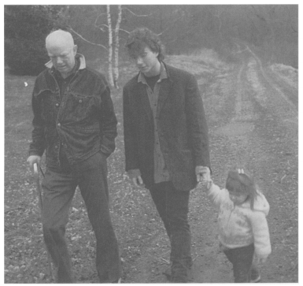
Thomas F. Gilbert
1927-1995
Bridging Research to Practice
Source: https://www.ncbi.nlm.nih.gov/pmc/articles/PMC2733603/pdf/behavan00019-0011.pdf

Slide 12
Why Gilbert, why still, why now?
Bridging Research to Practice

Slide 13
“Because Gilbert Demonstrated That…”
Repeatedly providing people…
The right information,
At the right time,
In the right format…
…is the single most effective way to improve decision-making and obtain valued outcomes.
Source: https://www.pbisapps.org/Resources/SWIS%20Publications/SWIS%20Facilitator%20Training%20Materials.zip

Slide 14
How do we apply it in education?
The right data at the right time given to the right people results in decisions that are better, faster, and cheaper!
To make decisions, schools need decision systems with data that are:
  Relevant (right information in the right format)
  Accurate (consistent across staff, entered correctly)
  Timely (current, quick to find, continuously available)

Slide 15
Improving Decision Making
We used to go from …
Problem
Solution
Notes:
We used to go from identifying a problem to immediately launching into a solution. Often, we described problems very broadly (Cafeteria is out of control) and then implemented a solution (turn out the lights, reduce lunch time, more staff in lunchroom, etc.) that didn’t always specifically address who, what, when, where and why the problem was occurring.
Traditionally, schools spend time admiring the problem by talking and talking about the problem and then quickly launching into some solution.

Slide 16
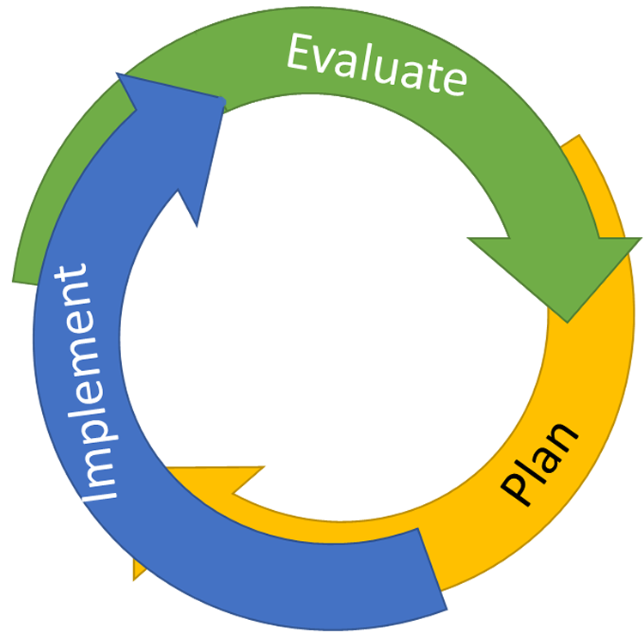
…To Continuous Quality Improvement
Reassess and revise solution(s) as needed
Identify problems with precision
Monitor outcomes and compare
to goal(s)
DATA
Establish goal(s)
Develop solution(s)
Implement solution(s) with integrity and fidelity
Notes:
Trainer Note: We want to interrupt the traditional cycle of admiring the problem, by talking and talking about the problem before quickly launching into determining solutions.
We can do this by building a system for improved decision making.

Slide 17
SWIS Drill-Down
Connecting the “Dots” for Precise Problem Identification

Slide 18
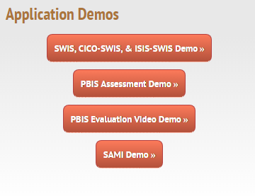
Log in to SWIS Demo Account
https://www.pbisapps.org/Applications/Pages/Application-Demos.aspx
Click on “SWIS, CICO-SWIS, & I-SWIS Demo” button

Slide 19

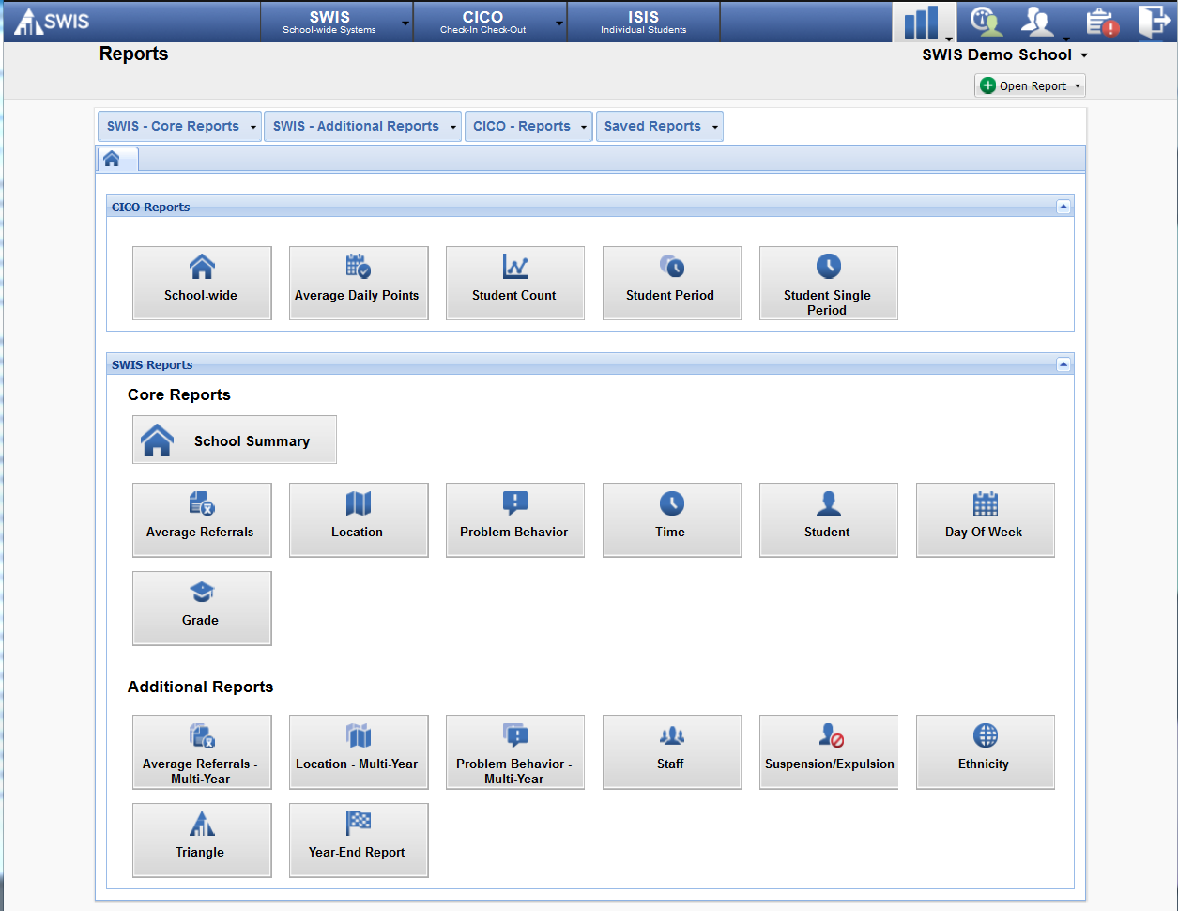
SWIS Demo School - Reports
Notes:
Within the SWIS application, users have access to multiple reports representing various data sets. SWIS organizes the 16 available reports into Core Reports and Additional Reports.
***Trainers should familiarize themselves with the information below about Core Reports and Additional Reports. The information for each report set will be discussed with the subsequent slides.***
Core Reports provide information at the school-wide level. These reports are presented on the main SWIS Dashboard and are also available in the reports dashboard (View Reports). The value of the Core Reports is that they help schools quickly and visually identify “red flags” or potential problems that may need further inquiry. The Core Reports include: Average Referrals Per Day Per Month, Referrals By Location, Referrals By Problem Behavior, Referrals By Time, Referrals By Student, Referrals By Day of Week, and Referrals By Grade. Both the day of week and grade reports are new in SWIS 5.
Additional Reports provide some of the same information presented in the Core Reports and display it in a multi-year format so that schools/facilities can see changes over time. For example, the Average Referrals Per Day Per Month report is represented in a multi-year format so users can see a specific month (e.g., March) and compare it to the previous year, the year before that, etc.
The same is true for the Location report presented in the multi-year format. This report allows users to see the number of referrals in various locations compared across years.
The Problem Behavior report presented in the multi-year format allows users to see the number of referrals associated with individual problem behaviors compared across years.
The Staff report is only accessible to certain users with appropriate access levels. The Staff report displays the number of referrals written by staff members within a designated time range.
The Suspension/Expulsion report displays the total number of students, total number of events, and total number of days involved in in-school suspensions, out-of-school suspensions, and expulsions. This report will also display individual student information and note which students received a suspension or expulsion.
The Ethnicity report is presented using three different graphs and is used to monitor referral patterns across a school/facility’s various racial/ethnic groups. The Ethnicity report can assist schools in providing equity in education and taking actionable steps toward avoiding disproportionality in discipline practices. We will go deeper in utilizing the Ethnicity report for decision making in Module 6.

Slide 20
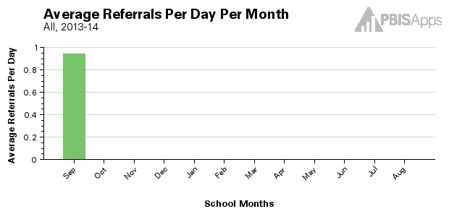
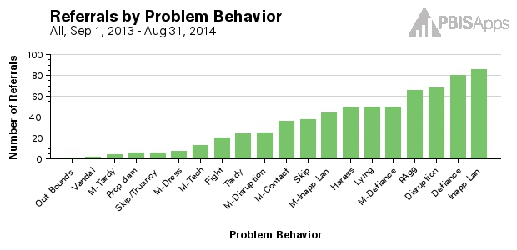
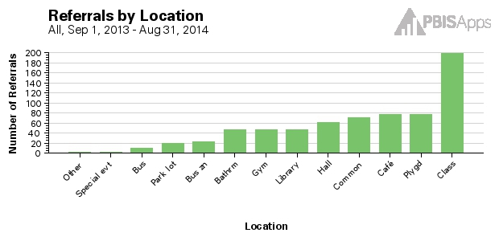
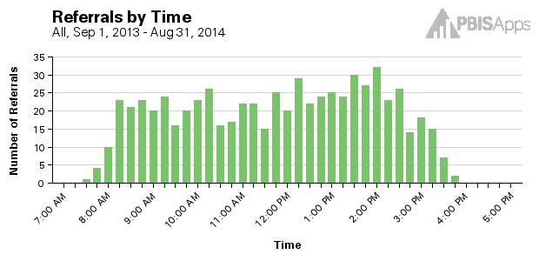
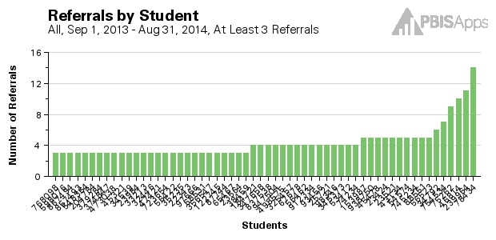
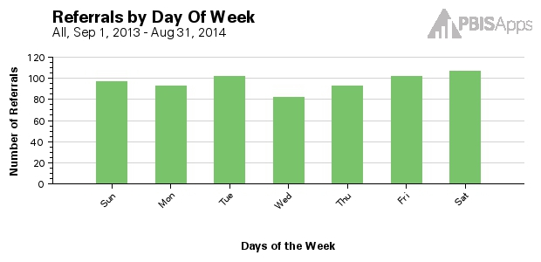
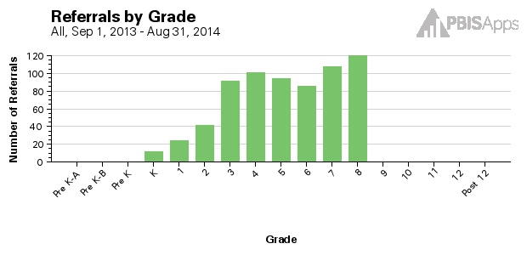
Core SWIS Reports
Notes:
Core Reports provide information at the school-wide level. These reports are presented on the main SWIS Dashboard and are also available in the reports dashboard (View Reports). The value of the Core Reports is that they help schools quickly and visually identify current “red flags” or potential problems that may need further inquiry.
The Core Reports include:
Average Referrals Per Day Per Month
Referrals By Location
Referrals By Problem Behavior
Referrals By Time
Referrals By Student
Referrals By Day of Week
Referrals By Grade
(Both the day of week and grade reports are new in SWIS 5)

Slide 21
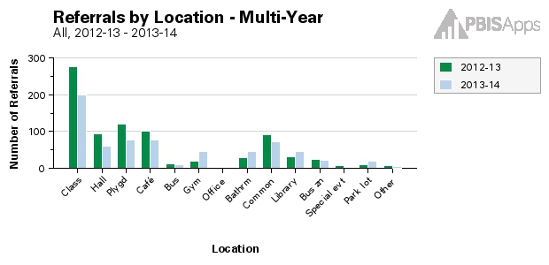
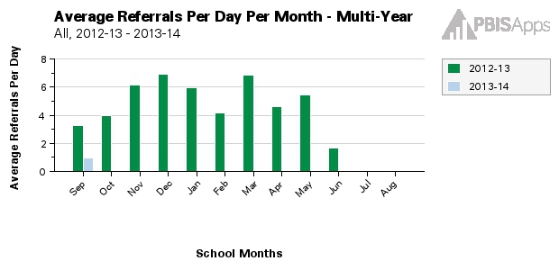
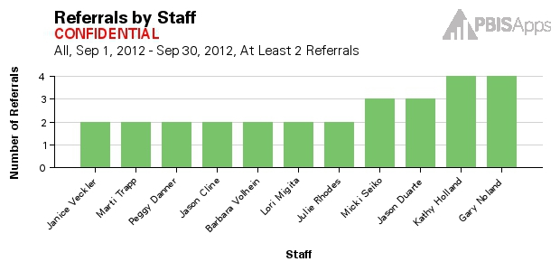
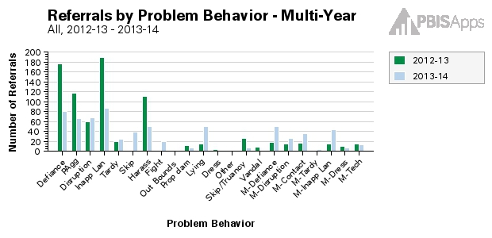
Additional SWIS Reports
Notes:
Additional Reports provide some of the same information presented in the Core Reports and display it in a multi-year format so schools/facilities can see changes over time. For example, the Average Referrals Per Day Per Month report is represented in a multi-year format so users can see a specific month (e.g., March) and compare it to the previous year, the year before that, the year before that, etc.
The same is true for the Location report presented in the multi-year format. This report allows users to see the number of referrals in various locations compared across years.
The Problem Behavior report presented in the multi-year format allows users to see the number of referrals associated with individual problem behaviors compared across years.
The Staff report is only accessible to certain users with appropriate access levels. The Staff report displays the number of referrals written by staff members within a designated time range.

Slide 22
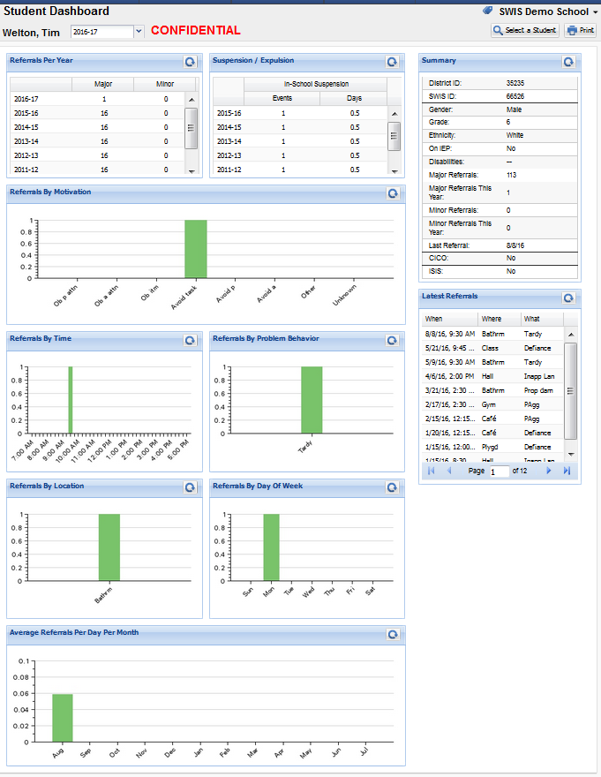
Student Dashboard
Notes:
The Student Dashboard provides the most relevant reports about a specific student. This report includes graphs similar to the SWIS Dashboard. There are not options for narrowing the date range (you can change the school year as well).
When a student is identified or referred for additional supports, this tool provides a summary of the student’s referral data. This is also a set of reports that would be appropriate to include in a student’s file if they transfer to another school.
Teachers may request these reports during parent-teacher conferences. This would be something to schedule extra data analyst/reporter time for since there are typically only 1-3 people available who have access to create the reports, and they might be overwhelmed if this were a last-minute request!

Slide 23
Why Use Data For Decision Making?
Decisions are more likely to be effective and efficient when they are based on data.
The quality of decision making depends most on the first step; defining the problem to be solved with precision and clarity.
Notes:
Understanding what data-based decision making is and how it is useful is one of the essential learner outcomes (i.e., learning targets) for this module. This slide and the seven slides that follow are designed to help participants understand what data-based decision making is, why it should be used, and how SWIS can help.
On this slide, highlight for participants that informed decisions are the most effective decisions. When a decision is based upon information, especially data, it is more likely to effectively address the true problem. Using data for decision making involves defining the problem to be solved and clarifying what decision is to be made.
Analogy: When you go to the doctor’s office or the ER, they do not simply take your blood pressure and then decide to remove your appendix. Quite the contrary. They make informed decisions based upon the data and define the problem with precision to clarify the solution.

Slide 24
Why Use Data For Decision Making?
Data help place the “problem” in the local context rather than on the students.
Data help us ask the right questions…they do not provide the solutions.
Use data to:
  Identify problems
  Refine problems and understand the context
  Define the questions that lead to a solution
Notes:
By gathering data to use in our decision making, we reframe problems and begin thinking about contextual factors such as location, time, and specific behavior as opposed to merely identifying problem students and repeat offenders.
Data help us ask the right questions so that we can design the right solutions. Data present “red flags” that may be issues and need further inquiry, and then they help us to narrow down the issue precisely.
Analogy: When you go to the Emergency Room or the doctor’s office, the first thing they do is check your vital signs. By checking blood pressure, heart rate, respiratory rate, and temperature the physician has better indicators of overall health and well-being. By collecting this information, the doctor is better equipped to respond when you say “I don’t feel well,” or “I have a problem.”

Slide 25
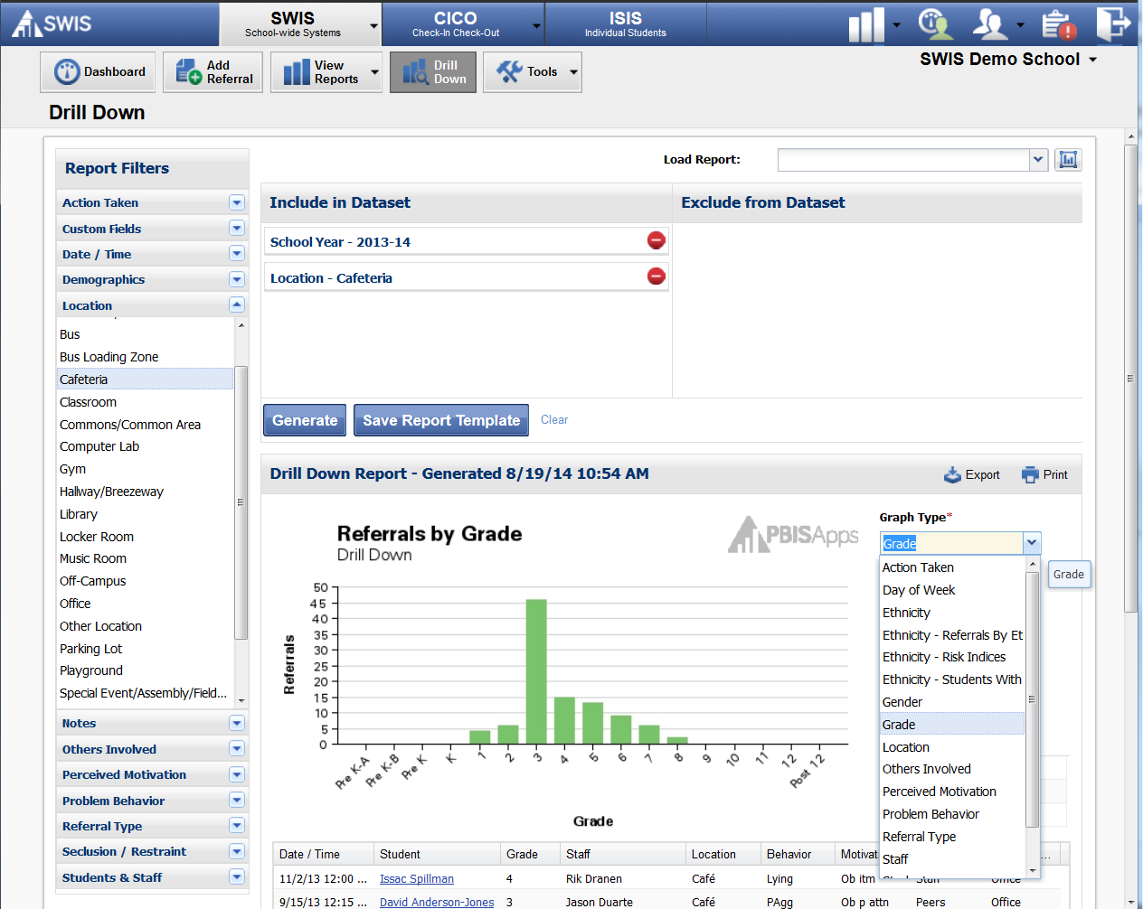
Data Drill Down
Use the information from the SWIS Dashboard to drill down and analyze data.
Change the graph type to change the lens of analysis.
Notes:
This is the SWIS Drill Down tool. In Drill Down we can focus on taking one piece of information and filtering down to better understand the context of problem behaviors.

Slide 26

Building Decision Systems
Analyzing data in layers to “drill down”
  What is our current reality?
  Is there a problem? (red flag)
  Note: It’s ok to be doing well!
  Put the problem into context (get specific).
    what, where, when, who, how often, why
  Be efficient; don’t drown in the data.
Notes:
In summary, we want to avoid drowning in data. Users want to use data in layers to be specific and laser-like.
For example:
Do we have a problem?
What is the problem?
Where is the problem occurring?
When is the problem likely to occur in the identified location?
Who is involved/contributing (grades, specific students, gender)?
Why is the problem being maintained in the specific location at the specific times?
The overall goal is to use the data as an effective tool and look to identify connections.

Slide 27








Using SWIS Data to Solve Problems
Problem
The first step in any problem-solving process is identifying the problem.
Notes:
The first step in any problem-solving process is identifying the problem. SWIS helps schools/facilities move from “I think I have a problem,” to “My problem is….”
Data analysts use the SWIS Core Reports to help locate problems. They provide the vital signs that help schools identify if a problem exists, what it is, where it is occurring, how often it’s occurring, etc. Continuing our analogy, it is a way to check both the temperature and blood pressure to see what problems may exist.
Each one of the graphs and reports featured in the Core Reports needs to be reviewed for potential “red flags.” Some things you notice might simply be “red flags” and items of note for future thought and discussion. Then again, some things you notice will truly be items you need to dig into deeper and analyze further to isolate problems and develop solution plans.

Slide 28
Gathering the Pieces
SWIS Core Reports can help teams identify current status and potential problems (red flags)
Questions | Reporting Tools
What problem behaviors are most common? | Referrals by Problem Behavior
Where are problem behaviors most likely? | Referrals by Location
When are problem behaviors most likely? | Referrals by Time
Who is engaged in problem behavior? | Referrals by Student
Why are problem behaviors sustaining? | Data Drill Down
Notes:
SWIS helps schools/facilities answer each of the “wh…” questions by presenting the data in a usable format and report.
Use Referrals By Problem Behavior to answer the question, “What problem behaviors are most common?”
Use Referrals By Location to answer the question, “Where are problem behaviors most likely to occur?”
Use Referrals By Time to answer the question, “When are problem behaviors most likely to occur?”
Use Referrals By Student to answer the question, “Who is engaging in problem behavior?”
Use the Data Drill Down feature to answer the question, “Why are problem behaviors sustaining?”

Slide 29

Using SWIS Data to Solve Problems
Problem identification involves identifying the context!
Location
Problem
Behavior
Time
Students
Motivation
Knowing the context of a problem helps identify relevant solutions!
Notes:
The SWIS Core Reports are used to check the temperature or blood pressure to see what problems may exist. It keeps the focus at the school-wide level.
For those items off of the Core Reports that need a deeper level of inquiry, SWIS assists by providing a Drill Down tool that allows the data to be filtered strategically. Data can be analyzed based upon action taken, motivation, grade level, others involved, date range, gender, ethnicity, IEP status, time range, etc.
The use of these filters can be helpful when trying to isolate problems and develop solution plans. This image is a little bit misleading in showing a linear drill down process. Really, after data are filtered by the initial red flag, then you follow the ‘clues’ and patterns to narrow down to the specific context (who, what, where, when, how often, and why) that is enabling the problem.

Slide 30
Summary… Problem-Identification
Problem identification involves identifying current red flags and their context.
Precise problem identification ensures that problems are current and relevant!
Knowing the context of a problem helps identify relevant solutions.
Each data analyst and team will have a unique process for drilling down.
Time Range
Problem
Behavior
Grade
Action Taken

Slide 31




The Last (and Hardest) Question
Notes:
Yes, the last question is “Why.” It’s the last and hardest question to answer in building a statement with precision… at least it feels that way sometimes.

Slide 32

Perceived Motivation
Why asks, “What is perceived as maintaining the problem behavior?”
  Perceived Motivation Falls Into These Two Categories:
Obtain | Avoid
Attention (adults or peers) Tangible (items, activities) Sensory | Attention (adults or peers) Tangible (items, activities) Sensory
Notes:
In SWIS, the “Why” is called Perceived Motivation. What is perceived as maintaining the problem behavior? Why does it keep happening?
This is based in behavioral research, and we’re trying to find out what the student was trying to (or did) accomplish with their behavior.
In behavioral theory and research, all behavior is motivated by either Obtain or Avoidance.
We might want to access or avoid people or at least attention from people. In SWIS, we split this into adult or peer attention.
We might also want to access or avoid other “things” such as tangible items, activities/tasks, or specific sensory stimulation. In SWIS, we can choose from avoid tasks/activities, obtain items/activities.
Often if the staff who observe the problem behavior will pause and ask themselves what happened before and after the problem behavior, they can make an educated guess about the function or motivation. It’s okay to ask the student too. They might not use the official terminology, but they often know best why they did what they did.
Even after reflection and/or asking the student, we might not be 100% certain of the perceived motivation each time, but a best guess across multiple instances of similar problem behaviors will begin to reveal the patterns for which we are looking. Understanding the motivation is critical because effective solutions to problems must address the same function. If the student disruption across 8th graders is related to avoiding tasks, then we need to look at whether the task is appropriate for the students’ skill level. The 3rd grade boys are using inappropriate language to gain adult and peer attention, so we need to remove attention for inappropriate language and provide the student with appropriate and easy ways to get the attention for which they are looking.

Slide 33
Always LAST!
Always assess motivation AFTER you have defined: Who? What? When? Where?
WHY are students misbehaving in this context?
Multiple Motivations?
Look for the “primary” motivation
Notes:
The SWIS Dashboard and the Core Reports do not give you information about motivation at the school-wide level.
You cannot answer the question “Why are problem behaviors sustaining?” unless you use the Drill Down feature to first identify the CONTEXT of interest.
Use the Data Drill Down feature to answer the question, “Why are problem behaviors sustaining?” by selecting all the contextual filters first and then changing the graph type to “Perceived Motivation.”
Let’s look at a couple of examples.

Slide 34

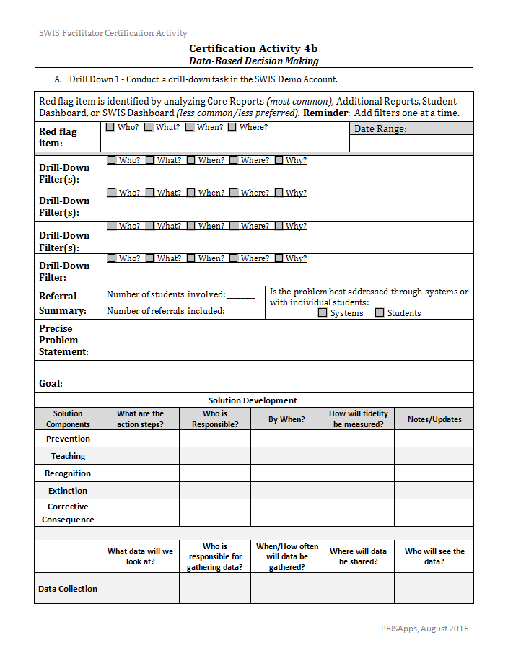


“SWIS Drill-Down Worksheet” Activity
Demo Account
Drill Down
Log into the
Demo Account
Notes:
Time for you to conduct a couple of drill-downs independently…

Slide 35
SWIS Drill-Down Worksheet - “We do”
Let’s do Drill Down 1 together
Look at the red flag of Time of Day.
Let’s Drill Down step-by-step (1 filter at a time)
Use the Drill Down Guide Sheet to check each step
Check if precise problem statement fits the information we found together
Notes:
If you look at Activity 4a you will find the problem behavior most commonly reported and the location most commonly reported. For your first drill down look at that problem behavior for the current year (or previous year if there aren’t enough data yet for the current school year). Then you’ll conduct a second drill down with the most common location where problems are being reported.
Remember that we generally want to add ONE filter at a time unless there is a clear rationale for combining two locations, behaviors, etc together.
You’re going to use the Drill Down Guide Sheet to record the order of your drill down… this is helpful if you need to backtrack.
Hint: Although a system-level problem typically has at least 10 students involved we are trying to build fluency with the process. If you get near the end of your drill down and the summary indicates that your problem is too small, don’t worry too much. You can remove filters if this happens early in the drill down and just adjust the Guide Sheet.

Slide 36
SWIS Drill-Down Worksheet - “You try”
Try Drill Down 2 on your own or with partner
Look at the red flag of Behavior.
Try a SWIS Drill Down (1 filter at a time)
Complete the Drill Down Guide Sheet to record the order of steps
Develop a precise problem statement
Notes:
If you look at Activity 4a you will find the problem behavior most commonly reported and the location most commonly reported. For your first drill down look at that problem behavior for the current year (or previous year if there aren’t enough data yet for the current school year). Then you’ll conduct a second drill down with the most common location where problems are being reported.
Remember that we generally want to add ONE filter at a time unless there is a clear rationale for combining two locations, behaviors, etc together.
You’re going to use the Drill Down Guide Sheet to record the order of your drill down… this is helpful if you need to backtrack.
Hint: Although a system-level problem typically has at least 10 students involved we are trying to build fluency with the process. If you get near the end of your drill down and the summary indicates that your problem is too small, don’t worry too much. You can remove filters if this happens early in the drill down and just adjust the Guide Sheet.

Slide 37
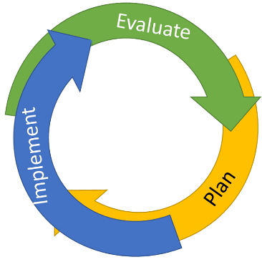
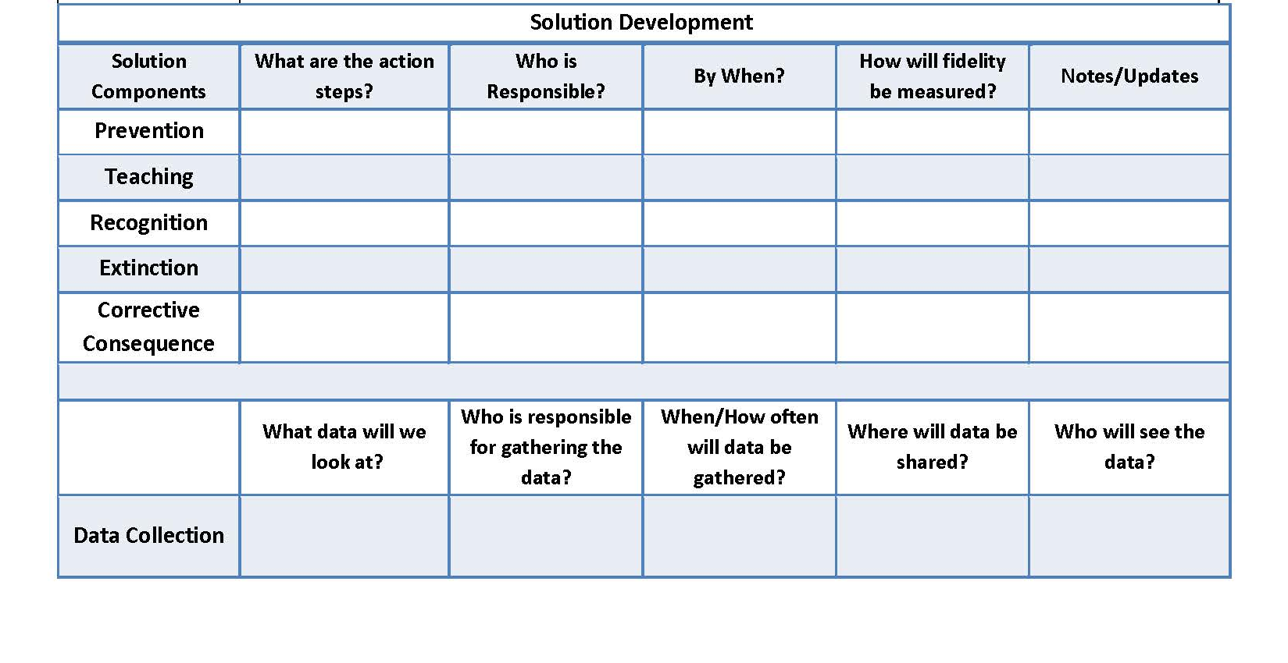
If you have a precise problem statement…
Bonus Activity
Try to develop a solution action plan at bottom of worksheet.
  Determine a measurable & reasonable goal
  Complete the Solution Development Action Plan Template. Incorporates all solution components.
    Prevention
    Teaching
    Recognition
    Extinction
    Corrective Consequence
    Data Collection
Notes:
***After 10 minutes, for those who are finished move to the Follow-Up Activity (to allow time for other participants to finish the drill down).***
For those who are finished with your two drill downs, choose one of the precise problem statements and try moving to the next steps. We don’t generally recommend that one person build the goal and solution independently but this will give you an opportunity to identify how you will coach teams to move to this step.
***If asked why this step should not be done independently by data analysts here is one possible response: Best practice is for a representative team to collaborate on the goal and solution development so that they better reflect the values of the staff/community and are realistic to implement. This also allows the team members to take ownership of the solution which increases the fidelity of implementation.***

Slide 38
YES!
Can we get SWIS?

Slide 39
Pricing Model – 2016-2017
 | 1 Application a la carte | 2 Applications bundled | 3 Applications bundled
1-19 Schools on a single invoice | $350 | $460 | $570
20-39 Schools on a single invoice | 10% discount ($315) | 10% discount ($414) | 10% discount ($513)
40+ Schools on a single invoice | 20% discount ($280) | 20% discount ($368) | 20% discount ($456)
ISIS-SWIS
CICO-SWIS
SWIS
Notes:
The pricing model is based on the invoice.
The first question is how many schools are being paid on a single invoice.
If you are working with large districts who use the SWIS Suite Applications across at least 20 schools, then there is a discount for paying for all the accounts at the district level on one invoice.
The second question is how many applications are each of the schools working with.
Typically, a school will purchase CICO-SWIS or ISIS-SWIS separately when they meet readiness, so for the first year, there is usually not a bundling discount (unless they wait until August to sign up). However, any applications added after initial purchase would be added at a prorated basis for the remainder of that school year.
In September of the second year, if they are using multiple SWIS Suite applications there will be a discount at invoice time.
Folks may throw out all sorts of examples of how their district would want to be billed. Questions about pricing are best directed to the Accounts team. There are too many variations to consider in this format. Highly encourage folks to simply contacting accounts@pbisapps.org.

Slide 40
Closing Thoughts
The right information, in the right form, at the right time leads to more effective & efficient decisions.
SWIS helps “precision problem-solve” challenging behaviors to determine whether it is
  a school-wide problem,
  a small group problem,
  or 1-2 students that need specific supports…
… in “real time” (e.g., a 30-45 minute meeting).
We have a network of SWIS Facilitators across Minnesota available to help schools…
…find out how to become one too!

Slide 41
SWIS Facilitators – Roles & Responsibilities
Who are we looking for & what do you need to do?

Slide 42
Qualities of a Successful Facilitator
Basic presentation and social skills
Basic computing skills (e.g., email, internet, using electronic documents)
Knowledge about how schools work
Facilitator vs. Consultant Role
  Facilitator role includes long-term capacity building within and across schools.
  Facilitators work to make everyone around them more effective.
Notes:
Tomorrow afternoon we cover your roles and responsibilities as a SWIS facilitator in much greater depth, but our experience has been that there are some foundational qualities consistent across the facilitators who successfully support schools toward continuous quality improvement. You are here for the next two and a half days in order to join this network of facilitators who support schools in their journey towards continuous quality improvement. We are excited that you’re here!

Slide 43

Facilitator Tasks
Getting Certified
  Initial SWIS Certification Training (2.5 days)
  Align role of SWIS facilitator into job description and responsibilities
  Build routines and procedures for maintaining contact with PBISApps Team and local SWIS network
    Visit PBISApps.org website
    Review newsletters, updates, reminders, and other communications
    View online videos and webinars
    Send feature requests, questions, and bugs
    Attend state and national PBIS conferences (as available)
Plan for 5-10 hours per year for SWIS Professional Development
Notes:
Trainer Note (draft):
In order to work with school on SWIS installation, facilitators must become certified by attending the training and embedding the role and responsibilities of a facilitator into their current position.

Slide 44
Facilitator Tasks
School Request & Installation
Introducing the need for decision systems
through presentation, demonstration, and conversation
Work with new schools/facilities to get ready, up,
and running with SWIS
  Readiness
  Licensing
  Swift at SWIS Training
  Coaching teams to use SWIS data for decision making
  (3+ meetings first year)
  Follow-up Readiness Review
Plan for 15-20 hours per school, per year for SWIS installation with schools/facilities
Notes:
Trainer notes:

Slide 45
Facilitator Tasks
Ongoing Training, Coaching,
Refinement & Sustainability
User Training
  training, technical assistance, and updates to each authorized user
Team Coaching
  team coaching and updates for continuous quality improvement
Systems Refinement
  improvement of systems, documentation, and procedures related to the quality of decision systems
Ongoing Sustainability
  Annual readiness reviews, communication, coaching, new user training, & other tasks to maintain implementation fidelity
  Sustainability requires approximately 5 hours per school per year
Notes:
Trainer notes:

Slide 46
Share the Love . . .

Slide 47

pbisMN.org

Slide 48




Social Media
twitter.com/pbisMN
facebook.com/pbisMN

Slide 49
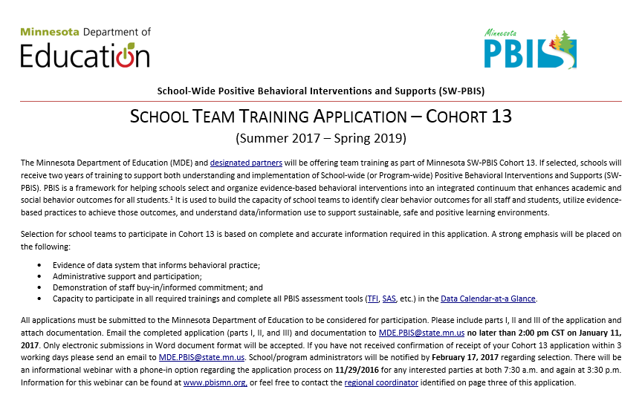
Applying for Cohort Training
Cohort application guides you through Exploration activities to form a team and get data system in place.
Teams get the pre-requisites in place to be ready for PBIS Installation, including commitment to data collection and analysis.
pbisMN.org
49
Notes:
http://www.pbismn.org/gsapplication.html
This school application requires school-wide team that is representative of that school. This applying school team represents the unit that all teams above need to support so that student outcomes will be positive. This application is reviewed by a state team member as well as a regional team member to determine fit for the school. In addition, there is a requirement in the application to name the members of a district team if more than one school is or will be implementing PBIS Data requirement is spelled out as well as commitment and buy-in.
Exploration/formation of District team
The lets teams know what will be required of them as well as what the training will provide.

Slide 50
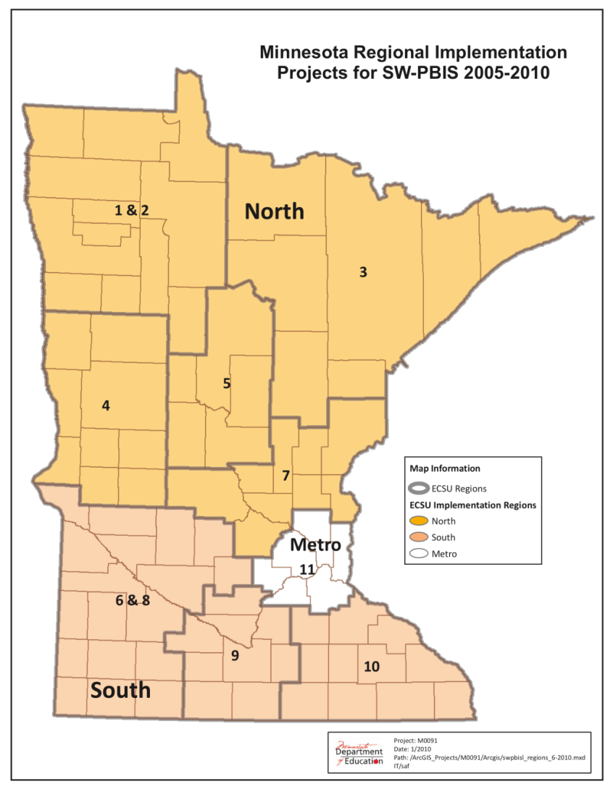
MN SW-PBIS
Regional Implementation Projects
Team-based training
9 training days over two years
Distributed, team-based implementation of PBIS
Intended to build capacity, skills, competency and beliefs to sustain implementation beyond initial training in a school

Slide 51
North Regional Contacts
North Regional Implementation Project
Erin Engness
NRIP Coordinator
pbis.erin@gmail.com
320-267-7818
Karie Belling
NRIP Conference Planner
belling@charter.net
320-529-9631
320-309-9735 cell
PBIS Management - Regional Contacts
Mary Hunt
Mary.Hunt@state.mn.us
651-582-8676
Ellen Nacik
Ellen.Nacik@state.mn.us
651-582-8665
Eric Kloos
Eric.Kloos@state.mn.us
651-582-8268
PBIS Evaluation Contact
Wilder Research
pbisevalmn@wilder.org
651-280-2960
Find other MN PBIS contacts on our website: www.pbismn.org/contactus.html

Slide 52
Metro Regional Contacts
Metro Regional Implementation Project
Ingrid Aasan
Regional Implementation Project Coordinator
Ingrid.Aasan@metroecsu.org
612-638-1517
Deborah Saxhaug
Regional Implementation Project Coordinator
dsaxhaug@macmh.org
Emily Robb
Coach Coordinator
pbis.emily@gmail.com
Megan Gruis
Data & Evaluation Coordinator
pbis.megan@gmail.com
PBIS Management - Regional Contacts
Maci Spica
Maci.Spica@state.mn.us
651-582-8596
Becky Nies
Rebecca.Nies@state.mn.us
651-582-8648
Eric Kloos
Eric.Kloos@state.mn.us
651-582-8268
PBIS Evaluation Contact
Wilder Research
pbisevalmn@wilder.org
651-280-2960
Find other MN PBIS contacts on our website: www.pbismn.org/contactus.html

Slide 53
South Regional Contacts
South Regional Implementation Project
Teresa Hunt, South West Service Cooperative
SRIP Coordinator, Marshall Area PBIS
Teresa.Hunt@swsc.org
Erin Toninato, South Central Service Cooperative
Mankato Area PBIS
etoninato@mnscsc.org
PBIS Management - Regional Contacts
Aaron Barnes
Aaron.Barnes@state.mn.us
651-582-8592
Garrett Petrie
Garrett.Petrie@state.mn.us
651-582-8396
Eric Kloos
Eric.Kloos@state.mn.us
651-582-8268
PBIS Evaluation Contact
Wilder Research
pbisevalmn@wilder.org
651-280-2960
Find other MN PBIS contacts on our website: www.pbismn.org/contactus.html

Slide 54
Contact Us
Aaron Barnes aaron.barnes@state.mn.us
Garrett Petrie garrett.petrie@state.mn.us

Slide 55
References
Excerpts & lessons are from SWIS Facilitator Training Materials:
https://pbisapps.org/Resources/SWIS%20Publications/SWIS%20Facilitator%20Training%20Materials.zip

