Slide 1
Non-classroom Settings

Slide 2
SWPBS
Subsystems
School-wide
Classroom
Family
Non-classroom
Student
Notes:
*
Review the School-wide system’s key components and emphasize this morning’s portion of the training focuses on non-classroom settings. Point out that most will assume behavioral issues are generated from the classroom. However, we have learned student behavioral concerns are often generated in unstructured areas of the building.

Slide 3
Purposes
Development and implementation of a formal, consistent, and continuous system of SW-PBIS in non-classroom settings.
To review critical features & essential practices of active supervision.
Notes:
Point out the key feature of improving student behavior in non-classroom settings is to involve all school personnel in Active Supervision, emphasizing ALL school staff.
*

Slide 4
Outcomes
Teams will update their Action Plan to include a method, materials, personnel etc. needed to train staff on the use of Active Supervision.

Slide 5
Examples (SWPBS Workbook page 79 )
An elementary school principal found that over 45% of their behavioral incident reports were coming from the playground.
Notes:
First slide in a series that points out incidents outside of the classroom. Emphasize using ODR data and the location of incidents.
*

Slide 6
High school assistant principal reports that over 2/3 of behavior incident reports come from “four corners.”
Notes:
*

Slide 7
A middle school secretary reported that she was getting at least one neighborhood complaint daily about student behavior on & off school grounds.
Notes:
*

Slide 8
High school nurse lamented that “too many students were asking to use her restroom” during class transitions.
Notes:
*

Slide 9
At least 2 times/month, police are called to settle arguments by parents & their children in parking lot
Notes:
*

Slide 10
Over 50% of referrals occurring on “buses” during daily transitions.
Notes:
Often bus referrals are more prevalent in elementary and middle schools than they are in the high schools.
*

Slide 11
Nonclassroom Settings
Particular times or places where supervision is emphasized:
Cafeteria, hallways, playgrounds, bathrooms
Buses & bus loading zones, parking lots
Study halls, library, “free time”
Assemblies, sporting events, dances
Wherever instruction is not available as behavior management tool
Notes:
*

Slide 12
Social Competence &
Academic Achievement
Positive
Behavior
Support
OUTCOMES
DATA
Supporting
Decision
Making
Supporting
Staff Behavior
SYSTEMS
PRACTICES
Supporting
Student Behavior
Notes:
*

Slide 13
Classroom v. Nonclassroom
Classroom
Teacher directed
Instructionally focused
Small # of predictable students
Nonclassroom
Student focused
Social focus
Large # of unpredictable students
Notes:
*

Slide 14
Notes:
*

Slide 15
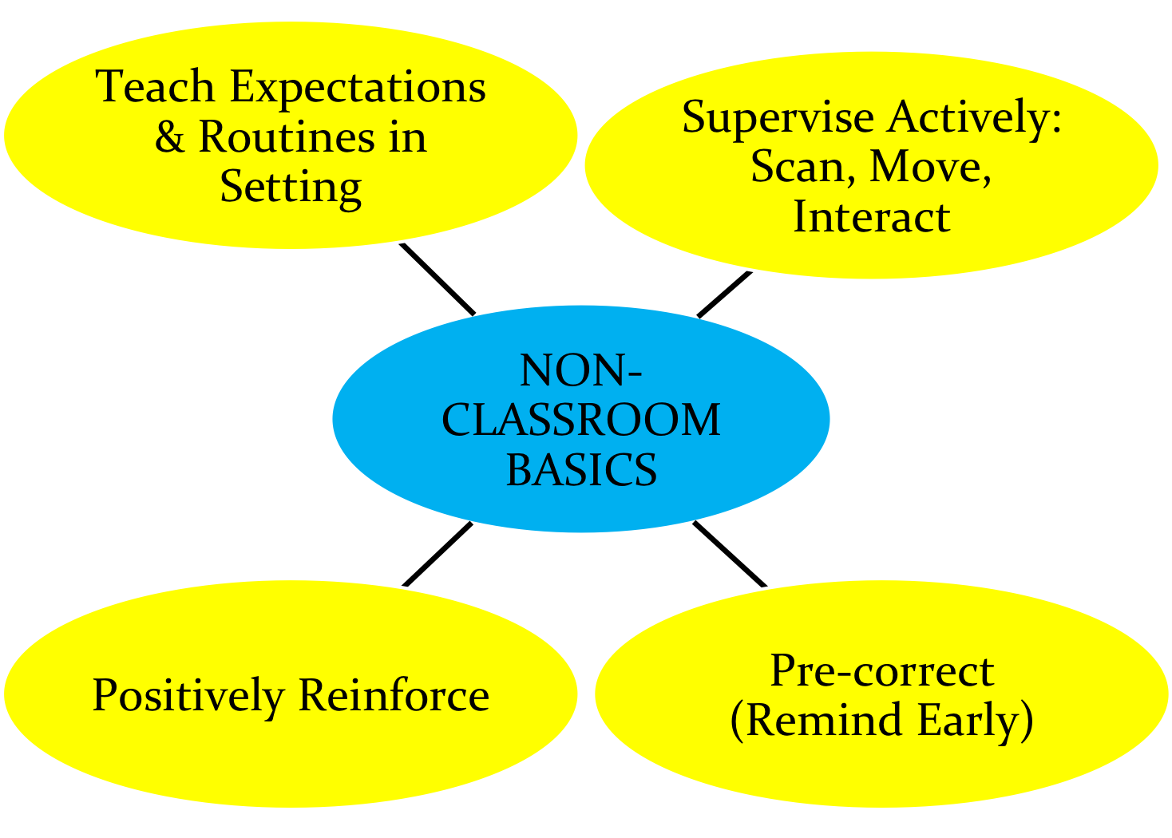

Slide 16
Basics
“Active Supervision:
Self-Assessment”
YES or NO
Notes:
*

Slide 17
Non-Classroom Management: Self-Assessment
Name______________________________ |  | Date_____________
Setting □ Hallway □ Entrance □ Cafeteria □ Playground □ Other_______________ |  | Time Start_________ Time End _________
Tally each Positive Student Contacts | Total # | Ratio of Positives to Negatives: _____: 1
Tally each Negative Student Contacts | Total #
Notes:
*

Slide 18
Did I have at least 4 positive for 1 negative student contacts? | Yes No
2. Did I move throughout the area I was supervising? | Yes No
3. Did I frequently scan the area I was supervising? | Yes No
4. Did I positively interact with most of the students in the area? | Yes No
5. Did I handle most minor rule violations quickly and quietly? | Yes No
6. Did I follow school procedures for handling major rule violations? | Yes No
7. Do I know our school-wide expectations (positively stated rules)? | Yes No
8. Did I positively acknowledge at least 5 different students for displaying our school-wide expectations? | Yes No
Overall active supervision score: 7-8 “yes” = “Super Supervision” 5-6 “yes” = “So-So Supervision” <5 “yes” = “Improvement Needed” | # Yes______
Notes:
*

Slide 21
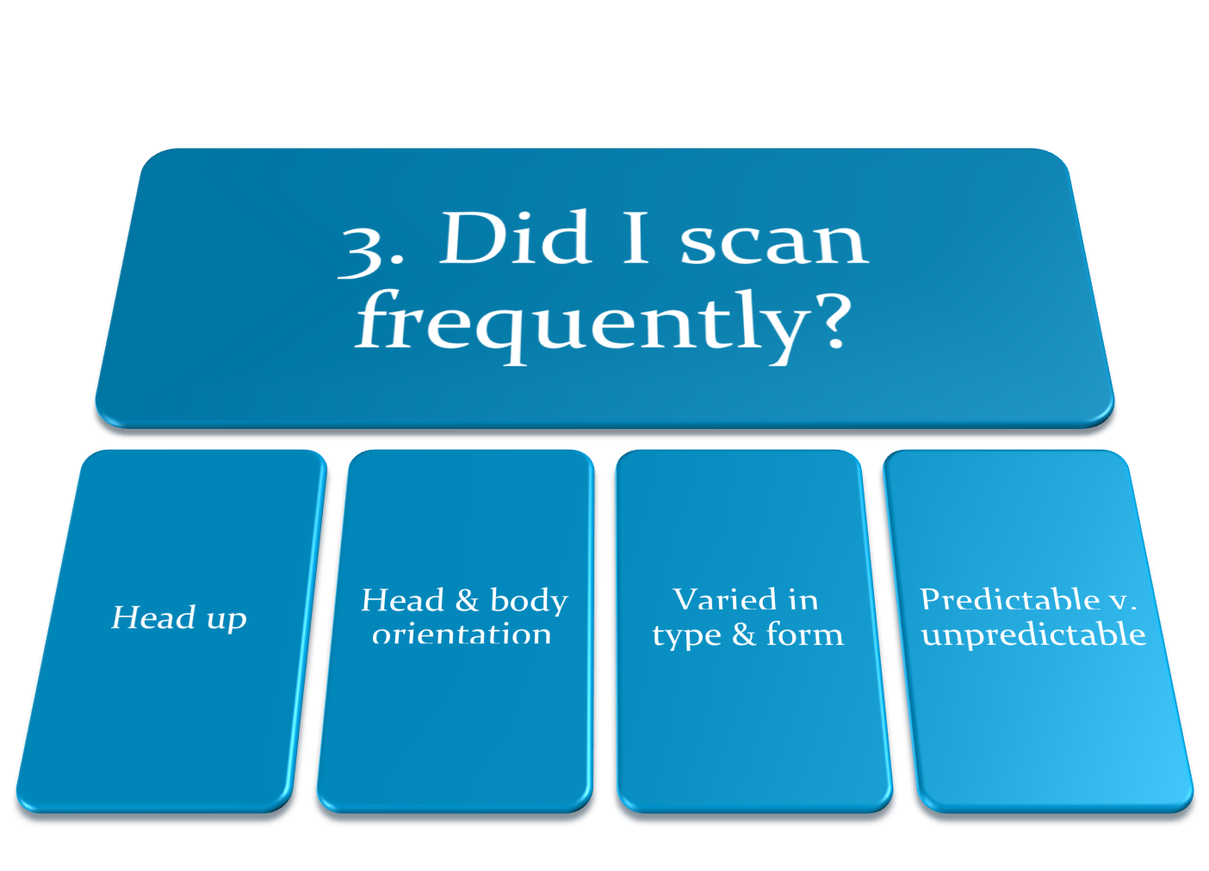

Slide 23
“Good morning, class!”
Teachers report that when students are greeted by an adult in morning, it takes less time to complete morning routines & get first lesson started.
Notes:
*

Slide 24
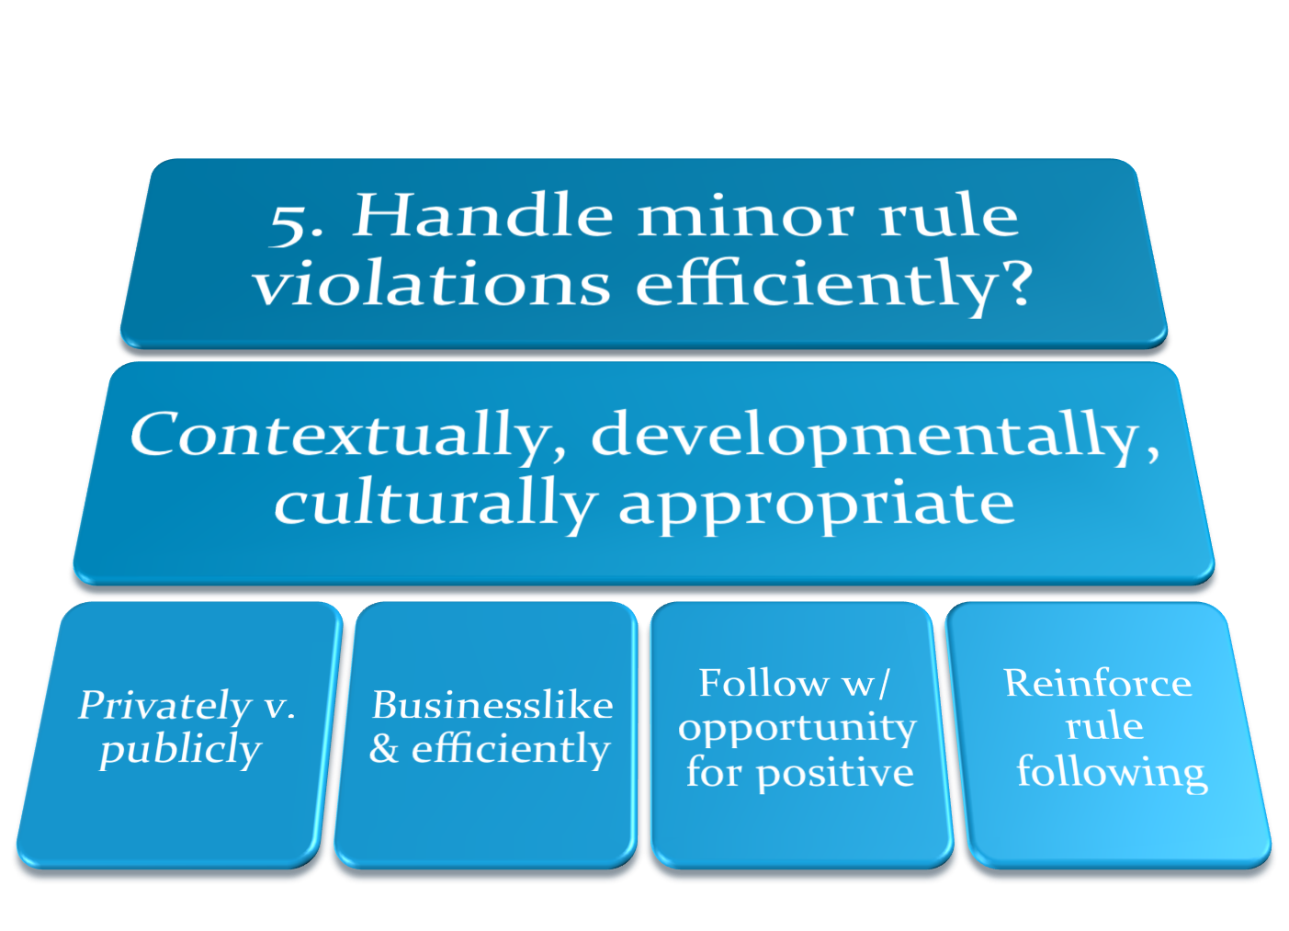

Slide 27
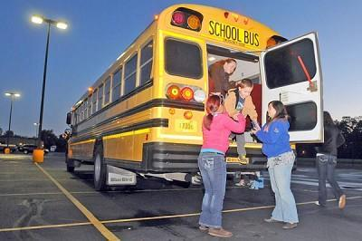
Teach Expectations in the Setting
Notes:
Point out that many PBIS schools – particularly at the elementary level – use a checkoff system where expectations are taught in each setting by different staff – and students have their list “checked off” for each non-classroom setting.
*

Slide 28
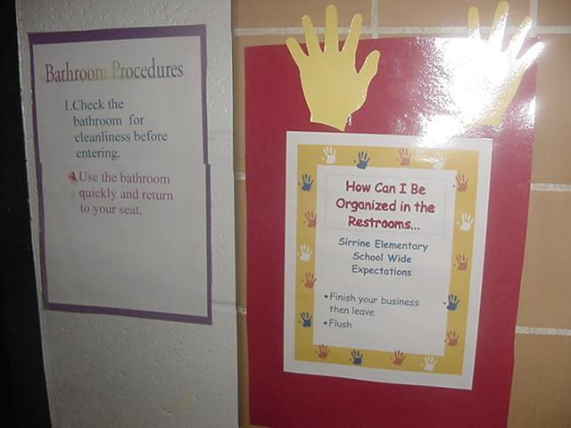
Expected behaviors are visible
Sirrine Elementary June 8, 2004 SC
Notes:
*

Slide 29
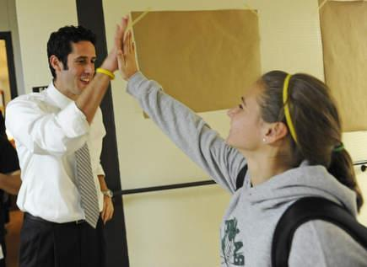
Positive Recognition

Slide 31
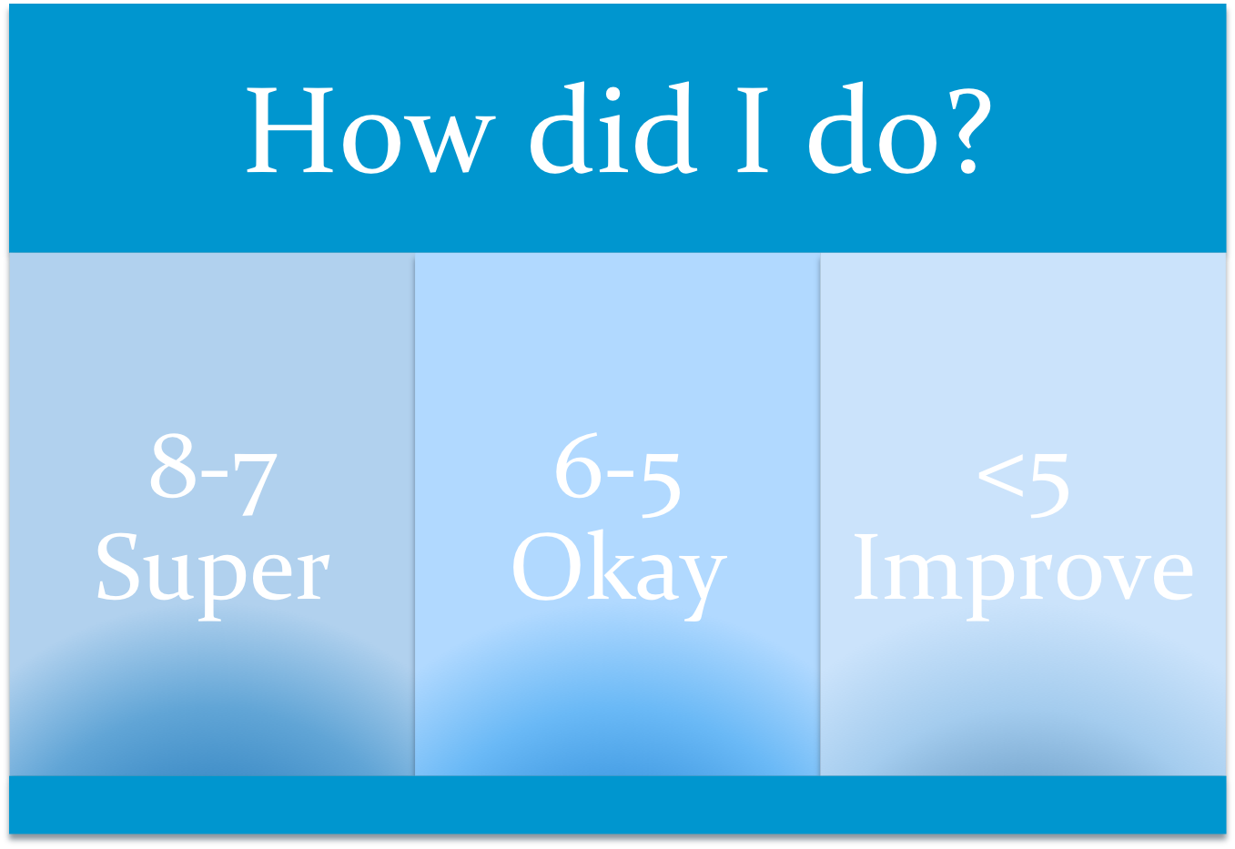

Slide 32
SYSTEMS FEATURES
School-wide implementation
All staff
Direct teaching 1st day/week
Regular review, practice, & positive reinforcement
Team-based identification, implementation, & evaluation
Data-based decision making
Notes:
*

Slide 33
Why does everyone need to be involved?
Staff outnumbered
Unified Front/Same page
Adult presence
Prompts desired behavior
Deters problem behavior
“Being a good citizen”
Contribute to school climate
Notes:
*

Slide 34
Non-classroom areas
Note to trainer: include here your local examples of active supervision – may include videos, plans, etc. that involve cafeterias, hallways, assemblies, office, extra-curricular activites, …….

Slide 35
Example Supervisors’ Activities
For each item on Self-Assessment share one specific strategy you try to use.
Observe colleague.
Video tape & assess.
Agree on one item that everyone will emphasize next week, & tell all staff.
Complete Self-Assessment for one setting next week, & turn into Team on Friday.
COLLECT DATA
Notes:
Optional exercise for team leaders to assign to their team members.
*

