Slide 1
Teaching Expectations
Taking a look at:
Practicing
Reinforcing
Explaining

Slide 2
Problem Behaviors
More often occur because:
Students do not have appropriate skills- “Skill Deficits”
Students do not know when to use skills
Students have not been taught specific classroom procedures and routines
Skills are not taught in context

Slide 3
Why Develop a System for Teaching Behavior?
Behaviors are prerequisites for academics
Procedures and routines create structure
Repetition is key to learning new skills:
For a child to learn something new, it needs to be repeated on average of 8 times
For a child to unlearn an old behavior and replace with a new behavior, the new behavior must be repeated on average 28 times (HarryWong)
Notes:
3

Slide 4
Why Develop a System for Teaching Behavior?
We can no longer assume:
Students know the expectations/rules and appropriate ways to behave
Students will learn appropriate behaviors quickly and effectively without consistent practice and modeling
Notes:
4

Slide 5
Why Develop a System for Teaching Behavior?
We must assume:
Students will require different curricula, instructional modalities, etc… to learn appropriate behavior
We need to teach expectations/rules and appropriate behaviors as effectively as we teach academic skills
Notes:
5

Slide 6
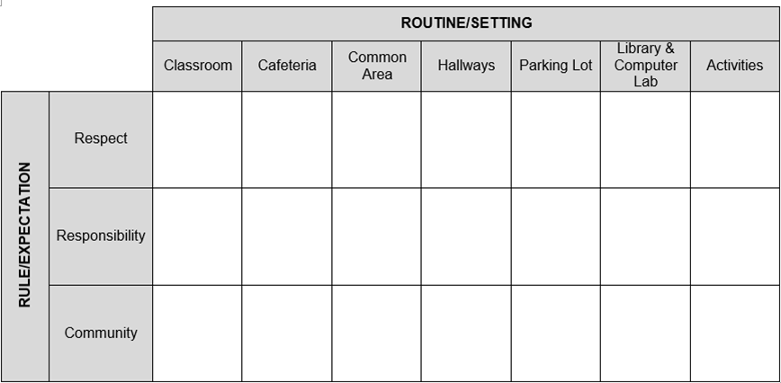
Teaching Expectations - Planning

Slide 7
How Do We Teach Behavior?
Introductory Events
On-going Direct Instruction
Embedding in Other Curriculum
Booster Trainings
Keeping it Out There
Notes:
7

Slide 8
Introductory Events
All faculty and students participate
Decide on method that will be most effective for your school
Consider Importance/Impact
Activity/event should be a high priority
Not given a few minutes in some other activity
We reviewed Introductory Events at the last C10 meeting.
What were some of the ideas?
Notes:
8

Slide 9
Introductory Lesson Examples
Provide students with a script that includes actions and words expected
Rotate students through different settings-Teach the behaviors in the setting where the behaviors are expected to occur
Have classes compete to come up with unique ideas (student projects, bulletin boards, skits, songs, etc…)
Recognize staff for creative activities
Video students role-playing to teach expectations and rules and show during morning show
Notes:
9

Slide 10
How Do We Teach Behavior?
Introductory Events
On-going Direct Instruction
Embedding in Other Curriculum
Booster Trainings
Keeping it Out There
Notes:
10

Slide 11
On-going Direct Instruction
Using already scheduled time
Advisory
Homeroom
Study Halls
Morning Meeting
Assemblies
Something that has worked well at my school/I’ve heard has worked well is…...

Slide 12
Specially Designed Lessons
Provide initial lesson plans and/or lesson plan format for teachers to begin teaching behavior
pinterest
schoolconnect
iris.ed
teacherspayteachers
Build on what you have (i.e. character ed.)
Develop a system for expanding behavior lesson plan ideas throughout the year
Determine the minimum requirements for teaching behavior (i.e. how often)
Notes:
12

Slide 13
Guidelines for Teaching Expectations
Identify problem settings
Review school-wide expectations
Describe the specific, observable skill(s) for a targeted location and provide examples and non-examples
Engage students in an activity that will allow them to practice the desired behavior
Reward appropriate behavior
Notes:
13

Slide 14
Expectations and Rules: Mr. Michael’s Class
Expectations | Rules
Be Respectful of Self and Others | Use a positive voice and language Raise your hand to share your ideas
Follow Directions of all School Staff | Complete all assigned tasks
Stay Safe | Stay in assigned area Keep hands and feet to yourself
Notes:
14

Slide 15
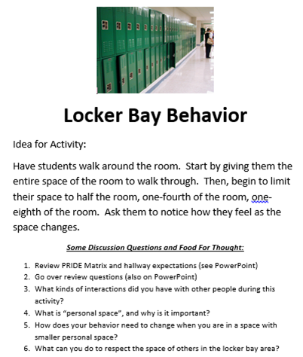

Slide 16
PRIDE with Self & Others

Slide 17
How Do We Teach Behavior?
Introductory Events
On-going Direct Instruction
Embedding in Other Curriculum
Booster Trainings
Keeping it Out There
Notes:
17

Slide 18
Why Embed Expectations
into Curriculum?
Behavior curriculum does not have to be separate
Helps to eliminate time crunches
Provides a rationale for student- helps students to see how the expectations fit into everyday life
Meets best practices approach
Hands on activities
Meets all learning styles (oral, visual, kinesthetic)
Higher order learning activates (synthesize, analyze, etc.)
Notes:
18

Slide 19
Embedding Expectations into
Current Daily Curriculum
Social Studies
Have students research different cultures to find out how they define “Respectful”
Talk about how different historical events occurred because of conflict and come up with solutions on how the conflict could have been resolved
Notes:
19

Slide 20
Embedding Expectations into
Current Daily Curriculum
Language Arts and Reading
Use a novel that has an expectation as a theme
Discuss characters in a novel and how they did not show respect, then have the students write the story with the character showing respect
Have the students develop their own expectations and/or rules and then have them write a persuasive essay or debate why theirs should be used instead of the school’s
Notes:
20

Slide 21
Embedding Expectations into
Current Daily Curriculum
Fine Arts (Music, Art, Computers, Graphics)
When choosing a school play, choose one with a theme centered around one of the school expectations or write your own play
Have the students compose a song/rap with the expectation
Have students come up with a campaign for promoting expectations to the entire student body
Notes:
21

Slide 22
Embedding Expectations into
Current Daily Curriculum
Science and/or Math
Have students develop a hypothesis about what they think are the top behavior problems at school. Have them survey students, parents, & teachers; make graphs; and reach a conclusion about the hypothesis
Have the students count the number of tickets redeemed monthly for prizes & graph them. You can include ratio of number of tickets to student, # of tickets per teacher, etc.
Notes:
22

Slide 23
Guidelines for Teaching Expectations:
Teach As You Teach Core Academics:
Define in terms that students will understand
List critical attributes
Provide examples and non-examples
Enhance concept development
Check for understanding
Extend concept development
Acknowledge efforts
Re-teach and restructure teaching
Notes:
23
Example: To be prepared means that you are ready on time and have the materials and/or information you need in order to participate.
Critical attributes include (a) being on time, (b) having materials and/or information
Examples: being dressed out and on your spot when the whistle blows to signal the start if p.e. / having the math textbook, paper and a sharpened pencil and being in your assigned desk when the bell rings for math class
Non-examples: being dressed out and sitting in the locker room when the whistle blows to signal the start of p.e. / having your spelling book, paper, and a broken pencil and being seated in your desk when the bell rings for math class to start

Slide 24
How Do We Teach Behavior?
Introductory Events
On-going Direct Instruction
Embedding in Other Curriculum
Booster Trainings
Keeping it Out There
Notes:
24

Slide 25
Booster LEssons

Slide 26
Booster Trainings
Using already scheduled time
Advisory
Homeroom
Study Halls
Morning Meeting
Assemblies
Something that has worked well at my school/I’ve heard has worked well is…...

Slide 27
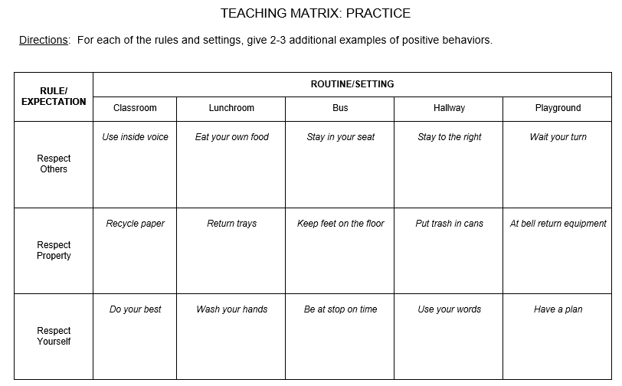

Slide 28
Booster Trainings
Re-introducing the:
Passport System
Station rotation
Teaching lessons in subject areas
Having teacher re-teach:
3-5 behavior expectations
Beginning of the year lessons

Slide 29
How Do We Teach Behavior?
Introductory Events
On-going Direct Instruction
Embedding in Other Curriculum
Booster Trainings
Keeping it Out There
Notes:
29

Slide 30
Keeping it out there
Visual displays
Posters
Planners
Communications home
Display cases
Daily announcements
Repeating expectations
Student/staff videos
Reporting data

Slide 31
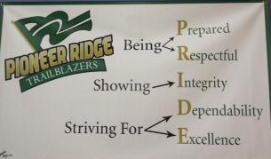
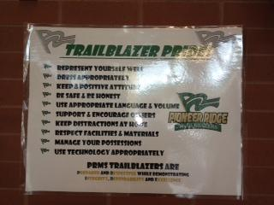
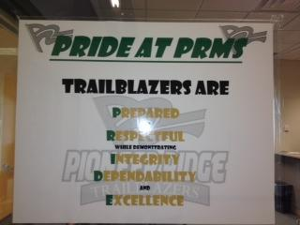

Slide 32
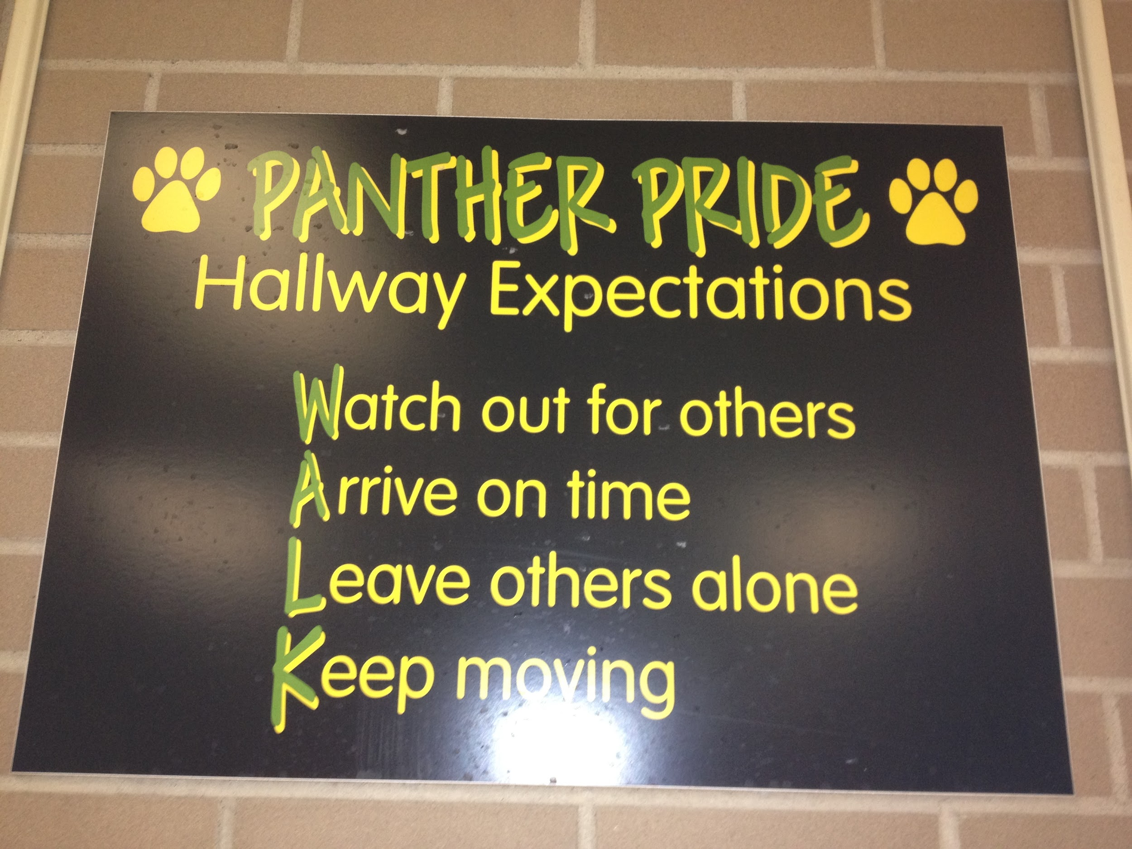

Slide 33
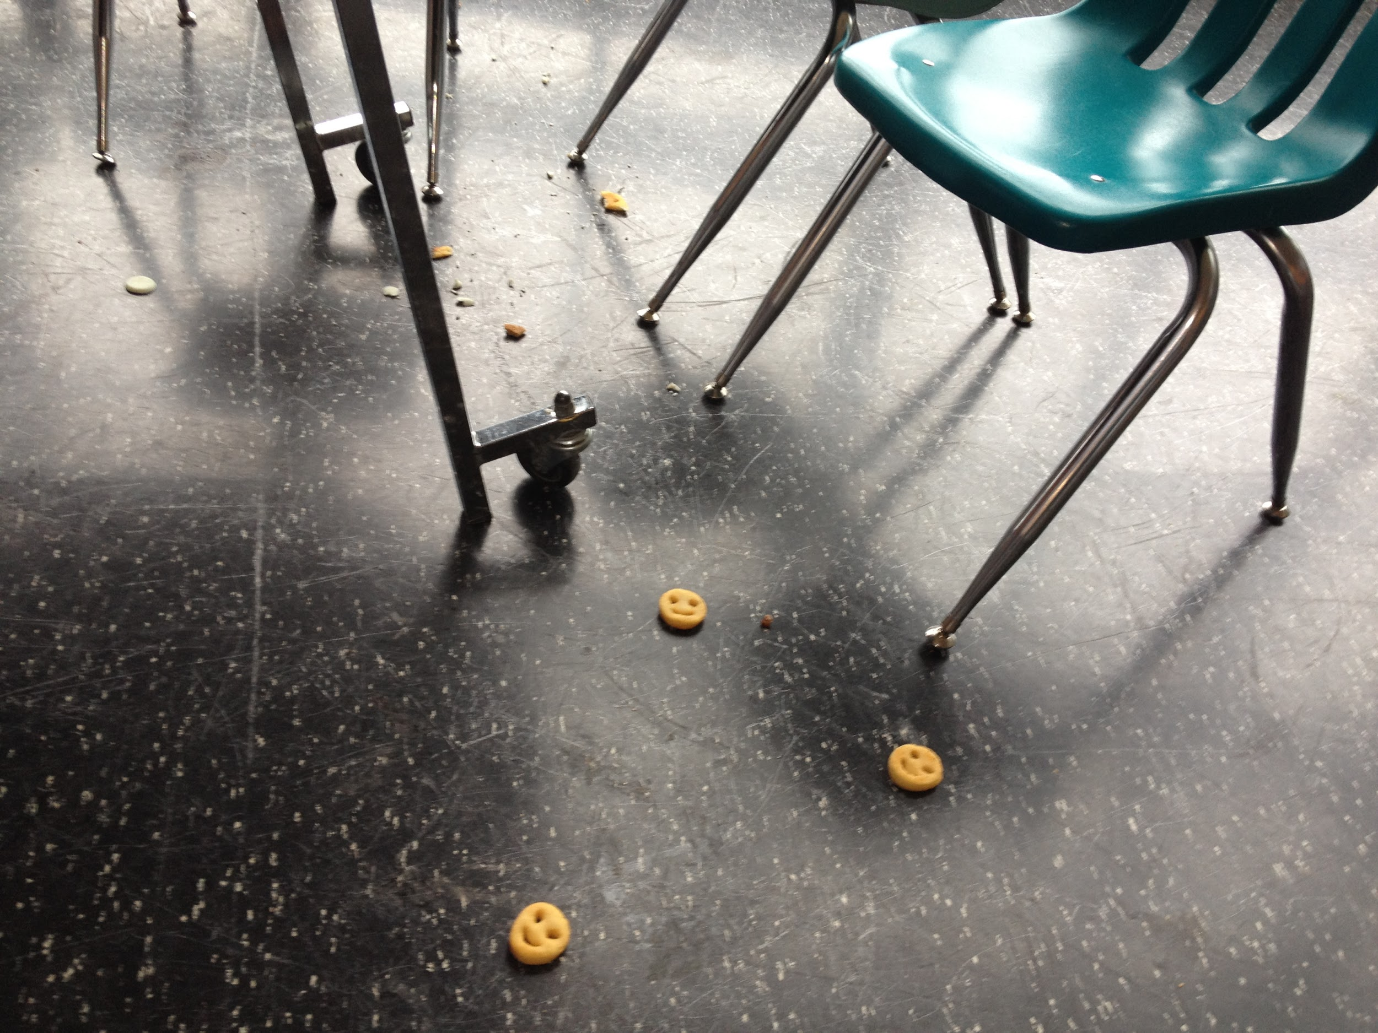
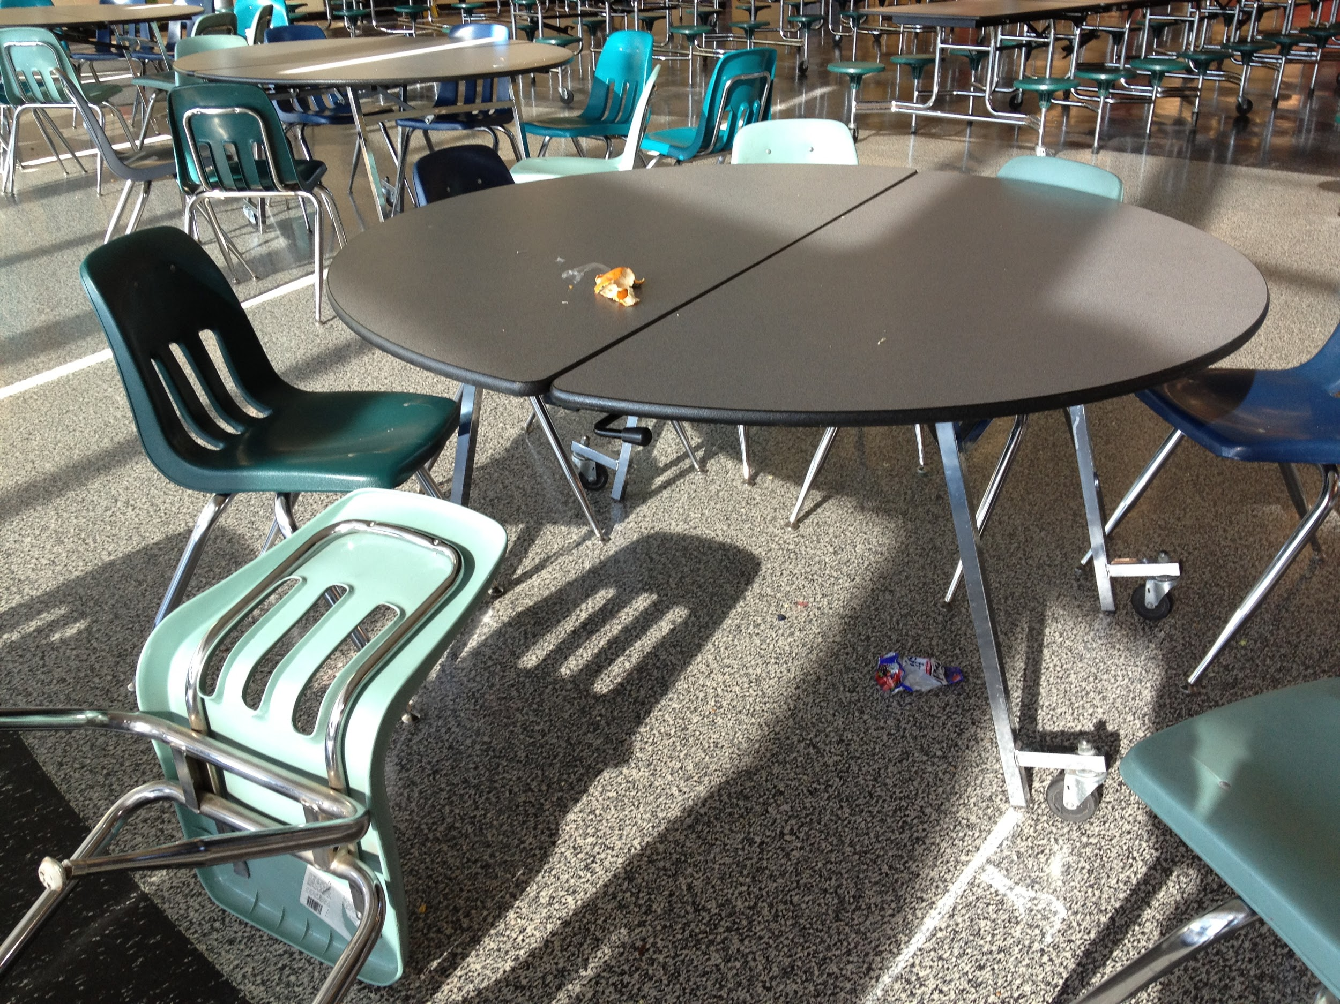
To do….or not to do?

Slide 34
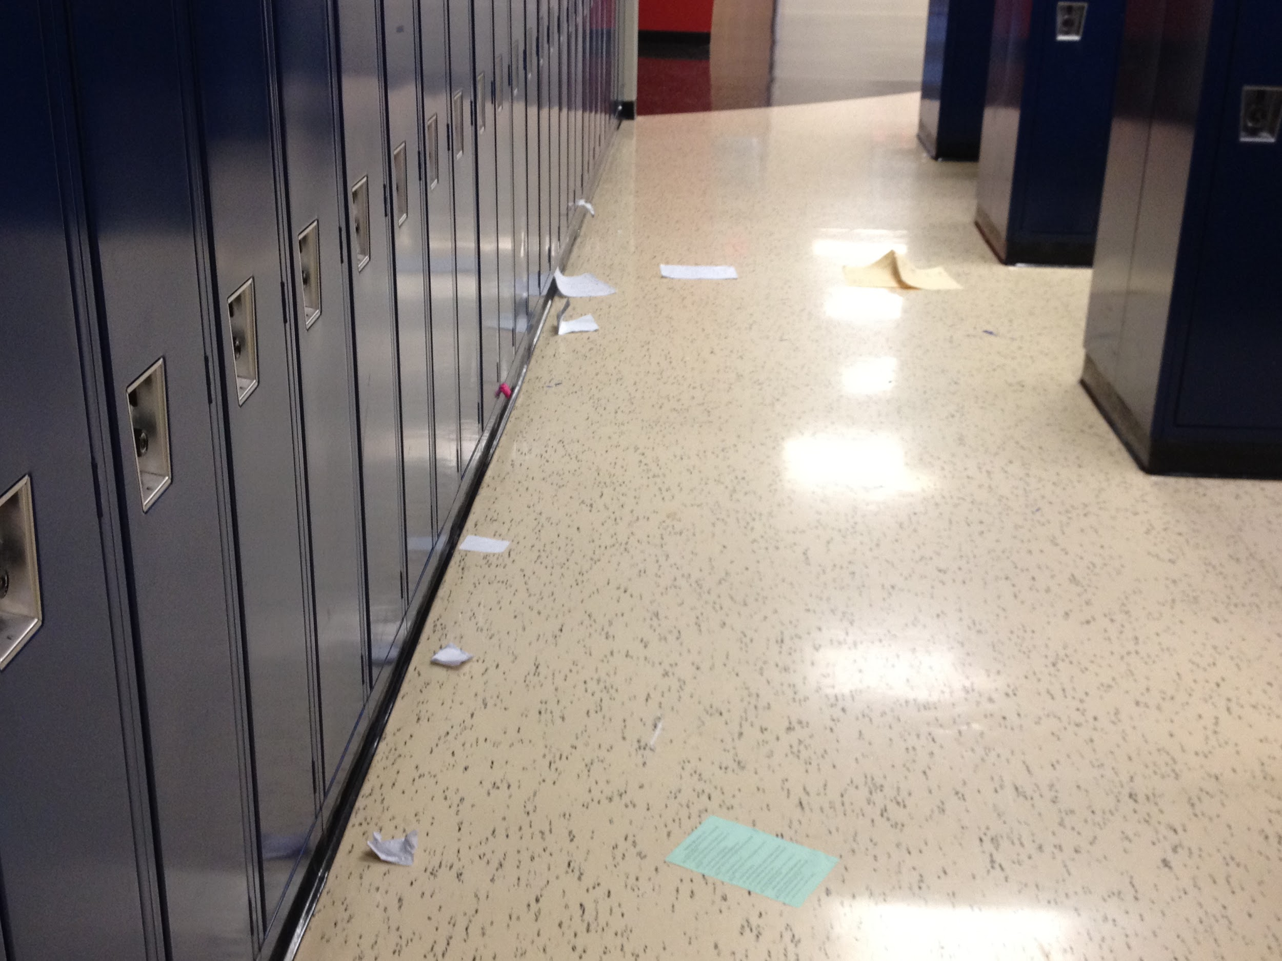
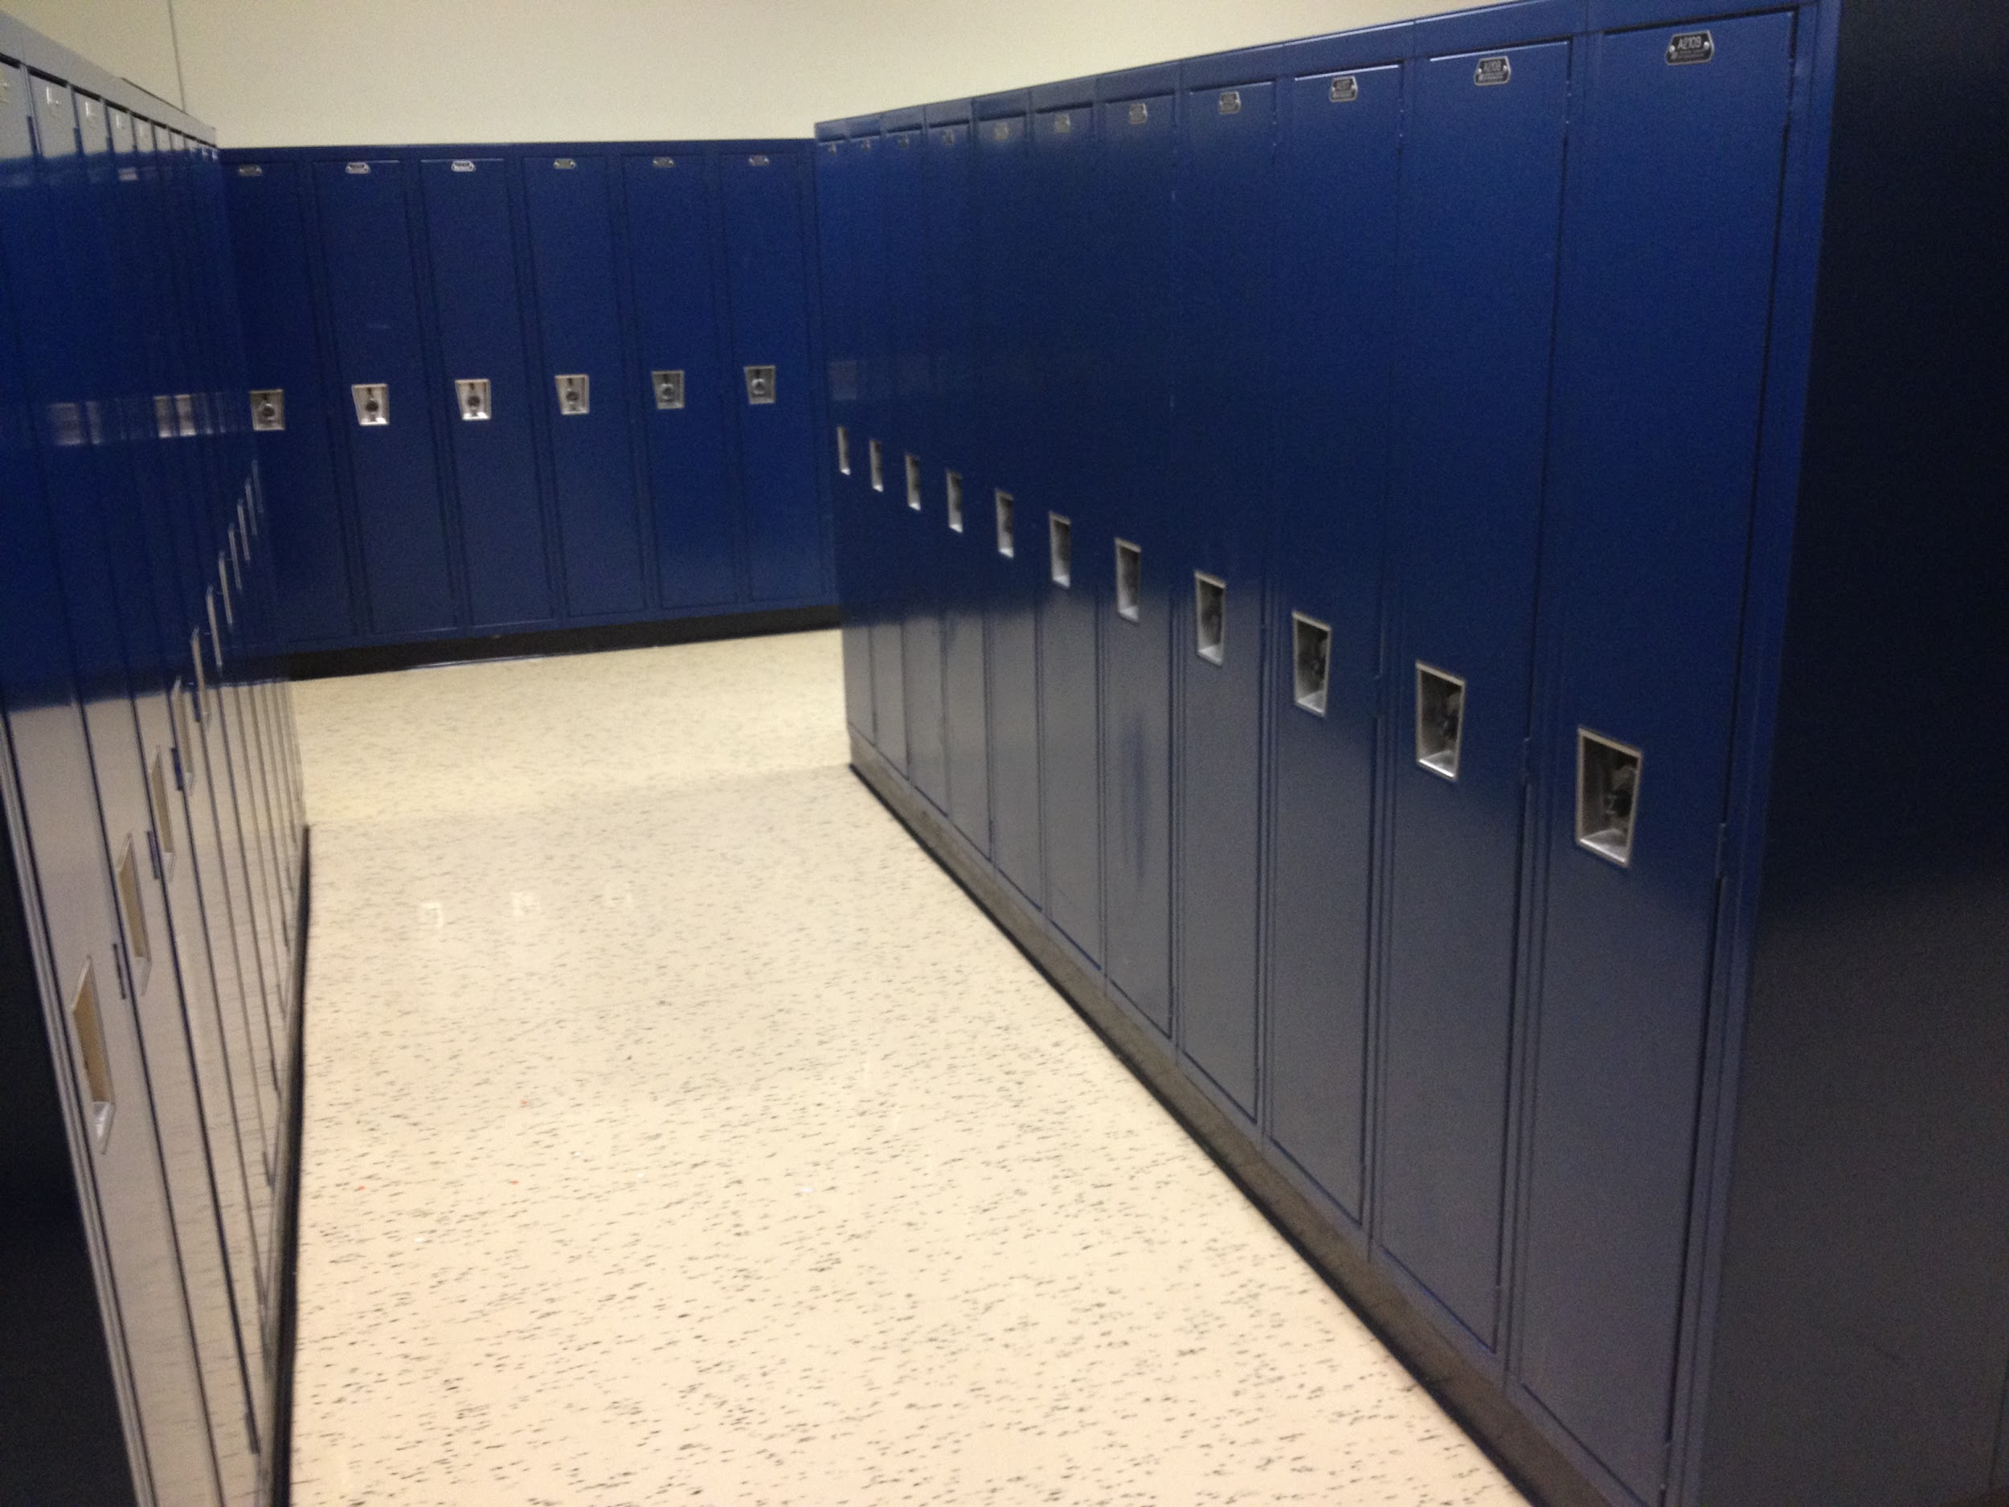
This OR That?

Slide 35
