Slide 1
Positive Behavioral Interventions & Supports: Tier II Group Supports
Download today’s slides here:
bit.ly/pbis15mea
(case-sensitive)
Minnesota Educator Academy #MEAmn15
October 15, 2015 – 8:30 a.m.–9:30 a.m.
Emily Robb, Aaron Barnes, Garrett Petrie
Maci Spica
Slides adapted from Chris Borgmeier, PhD, Portland State , Kevin Filter, PhD, Minnesota State University, Mankato and Tim Lewis, PhD with local examples from schools that are part of our Metro Regional Implementation Projects.

Slide 2




Social Media
#pbisMN
facebook.com/pbisMN/
twitter.com/pbisMN

Slide 3
System = more than an intervention

Slide 4
Dichotomy or Continuum?
The difference here is NOT about INTERVENTIONS, it’s about SYSTEMS
TIER 2
CICO
Decision rules
DATA
Screening process
Interventions
Program manager
Team

Slide 5

543
Notes:
This is

Slide 6
By the Numbers………….
# of Districts/Charters in MN PBIS to date = 189
# Schools in MN PBIS to date = 543
% of MN schools PBIS = 27%
# Students impacted by SW-PBIS = 247,009
Notes:
The percentage of students served is 29.5%

Slide 7
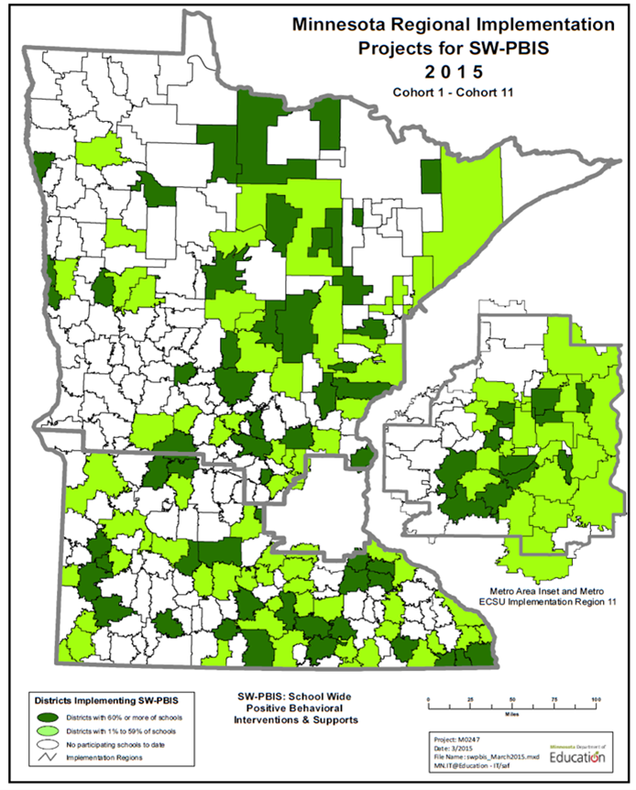
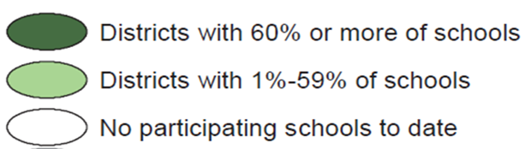
Building Capacity of Effective Implementation of SW-PBIS
District participation in
Cohort training
Cohorts 1- 11
(2005-2017)
Notes:
The percentage of students served is 29.5%

Slide 8
Tier II FAQs
www.pbis.org/school/secondary-level/faqs

Slide 9
4 Questions for Implementing a
Tier 2 System
  Are you implementing a continuum of research-based intervention(s) with fidelity?
  Is there a screening process to ensure early identification of students at-risk?
  Are you using sensitive progress monitoring tools to inform decision making related to student progress and system efficacy?
  Are you implementing at a scale that is making a meaningful impact (10% of student population)?

Slide 10
Tier II Support Process – 5 Steps
Step 1 – Ensure Universals (including Classroom) in place
Step 2 – Student Identification Process
  Decision Rules, Referral, Screen
Step 3 – Classroom Problem Solving
  Classroom supports (function-based)
  Progress monitor
Step 4 - Tier II supports
  Non-responders to grade-level supports
  Match function of student behavior to intervention
  Progress monitor
Step 5 - Evaluate Process

Slide 11
8 Essentials
Classroom expectations & rules defined and taught (all use school-wide, create classroom examples)
Procedures & routines defined and taught
Continuum of strategies to acknowledge appropriate behavior in place and used with high frequency (4:1)
Continuum of strategies to respond to inappropriate behavior in place and used per established school-wide procedure
Students are actively supervised (pre-corrects and positive feedback)
Students are given multiple opportunities to respond (OTR) to promote high rates of academic engagement
Activity sequence promotes optimal instruction time and student engaged time
Instruction is differentiated based on student need

Slide 12
Major Features of Tier 2 Interventions
Early Identification & Early Intervention
Intervention is continuously available
Rapid access to intervention (72 hr)
Very low effort by teachers
Consistent with school-wide expectations
Implemented by all staff/faculty in a school
Flexible intervention based on assessment
  Functional Assessment
Adequate resources (admin, team)
  weekly meeting, plus 10 hours-a-week
Continuous monitoring for decision-making
(Anderson & Borgmeier, 2010)
Notes:
http://www.ncbi.nlm.nih.gov/pmc/articles/PMC3004682/pdf/i1998-1929-3-1-33.pdf
Anderson, C. M., & Borgmeier, C. (2010). Tier II Interventions within the Framework of School-Wide Positive Behavior Support: Essential Features for Design, Implementation, and Maintenance. Behavior Analysis in Practice, 3(1), 33–45.

Slide 13
Surprise!
We are not going to talk at length about Check-in Check-out this morning:
Recent research has shown it is the top Tier II intervention in 180 School-wide PBIS implementing schools across 8 states.
There are resources to help you implement and measure CICO.
Presentations like this leave you with takeaways, but won’t get you implementation-ready.

Slide 14
So… what other Tier 2 interventions are there besides CICO?

Slide 15
Tier 2 Interventions in SW-PBIS:
A survey of school implementation
Rodriguez, Loman & Borgmeier, 2015
in Preventing School Failure,
June, 2015
Notes:
http://ebx.sagepub.com/content/23/2/78

Slide 16
Participants
180 Respondents from 8 states
School Level
  92 = Elementary
  42 = Middle School
  24 = High School
  22 = K-8 or K-12
School Role
  59 = School Counselor
  30 = School Psychologist
  20 = Special Education
172 schools reported implementing SW-PBIS

Slide 17
5 most frequently reported
Tier 2 interventions
#1 – CICO = 108
#2 – Behavioral Contracts = 96
#3 – Mentoring = 67
#4 – Social Skills training = 61
#5 – Academic Skills training = 33

Slide 18
Percent of schools implementing specific Tier 2 interventions x years of SWPBIS implementation

Slide 19

Describe what implementation of
Tier 2 intervention looks like
CHECK-IN/CHECK-OUT
81% of respondents clearly described a structure similar to that in Crone, Hawken & Horner, 2010
Defined Critical Features
  Can measure Fidelity
Research Support for Efficacy & Efficiency
Notes:
https://books.google.com/books?hl=en&lr=&id=wWnNsr2L808C&oi=fnd&pg=PP1&dq=Crone,+Hawken+%26+Horner,+2010+Responding+to+Problem+Behavior+in+Schools&ots=FShtdBCsRt&sig=NGgU5rtTfRtgDVy1vCRTEQYNmIU#v=onepage&q=Crone%2C%20Hawken%20%26%20Horner%2C%202010%20Responding%20to%20Problem%20Behavior%20in%20Schools&f=false

Slide 20
Challenge of Many Interventions Identified as Tier 2 Supports
Can’t determine Implementation Fidelity – because intervention is not well-defined or studied
  What are the critical features of… Lunch Buddies? Homework Club? Social Skills Group? Anger Management Group?
Limited research supporting school implementation
…Just because it’s easy to implement in schools doesn’t mean it’s effective or worthwhile

Slide 21
Describe what implementation of the Tier 2 intervention looks like
LUNCH BUDDIES
20 respondents identified “Lunch Buddies” as a Tier 2 Intervention – w/ widely varying descriptions of program
  Little Consistency in what is “lunch buddies” across schools
What does the research say?
  Cavell et al, 2009; Elledge, Cavell, Ogle & Newgent, 2010
So how do you do Lunch Buddies?
  Mentor is a college student assigned to a student
  Visits 2 x’s/week during lunch (average 30 min/visit)
  Received a 2 p. handout as training describing mentor roles, responsibilities, & tips for listening & communicating w/ mentees
Results of Research studies were inconclusive as to effectiveness of Lunch Buddies
Notes:
http://pdxscholar.library.pdx.edu/cgi/viewcontent.cgi?article=1079&context=socwork_fac
http://link.springer.com/article/10.1007%2Fs10935-010-0215-7

Slide 22
Average number of Tier 2 interventions implemented x School level
Elementary Schools = 3.97
Middle Schools = 3.24
High School = 2.79

Slide 23
Challenge of Many Interventions Identified as Tier 2 Supports
Interventions not set up as systems for efficient or effective implementation in schools
Difficult to implement at a scale that is meaningful (serving 3-4% of students)

Slide 24
Tier 2 Intervention: Critical Features
(from Tiered Fidelity Inventory - TFI)
Additional Structure/time for instruction/skill development
Additional Structure/predictability
Increased opportunity for feedback (e.g. daily progress report)
Notes:
https://www.pbisapps.org/Applications/Pages/PBIS-Assessment-Surveys.aspx#tfi

Slide 25
Social Skills Groups - Typical
Traditional Model
Meet every Friday in small group of at-risk students
Practice skills in counselor’s office during group
Follow published curriculum
Teach & Hope
Limited prompts or attention to support social skill use in school environment
Limited feedback for real-world implementation
How could we modify Social Skills to incorporate Critical Features?
CRITICAL FEATURES OF TIER 2 INTERVENTIONS
Additional Structure/time for instruction/skill development
Additional Structure/predictability
Increased opportunity for feedback (e.g. daily progress report)
HOW ARE WE DOING WITH THE CRITICAL FEATURES?

Slide 26
Social Skills Groups - Modified with
Critical Features
How did we modify Social Skills to incorporate Critical Features?
Modified Model
Meet more regularly (every day for 10 days)
Focus on specific skills (asking peers to share a toy; appropriate greetings w/ adults) w/ clear link to real world application
Practice in real world scenarios
Link w/ Daily Progress Report – specifically targeting instructed social skills for regular feedback
Daily check-in & check-out w/ prompts
CRITICAL FEATURES OF TIER 2 INTERVENTIONS
Additional Structure/time for instruction/skill development
Additional Structure/predictability
Increased opportunity for feedback (e.g. daily progress report)

Slide 27
Challenge of Many Interventions Identified as Tier 2 Supports
If we can’t be assured of the effectiveness of the Intervention we need to use good measures to monitor student progress
Often there is not a system for measuring outcomes and monitoring student progress linked to interventions
  must be sensitive to change; referrals (ODRs) may not be very sensitive to change

Slide 28
Do you measure outcomes for specific
Tier 2 interventions? (% = Yes)
Acad. interventions = 96%
CICO = 83%
Beh. Contracts = 79%
Social Skills = 74%
Mentoring = 53%
Homework Clubs = 52%
Peer Interventions = 44%
Lunch Buddies = 29%
Cultural Groups = 25%

Slide 29
How do you measure student outcomes for Tier 2 behavior?
CICO = DPRs & ODRs
Behavior Contracts = 6 different measures reported
Social Skills = ODR & Teacher Report
Is the measure sensitive enough to measure change (progress monitoring) – Potential concern w/ ODRs only

Slide 30
Homework Club
What are the critical features of effective Homework Clubs? What is it at your school?
What is the goal of the Tier 2 intervention?
  What are the behavioral outcomes desired?
  What are the academic outcomes desired?
How can you evaluate progress toward this goal in an observable/measurable way?

Slide 31
determine student success in Homework Club
 | 1 | 2 | 3 | 4 | 5 | 6
Be Safe | 2 | 1 | 2 | 1 | 2 | 2
Be Responsible -turned in Homework | 2 | 0 | 0 | 1 | 2 | 1
Be Respectful -on task, approp lang. | 2 | 0 | 1 | 1 | 2 | 1
What would you measure to determine student success in Homework Club?
for behavior?
for academic outcomes?

Slide 32
Small Changes - “Tweaks”
In Progress Monitoring meetings – always weighing Minutes/Kid
  Tweaks to the plan for Borderline Responders should only take a couple of “minutes”
  Look at initial CICO data
  Not an extensive discussion
Should have a menu of quick changes/ “tweaks”:
  Change CICO mentor
  Change incentives
  Change/individualize goals
  More frequent check-ins -- “adding hair”

Slide 33
Selecting Students
Office Discipline Referrals: Using existing data
  Review ODR database before Tier 2 team meetings
  Rule of Thumb = 2 to 7 major ODRs per year
  Not an immediate danger to self or others
    What are the problem behaviors?

Slide 34
Other Screening Options
Teacher Nomination
  Process similar to Teacher Assistance Team
Formal Measures
  Systematic Screening for Behavior Disorders (SSBD)
    Teachers nominate a few students each
    Rank ordered by severity
    Observed in class and on playground

Slide 35
Matching student to intervention
It is important to match students to intervention based on function of student behavior
Positive Reinforcement (Attention) | Negative Reinforcement (Escape)
CICO in standard form is good for these students | CICO can be modified to better fit these students
Other Tier 2 supports in school? | Other Tier 2 supports in school?

Slide 36
How to determine behavior function at Tier 2
Review existing data
  Do your ODR’s include data about perceived function?
Conduct brief interviews with adults who work most closely with student
  What happens before and after the behavior?
  Is student trying to gain something (e.g., attention) or get out of something (e.g., escape task)?
Record results in Tier 2 Record Form

Slide 37
What comes next?
OK, we’ve found them and they are in the program now – what comes next?
Keeping track of our Tier 2 students and programs
…using data

Slide 38
Records and Decisions
Keep records of who is participating in each program
  Name
  Behavior Function
  Support/intervention assigned
  Progress
  Decision
    KIDS DON’T STAY IN THE PROGRAM INDEFINITELY!!!
  Follow-up AFTER they are removed from program

Slide 39
Example Tier 2 Record Form
Student/ Grade/Homeroom Teacher | Hypothesized Function of Behavior | Intervention Selected | Begin Date | End Date | Decision (different Tier 2 intervention, move to Tier 1, move to Tier 3)
1.
2.
3.

Slide 40
Importance of Baseline Data
Before implementing an intervention, keep several days of data on a student
  For example, with CICO you can have teachers rate student behavior without giving feedback to students
This allows you to compare performance before an intervention to performance during intervention
  Student decisions
  PROGRAM decisions!!!

Slide 41
Progress Monitoring

Slide 42
More Progress Monitoring

Slide 43
Program-Level Decision Making
How many students are being adequately supported by our Tier 2 program(s)?
  Baseline vs. During program
    CICO Points
    ODRs
    Grades
Decisions
  Keep program as is
  Improve fidelity of program
  Replace program with other evidence-based program

Slide 44
Next Steps
PLANNING FOR SUCCESS
PLANNING FOR MORE SUPPORT

Slide 45
Planning For Success
Develop criteria for moving between levels
Develop a system to fade the Tier 2 intervention

Slide 46
Planning for More Support
If Tier 2 intervention and modified Tier 2 intervention do not lead to improvements for children, then the Tier 3 process should be initiated
Tier 3 = FBA that leads to individual behavior support plan

Slide 47

Individualized Point Card
Fill in more specific behaviors

Slide 48
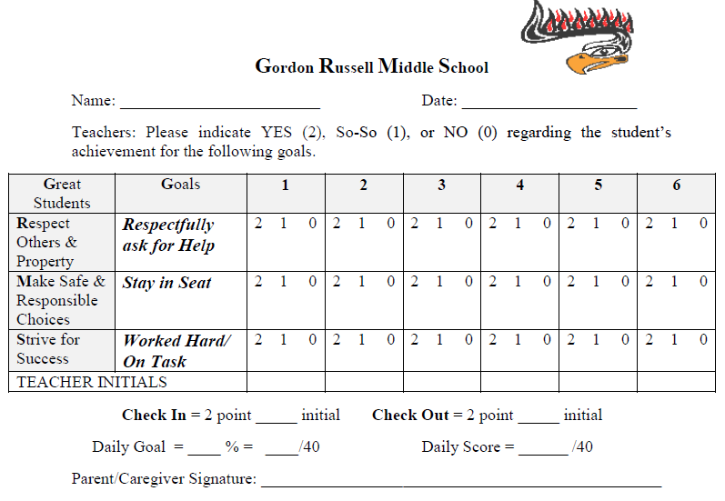
Individualized Point Card
Robbie
Oct. 14th 20--

Slide 49
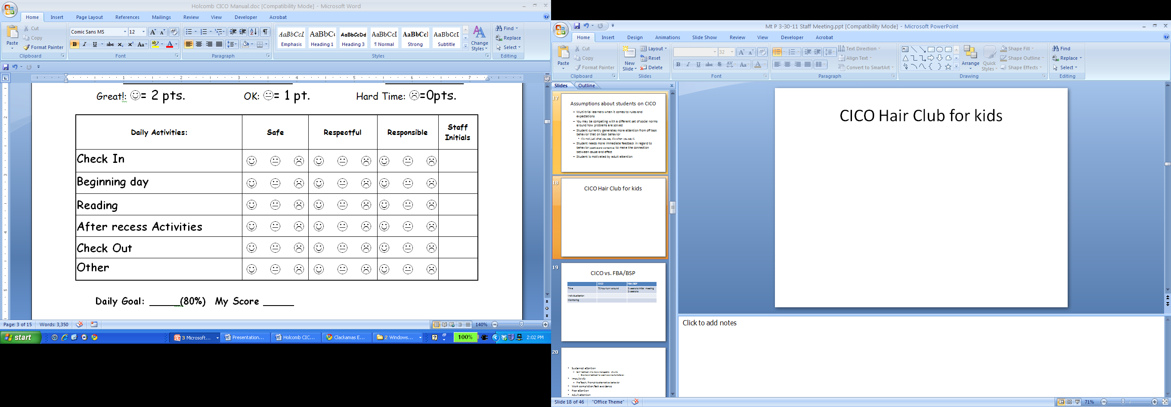
More Frequent Check-Ins
“CICO Hair Club for Kids”
Teacher gives more frequent feedback by applying hair – then uses hair to inform overall score for period
Another Alternative – Create alternate card which breaks day into smaller intervals

Slide 50
Tier II Minnesota Examples

Slide 51
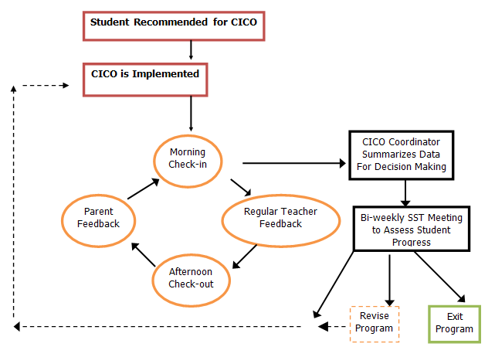
Check In Check Out

Slide 52
Check In Check Out
✓
explicit instruction of skills
structured prompts for appropriate behavior,
opportunities for the student to practice new skills in the natural setting, and
frequent feedback to the student.
✓
✓
✓

Slide 53
Mentoring
Students selected based on ODRs.
Staff choose student to work with, meet with on weekly basis.
Staff has access to student records/grades.
Talk through behavior/academic issues.
Staff and student make goals in one to two areas.

Slide 54
Mentoring
✓
explicit instruction of skills
structured prompts for appropriate behavior,
opportunities for the student to practice new skills in the natural setting, and
frequent feedback to the student.
✓
✓
✓

Slide 55
Weekly Re-Teaching
Weekly topic, related to SW expectations
Staff refer students who could use reminders/re-teaching
Students are retaught the expectations in the area of focus for that week.

Slide 56
Weekly Re-Teaching
✓
explicit instruction of skills
structured prompts for appropriate behavior,
opportunities for the student to practice new skills in the natural setting, and
frequent feedback to the student.
✓
✓
✓

Slide 57
Non-Verbal, Self Monitoring System
Student is given a laminated card
Card works as a self-monitoring system
Card has both positive and behavior infraction steps
Teacher and student work together to mark off steps to next acknowledgment/process

Slide 58
Non-Verbal, Self Monitoring System
✓
explicit instruction of skills
structured prompts for appropriate behavior,
opportunities for the student to practice new skills in the natural setting, and
frequent feedback to the student.
✓
✓
✓

Slide 59
Social Skills Training
Students are identified based on ODRs/teacher observation
Students are assigned to small groups based on behavior infractions/need
Students receive social skills training

Slide 60
Social Skills Training
✓
explicit instruction of skills
structured prompts for appropriate behavior,
opportunities for the student to practice new skills in the natural setting, and
frequent feedback to the student.
✓
✓
✓

Slide 61
Behavior Punch Cards
Student is given a punch card
When the student shows the target behavior(s), the teacher punches the card
When the student fills the card, they turn it in for a predetermined recognition/reward.

Slide 62
Behavior Punch Cards
✓
explicit instruction of skills
structured prompts for appropriate behavior,
opportunities for the student to practice new skills in the natural setting, and
frequent feedback to the student.
✓
✓

Slide 63
Recess Leadership Team
Students identified based on recess behavior
Students are taught lessons on self-regulation
Students then learn new game
Students teach their classmates the game at recess

Slide 64
Recess Leadership Team
✓
explicit instruction of skills
structured prompts for appropriate behavior,
opportunities for the student to practice new skills in the natural setting, and
frequent feedback to the student.
✓
✓

Slide 65
Restorative Circles
Students identified based on ODRs and specific behavior infractions
Students involved in one to two circles per week
  Empathy
  Relationships with staff
  ID emotions
  Coping strategies

Slide 66
Restorative Circles
✓
explicit instruction of skills
structured prompts for appropriate behavior,
opportunities for the student to practice new skills in the natural setting, and
frequent feedback to the student.
✓
✓
✓

Slide 67
Tier II Toolboxes
Materials collected, along with instructions, for three different classroom interventions.
Used in classrooms with high frequency of ODRs

Slide 68
Tier II Toolboxes
explicit instruction of skills
structured prompts for appropriate behavior,
opportunities for the student to practice new skills in the natural setting, and
frequent feedback to the student.

Slide 69
Yes Card
Student is given a card with several boxes (6, 8, 10).
Student self-monitors behavior reminders
If student successfully makes it through given amount of time, gives him/herself a Yes! in the box.
If the student needs a reminder for this behavior, then the time starts over.

Slide 70
Yes Card
✓
explicit instruction of skills
structured prompts for appropriate behavior,
opportunities for the student to practice new skills in the natural setting, and
frequent feedback to the student.
✓
✓

Slide 71
Online SW-PBIS Coaching Certificate
Fall Term Started in September 2015
SW-PBIS:
Coaching Tier 2
www.pdx.edu/sped/MTSS

Slide 72
Tier II Online Resources
www.pbismn.org/st_tierII.html
Look for upcoming videos from Chris Borgmeier’s presentations at our MN PBIS Summer Institute
Alternative Delivery of Specialized Instructional Services (ADSIS) Tuesday Talks
contact Rebecca.Nies@state.mn.us for scheduled monthly topics
www.pbis.org/school/secondary-level
www.tier2pbis.pbworks.com

Slide 73
Upcoming Events & Meetings
www.pbismn.org/RIPs/METRO/mr_trainingcalendar.html
Metro Regional District Leadership Team meetings (next 10/22)
Metro Regional Coaches Meetings (next 10/27)
“Data Dump” Days (next 12/2)
www.pbismn.org/RIPs/SOUTH/sr_trainingcalendar.html
South Regional Coaches Meetings
Meetings for Sustaining School Teams
www.pbismn.org/RIPs/NORTH/nr_trainingcalendar.html
North Regional Coaches Meetings (next1/12)
Meetings for Sustaining School Teams (next 1/11)

Slide 74



2016 Minnesota PBIS Institute &
Film Festival
June 21 & 22, 2016 at MDE - Roseville, MN
Request for Proposals out Nov. 2015
Presentations from previous institutes at www.pbismn.org/pbisinstitute.html
Notes:
https://education.state.mn.us/MDE/Welcome/Direc/

Slide 75

Applications Due
pbisMN.org
Applications Due January 13, 2016

Slide 76
Contact Us
Emily Robb - PBIS.Emily@gmail.com
Aaron Barnes - Aaron.Barnes@state.mn.us
Garrett Petrie - Garrett.Petrie@state.mn.us
Maci Spica - Brianna.Spica@state.mn.us

