Slide 1
PBIS – Classroom*
Materials modified from the Midwest PBIS Network
*Classroom is not limited to traditional classroom spaces. It is any space where instruction takes place.

Slide 2
6 Classroom Practices
Physical environment
Classroom Teaching Matrix (Expectations, Rules, Routines)
Active Supervision
Encouraging Appropriate Behavior
Direct instruction of expectations, rules, routines
Preventative Prompts
Specific Praise for Behavior
Individual Reinforcers
Class-Wide Group Contingency
Continuum of Response Strategies for Inappropriate Behaviors
Praise other students/groups
Specific Error Correction
Etc.
Engagement & Opportunities to Respond
Rev 4-15-19. Midwest PBIS Network. Developed through the ongoing research and shared knowledge of many partners, including the National TA Center on PBIS, Midwest PBIS Network, Mid-Atlantic PBIS Network, Missouri PBIS, Lincoln Public Schools, Brandi Simonsen (UConn) & Diane Myers (Texas Women’s University).
Notes:
These are the 6 Classroom Practices that research has shown has a positive impact on students. The goal is consistent use of these practices by all teachers.
Tier I features are implemented within classrooms and are consistent with school-wide systems.
These strategies maximize classroom supports to allow for increased instructional time and reduced teacher and student stress.

Slide 3
Rationale
Good Classroom Management is linked with:
positive student outcomes both academically and behaviorally
increased risk of preventing more serious problems among at-risk students.
supporting all students in the prevention of possible current and future behavior problems.
Strong management signals to kids that the class is a safe place to learn.
Well managed classrooms are rated as having more positive climates. (Aber et el., 1998; Mitchell, Bradshaw & Leaf, 2009)

Slide 4
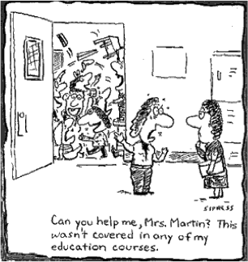
One Truth of the Matter…
Notes:
Most younger teachers will readily admit to this being the case at their college or university. It is a good reminder for the participants to keep in mind as they progress through the 6 classroom management practices.

Slide 5
Student Engagement
Most studies that measure effective teaching strategies use student engagement as the measure.
Wong and others analyzed over 11,000 statistical findings to determine those factors that correlated the highest with student engagement, and rank ordered 28 variables. Classroom management was at the top of the list.
Despite this statistic, only a third of teaching colleges teach classroom management.

Slide 6
What We Know…
Lack of discipline is one of the biggest problems facing public schools
More time is being spent on reactive classroom and behavioral management and less time on academic instruction
Effective Classroom Management strategies and practices implemented by teachers and support staff are the foundation of both behavior and academic interventions… Information from Maryland PBIS Network

Slide 7
PBIS
Positive Behavioral Interventions and Supports (PBIS) for Continuous Improvement and Alignment of Initiatives
is a Multi-Tiered System of Supports (MTSS) Framework
Supporting culturally equitable Targets including social/emotional competence & academic achievement
OUTCOMES
Supporting culturally knowledgeable Staff Behavior
team-based leadership and coordination
professional development, coaching, and content expertise
Supporting culturally valid Data-based Decision Making
universal screening
progress monitoring
evaluation of fidelity
SYSTEMS
DATA
PRACTICES
Midwest PBIS Network 2/7/19. Adapted from:
“What is a systems Approach in school-wide PBIS?” OSEP Technical Assistance on Positive Behavioral Interventions and Supports. https://www.pbis.org/school
McIntosh, K.& Goodman, S. (2016). Integrated Multi-Tiered Systems of Support: Blending RTI and PBIS. New York: Guilford Press.
Supporting Student Behavior
three-tiered continuum of culturally relevant evidence-based interventions
Notes:
7
Slide Starter: “This visual is the organizing logic of a Multi-Tiered Behavioral Framework…
Sources:
1. What is a systems Approach in school-wide PBIS? OSEP Technical Assistance on Positive Behavioral Interventions and Supports.
2. McIntosh, K.& Goodman, S. (2016). Integrated Multi-Tiered Systems of Support: Blending RTI and PBIS. New York: Guilford Press.
Outcomes: academic and behavior targets that are endorsed and emphasized by students, families, and educators. (What is important to each particular learning community?)
Practices: interventions and strategies that are evidence based. (How will you reach the goals?)
Data: information that is used to identify status, need for change, and effects of interventions. (What data will you use to support your success or barriers?)
Systems: supports that are needed to enable the accurate and durable implementation of the practices of MTSS. (What durable systems can be implemented that will sustain this over the long haul?)
The framework language is familiar and used often when discussing MTSS. By framework, we mean MTSS is a singular method of organizing the decision making, implementation, and progress monitoring of school operations. The circles represent the key components of that framework, and are used to organize the school’s way of work. Start with identifying outcomes, which for whole school is often Social Competence and Academic achievement…
Then we look to the data to uncover our “current reality” or what is showing up around this outcome-where are we/where do we stand. We would use the data to identify a precision statement that clearly defines the current reality (problem to address). Then we would look to our resources (e.g., resource map) to identify what practices we might have that would support students with the issues showing up in our data (e.g., school-wide expectations defined, taught, and reinforced for respectful behavior). Then we look at what supports would be necessary to support the adults to implement the practices identified to support students. Then we return to data to monitor progress and make decisions as to whether or not what we implemented worked. If not, was it because we lacked fidelity? Or was it because it wasn’t the right match of practices to need? Do we need different systems (supports) for the adults.
Cultural Relevancy:
Culturally relevant behavior support: Teach behaviors that are socially relevant to Culturally and Linguistically Diverse (CLD) students
Culturally validating behavior support: Acknowledge students’ cultural identity as a strength
Establish cultural validity of data: Carefully review operational definitions of behavioral violations
Disaggregate ODR data by student race. For example, ethnicity report of the School Wide Information System (www.swis.org)
Revise measures: Provide schools with tools to assess extent to which culturally responsive systems and practices are in place
Generate school-wide commitment to culturally equitable behavioral outcomes: Define school-wide behavioral goals in collaboration with parents of CLD students
Increase accountability for equitable outcomes. Review extent to which defined goals are met.

Slide 8
Installing Classroom Practices within the PBIS/MTSS
OUTCOMES
Increased Instructional Time
Increased Relationships
Positive Climate
SYSTEMS
DATA
School-wide plan for teaching, installing, and coaching Classroom Practices
Connecting to School-wide PBIS Components
Tiger Pride Team
Staff Self-Assessments
Minor/Major ODRs
PRACTICES
Classroom Practices
Notes:
8
The framework language is familiar and used often when discussing PBIS. By framework, we mean PBIS is a singular method of organizing the decision making, implementation, and progress monitoring of school operations. The circles represent the key components of that framework, and are used to organize the school’s way of work. Start with identifying outcomes, which for whole school is often Social Competence and Academic achievement…
Then we look to the data to uncover our “current reality” or what is showing up around this outcome-where are we/where do we stand. We would use the data to identify a precision statement that clearly defines the current reality (problem to address). Then we would look to our resources (e.g., resource map) to identify what practices we might have that would support students with the issues showing up in our data (e.g., school-wide expectations defined, taught, and reinforced for respectful behavior). Then we look at what supports would be necessary to support the adults to implement the practices identified to support students. Then we return to data to monitor progress and make decisions as to whether or not what we implemented worked. If not, was it because we lacked fidelity? Or was it because it wasn’t the right match of practices to need? Do we need different systems (supports) for the adults.
Cultural Relevancy:
Culturally relevant behavior support: Teach behaviors that are socially relevant to Culturally and Linguistically Diverse (CLD) students
Culturally validating behavior support: Acknowledge students’ cultural identity as a strength
Establish cultural validity of data: Carefully review operational definitions of behavioral violations
Disaggregate ODR data by student race. For example, ethnicity report of the School Wide Information System (www.swis.org)
Revise measures: Provide schools with tools to assess extent to which culturally responsive systems and practices are in place
Generate school-wide commitment to culturally equitable behavioral outcomes: Define school-wide behavioral goals in collaboration with parents of CLD students
Increase accountability for equitable outcomes. Review extent to which defined goals are met.

Slide 9
Three-tiered Continuum of Evidence-based Practices
Tier III Prevention:
Specialized, Individualized
Data, Systems, Practices for High-Need and Complex Behaviors
~5%
Students
Staff
Families
Community
~15%
Tier II Prevention:
Group-based Data, Systems, Practices Targeting At-Risk Behaviors
Tier I Prevention:
School/Classroom-wide Data, Systems, Practices
for all Students, Staff, Settings
~80% responding
Midwest PBIS Network 1-15-19
Adapted from: USDOE OSEP PBIS TA Center
Notes:
Primary prevention is provided to all students and focuses on giving students the necessary pro-social skills that prevents the establishment and occurrence of problem behavior. If done systemically and comprehensively with fidelity, we now that will be sufficient for about 80% of our students.
For a small group of students (typically around 10-15%) we will need to add another layer of support- secondary/tier 2/targeted supports. The goal of secondary prevention is to reduce/prevent the likelihood of problem behavior occurrences, and to enable these students to be supported by the school-wide MTSS effort.
Still, a small number/few students (about 1-5% )will need yet another layer of very individualized/intensive support. The goal of tertiary/tier 3 supports is to reduce the intensity, complexity, and impact of the problem behaviors displayed by these students by providing supports that are (a) function-based, (b) contextually appropriate and person-centered, (or core tier 1 curriculum and practices.

Slide 10
Classroom Practices
Classroom Practices
6 Classroom Practices
Physical environment
Classroom Teaching Matrix (Expectations, Rules, Routines)
Active Supervision
Encouraging Appropriate Behavior
Direct instruction of expectations, rules, routines
Preventative Prompts
Specific Praise for Behavior
Individual Reinforcers
Class-Wide Group Contingency
Continuum of Response Strategies for Inappropriate Behaviors
Praise other students/groups
Specific Error Correction
Etc.
Engagement & Opportunities to Respond
These classroom practices have been identified to improve the likelihood of appropriate behavior and decrease problem behavior, while increasing academic learning time.
What do you think of this list? Any you would add/delete?
Rev 4-15-19. Midwest PBIS Network. Developed through the ongoing research and shared knowledge of many partners, including the National TA Center on PBIS, Midwest PBIS Network, Mid-Atlantic PBIS Network, Missouri PBIS, Lincoln Public Schools, Brandi Simonsen (UConn) & Diane Myers (Texas Women’s University).
Notes:
These are the 6 Classroom Practices that research has shown has a positive impact on students. The goal is consistent use of these practices by all teachers.
Tier I features are implemented within classrooms and are consistent with school-wide systems.
These strategies maximize classroom supports to allow for increased instructional time and reduced teacher and student stress.

Slide 11
Tiered Fidelity Inventory
TFI 1.8 Classroom Procedures:
Tier 1 features (school-wide expectations, routines, acknowledgements, in-class continuum of consequences) are implemented within classrooms and consistent with school-wide systems.
How has the school-wide system translated to classrooms?
Notes:
This work is based on the TFI 1.8. Remind the participants about the possible data sources so they know where they can begin.

Slide 12
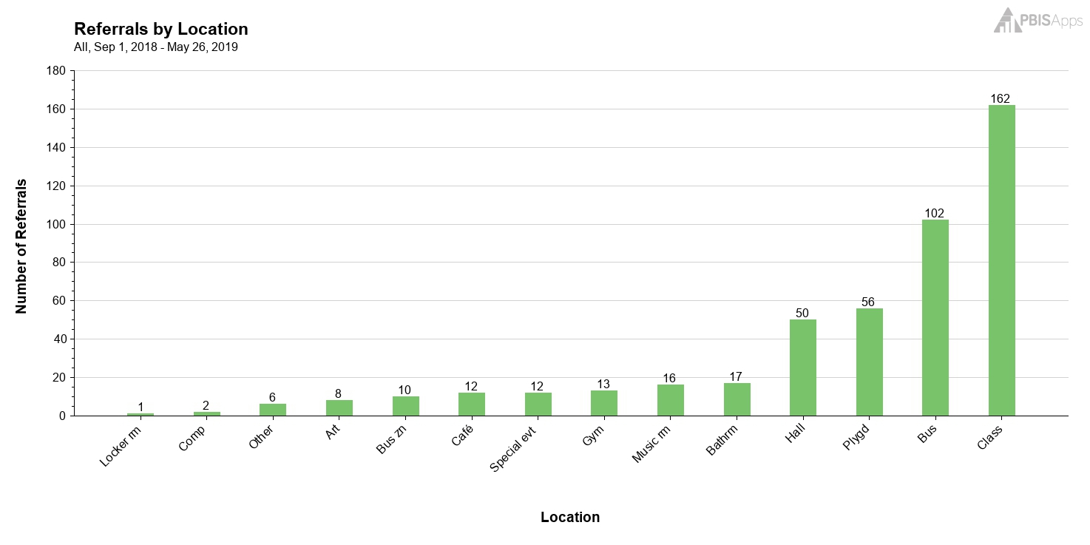
Office Discipline Referrals
When the majority of referrals come from the classroom setting, behavior is interfering with students academic learning and engagement

Slide 13
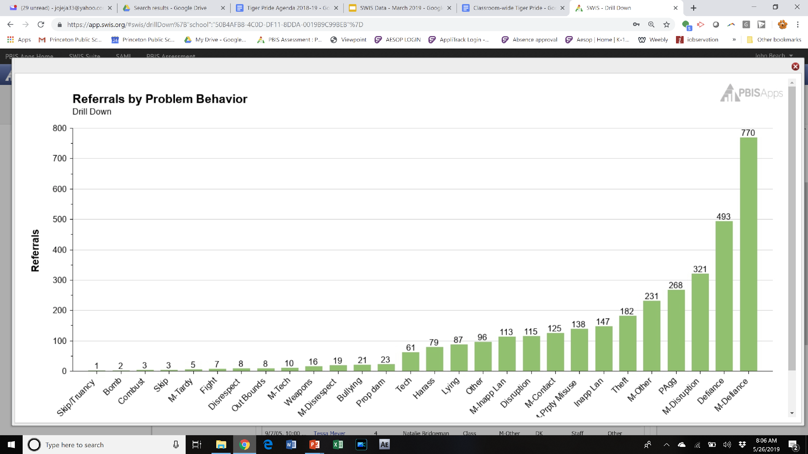
Office Discipline Referrals
Since September 2005 – Classroom Referrals

Slide 14
Office Discipline Referrals
Since September 2005 – Classroom Referrals

Slide 15
Quick Activity
Step 1:
Think of a student you have who exhibits a lot of behavioral excitement (i.e. disruption) in your class.
Step 2:
On a piece of paper, rate the quality of your connection/ relationship with that student on a Scale of 1-4. Write it down.
Sample Rubric:
1 = Quite Poor
2 = Poor
3 = Good
4 = Very good
So what is in a 4?
You know more about them than just the basics
The student would also rate you as someone helpful they can talk to
They feel you care
Other ideas??

Slide 16
Research-Based Benefits of Relationships
DISCIPLINE
: In a meta-analysis of more than 100 studies- teachers who had high-quality relationships with students had 31% fewer discipline problems, rule violations, and other related problems over a year’s time than did teachers who did not (Marzano, Marzano, and Pickering 2003)
: John Hattie’s Visible Learning research is based on a meta-analysis of 800 studies where he ranked 138 influences on student learning. The average effect size of all influences studied was .40. Teacher-Student relationship had an effect size of .72, which is in the high zone of desired effects. (just below “feedback”- .73)
: “The single most common factor for children who develop resilience is at least one stable and committed relationship with a supportive parent, caregiver, or other adult” (Center on the Developing Child at Harvard University)
LEARNING OUTCOMES
RESILIENCY
Notes:
Discipline, Improved Learning Outcomes, and Resiliency.
We have learned that teachers with high quality relationships with students have fewer discipline problems,
We have learned that Teacher-Student relationships have an impact on students that is above average when compared with 138 other influences (including different interventions)
The research says that there are some concrete places of impact from strengthening relationships.
Fewer problem behaviors
Less externalizing behaviors and stopping the trajectory of internalizing behaviors over time
Protective Factors
Strengthened Cognitive and Social development
Increased health benefits
Marzano, Hattie, Perry, Center on Developing Child at Harvard, etc.

Slide 17
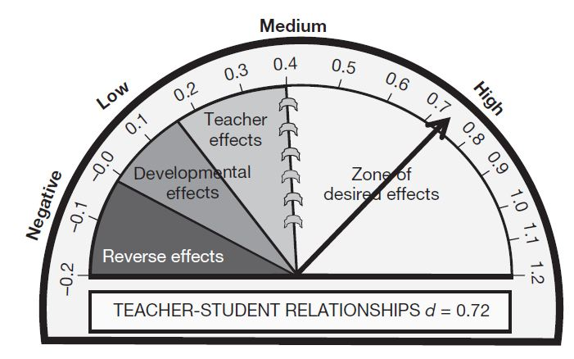
Relationship = Key to Success
One stable and committed adult relationship
National Scientific Council on the Developing Child (2015). Supportive Relationships and Active Skill-Building Strengthen the Foundations of Resilience. Harvard University.
Teacher-Student Relationship has a .72 effect size on student learning’
Average effect size of all interventions studied was .40
Hattie. J. (2009). Visible learning: A synthesis of over 800 meta-analyses relating to achievement. London: Routledge.
Notes:
Interpreting Effect Size:
Effect size of 0.72 means that the score of the average person in the experimental group is 0.72 standard deviations above the average person in the control group, and hence exceeds the scores of 71% of the control group.
National Scientific Council on the Developing Child (2015). Supportive Relationships and Active Skill-Building Strengthen the Foundations of Resilience. Harvard University. Retrieved from: https://developingchild.harvard.edu/resources/supportive-relationships-and-active-skill-building-strengthen-the-foundations-of-resilience/
John Hattie’s Visible Learning research is based on a meta-analysis of 800 studies where he ranked138 influences on student learning. The average effect size of all influences studied was .40, which is the ‘hinge point’ in graphic above. Teacher-Student relationship had an effect size of .72, which is in the high zone of desired effects. When teachers, parents, principals and teachers were asked about what influences student achievement, all but the teachers emphasized the importance of teacher-student relationships. Teachers focused more on the child’s attitude and disposition. Developing relationships requires skills such as listening, empathy, caring and positive regard for others. Good news is these are things the teacher has control over.
More on Visible Learning: https://visible-learning.org/hattie-ranking-influences-effect-sizes-learning-achievement/

Slide 18
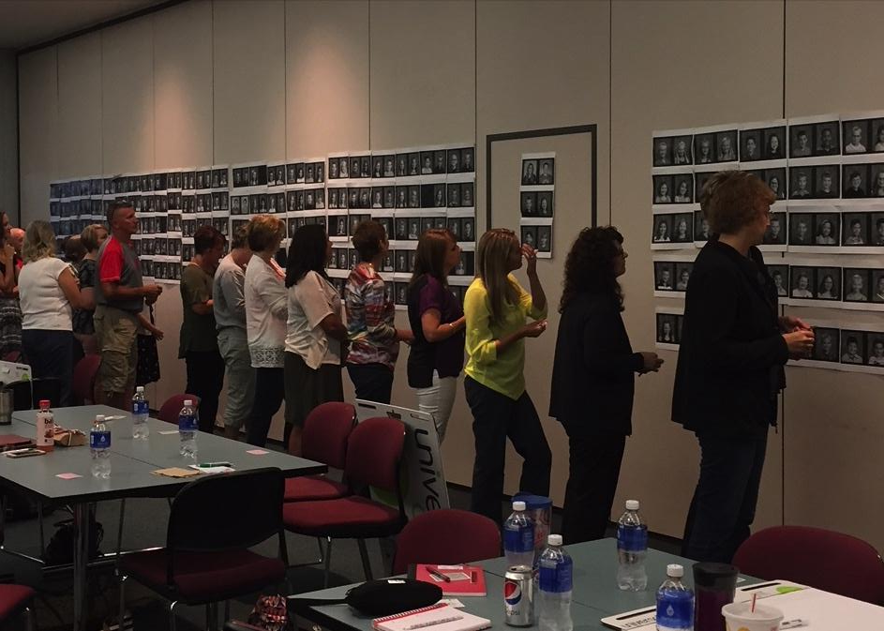
The Sticker Project
Notes:
There was only so far the kids would get without the grownups helping to support.
We had to get the adults up to speed, on the same page, and having a similar desire for change. We wanted to get a pulse on where things were at in their minds around relationships between students and staff.
During an Institute Day:
Round One- Put star stickers on pictures of students with (clearly identified definition of) strong relationships.
Gathered data on students with 0 stars. Compared to what staff had hypothesized.
Round Two- Created an action plan on how to improve/strengthen relationships.
Round Three- Aligned college and career readiness data to those same students.
Now making connections, using as a screener to get youth into Tier 2, etc. Will assess again at the end of the year and do it at the beginning and end of the year from now on.

Slide 19
Data from our 2019 Student Survey Percentage
Notes:
STAFF:
All student pictures were put on the wall.
Staff put stickers on the faces of students who they feel they have a "strong relationship" with a definition of “strong relationship” was provided”.
Of those 800 students, 27% were identified as having NO stickers on them.
STUDENTS:
Students completed a culture and climate survey, and approximately 25% said that they DID NOT feel that they had an adult they could talk to. N = 185 surveys.

Slide 20
Data from our 2019 Student Survey Percentage
605 students surveyed – 183 not enjoying and 54 of those not feeling connect to at least one staff member.
Notes:
STAFF:
All student pictures were put on the wall.
Staff put stickers on the faces of students who they feel they have a "strong relationship" with a definition of “strong relationship” was provided”.
Of those 800 students, 27% were identified as having NO stickers on them.
STUDENTS:
Students completed a culture and climate survey, and approximately 25% said that they DID NOT feel that they had an adult they could talk to. N = 185 surveys.

Slide 21
Self-Assessment (we will maintain confidentiality)
Think of the student who you identified earlier
Determine what failure factors are relevant to the identified student (e.g. attendance, behavior, academic/social performance, etc.)
What SEL skills might be missing? (e.g. self-awareness, self-management, social-awareness, interpersonal skills, decision-making, responsible behaviors)
Identify 1-2 things you can do to improve that relationship, and how you can teach those missing skills.
Discuss
CASEL SEL competencies
Third Grade Second Step Scope and Sequence
Fourth Grade Second Step Scope and Sequence
Fifth Grade Second Step Scope and Sequence
Classroom Matrix Template

Slide 22
How do PBIS classroom practices support the Trauma lens?
Kids don’t care what you know until they know that you care.
Notes:
We need to continue to remind teachers and all staff members to work on relationship building with ALL the students in their classrooms, and also other students in the school. Connecting with the students will definitely make a difference in how students behave in their classroom, as well as throughout the school.

Slide 23
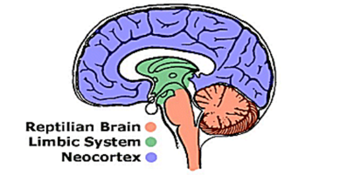
Bottom-Up Development
Adverse Experiences
Typical Development
Cognition
Cognition
Social/ Emotional
Social/ Emotional
Regulation
Regulation
Survival
Survival
Adapted from Holt & Jordan, Ohio Dept. of Education
Notes:
The brain develops from the bottom up. The bottom part of our brain is all about survival. As we go up the brain, it becomes more complicated: helps us stay regulated, think, make decisions and learn new things.
The upper part of the brain is the prefrontal cortex. It regulates judgment, decision making, moral reasoning, planning, impulse control, cause & effect thinking, comprehension skills, information processing, self awareness and self esteem, delay of gratification, and many other functions that involve rational thinking.
The mid-brain is deals with key functions of emotions and memory.
The lower part of the brain mobilizes the body for action (i.e., fight or flight response) when danger is perceived and overrides the upper part of the brain.
When a child perceives or is on watch for danger persistently (i.e., constant state of “yellow alert”), this causes higher and prolonged levels of cortisol to be present in the bloodstream, resulting in toxic stress, and the prefrontal cortex may be underdeveloped. The result doesn’t just change brain functioning; it can actually change the brain structurally.
The typical child spends little time focused on survival and can devote most of her/his waking time to cognition and social-emotional functioning. For a child who has experienced developmental trauma, the triangle can become inverted with the majority of the brain’s attention focused on survival, leaving little left for cognition.

Slide 24
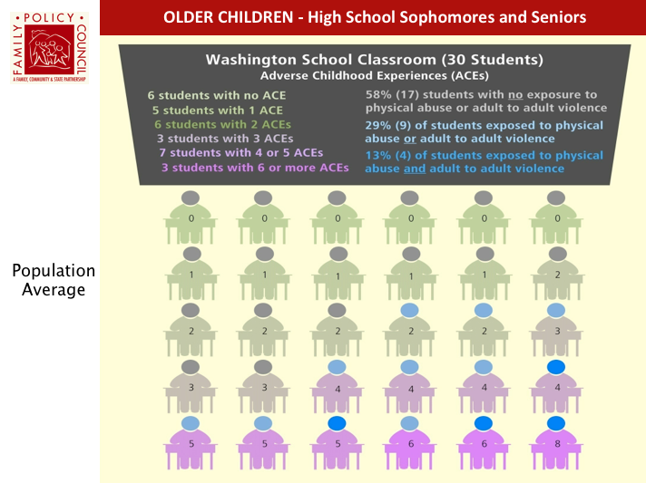
What to Expect In Our Classrooms
13 of every 30 students in a classroom experience toxic stress from 3 or more Adverse Childhood Experiences (ACEs)
11 students in charids
Source: Washington State Family Policy Council

Slide 25
What Flight, Fight, or Freeze Looks Like in the Classroom
Flight | Fight | Freeze
Withdrawing | Acting out | Exhibiting numbness
Fleeing the classroom | Behaving aggressively | Refusing to answer
Skipping class | Acting silly | Refusing to get needs met
Daydreaming | Exhibiting defiance | Giving a blank look
Seeming to sleep | Being hyperactive | Feeling unable to move/act
Avoiding others | Arguing
Hiding or wandering | Screaming/yelling
Becoming disengaged
Fostering Resilient Learners
Strategies for Creating a Trauma-Sensitive Classroom
Kristin Souers with Pete Hall
Notes:
In the book Fostering Resilient Learners by Kristin Souers and Pete Hall, they provide examples of what Fight, flight and flee look like in the classroom. Point out some behaviors that may not typically be considered as fight, flight or freeze reactions. For example, skipping class...do you consider that a student may have just seen a bear? Or what about acting silly...do you ever think it may be a reaction to a trigger? Or what about refusing to answer….do we see that as trauma or defiance?
We always need to have our trauma glasses on!

Slide 26
Trauma Lens Crosswalk with the 6 Classroom Practices
1. Physical Environment | A well-designed classroom environment promotes of sense of safety and security for students impacted by trauma.
2. Classroom Teaching Matrix (Expectations, Rules, & Routines) | A well-designed teaching matrix creates consistency and predictability through clearly stated positive expectations with examples (rules). Routines support regulation, and can develop social-emotional competencies.
3. Active Supervision | Active supervision provides a sense of safety as well as frequent opportunities for relationship development for students impacted by trauma.
4. Encouraging Appropriate Behavior | These practices (Behavior lesson plans, preventative prompts, specific praise, individual reinforcers, and group contingencies) teach and increase use of desired social-emotional competencies (e.g.: sense of self, emotional regulation) often underdeveloped in students impacted by trauma.
5. Continuum of Responses to Inappropriate Behavior | The continuum of response provides opportunity to use trauma informed strategies to help the student regulate, connect (relate) with the adult, and allows the student to access their problem-solving skills (reason).
6. Engagement & Opportunities to Respond | Facilitating frequent opportunities for students to respond provides time to process or apply what students are learning, allowing neural networks to be strengthened. (Craig, S.E., 2016)
Rev 2-15-19. Midwest PBIS Network.

Slide 27
Self-Assessment your current classroom
Step 1:
Rate your overall classroom behavior on a scale of 1-5.
1 = off-task, disruptions, low prosocial skills
5 = academically engaged, effective routines, respectful behavior to each other and teacher, pro-social skills

Slide 28
Self-Assessment your current classroom
Step 2:
With your 1-5 rating in mind, reflect on your practices, and consider these questions:
Do my students know my expectations?
Do my students know the routines for the classroom?
Do my students feel comfortable and safe in my classroom?
Do I acknowledge my students good behavior?
Do I know how to handle inappropriate behavior?
Step 3: Discuss with partner or table

Slide 29
Self-Assessment of 6 Classroom Practices
On your own
Classroom Practices Tool - Classroom Practices – Rubrics
Reflect on the questions in each area to determine focus area(s).

Slide 30
Classroom-wide PBIS
These are proven components of successful “Tiger Pride” classrooms. The six practices were developed by the Midwest PBIS Network. Everyone will develop their classroom matrix. We encourage collaboration across teams and grade levels. Use the other resources to as needed to create your positive classroom environment. Classroom Practices - Rubrics (taken from each “Practice” link below)
Physical Environment - Practice 1
Matrix - Classroom Teaching Matrix - Practice 2 (Classroom Matrix Template, Routines and procedures examples, Previous Classroom Routines template) Place completed matrix in Classroom Matrix Folder
Active Supervision - Practice 3
Encouraging Appropriate Behavior - Practice 4
Continuum of Responses to Inappropriate Behavior - Practice 5
Nine variables that affect compliance
Error correction strategies
Engagement and Opportunities to Respond - Practice 6
Classroom Management Self-Assessment
Classroom Management Survey
Powerpoint with examples for each practice

Slide 31
Resources
National Website
http://www.pbis.org/school/pbis-in-the-classroom
Midwest PBIS – Classroom Modules
http://www.midwestpbis.org/materials/classroom-management
Florida PBIS Classroom Coaching
http://www.livebinders.com/play/play?id=2295063
Mid-Atlantic PBIS http://www.midatlanticpbis.org/materials-1/classroom
Additional Classroom Resources – Tim Lewis
https://www.pbis.org/resource/192/classroom-checklists-effective-classroom-plan-environmental-inventory-checklist
Supporting and Responding to Classroom Behavior Tool
http://www.pbis.org/resource/1016/supporting-and-responding-to-behavior

