Slide 1
Classroom Management Toolset: Proactive, Praise, & Relationships MN PBIS Summer Institute 2021 Michelle Marchant-Wood, PhD. University of Minnesota

Slide 2
WELCOME & INTRODUCTIONS
Notes:
Raise your hand if you are a teacher. A related service personnel. An administrator. A paraprofessional. Other?
Raise your hand if you work in Early Childhood. Elementary. Middle School. High School. Post-Secondary. Other?

Slide 3
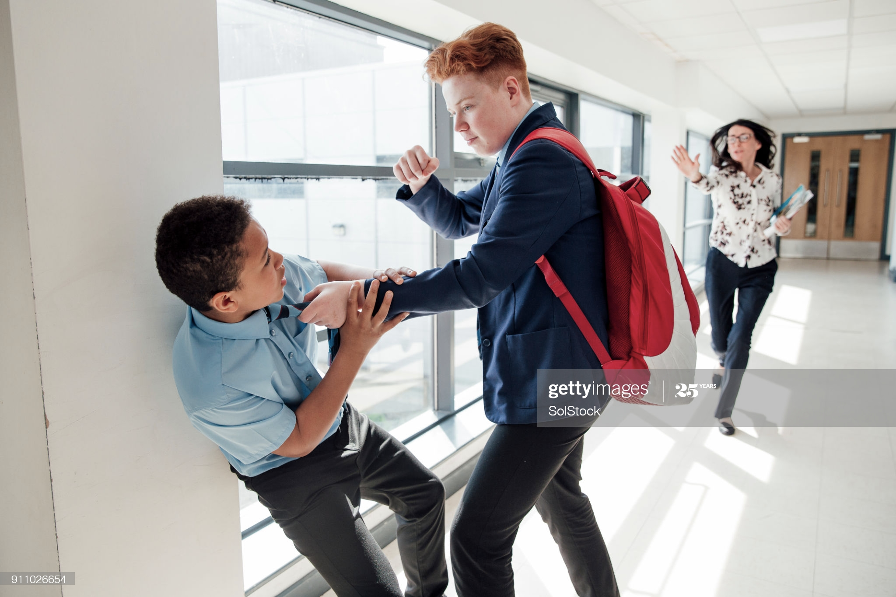
Share one of your greatest behavioral challenges demonstrated by students in your classroom or school to Padlet
Notes:
Put Padlet link into the chat box: https://padlet.com/mmarchan2/vyheh65ni74zmzst
Share the Padlet Screen

Slide 4
DISCIPLINE
Notes:
Time—12:05
What comes to your mind when I say the word “discipline?” (Invite a few people to share.)

Slide 5
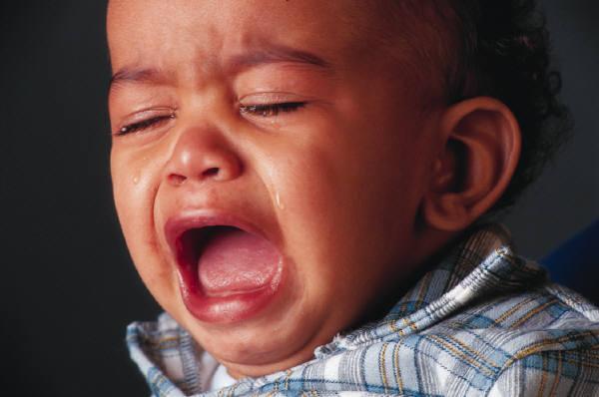
What is our most common reaction to misbehavior?
PUNISHMENT!
WHY?
Reflexive – quick and simple
It works! – it usually stops the behavior!
This is reinforcing to us!
Notes:
ME: Talk to these key points.
Note that punishment only stops a behavior temporarily.

Slide 6
Question
What types of punishers do you see in our society and schools?
Notes:
Seek a few verbal responses.

Slide 7
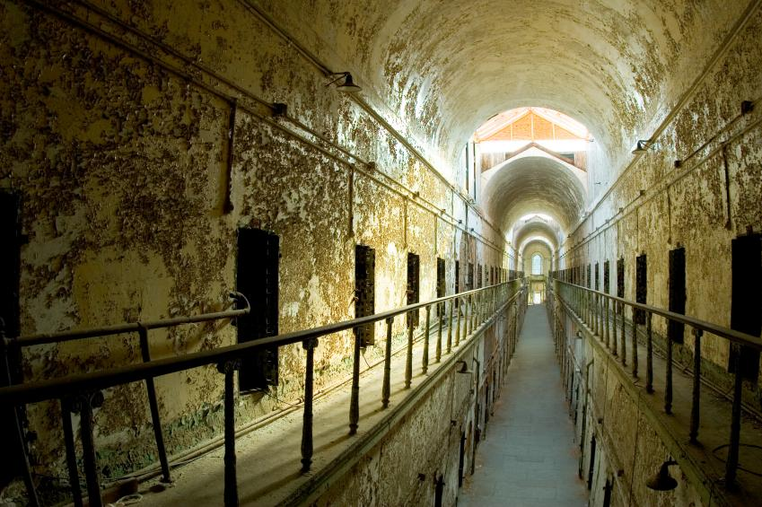
Outcomes
What outcomes do they produce?
Notes:
Rhetorical question—move toward other slides.

Slide 8
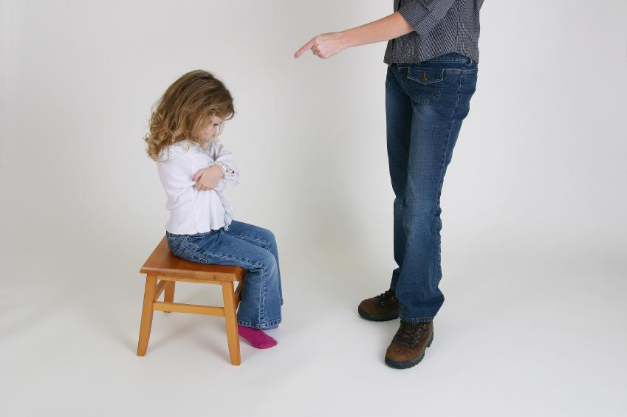
Products of Punishment
ESCAPE
AVOIDANCE
COUNTERAGRESSION
Notes:
If the school experience is PUNISHING, it often produces the following outcomes:
Escape: Dropping out, suspension
Avoidance: Sloughing, tardy, absenteeism
Counteragression: Throwing chairs, breaking classroom objects, vandalism, fighting, verbal abuse

Slide 9
CYCLE of PUNISHMENT
Teacher punishes
Student misbehaves
Teacher punishes
Student reacts negatively
Notes:
ME: Talk through this slide.

Slide 10
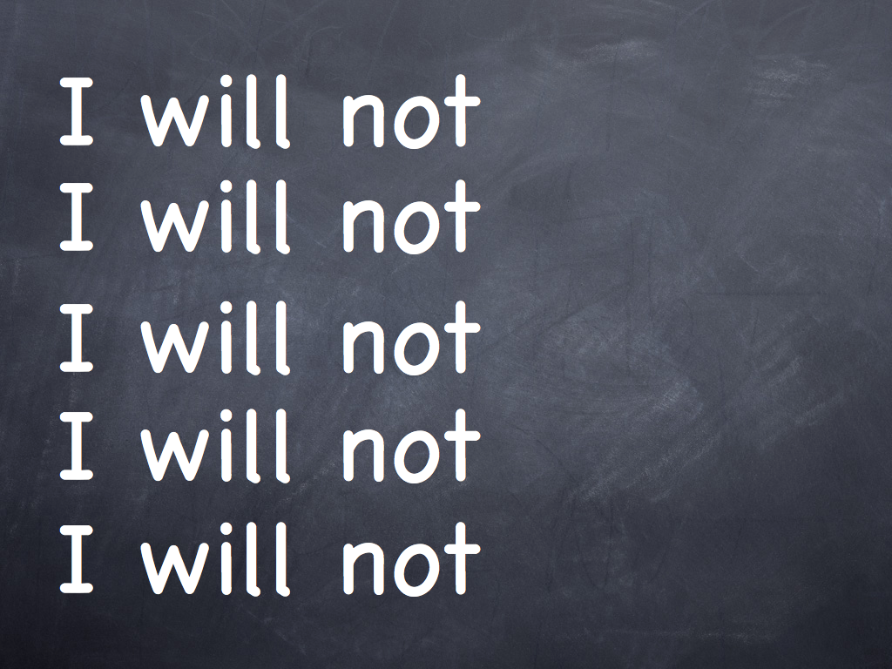
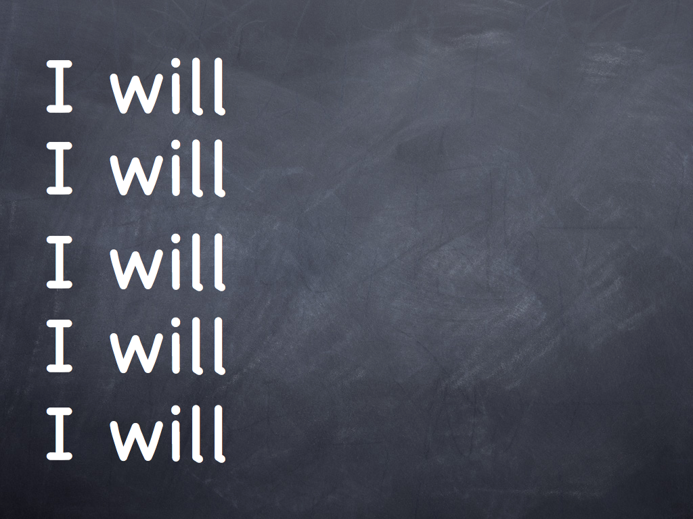
CYCLE of PUNISHMENT 2
Communicates “should not”
Does not communicate “should”
Short-term
Sets stage for violence, vandalism, & escape
Never addresses real problems
Notes:
ME: Talk through this slide.

Slide 11
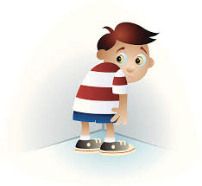
Questions to consider…
What is the purpose or function of a reinforcer?
So, what do you assume is the purpose or function of a punisher?
Notes:
Invite verbal responses.

Slide 12
Punishment… The contingent presentation of a stimulus immediately following a response, which decreases the future rate and/or probability of the response.
Notes:
This is the text book definition. What I want you to focus on is the word “decrease.” And what I want you to especially understand is that punishment only temporarily decreases or stops a behavior.

Slide 13
Why stop now?
We are models of good behavior
Our students learn from us and WILL do as we do
Punishment serves to decrease behavior
We need to focus on INCREASING good behavior
Let’s explore different STRATEGIES for approaching the “management” of behavior in schools, including within your classrooms.
Notes:
ME: Talk through this slide.

Slide 14
Session Objectives
Explore definition, purpose/goals, and outcomes of Schoolwide Positive Behavior Interventions and Supports (SWPBIS)
Learn how SWPBIS principles are implemented in local schools and the effect these principles have on student behavior
Explore strategies for implementing principles of SWPBIS in my school and classroom
Notes:
Time—12:05

Slide 15
PBIS Intro Video
As you watch the video:
What are the highpoints?
How would you define PBS?
What do you find valuable to use in your classroom?
Notes:
In the next slide I will show you a PBIS video. As you watch the video: Consider these questions.

Slide 16
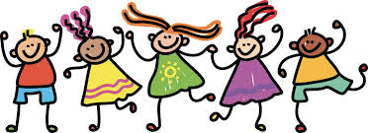
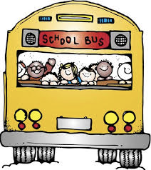
What is PBIS?
Notes:
Watch PBIS Intro video (2:39 minutes)
Invite responses to questions on previous slide

Slide 17
PBIS Big Ideas…
Positive Behavior Support is a process for teaching children appropriate behavior and providing the supports necessary to sustain that behavior.
PBIS is not a curriculum - it is a framework for systems to identify needs, develop strategies, and evaluate practice toward success
Notes:
ME: Read bullet points

Slide 18
ABA Principles
Not new...
Based on a long history of behavioral practices & effective instructional design & strategies
Notes:
ME: Read slide statement and Connect with ABA principles

Slide 19
Designing School-Wide Systems for Student Success
Academic Systems
Behavioral Systems
Intensive, Individual Interventions
Individual Students
Assessment-based
High Intensity
Intensive, Individual Interventions
Individual Students
Assessment-based
Intense, durable procedures
1-5%
1-5%
5-10%
5-10%
Targeted Group Interventions
Some students (at-risk)
High efficiency
Rapid response
Targeted Group Interventions
Some students (at-risk)
High efficiency
Rapid response
80-90%
80-90%
Universal Interventions
All settings, all students
Preventive, proactive
Universal Interventions
All students
Preventive, proactive
Notes:
19
Compare with RtI/MTSS models that many of you are likely to be familiar with.
Walk through the intent/purpose of the 3 tiers.
What I will share with you today is mostly focused on universal and targeted interventions.

Slide 20
Why a School-wide Approach?
It reduces challenging student behavior
AND
improves academic achievement
& social competence
Notes:
Offers a proactive rather than reactive approach to addressing student behavior
Research does support improved academic achievement and student social skills in schools that take a consistent, positive, and proactive approach in addressing behavior

Slide 21
Consistency Matters
Common Vision
Common Practices
Common Language
Notes:
SWPBIS creates consistency by developing common, vision, practices, and language within and entire school community

Slide 22
Achievement + Social Behavior
Notes:
RtI + PBIS=MTSS

Slide 23
Four PBS Elements
4 PBS Elements
Supporting Social Competence &
Academic Achievement
OUTCOMES
Supporting
Decision
Making
Supporting
Staff Behavior
SYSTEMS
DATA
PRACTICES
Supporting
Student Behavior
Notes:
Note the four elements and how the interact with each other to support staff behavior, decision making, student behavior, and social competence and academic achievement.
Today we will focus on the PRACTICES that support student behavior, social competence, and academic achievement.

Slide 24
Model
Community
Family
Individual
Classroom
Non-classroom
School Wide
Notes:
The PBS process and system builds consistency so that the focuses is on the individual student within the entire school community
Today our focus will be on classroom strategies (as you can see from the arrow) that support the individual student’s social and emotional needs.

Slide 25
Think on the behavioral challenge (from earlier), and the student who demonstrates that behavior. This will be your focus student/behavior in our journey together today.
Notes:
Write the student’s name on a paper or somewhere on your computer

Slide 26
Building Relationships
Strategy #1
Notes:
Time—12:20
Strategy #1 is the value of building relationships with the students in our classrooms.

Slide 27
POINT #1
Notes:
Show video—30 seconds

Slide 28
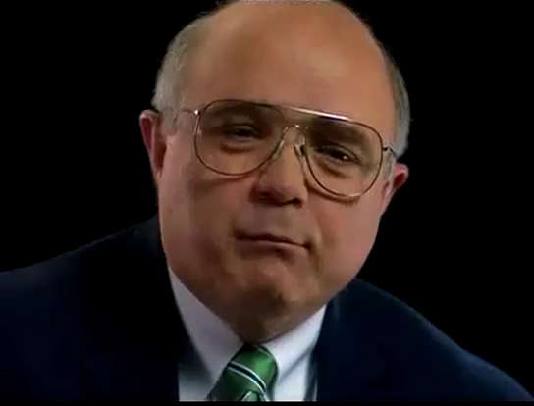
Point 2
POINT #2
Notes:
Share video: 15 seconds

Slide 29
Positive relationships…
enhance effectiveness of role modeling.
help students be more willing to spend time with teachers who demonstrate kindness.
help students feel safe with teachers who they respect.
Notes:
“People don’t care how much you know until they know how much you care.”

Slide 30
ADULT BEHAVIORS judged by young people as
NEGATIVE
Overt displays of anger
Accusing/blaming statements
Giving no opportunities to speak
Mean, insulting remarks
Unpleasant physical contact
Lack of fairness
Bossy, demanding
Unpleasant
Talking only about mistakes
No eye contact
POSITIVE
Calm, pleasant voice tone
Offers to help
Compliments on their performance
Fairness
Explaining why, how, or what
Concern
Enthusiasm
Politeness
Getting right to the point
Giving specific examples
Pleasant facial expression
Stating expectations
~Adapted from Willner, et al. (1977)
Notes:
ME: Talk through a few of the bullet points and invite them to look at the list in its entirety, later.
ME: While a dated study, it is seminal and still remains true!

Slide 31
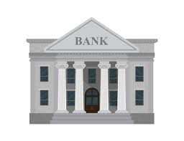
The Relationship Bank
Notes:
Let’s explore some information relevant to relationship building within our classrooms.

Slide 32
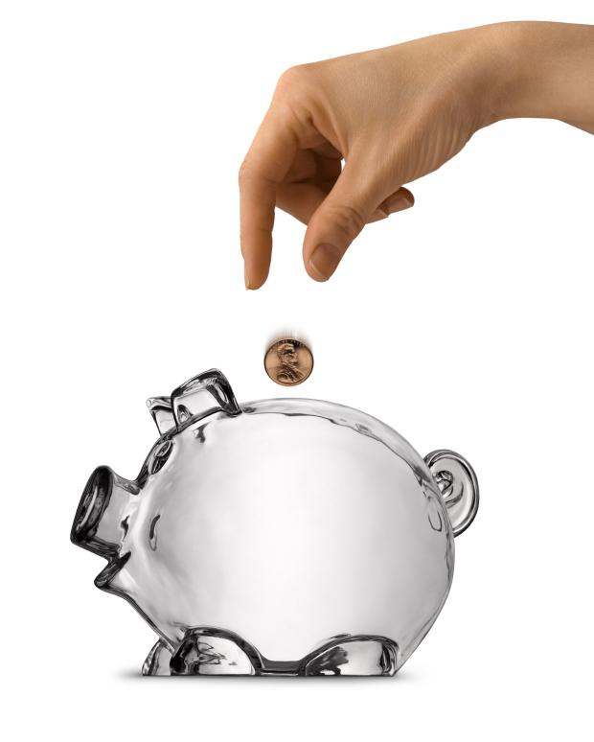
Credits
Every time you interact with another person, you have the opportunity to make a deposit in your account by behaving in a way that shows care and respect.
Notes:
Every time you interact with another person, you have the opportunity to make a deposit in you account by behaving in a way that shows care and respect.
As you get to know each student, especially those who demonstrate challenging behaviors, you will learn specific ways of that work for making deposits with him/her.

Slide 33
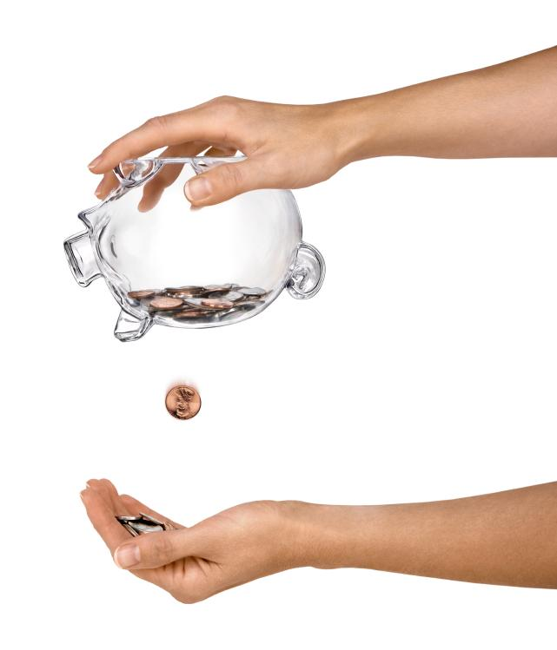
Debits
If you do or say things that are painful for the other person you withdraw funds from your account.
Notes:
Likewise, you will also learn what you do that “withdraws” from those relationships.

Slide 34
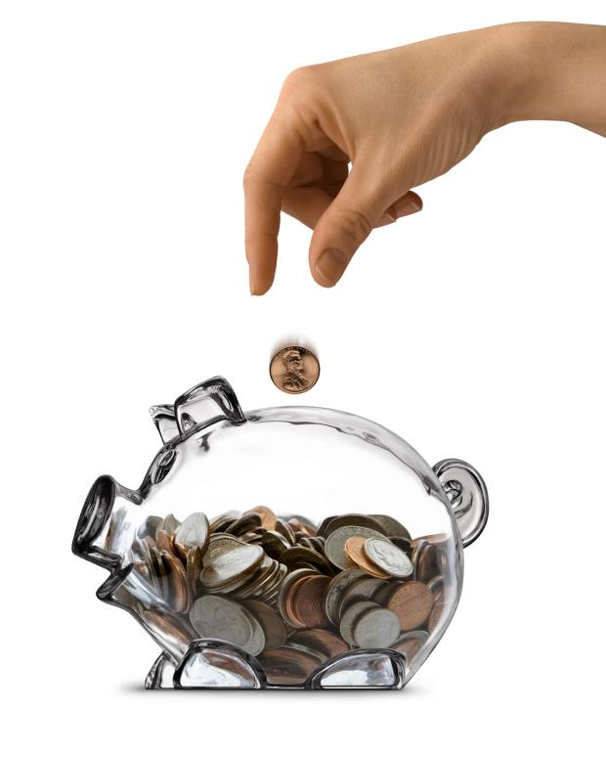
It takes TIME and EFFORT to build up a HEALTHY ACCOUNT BALANCE
Notes:
This doesn’t come easily, especially with kids who have challenging behaviors. You have to invest—BOTH TIME AND EFFORT!

Slide 35
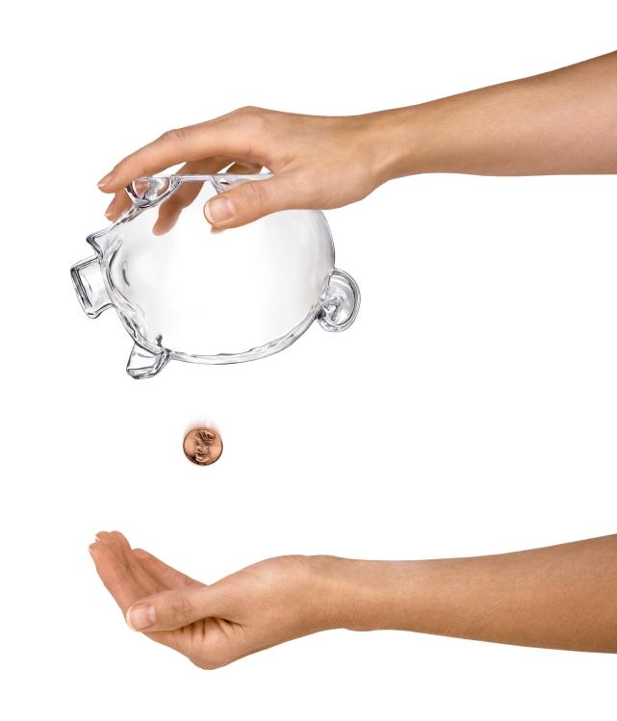
It takes restraint to avoid OVERDRAFTS.
Notes:
Similar to our personal finances. Even when you know what works and doesn’t work with each student, there are times when you’ll make mistakes. That is why it is critical to build up a fair amount of credit. Mistakes are likely, if not inevitable. (It’s like the inevitability that an appliance in your house will break down. Or you will start to have car problems. Having the money in reserves pays off at times like these, just like it pays off when a student is showing challenging behaviors.)
Share story of Uriah at Parkview Elementary:
Home challenges, teacher challenges, behavior challenges,
Behavior contract: time with me, with friends, and positive contact with his parents

Slide 36
How can you apply the relationship bank with the student you identified with the behavioral challenge?
Notes:
Journal
Place participants into pairs, in breakout rooms, to discuss
Large group: Invite a few people to share what they learned from others

Slide 37
Praise
Strategy #2
Notes:
Time—12:20
Strategy #1 is the value of building relationships with the students in our classrooms.

Slide 38
What is Praise?
Notes:
ME: Read question, responses on next slide.

Slide 39
Praise is...
Reinforcement
Specific
Descriptive
Accurate
Sincere
Contingent
Age appropriate
Relationship building
Notes:
ME: Read the words on the slide. NOTE these 2 points:
REINFORCEMENT for things that are under the student’s control.
RELATIONSHIP BUILDING: Serves the purpose of building relationships and teaching.

Slide 40
Praise is not...
A compliment
A statement with an accompanying ‘zinger’ statement
Insincere comments made out of duty
Notes:
ME: Read through the statements on the slide
Compliment—Nice looking shirt.
Zinger: It’s great having you at school today. Sure wish you could show up on time!
Kids pick up on insincerity very quickly.

Slide 41
3 Types of Praise…
GENERAL: simple, not specific
EFFECTIVE: specific, sincere, immediate, and contingent upon something a child has done or an effort he has made
INSTRUCTIVE: praise that teaches, includes the components of effective praise along with a rationale
Notes:
I share all of these with you because there is a place for all of them within our school systems. A balance goes a long ways!
GENERAL PRAISE: “good job”, “thanks”, or a smile
EFFECTIVE PRAISE:“I like the way you completed your homework accurately.”
INSTRUCTIVE PRAISE: Used as a student approximates improvements you are trying to teach

Slide 42
EXAMPLES
PRAISE
Thanks for putting your coat away so quickly.
I appreciate the way you shared your cookies with Alan.
Wow! Your writing has excellent flow and organization.
COMPLIMENTS
You look great today.
Nice shoes.
You are a good boy.

Slide 43
Five to one
5:1
positives : negatives
Adult‘withdrawals’ are more powerful
Deposits > Withdrawals
Balance feedback with positives
Notes:
What is the recommended ratio of positives to negatives?
Students recognize that adults are powerful and can hurt them, your WITHDRAWLS, therefore, are MORE POWERFUL.
You need to make MORE DEPOSITS than withdrawals.
Even if feedback is justified, it needs to be balanced out with EIGHT or more positives: What is key here is that you ensure that you provide more positive than negative statements

Slide 44
Write a praise statement that you can use with the student you identified with the behavioral challenge.
Notes:
Journal
Invite a couple of participants to share out in large group

Slide 45
Proactive
Strategy #3
Notes:
Time—12:20
Strategy #1 is the value of building relationships with the students in our classrooms.

Slide 46
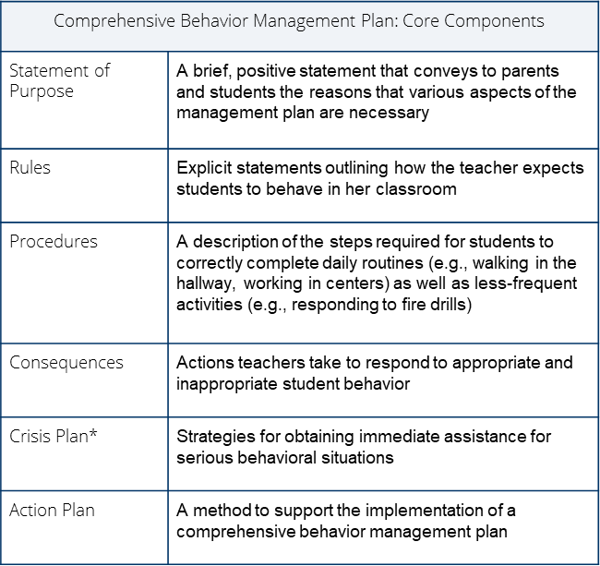
Key Components of Classroom Management
Notes:
Note that these are the key components: Statement of purpose, Rules, Procedures, Consequences, Crisis Plan, and Action.
On your own time, I invite you to explore these components and review/learn how to put them in place by doing the following…

Slide 47
Development & Implementation of a Classroom Management Plan
Notes:
Time—12:45
Play challenge video from Classroom Management (Part 1) Iris Module: https://iris.peabody.vanderbilt.edu/module/beh1/challenge/#content as a segue into this section.
The student who you’ve been thinking about during our discussion deserves a classroom that has structure. Let’s look at what that consists of (move to next slide).

Slide 48
Recommend
Exploring IRIS Center Modules:
Classroom Management (Part 1): Learning the Components of a Comprehensive Behavior Management Plan AND/OR
Classroom Management (Part 2): Developing Your Own Comprehensive Behavior Management Plan AND/OR
Early Childhood Behavior Management
Notes:
Show links to modules and share a bit about IRIS overall.
I encourage you to explore, specifically, complete one of these modules. Part 2 module actually walks you through designing a classroom management. Even for veteran teachers, you might learn some new skills and receive a refresher of how to set up a solid classroom management system.

Slide 49
Evidence Based Recommendations…
IRIS CM Modules #1 & #2
Early Childhood IRIS Module
Establishing Norms & Expectations: IRIS Case Studies & Star Sheets
Effective Room Arrangement IRIS Case Studies & Star Sheets
Behavior Game (IRIS)
Teaching Channel Videos
New Teacher Survival Guide: Classroom Management
Strategies to Improve Transitions and Time Management
CHAMPS by Randy Sprick
Keys to an Effective Classroom by Glenn Latham
Classroom Management for Elementary and Secondary Teachers by Emmer & Evertson
Notes:
Here are some additional classroom management resources that you might find helpful.

Slide 50
Consider a rule that your focus student needs. What is one positive consequence that this student would respond to? Make note of both of your answers.
Notes:
Journal
If time: Put in pairs to discuss.
Invite a few students to share out with large group.

Slide 51
CONCLUSION
Notes:
1:10

Slide 52
PBIS Big Ideas2…
Positive Behavior Support is a process for teaching children appropriate behavior and providing the supports necessary to sustain that behavior.
PBIS is not a curriculum - it is a framework for systems to identify needs, develop strategies, and evaluate practice toward success
Notes:
Reminder….

Slide 53
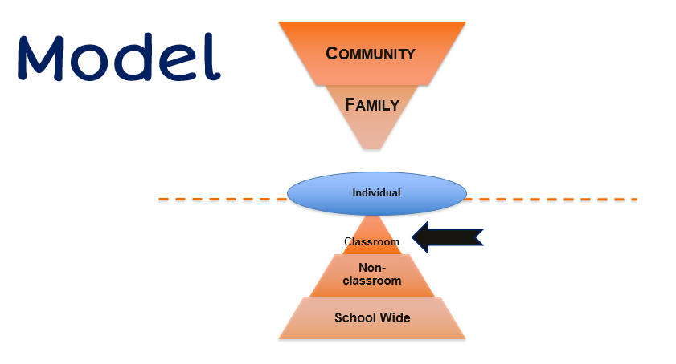
Model 2
Notes:
Write one strategy you will focus on for your classroom from our today’s journey.

Slide 54
QUESTIONS?
Notes:
1:10

Slide 55
Thank You! mmarchan@umn.edu & michellemarchant22@gmail.com
Notes:
Please reach out for additional resources or to ask questions.

