Slide 1

Commitment Issues: Understanding and Supporting Staff Buy-In
Kevin J. Filter, Ph.D.
Minnesota State University, Mankato
MN PBIS Summer Institute 2022

Slide 2
We need buy-in! But… buy-in to WHAT?
PBIS as a broad idea?
PBIS as a tiered framework?
PBIS as a specific set of local practices?

Slide 3

Individuals implement PBIS within a system of supports
Support is provided to encourage implementation
  Administrative support
  Training/Coaching
  Resources
But, ultimately, individual teachers and staff CHOOSE to implement specific practices

Slide 4
Choose to do WHAT?
Staff buy-in may not be equal across all practices involved in PBIS

Slide 5


Core Features
In order to address buy-in, we first need to be able to communicate what educators are expected to DO when implementing PBIS
Core Features
Implementation Components
Practice Elements
Student outcomes

Slide 6
Implementation Component vs. Practice Element
Implementation Component
vs
Practice Element
Lyon and Cook (2019) note that research in implementation science has differentiated IMPLEMENTATION FIDELITY from INTERVENTION FIDELITY
•Implementation Fidelity aligns with ICs
•Intervention Fidelity aligns with PEs
Notes:
Lyon and Cook (2019) note that research in implementation science has differentiated IMPLEMENTATION FIDELITY from INTERVENTION FIDELITY
•Implementation Fidelity aligns with ICs
•Intervention Fidelity aligns with PEs

Slide 7
Key terms
Terms | Definition | Actors | Recipients
Core Features | Inclusive of all the implementation components and practice elements of a given evidence-based program that lead to changes in student outcomes. | Adults and students | Adults and students
Implementation Components | Actions associated with an evidence-based program taken by coaches, educators, and administrators that support and prepare for the adoption and delivery of the core practice elements with fidelity. | PBIS team members, Trainers, Administrators | Teachers and other staff
Practice Elements | The individual observable actions associated with an evidence-based program that expected implementers deliver, in isolation or combination, to achieve desired student outcomes. | Teachers and other staff | Students

Slide 8
Implementation Component
-or-
Practice Element
Team meets regularly
Reminding students of behavior expectations
Administrator supports PBIS
3-5 behavior expectations established by school
Lesson plans created by team
Reward systems established school-wide
Regularly acknowledge appropriate student behavior
Directly teaching expectations to students
Data are reviewed by team
Staff development to implement PBIS
Providing feedback to correct misbehavior
Budget dedicated to PBIS
Collect data on student performance

Slide 9
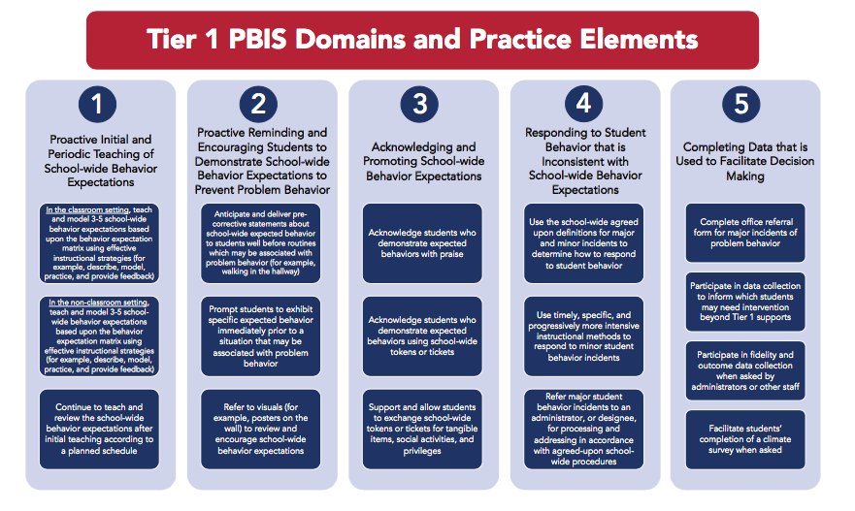
Tier 1 PIBS Domains and Practice Elements
Filter et al. (2022)
Notes:
Expert consensus with Tier 1 PBIS PE

Slide 10
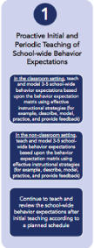
Proactive Initial and Periodic Teaching
Proactive Initial and Periodic Teaching of School-wide Behavior Expectations
•In the CLASSROOM setting, teach and model 3-5 school-wide behavior expectations based upon the behavior expectation matrix using effective instructional strategies (for example, describe, model, practice, and provide feedback).
•In the NON-CLASSROOM setting, initial teaching and modeling of 3-5 school-wide behavior expectations based upon the behavior expectation matrix using effective instructional strategies (for example, describe, model, practice, and provide feedback).
•Continue to teach and review the school-wide behavior expectations after initial teaching according to a planned schedule.

Slide 11
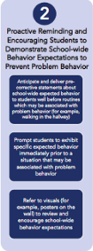
Proactive Reminding and Encouraging Students
Proactive Reminding and Encouraging Students to Demonstrate School-wide Behavior Expectations to Prevent Problem Behavior
•Anticipate and deliver pre-corrective statements about school-wide expected behavior to students well before routines which may be associated with problem behavior (for example, walking in the hallway).
•Prompt students to exhibit specific expected behavior immediately prior to a situation that may be associated with problem behavior.
•Refer to visuals (for example, posters on the wall) to review and encourage school-wide behavior expectations.

Slide 12
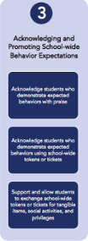
Acknowledging and Promoting School-wide Behavior Expectations
•Acknowledge students who demonstrate expected behaviors with praise.
•Acknowledge students who demonstrate expected behaviors using school-wide tokens or tickets.
•Support and allow students to exchange school-wide tokens or tickets for tangible items, social activities, and privileges.

Slide 13
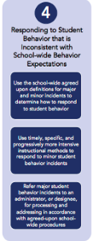
Responding to Student Behavior that is Inconsistent with School-wide Behavior Expectations
•Use the school-wide agreed upon definitions for major and minor incidents to determine how to respond to student behavior.
•Use timely, specific, and progressively more intensive instructional methods to respond to minor student behavior incidents.
•Refer major student behavior incidents to an administrator, or designee, for processing and addressing in accordance with agreed-upon school-wide procedures.

Slide 14
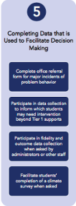
Completing Data that is Used to Facilitate Decision Making
•Complete office referral form for major incidents of problem behavior.
•Participate in data collection to inform which students may need intervention beyond Tier 1 supports.
•Participate in fidelity and outcome data collection when asked by administrators or other staff.
•Facilitate students’ completion of a climate survey when asked.

Slide 15
Commitment and Buy-In
Great ideas but what do we know?

Slide 16
Importance of the Individual Implementer in PBIS
Buy-In as a Barrier to PBIS implementation (Kincaid, Childs, Blasé, and Wallace, 2007)
Bambara, Goh, Kern, & Caskie (2012):
“Among the top 10 most problematic and commonly experienced barriers, 5 pertained to the domain of school culture, practices and beliefs. Barriers such as staff resistance to changing behavior management practices, and beliefs that problem behaviors should be punished, students with problem behaviors are better served in segregated settings, and behavior interventions should result in rapid reductions in problem behaviors, suggest that some of the strongest impediments to implementing IPBIS have to do with the core beliefs or mindset of school staff and their allegiance to traditional practices. “
Ubiquity of “80%”

Slide 17
And yet, we don’t really know much…
Undefined terms
  Buy-in, commitment, support, agreement, intention
No grounded theory
  What are the elements of buy-in?
Is it actually important?
  If so, how much do you need? Is it REALLY 80%
  WHEN is it important?
Lack of empirical studies of solutions

Slide 18
Multiple profiles of those not bought-in
Doubter – I know what it is and I don’t think it will work with these kids
Time Skeptic – This sounds great, but I already have a lot of other things I need to do
Prejudiced – I don’t really know what it is, and I don’t want to find out
Eye on Others – I don’t see other doing it and I don’t think that they want to do it
Self-Doubter – I only kind of understand and don’t think I’ll be good at it… I am good at other things
Philosopher – This isn’t the way to help kids, I believe in ___
MY Classroom – I manage things how I want to manage things
Misunderstander – Helping kids is about more than just being nice to them
*Note: I MADE THIS LIST UP!

Slide 19

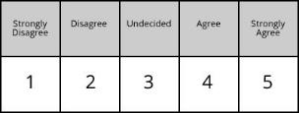

Commitment
Important idea: Commitment exists along a continuum
Resistant to Participating
Maybe willing but need more time/information
Ready and enthusiastic to participate

Slide 20
The Question
The questions isn’t, “Are you bought in?”
The question is, “How much are you bought-in to all of the specific things what we plan to do?”

Slide 21
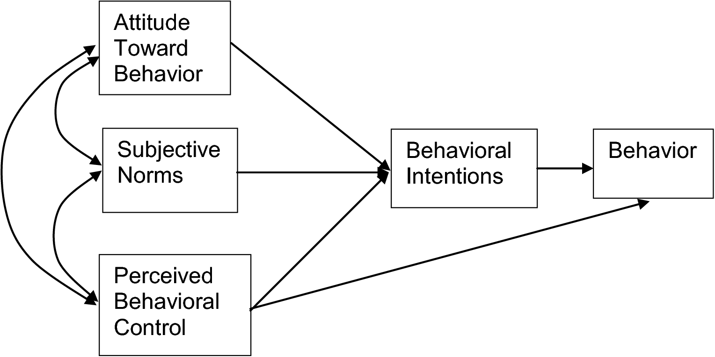
A potential theory to start with:
Theory of Planned Behavior (Ajzen, 1985)
“Sure, I feel like I can and should do that!”
“I’ll actually DO that soon”
“I’m doing it”

Slide 22
TPB Evidence
Teachers with high intentions were five times more likely to adopt and deliver an EBP for autism than teachers with low intentions (Fishman, Beidas, Reisinger, & Mandel, 2018)
Meta-analysis of 123 interventions based on TPB showed a .50 effect size across a variety of behaviors (Steinmetz et al., 2016)
  e.g., alcohol and drug use, adherence to medical regimens

Slide 23
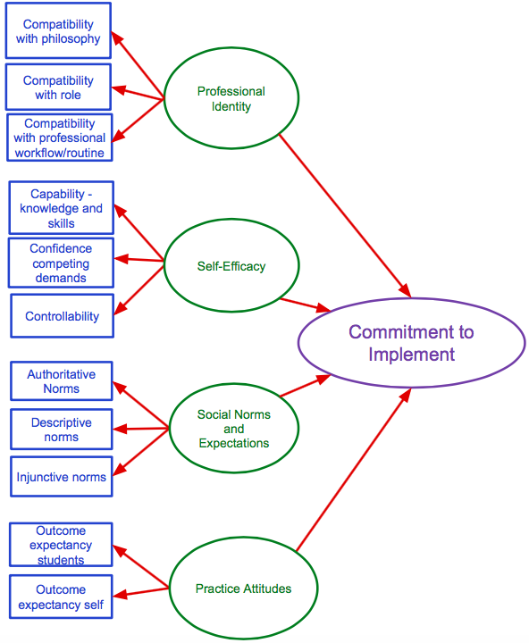

Updated Model of Commitment to Implement

Slide 24
Commitment (Intention) to Action Gap
Commitment
?
Action
TPB explains 59% of variance in intention and 31% of variance in implementation behavior (Godin et al., 2008)
Implication – There are at least two explanations for individuals not implementing
Not bought-in
Bought-in but not acting
NOT ALL IMPLEMENTATION PROBLEMS ARE COMMITMENT PROBLEMS
Action Planning
Coping Planning

Slide 25

Measuring Staff Buy-In

Slide 26
Measuring Buy-In and Commitment
Although buy-in is cited as critical across many areas of organizational change (education, business) measurement remains elusive (Mathews & Crocker, 2016)
Current PBIS buy-in literature is qualitative not psychometric
Staff vote (McKevitt & Braaksma, 2005)
  Traditional approach to measuring buy-in
New Measure = PBIS Planned Action and Commitment Tool (PBIS-ACT; Filter & Brown, 2019)

Slide 27

PBIS ACT
Behaviors
Indicators
a. Doing
b. Willing
c. Value
1. Teach
2. Prompt
3. Praise
4. Tangible
5. Major Violations
6. Minor Violations
7. Classroom
8. Non-Classroom
PBIS-ACT
a. Doing
b. Willing
c. Value
a. Doing
b. Willing
c. Value
a. Doing
b. Willing
c. Value
a. Doing
b. Willing
c. Value
a. Doing
b. Willing
c. Value
a. Doing
b. Willing
c. Value
Each item rated on a 0-10 scale
a. Doing
b. Willing
c. Value

Slide 28
Validation study of PBIS-ACT Full
(Filter and Brown, 2019)
26 schools
MN (majority), CT, PA, CA
15 Elem, 4 MS, 4 HS, 3 PreK-12
11 pre-implementation, 5 YR1, 5 YR2, 5 YR3+
912 respondents
49.3% response rate (range = 23% to 83%)
86% Non-Hispanic White, 4% Black, 3% Hispanic
61% GenEd teachers, 11% SPED teachers, 9% licensed/non-teaching, 14% non-licensed/non-teaching

Slide 29
Factor Analysis
EFA:
8 factor solution
Acceptable fit: RMSEA: .08 95%C.I. [.074, .087], SRMR: .018
Factors closely aligned with theoretical design of the measure, with one exception – items 7 and 8
CFA:
7 factor model
Acceptable fit: RMSEA .091, 95% C.I. [.085, .096] and an SRMR of .051

Slide 30
Reliability
Scale | Chronbach’s α Coefficient | Number of Items
Teaching | .851 | 3
Prompting | .890 | 3
Praise | .914 | 3
Tangibles | .920 | 3
Majors | .781 | 3
Minors | .866 | 3
Cross-Setting Implementation | .909 | 6
Total Scale | .949 | 24

Slide 31
Descriptives for 24-Item Sum Scores
Range: 23 to 240
Mean: 203.36 (84.73% commitment)
Standard deviation: 36.19
Median: 213 (88.75% commitment)
Mode: 240 (100% commitment- 7.3% respondents reporting this score)

Slide 32

80% “Rule of Thumb”
Sample mean = 84.73% commitment
74% of respondents reported 80% or more commitment
  7.3% reported 100% commitment
80% of respondents were at least 76% committed

Slide 33

Accessing PBIS-ACT For Your School
We have discontinued the online management of the PBIS-ACT, but a link to an editable document version of the questionnaire that you can use can be found here:
PBIS-ACT

Slide 34
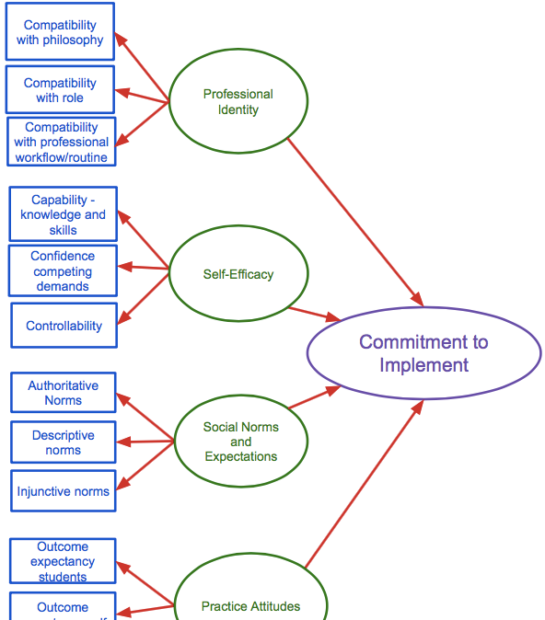
Coming Soon: Planned Action and Commitment Tool (PACT)
PBIS-ACT is a very practical current tool
PACT will be much better designed and can be adaptable for other evidence-based practices
  Large scale validation currently underway
IES Award #R305A190182

Slide 35

Supporting Staff Buy-In

Slide 36
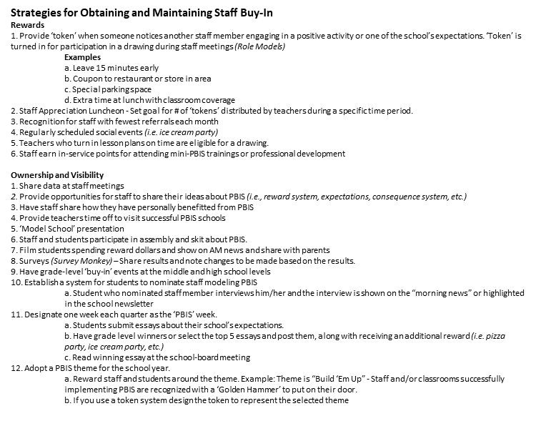
There are many places to find suggestions but we’re still trying to figure out what really works

Slide 37
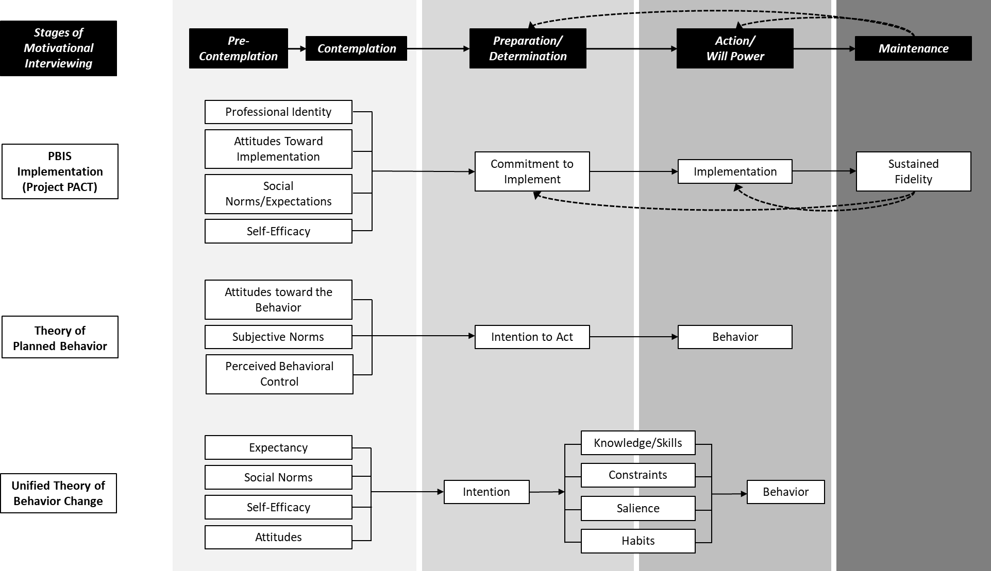
Stages of Motivational Interviewing
Cowger (2022)

Slide 38

Two Stages at Which to Support
Pre-Intenders
Post-Intenders
Not currently bought in
Focus is on creating BUY-IN
Already bought-in
Focus is on creating ACTION

Slide 39

Pre-Intenders
Gaining buy-in

Slide 40
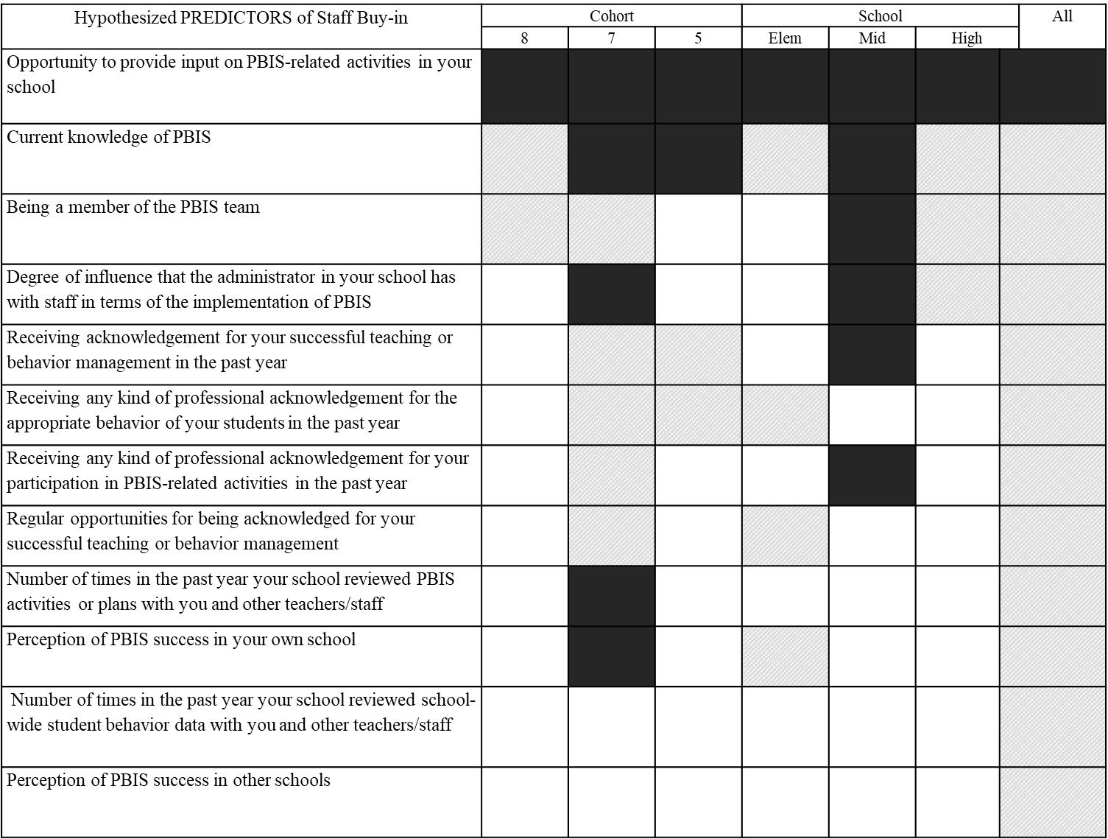
What predicts staff buy in?
What PREDICTS Staff Buy-In?

Slide 41


Pre-Intenders: GENERAL SOLUTIONS
Ensure that staff have VOICE in the process
Ensure that staff have KNOWLEDGE of PBIS
See data regularly
Provide feedback to team/admin regularly
Purpose
Actions
Outcomes

Slide 42
Pre-Intenders: GENERAL SOLUTIONS 2
Motivational Interviewing
  MI attempts to increase commitment to change through the interpersonal facilitation of barrier identification, exploration of values, aligning values with behavior, and facilitating the use of “change talk” (Frey et al., 2013).
  Change talk is evoked by a series of open-ended questions that aim to highlight the discrepancy between desired outcomes and actual behaviors.
  MI relies on a collaborative partnership between the provider and client and is typically facilitated by someone with professional training.
  Ultimately, the MI process aims to foster acceptance, partnership, and compassion between the practitioner and client, resulting in behavior change that can be sustained over time.
Cowger (2022)

Slide 43

Pre-Intenders 2
TARGETED SOLUTIONS
*Logical but untested

Slide 44
Systematic Literature Review Underway
Project PACT is currently reviewing 18,000 articles for specific and effective solutions to buy-in problems based on the following constructs:
  Professional Identity
  Attitudes Toward Implementation
  Social Norms & Expectations for Implementation
  Self-Efficacy for Implementation
It will be many months until we have good information… SORRY!

Slide 45
Professional Identity
A person’s perceptions of whether a given practice or set of practices is compatible with one’s professional self-concept based on beliefs, experiences, and values
  Compatibility with philosophy, compatibility with role
SOLUTION:
  Teacher writes down core personal values in teaching and behavior management within their role
  Coach discusses in each relation to PBIS

Slide 46
Attitudes Toward Implementation
A person’s subjective appraisal or evaluation of a given practice or set of practices based on their beliefs, knowledge, prior experiences, and feelings
  Outcomes expectancies for self, outcome expectancies for students
SOLUTIONS:
  Share data about outcomes for students (published or local examples)
  Testimonials from other educators about the personal experience of implementing

Slide 47
Social Norms & Expectations for Implementation
A person’s perceptions of the formal and informal rules about what is considered appropriate in terms of implementing a given practice or set of practices
  Injunctive norms, descriptive norms, authoritative norms
SOLUTIONS:
  Social Proofing – Share data about implementation levels in local and other schools
  Testimonials from “go-to-colleagues” about implementation experience
  Clear statement from administrator about what is expected of each educator in school

Slide 48
Self-Efficacy for Implementation
A person’s perceptions of their own ability (i.e., confidence) to implement a practice given their current capabilities and situation
  Capability, Confidence against competing demands, controllability
SOLUTIONS:
  Ensure full training on practice elements
  Explain how practice elements fit into regular daily activities
  Reflect on previous successes helping students

Slide 49
Post-Intenders
Already bought-in but not implementing

Slide 50
Action Planning
“Optimally effective planning interventions should adopt “if–then” plans, account for salient and relevant cues, include examples of cues, be guided rather than user-defined, and include boosters.” (Hager & Luszczynska , 2014)
Step 1: Dedicated individual planning time
  Time for each educator to review the specific expected practices and work out the when, where, and how in their own schedule and setting
Step 2: Publicly shared commitments
  In smaller groups (by grade, department), each educator shares their plan for implementation

Slide 51
Coping Planning
After initial action planning…
Dedicated individual planning time to work out
  Likely impediments
  Potential solutions to impediments

Slide 52

Wrapping Up

Slide 53

Buy-In is…
Reported to be important to implementation
Multi-faceted
On a continuum
Not well-researched

Slide 54

To address Buy-In
Determine if the problem is Pre-Intention (buy-in) or Post-Intention (action)
Use general solutions, such as
  Ensure Voice in PBIS
  Increase knowledge of PBIS (outcomes and practices)
Consider solutions that target specific problems
  Professional Identity
  Attitudes Toward Implementation
  Social Norms & Expectations for Implementation
  Self-Efficacy for Implementation
Review and consider general advice on PBIS websites

Slide 55

Thank you

