Slide 1
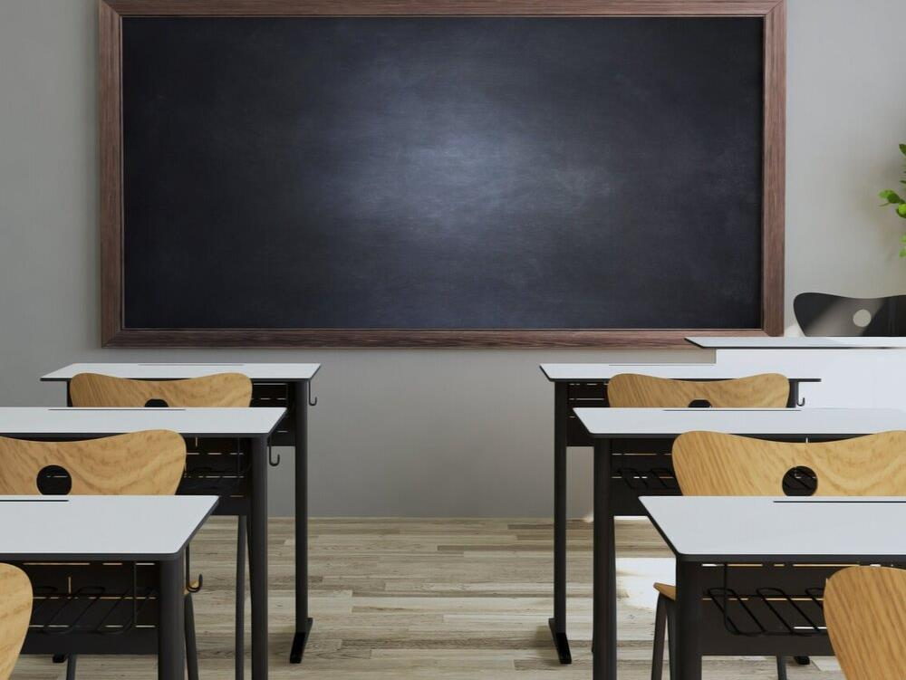
Evidence-based Practices That Create Consistently Helpful Adult Actions

Slide 2
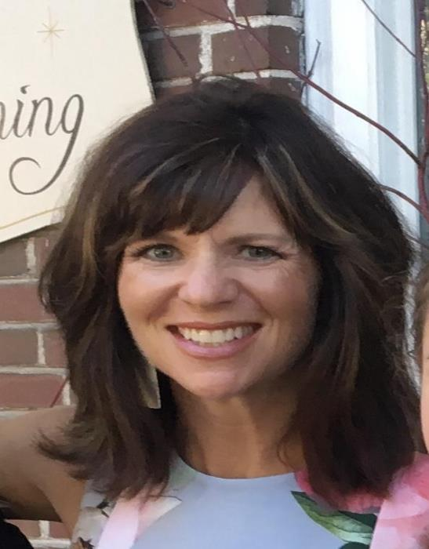
Presenter Information
Cheryl Cook-Glad
Retired Teacher, PBIS Coordinator, # 742
PD Manager #287
PBIS Trainer
PBIS External Coach
SWIS Facilitator
Michele Wackman
School Psychologist in #623
PBIS Trainer
PBIS External Coach
SWIS Facilitator

Slide 3
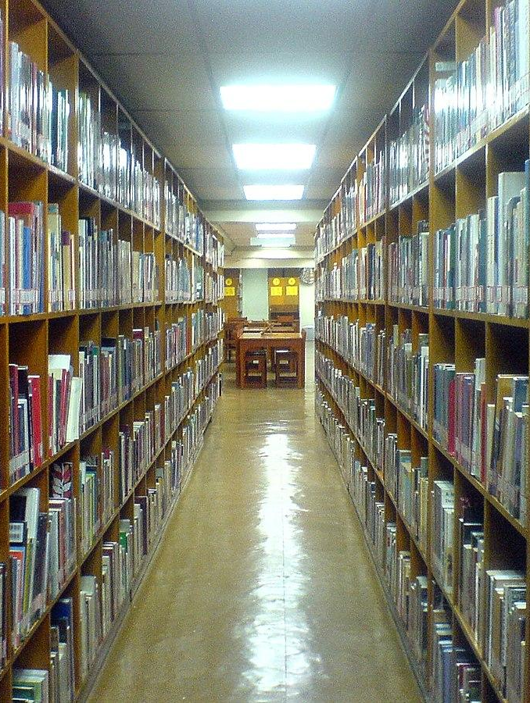
Session agenda
In This Session We Will Review Classroom Evidence-based Practices That:
Build Relationships
Promote SEB Brain Development
Maximize Predictability
Provide Feedback for Learning

Slide 4
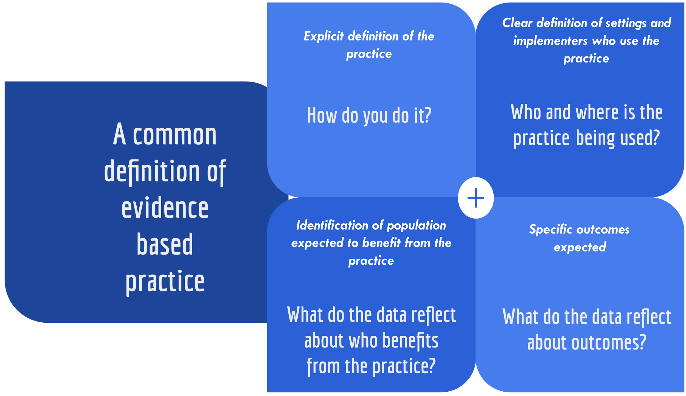
Definition of Evidence-based Practice

Slide 5
DISCLAIMER
These evidence-based practices will only yield celebrated outcomes when implemented with fidelity.

Slide 6
From Connection comes a Willingness to Cooperate, Collaborate & Create

Slide 7
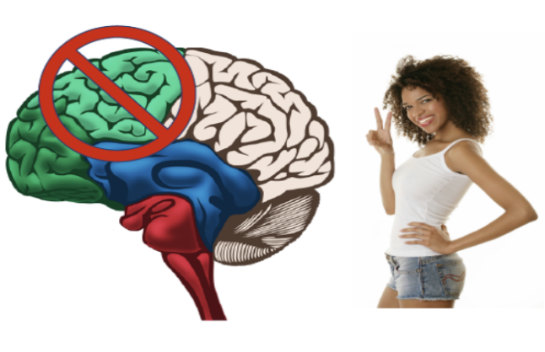
These Evidence-based Practices Promote SEB Brain Development
The executive skills housed in the prefrontal lobes take on average 24 years to mature.
Executive Skills develop in the context of relationships, through environmental support, conscious scaffolding by caregivers and stimulation.
Development Need: Problem solving in social situations.

Slide 8
Teacher-Student Relationship Effect Size
John Hattie, 2015
Notes:
.4 would be good or strong effect size
.72 is teacher-student relationship effect size and is actually very high

Slide 9
Why Relationship Matters
Shapes the way students think & act in school
Improves how well students do in school
Encourage active participation in class & self challenge
Increase social and emotional intelligence
(Gonzalez, 2016)

Slide 10
Why Relationship Matters
“A review of educational research analysis of 46 studies found that strong teacher-student relationships were associated in both the short and long term with improvements on practically every measure schools care about: high student academic engagement, attendance, grades, fewer disruptive behaviors and suspensions and lower school drop out rates. Those effects were strong even after controlling for differences in students’ individual, family and school backgrounds.”
(Education Week, March 12, 2019)

Slide 11
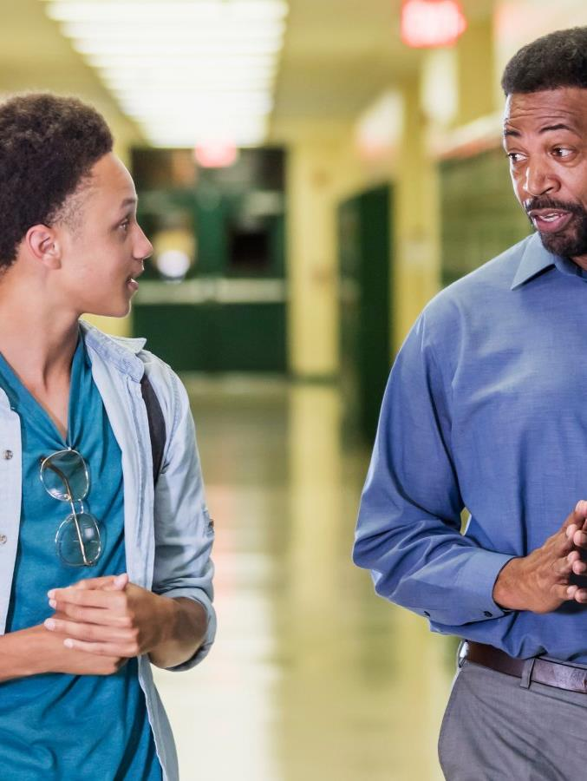
Continued Why Relationship Matters
“A study in the New England Journal of Psychology found that a teacher’s relationship with students was the best predictor of how much the teacher experienced joy versus anxiety in class.” (Education Week, March 12, 2019)

Slide 12
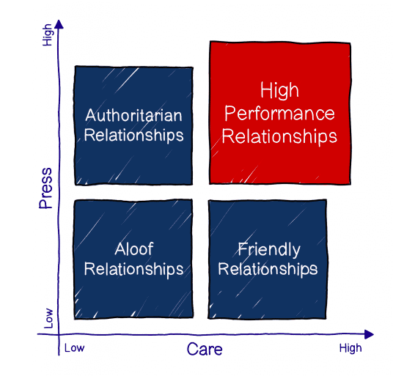
2 Key Components: Care & Expectations
Notes:
Similar to research on Loving Demanders or Warm Demanders. (high care AND high expectations)

Slide 13
3 Keys to CARING Teacher-Student Relationships
Warmth-Accept students for who they are. Show them they are important to you.
Empathy- Understand how your students think and feel.
Time- Take time to physically and mentally be present when talking with your students-BE INTENTIONAL.

Slide 14
“ARE YOU GOOD AT BUILDING RELATIONSHIPS WITH YOUR STUDENTS?
“DO YOU HAVE STRONG RELATIONSHIPS WITH YOUR CURRENT STUDENTS?”
Notes:
Nearly EVERY educator answers yes to both questions but it’s not always true.
The truth is that some people are naturally better at building relationships and they tend to have strong SEL skills themselves. However, ALL educators can learn strategies to build or improve relationships with students.

Slide 15
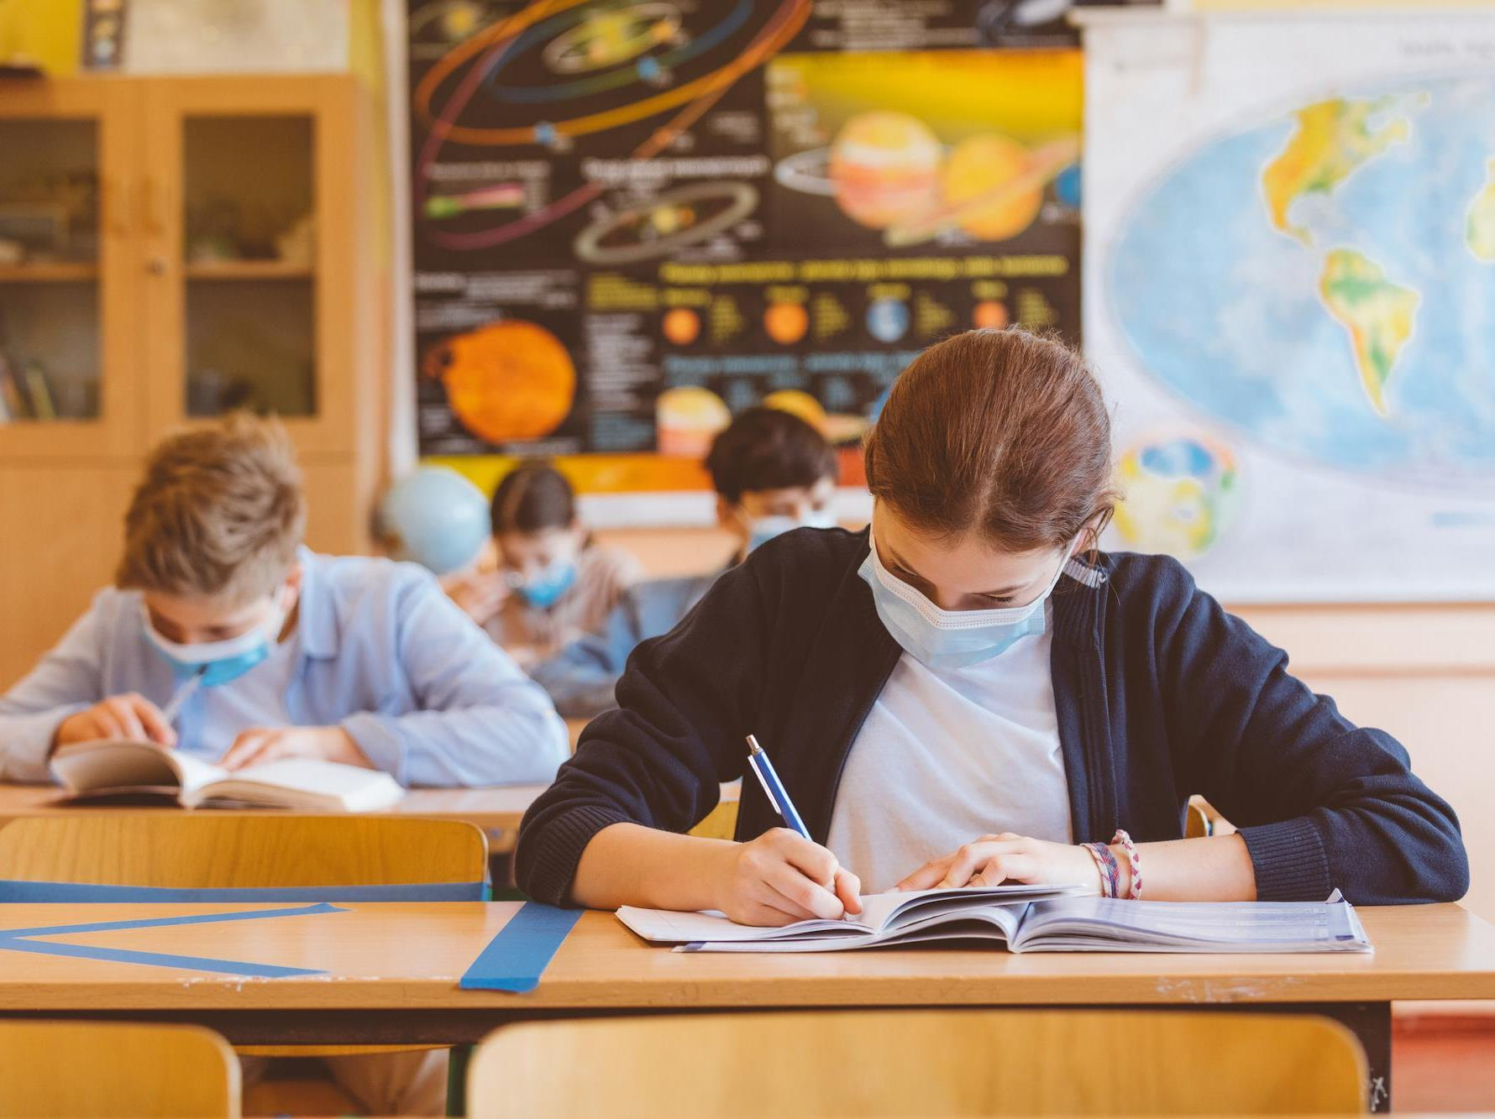
Be Intentional About Relationship E.M.R. (Establish-Maintain-Restore)

Slide 16
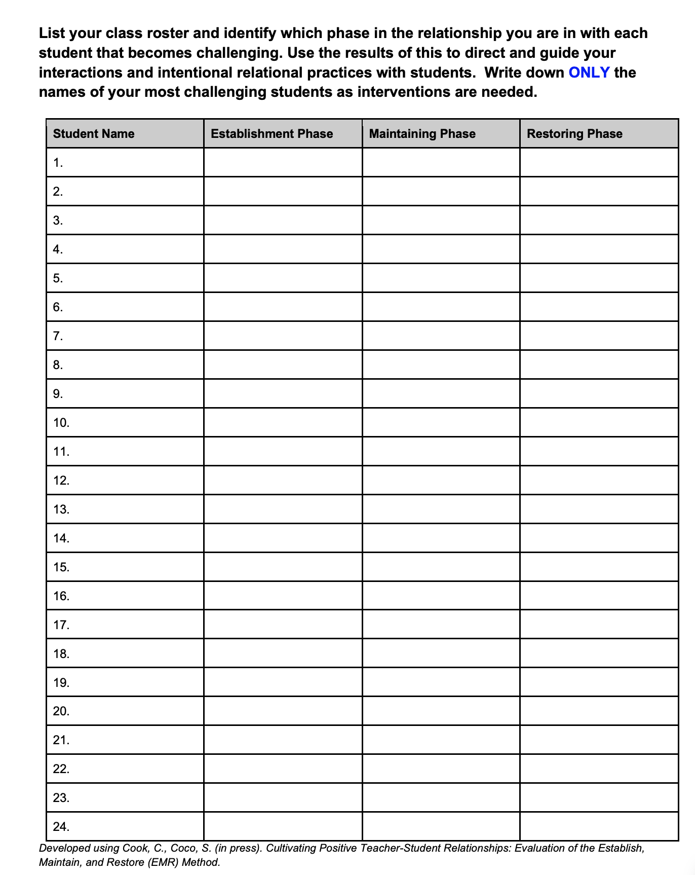
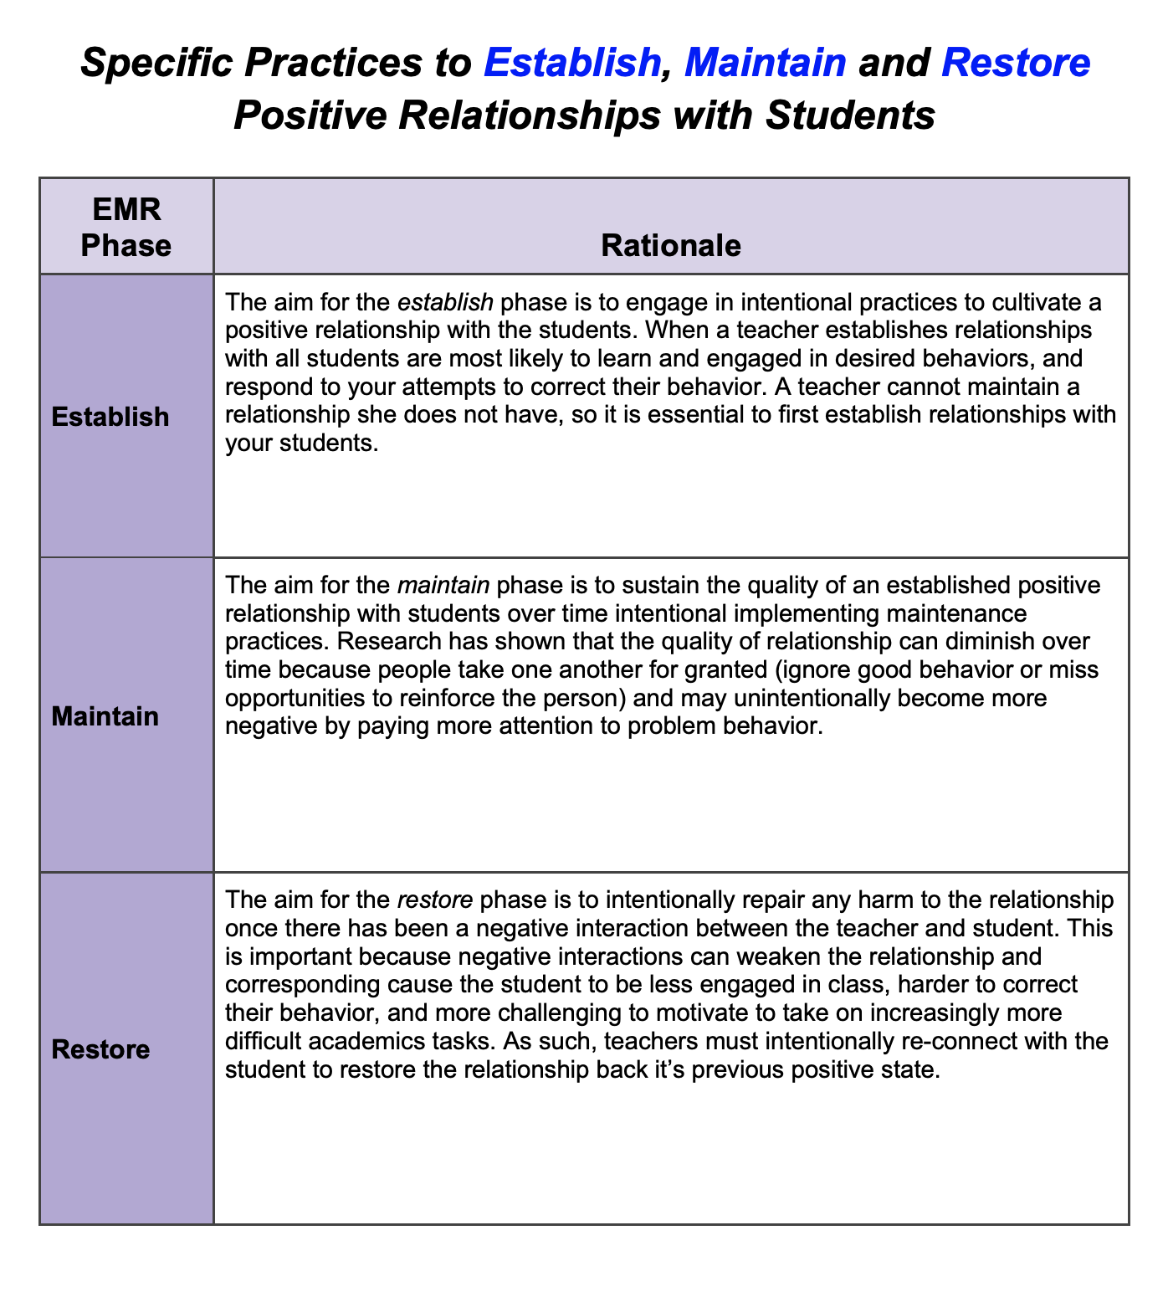
Practices to Establish, Maintain, and Restore

Slide 17
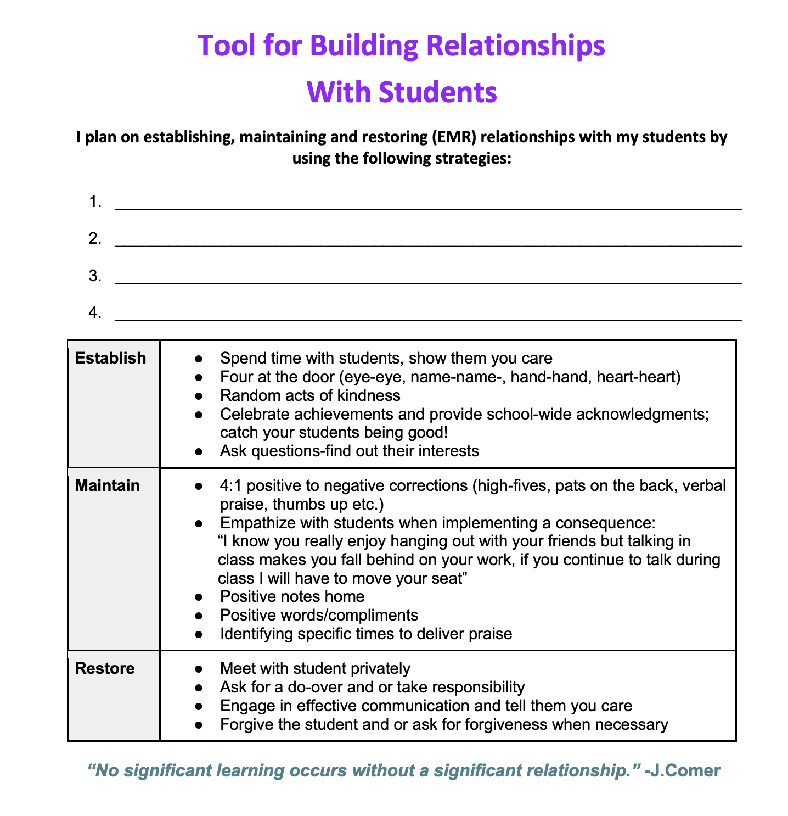
Tool for Building Relationships with Students
LEARN MORE about EMR
Learn More About EMR

Slide 18
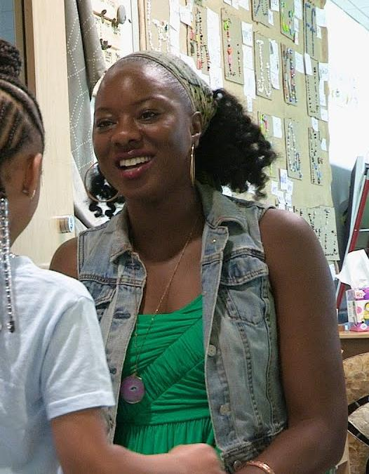
Positive Greetings At the Door
Greet Each Student by Name
Have a Short Positive Interaction
Direct them to the First Activity
VARIATION 1: • Offer the student a choice of handshake, fist bump, high five, pinkie shake, etc.
VARIATION 2: • Provide a quiet, independent entry activity (e.g., warm-up fluency activity, easy writing task) • Circulate around the room, ensuring you have a positive greeting with each student
VARIATION 3: • Train students in your class to be greeters or ‘greeter leaders’ • Students along with the teacher provide a greeting to each student in the morning • Students alternate the role of greeter every month or week

Slide 19
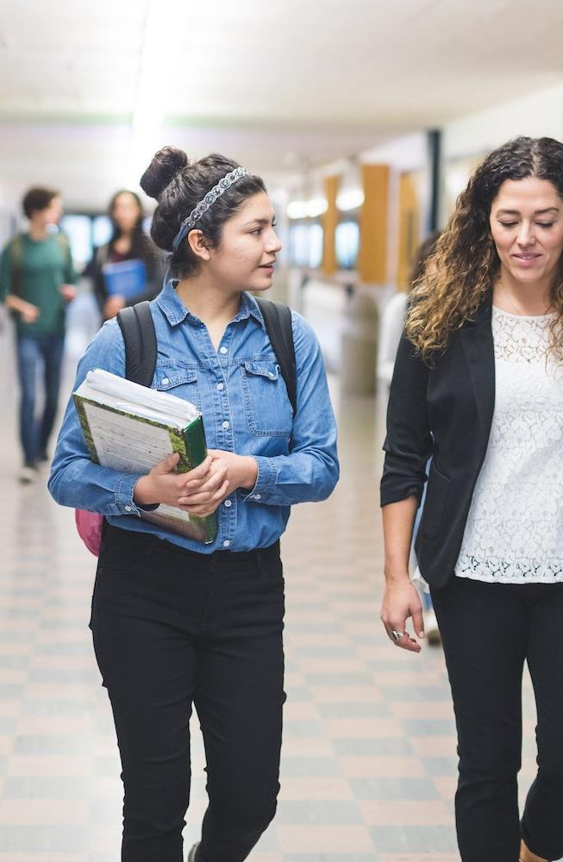
2x10 Relationship Building
2 minute conversation with a student
(not about academics)
10 consecutive days
[Very effective strategy for at-risk students or students who present with challenging behavior]
Aka “Two Minute Intervention”
by Raymond Wlodkowski

Slide 20
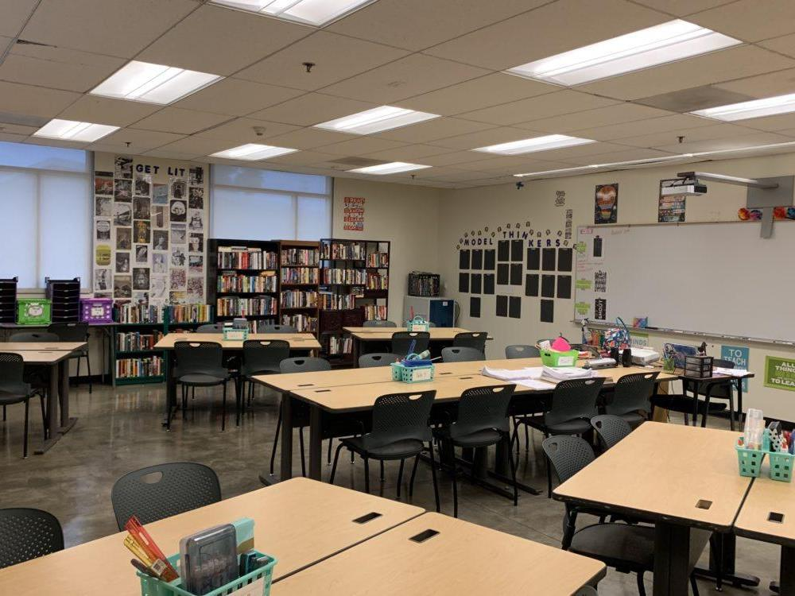
5:1 Ratio
5 POSITIVE interactions to every 1 NEGATIVE interaction
Research shows….
Improves student behavior
Improves academic engagement
Prevents problem behaviors
Contributes to positive classroom climate
Sustains constructive teacher-student relationships

Slide 21
Classroom Rituals for Connecting & Creating a Sense of Belonging.
Morning Meeting
Community Building Circles
Ideas from The SEL 3 Signature Practices Playbook

Slide 22
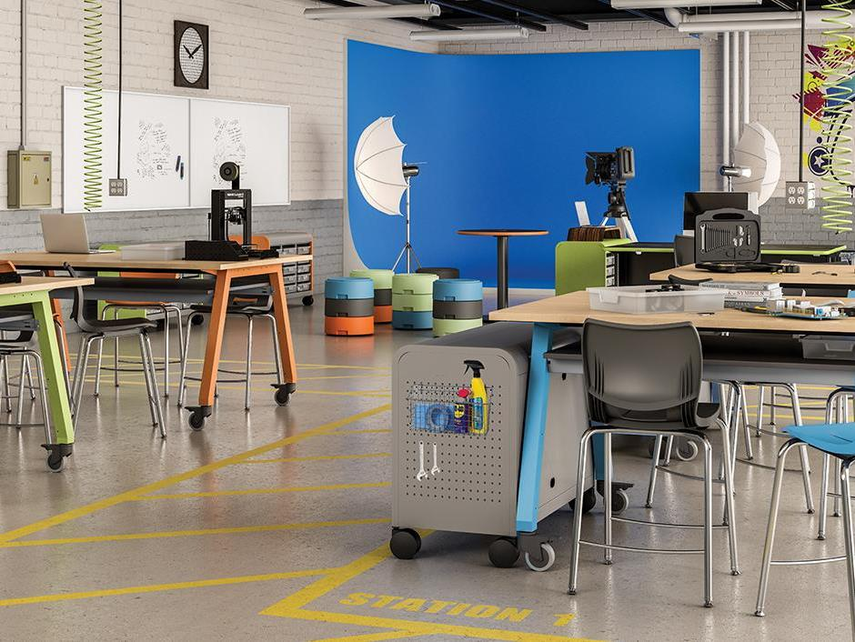
Teach Expected Behaviors Within Routines

Slide 23
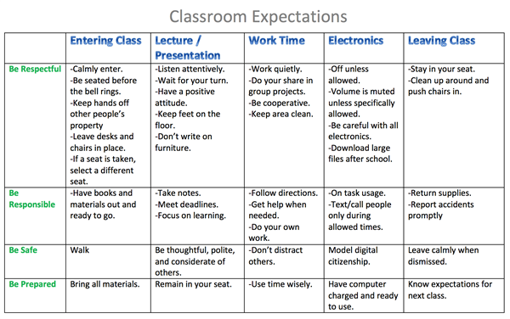
Classroom Expectations

Slide 24
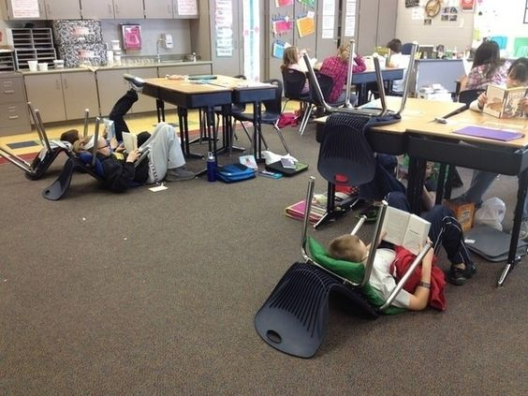
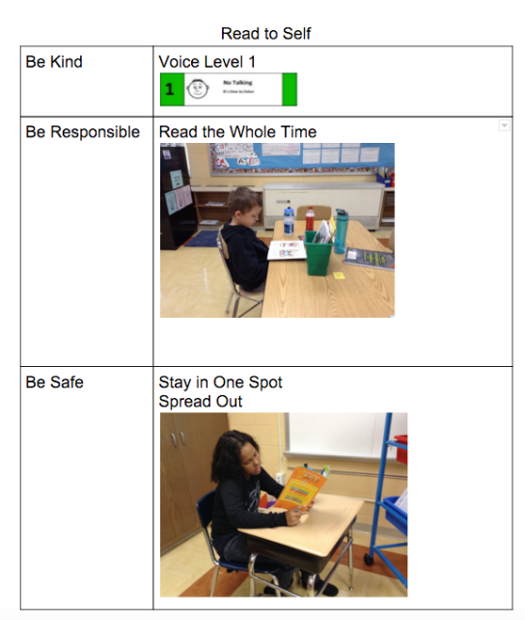
M.A.P. MODEL • ADD VISUALS • PRACTICE
PRE-CORRECTION
A short period of time taken prior to a certain routine or event to focus student attention on expected behavior.

Slide 25
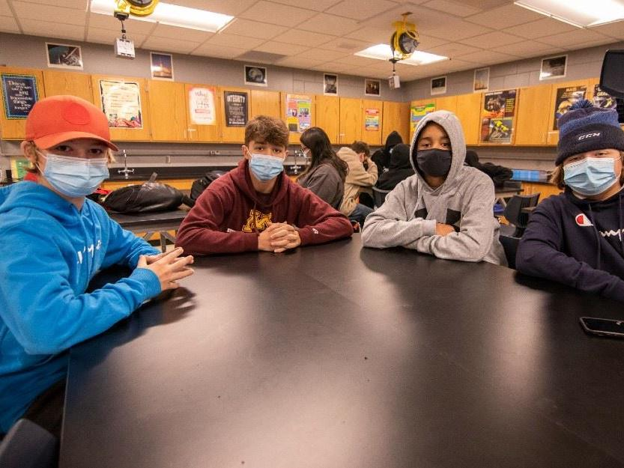
Provide Behavior Specific Praise

Slide 26
Checklist
Gives feedback about performance.
Strengthens or reinforces helpful behaviors
Builds relationships.
Helps establish a 5:1 praise to corrections ratio for growth mindset.

Slide 27
Steps for BSP
Steps for BSP:
1. Identify the student/group by name
2. Include term of praise
3. Describe skill being recognized
4. Link to classroom-wide expectation on your matrix
Example:
Hey Julie,
nice job
getting started on your work,
that shows responsibility

Slide 28
Provide Specific Error Correction

Slide 29
SUPPORTIVE Example
SUPPORTIVE
Just like we would correct an academic error
The message to the student is…
Oops! You made a mistake or you are off track with what is helpful to learning and/or expected. You can fix it and your school community can help.

Slide 30
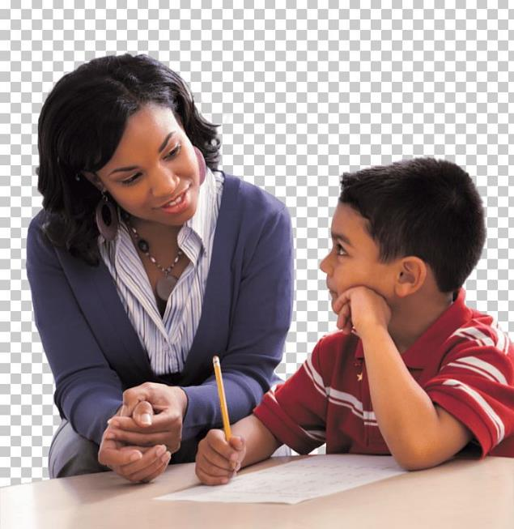
Supportive Error Correction Follows These Guidelines
1. Calm
2. Consistent
3. Brief
4. Immediate
5. Respectful
Steps for Specific Error Correction
1. Respectfully address the student
2. Describe inappropriate behavior
3. Describe expected behavior/rule
4. Link to expectation on the classroom matrix
5. End with encouragement
Example:
Hey Julie,
You haven’t started your work yet.
Starting your work will show responsibility.
Is there anything I can do to help you get started? (offer support)
Excellent Julie! You have started your work. Nice job being responsible.

Slide 31
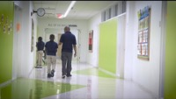
The Power of Relationship

Slide 32
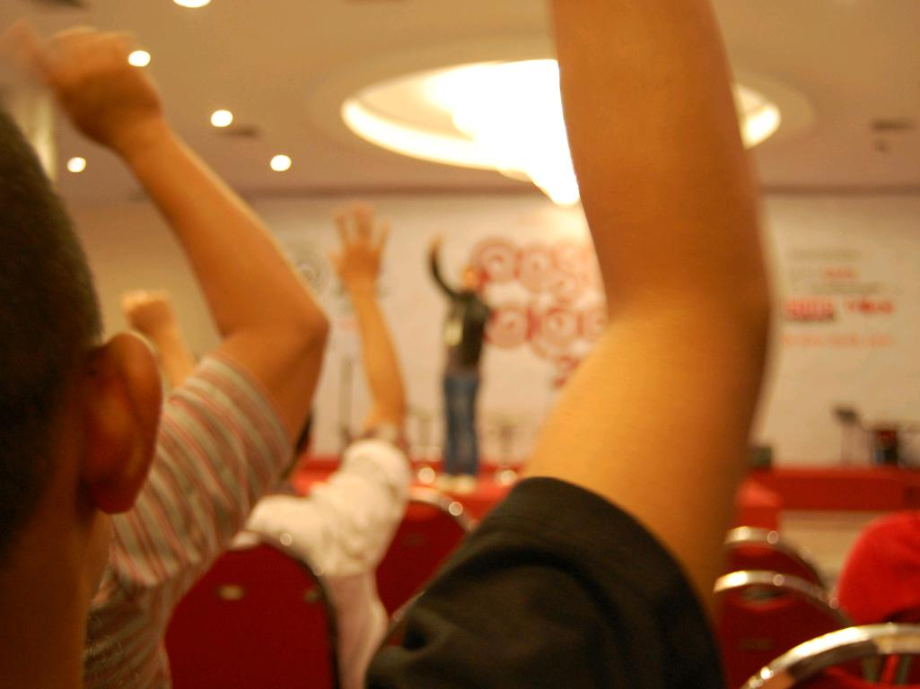
Questions?
cc: Ikhlasul Amal - https://www.flickr.com/photos/21372148@N00

