Slide 1
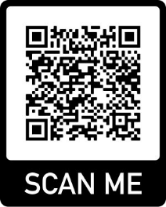
An Integrative Approach to Tier 1 Supports:
Balancing the Research & the Practice
Lindsay Butzer, MS, LSC Laketown Elementary, Waconia School Counselor, PBIS Coach
lbutzer@isd110.org
Megan Gruis, Ed.S., LSC Director of Implementation CharacterStrong megan@characterstrong.com

Slide 2
Let’s
Start Intentionally by Engaging Relationally!

Slide 3
The Path for Today
❏ Start Intentionally
❏ Common Language for the work
❏ The Tier 1 Recipe for integration
❏ Integration brought to life at Laketown Elementary
❏ Exit Intentionally

Slide 4
Common Language
Deﬁnition of Integration
the act or process of uniting different things
to form, coordinate, or blend into a functioning or uniﬁed whole

Slide 5
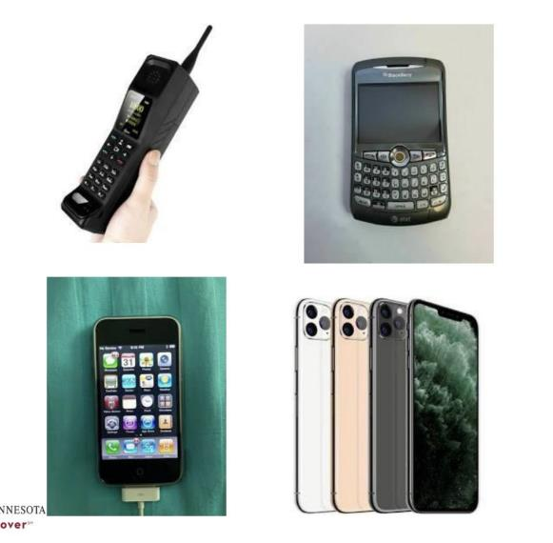
Integration

Slide 6
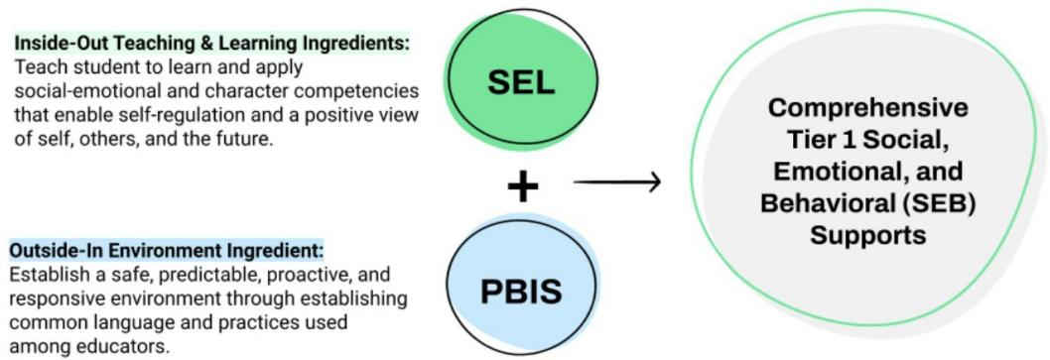
Integrated Prevention

Slide 7
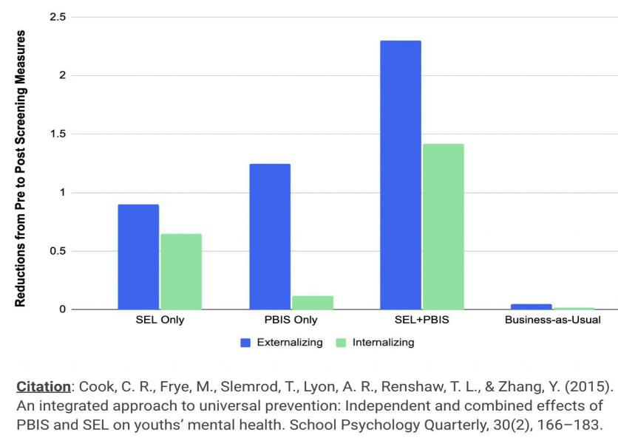
Integrated Prevention

Slide 8
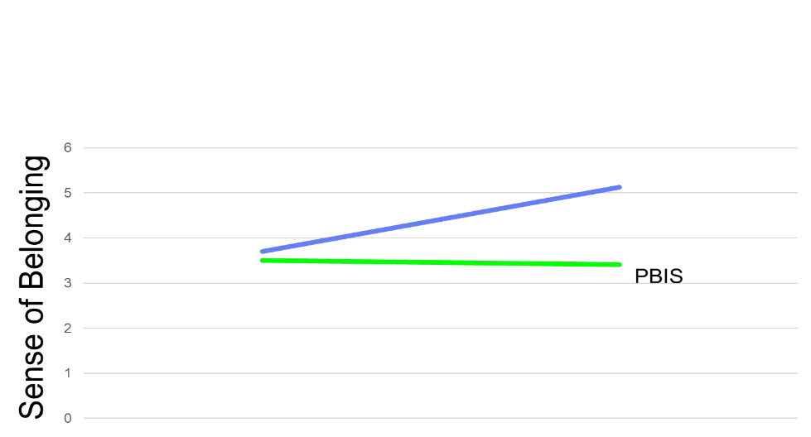
Integrated Prevention Graph
SEL+ EMR
SEL
Citation: Cook, C.R., Larson, M., Zhang, Y., *under review). Additive effects of combining relational practices with high ﬁdelity social-emotional learning programming. Prevention Science.

Slide 9
1 Common Language
Purposes of Tier 1
Prevent diﬃculties or problems from emerging in the ﬁrst place
Optimize and enhance success-enabling factors
Provide a solid foundation that enables more intensive interventions to work

Slide 10
2 Common Language
Tier 1
“Holistic Needs”

Slide 11
3 Common Language
Academic
Social Emotional
Physical
Behavior
Holistic Needs

Slide 12
4 Common Language
Tier 1
“Integration”

Slide 13
5 Common Language
Tier 1 Integration Deﬁnition
The intentional integration and high ﬁdelity implementation of social, emotional, behavioral, and academic supports that every student receives daily and consistently to be well, belong, and engage fully in learning experiences that cultivate critical competencies that enable students
to be life-ready.

Slide 14
6 Common Language
Outcome
what we want to achieve or happen on purpose as a result of what we do.

Slide 15
7 Common Language
What is a recipe?
a set of guidelines and instructions about how to combine ingredients together to produce speciﬁc outcomes of interest

Slide 16
8 Common Language
Ingredient
a component or part of a recipe that combines with other ingredients to produce an outcome

Slide 17
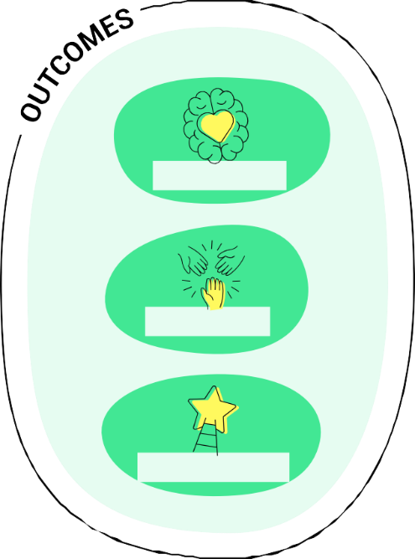
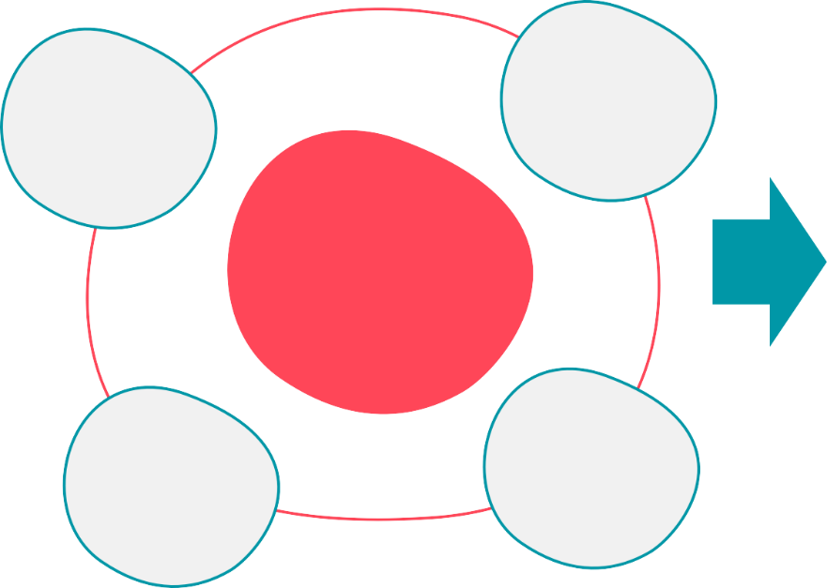
Social, Emotional Behavioral Supports
Tier 1 Recipe for LT
Empowerment
Relationships
Well-Being.
Tier 1 Recipe
Belonging
Teaching & Learning of SEL
Environment
Engagement

Slide 18
And the Survey Says
At Laketown Elementary
99% of parents report a welcoming environment
99% of parents feel supported by the school
96% of students report a sense of belonging
98% of students report at least 1 adult at school they are comfortable with
98% of parents say staff cares about future academic success of their children
97% of students report my teachers care about me
98% of students report having friends
97% of students are treated with respect
100% of staff feel supported by colleagues
100% of staff feel they are part of successful team

Slide 19
1 Social, Emotional Behavioral Supports
Tier 1 Recipe for LT
Empowerment
Relationships
Well-Being.
Tier 1 Recipe
Belonging
Teaching & Learning of SEL
Environment
Engagement

Slide 20
Safe
Nurturing Environments
Unsafe Unpredictable Reactive Exclusionary
Predictable
Proactive
Inclusive

Slide 21
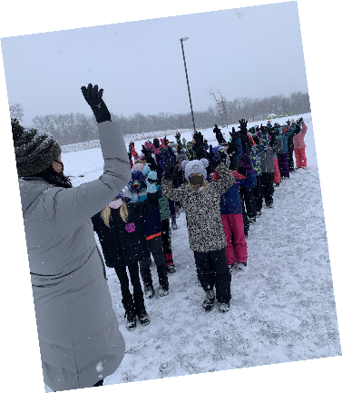
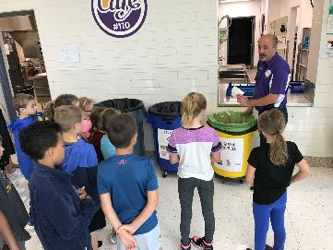
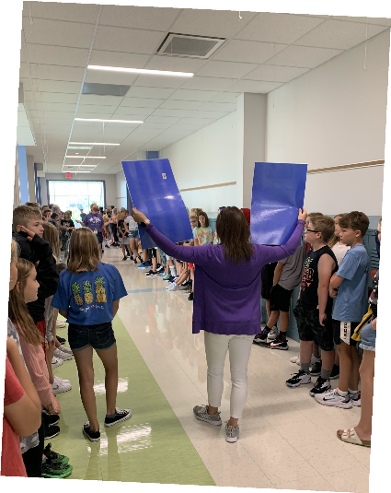
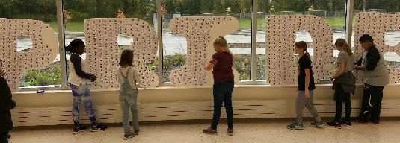
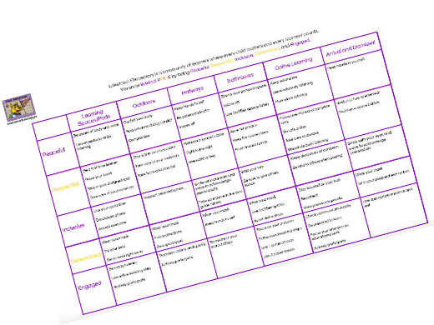
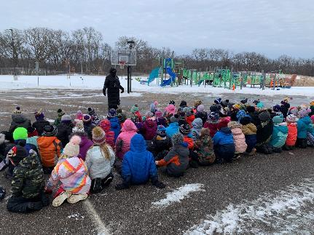
Environment
Engaging visuals for
students
Expectations taught by adults
that supervise
those areas

Slide 22
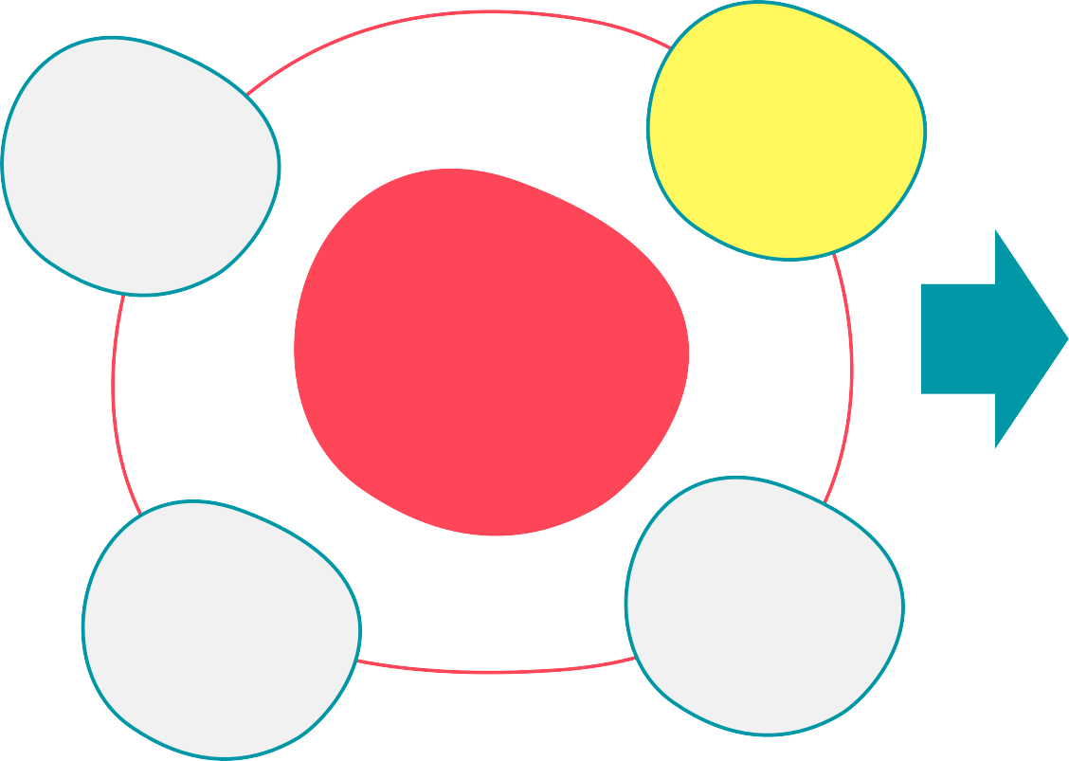
2 Social, Emotional Behavioral Supports
Tier 1 Recipe for LT
Empowerment
Relationships
Well-Being.
Tier 1 Recipe
Belonging
Teaching & Learning of SEL
Environment
Engagement

Slide 23
How Are They Doing?
●
Roughly half (52%)
of 6th – 12th graders say they enjoy
coming to school most of the time.
Disengagement leads to classroom management
challenges which, leads to
educator burnout.
Research shows that when students are given choice, they experience an increase in intrinsic motivation.
Effort, performance, and learning
all grow with choices.

Slide 24
3 Keys Empowerment
3 Keys Empowerment
Voice &
Choice
With them vs.To Them
Agency &
Hope

Slide 25
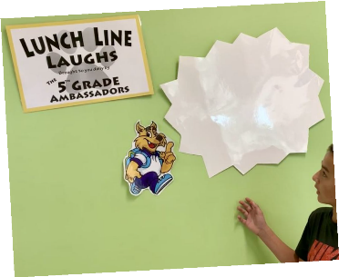
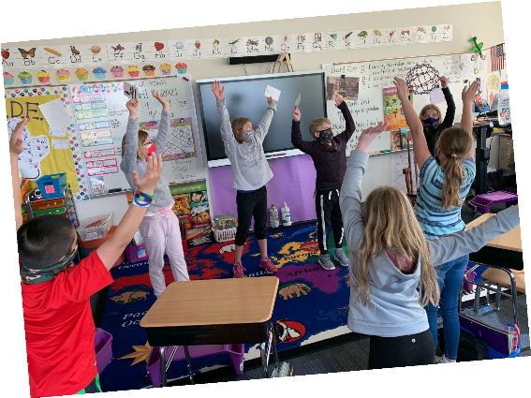
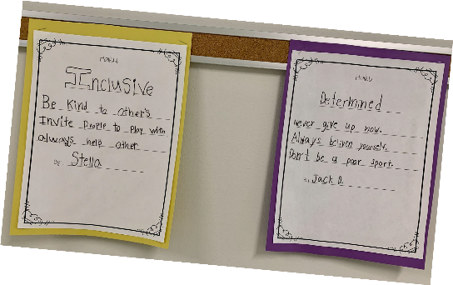
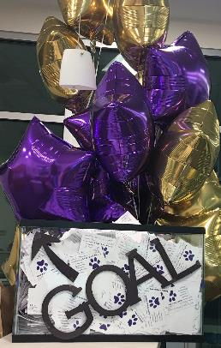
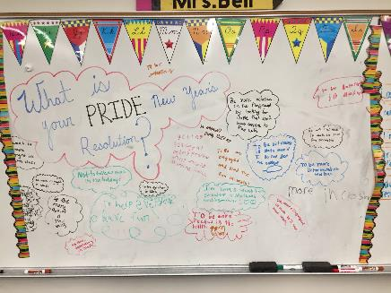
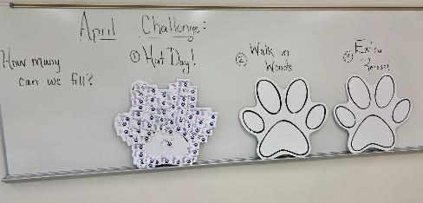
Empowerment
Student led MoveMindfully brain breaks
5th Grade Ambassadors
PRIDE behavior expectations
Embedded in daily experiences
Student voting and
choice in incentives

Slide 26
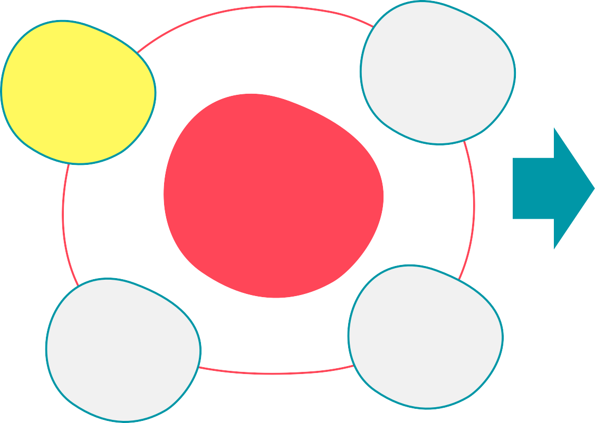
3 Social, Emotional Behavioral Supports
Tier 1 Recipe for LT
Empowerment
Relationships
Well-Being.
Tier 1 Recipe
Belonging
Teaching & Learning of SEL
Environment
Engagement

Slide 27
Relationships
98% of educators believe that
relationships
are an essential
ingredient to educational success.
Less than 40% of educators
have common
language and dedicated practices they use to intentionally maintain healthy relationships with all students.

Slide 28
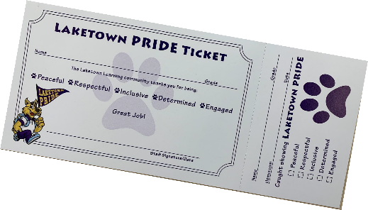
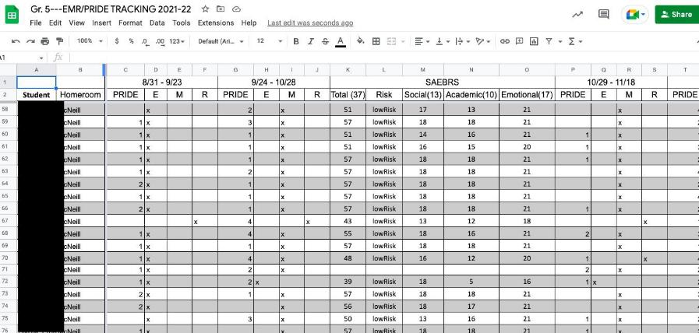
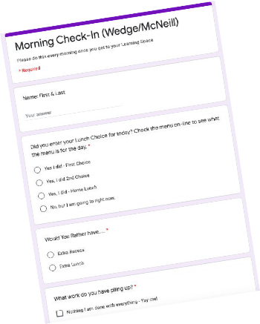
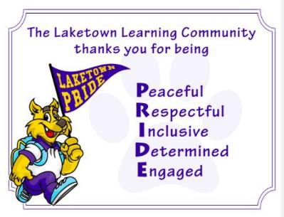
Relationship Visuals
EMR tracking system
Positive reinforcement
tracking to catch
students in restore
Daily Google Forms
Check-in

Slide 29
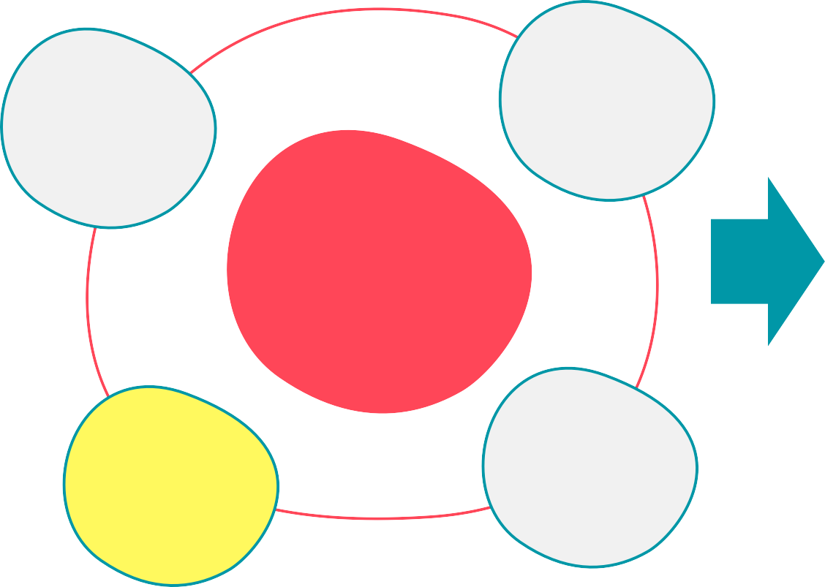
4 Social, Emotional Behavioral Supports
Tier 1 Recipe for LT
Empowerment
Relationships
Well-Being.
Tier 1 Recipe
Belonging
Teaching & Learning of SEL
Environment
Engagement

Slide 30
What is SEL?
SEL is the process
through which all young people and adults acquire and
apply the knowledge, skills, and attitudes to develop healthy identities, manage emotions and achieve personal and collective goals, feel and show empathy for others, establish and maintain supportive relationships, and make responsible and caring decisions.

Slide 31
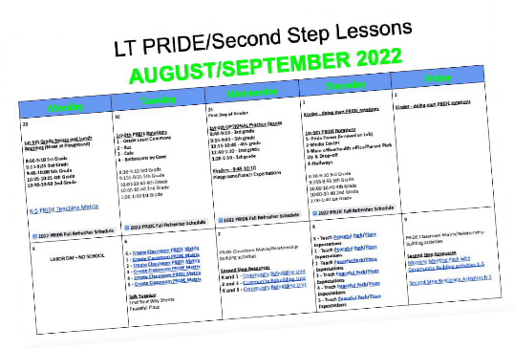
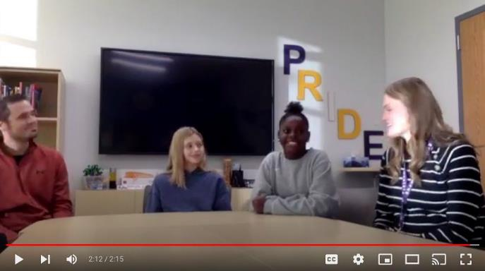
Teaching & Learning of SEL
MoveMindfully initiative to
bring mindfulness into SEL
Weekly school-wide video
teaching
reinforcing Second Step and
PRIDE skills
Second Step curriculum pacing calendar taught by all classroom teachers

Slide 32
Question: How do effective teams promote integrated implementation?
Answer: Create systems of support for staff
Implementation Leadership Team
Establish shared priorities & commitment
Protected time reﬂection, collaboration & planning
Create ongoing professional learning
Provide cues & reminders
Recognize & acknowledge staff
Gather ﬁdelity & provide feedback
Promote staff well-being & psychological safety
Boost collective eﬃcacy

Slide 33
Exit Intentionally
2-1
2
1
Things You Learned
Commitment

Slide 34
Questions

Slide 35
1 An Integrative Approach to Tier 1 Supports:
Balancing the Research & the Practice
Lindsay Butzer, MS, LSC Laketown Elementary, Waconia School Counselor, PBIS Coach
lbutzer@isd110.org
Megan Gruis, Ed.S., LSC Director of Implementation CharacterStrong megan@characterstrong.com

