Slide 1
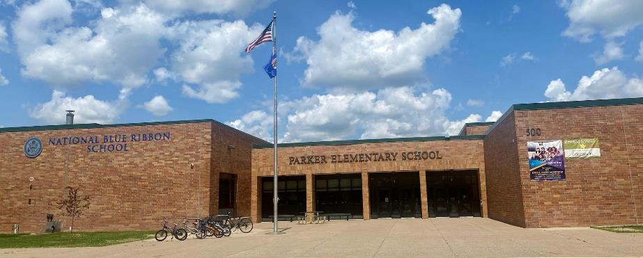
Parker Elementary
ISD 728
(Elk River, Otsego, Rogers, Zimmerman)
Jess Becker
Intervention Specialist
PBIS Coach
Notes:
Change anything you want here

Slide 2
Parker Elementary
Parker Elementary School (K-5)
Roughly 500 students
1 of 10 elementary schools in ISD 728
2016 Blue Ribbon School

Slide 3
Data Sources
SWIS
Behavior Data
Campus
Academic Data
Attendance Data
EduClimber (New to our district this year)
Academic Data- imported from multiple sources
Attendance Data- imported from Campus
Behavior Data- imported from SWIS

Slide 4
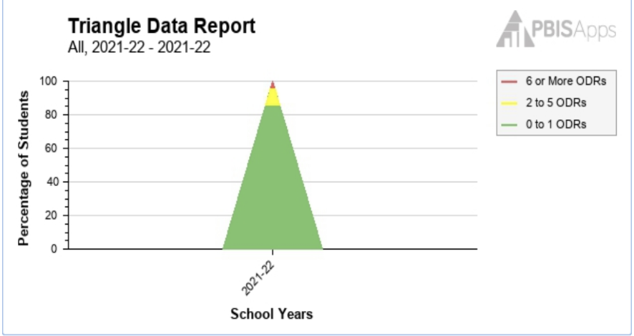
10,000 Foot View

Slide 5
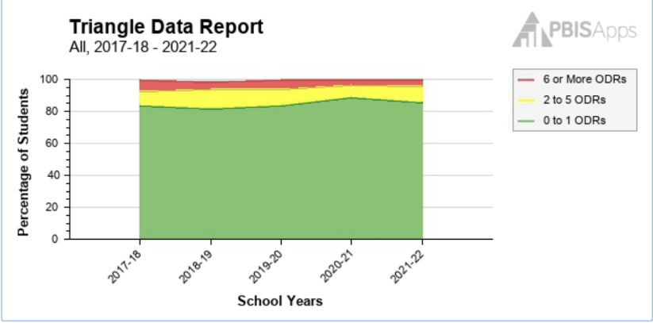
5,000 Foot View

Slide 6
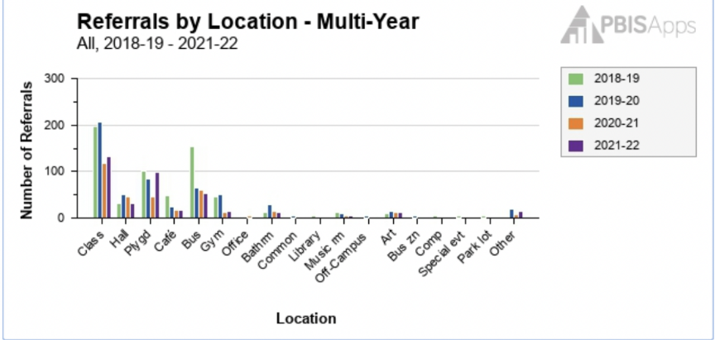
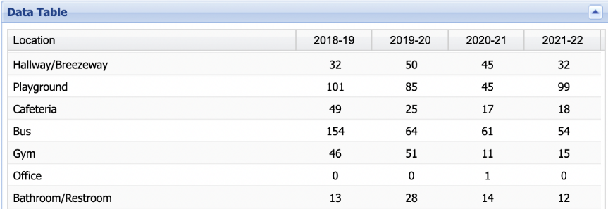
Glow & Grow

Slide 7
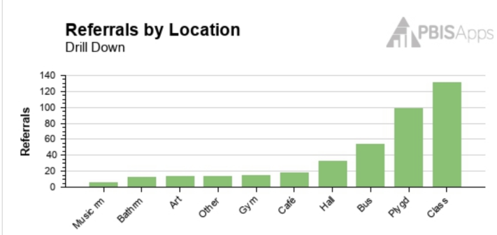
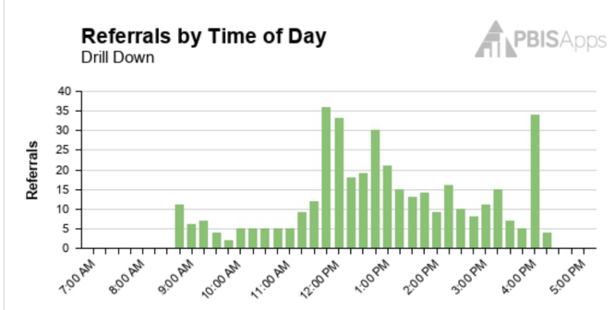
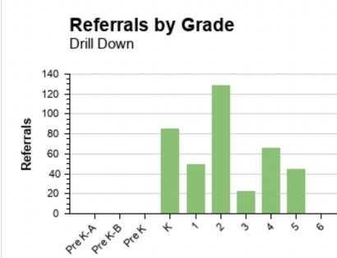
Bird’s Eye View

Slide 8
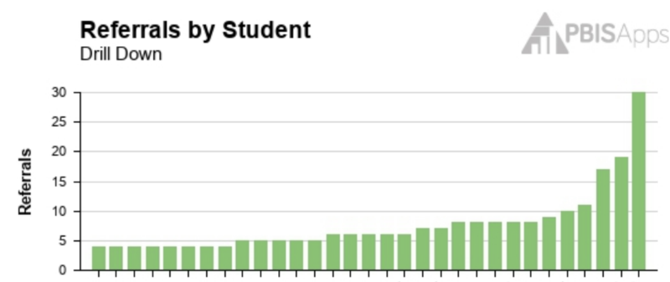
Ground Level View

Slide 9
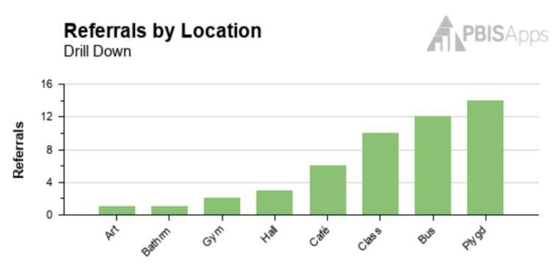
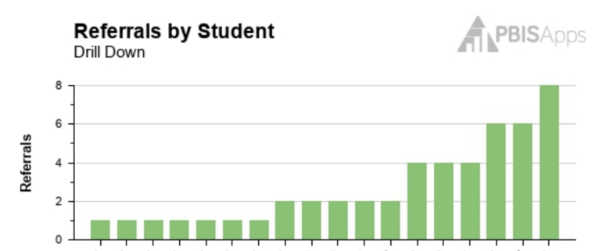
PLC Collaboration

Slide 10
PBIS Team Collaboration
TFI
(Tiered Fidelity Inventory)
SWIS Data
SAS
(Self Assessment Survey)

Slide 11
Next Steps
Action Planning Steps
Summer PBIS Meeting
Behavior Interventions with District Behavior Analyst
PBIS Summer Trainings

Slide 12
Contact Information
Jess Becker
Parker Elementary
Intervention Specialist
763-241-3400 ext 5244
jessica.becker@isd728.org

Slide 13
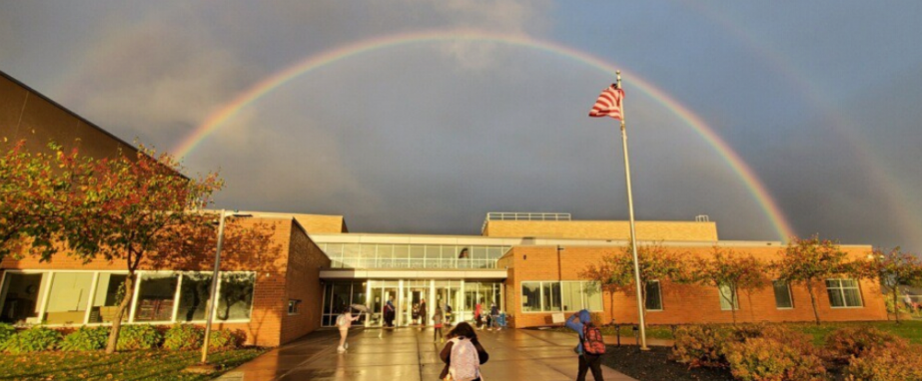
Isanti Intermediate School & School For All Seasons
Cambridge-Isanti School District
Mark Ziebarth
Principal
Notes:
Change anything you want here

Slide 14
About our School
Isanti Intermediate (grades 3-5)
Roughly 400 students
15 class sections
School For All Seasons (grades K-5)
STEAM focused optional program
Housed at IIS site
Roughly 150 students
6 class sections
Both schools share common spaces, support staff (principal, counselor, specialists, etc.), and the PBIS team!

Slide 15
Variety of Data Sources
Skyward Data
Attendance
Behavior
Academics (only report card grades K-5)
SAEBRS - behavior screener
Observational Data

Slide 16
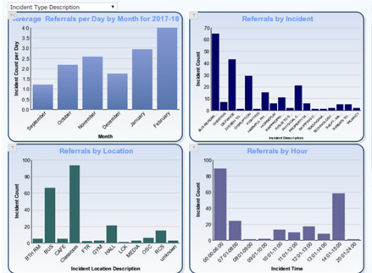
Skyward & Data Studio - Our Data Collection System
All of our office discipline referrals are entered into Skyward.
Graphs are accessible is Skyward, but we found them difficult to use for digging deeper into the data.

Slide 17
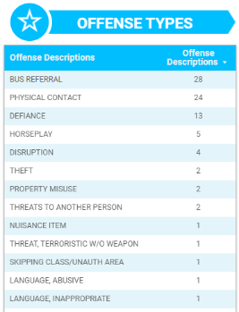
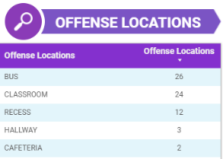
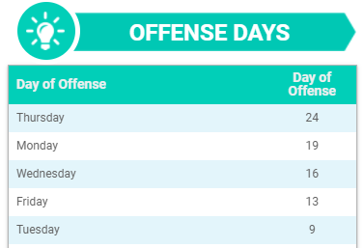
Skyward & Data Studio - Our Data Collection System 2
The Skyward information is pulled nightly and feeds into Google Data Studio. In Studio, we are better able to drill down into our data.

Slide 18
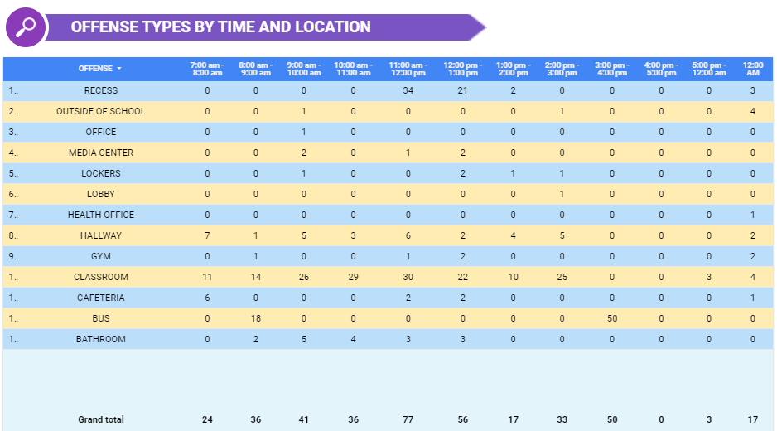
Offense types by time and location

Slide 19
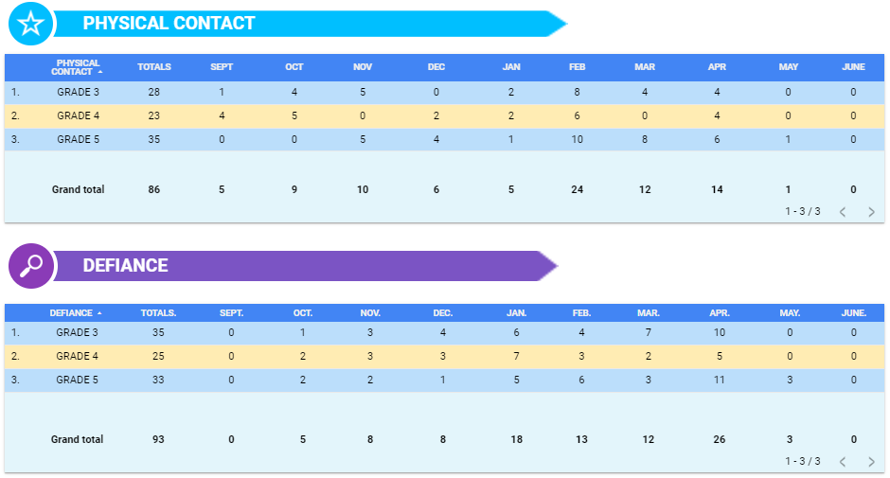
Physical contact and defiance
Notes:
Top two offenses by month and grade

Slide 20
So, your team has all of this data…
Now what??

Slide 21
“ Identify your problems but give your power and energy to solutions.”
- Anonymous

Slide 22
Using the Data
Our PBIS team starts most meetings with a data review that begins with these questions:
What do we notice?
What do we wonder?
What information do we need?
What could be our next steps?
Example from our PBIS team notes:

Slide 23
Solutions Focused
Dig into the data for more specifics.
Who, what, where, when, and why
What guidance lesson could support this?
Increased ODRs
Anxiety amongst students
Issues at bus dismissal
Bus referrals
Wrote a grant to create a Calming Room and then expanded that into having Calming materials in each classroom
Change to having all teachers walk their classes out at the end of the day
Reviewing Bus Safety expectations with all students.
District made changes to busing - moved to a tiered system

Slide 24
Sharing Data with Staff
Data is shared with staff in a variety of ways:
Emails
Faculty Meetings
Professional Development days
What did our data tell us about students’ behavior at IIS/SFAS?
What are areas that we can positively impact?
What are things we can do in the classroom?
What are things we can do as a building?

Slide 25
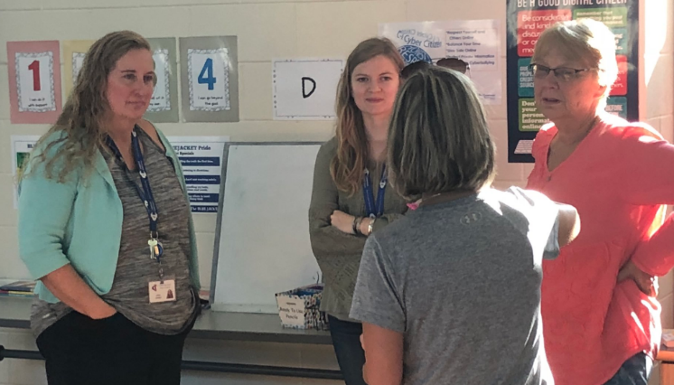
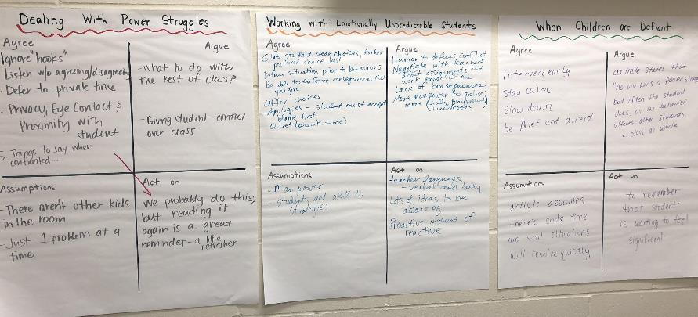
Addressing an Identified Issue and Learning Together
Notes:
Our ODR data and observational data from teachers all lead to defiance being an area of concern. We used that as an opportunity to work together as staff. We reviewed some articles around the topic, did some group processing, and then sharing out of conclusions.

Slide 26
Contact Information 2
Mark Ziebarth
mziebarth@c-ischools.org
Twitter: @IISSFAS

