Slide 1
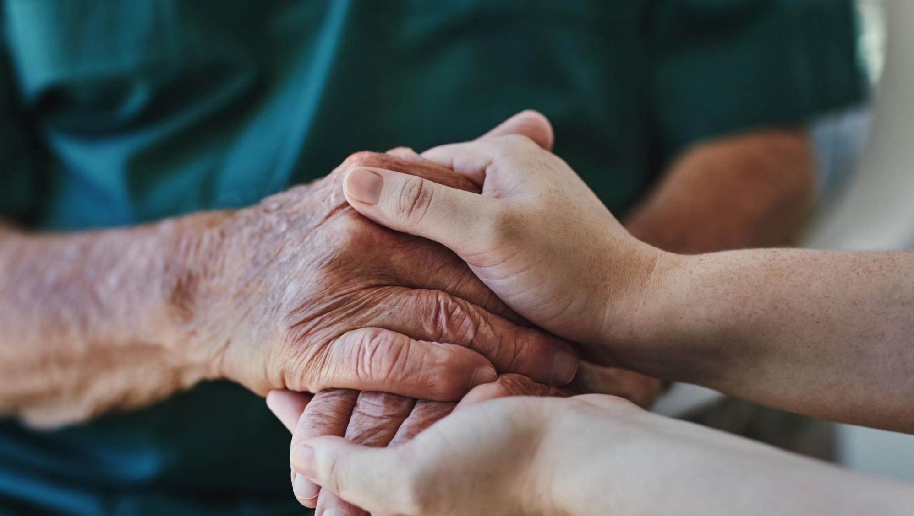
Rethinking Trauma-Informed Care to Support Sustainable Wellness
By Brandon Jones, M.A.
Executive Director
Minnesota Association for Children’s Mental Health (MACMH) & Consultant

Slide 2
Trainer: Brandon Jones, M.A.
Executive Director of Minnesota Association for Children’s Mental Health
A Professor, Consultant, and former Psychotherapist
B.A. in Sociology from the University of Minnesota, a Masters in Community Psychology from Metropolitan State University, and a Masters in Psychotherapy (MFT) from Adler Graduate School
2013 Bush Foundation Leadership Fellow

Slide 3
My Goal for Today
My only Goal of the day is to get you to Shift your Lens
Expand your Worldview
Disrupt Your Current Thought Process.
Provide some Context

Slide 4
Worldview Defined:
A particular philosophy of life or conception of the world.

Slide 5
Worldview Dynamics
Influences
Experiences

Slide 6
Stress During COVID-19

Slide 7
Welcome to the New Normal…
We Are Adjusting To A New World In The Moment
Remote Working
Distant Learning
Social Distancing
Sheltering In Place
Pandemics
Personal Protection Equipment (PPE)
Variants
Vaccines
Booster Shots!

Slide 8
WE ARE IN A STATE OF GRIEF!
WE HAVE LOST THE FOLLOWING…
Access
Our “Normal” Routine
The Ability Of Choice
Connection
Opportunities
Lives Of Loved Ones
THIS IS WHAT WE CALL AMBIGUOUS LOSS

Slide 9
Grief and Ambiguous Loss
The natural emotional response resulting from a significant loss.

Slide 10
Managing Grief and Ambiguous Loss

Slide 11
Languishing
Languishing is a sense of stagnation and emptiness. It feels as if you’re muddling through your days, looking at your life through a foggy windshield. And it might be the dominant emotion of 2021.
—According to the New Times

Slide 12
Understanding Stress and Distress
Stress: Is both experienced shared with others (objective reality) but also perceptions experienced within the body and mind (subjective reality).
Distress: Describes a person’s internal state of dysregulation and often, disorganization: what is happening to me right now is dangerous.

Slide 13
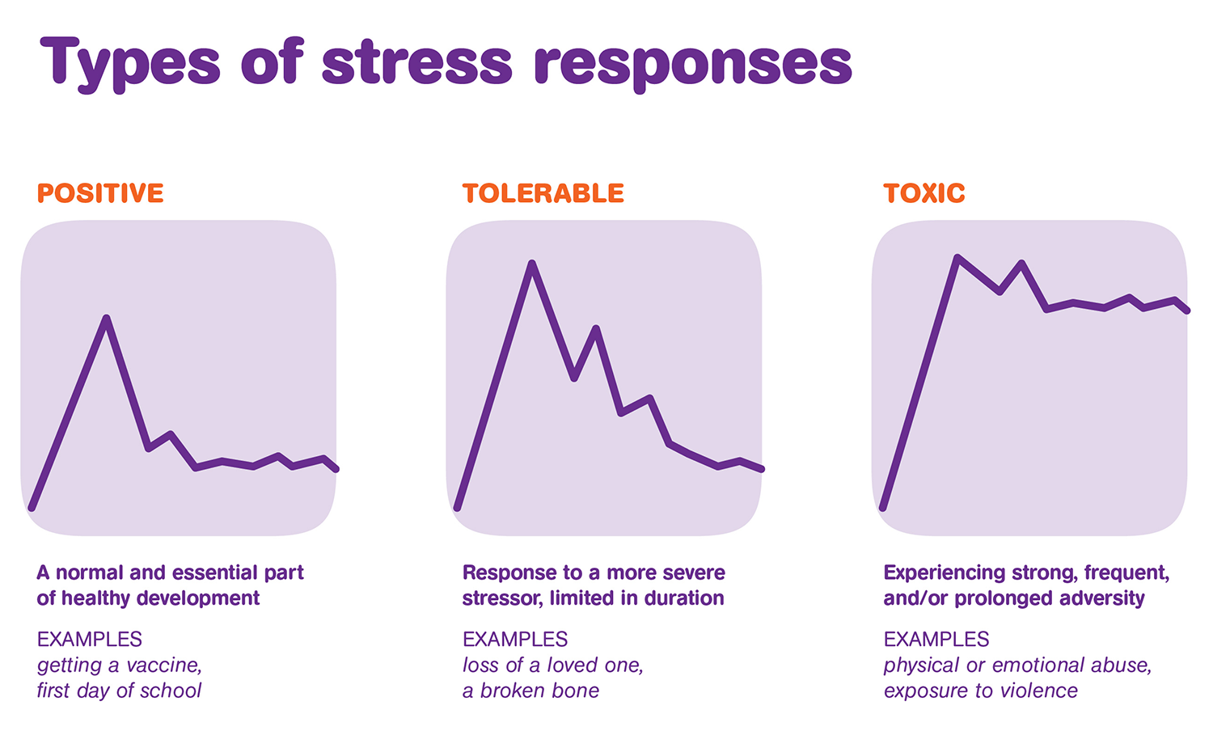
Types of stress responses

Slide 14
Normal reactions to stress
How do we recognize this?
Causes of stress can be:
Internal – arising from within the individual
External – arising from the external events and demands
The effects of stress can be:
Physical
Psychological
Behavioral
Cognitive

Slide 15
A DEEP EMOTIONAL WOUND!
closely connected to Toxic Stress or Toxic Environments

Slide 16
What is Trauma Informed Care
TIC is a strengths-based service delivery approach “that is grounded in an understanding of and responsiveness to the impact of trauma, that emphasizes physical, psy­chological, and emotional safety for both providers and survivors, and that creates opportunities for survivors to rebuild a sense of control and empowerment”.
(Hopper, Bassuk, & Olivet, 2010, p. 82)

Slide 17
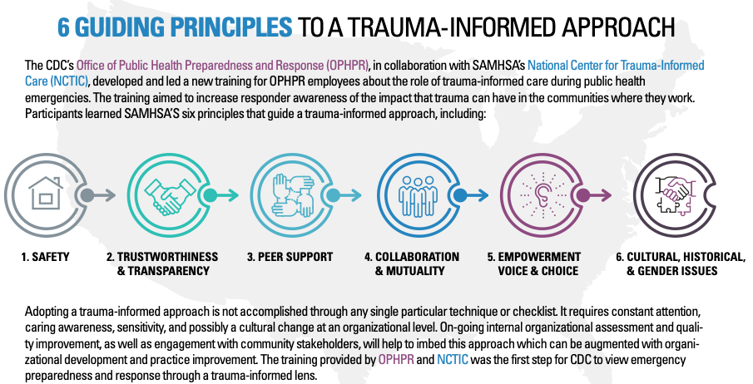
6 Guiding Principles

Slide 18
Hands holding a heart
Adopting a trauma-informed approach is not accomplished through any single technique or checklist. It requires constant attention, caring awareness, sensitivity, and possibly a cultural change at an organizational level.

Slide 19
How Trauma makes an Impact
Individuals who have survived trauma vary widely in how they experience and express traumatic stress reactions.
Traumatic stress reactions vary in severity; they are often meas­ured by the level of impairment or distress that young people report and are determined by the mul­tiple factors that characterize the trauma itself, individual history and characteristics, developmental factors, sociocultural attributes, and available resources.

Slide 20
How Trauma Impacts an Individual’s Worldview
The characteristics of the trauma and the subsequent traumatic stress reactions can dramatically influence how indi­viduals respond to the environment, relationships, interventions, and treatment services, and those same characteristics can also shape the assumptions that individuals make about:
Their world (e.g., their view of others, sense of safety)
Their future (e.g., hopefulness, fear of a foreshortened future)
Themselves (e.g., feeling resilient, feeling incompetent in regulating emotions).

Slide 21
How are we adjusting?

Slide 22
3 Conditions Related to the Impact of Stressors
Secondary Traumatic Stress: Characterized by the presence of PTSD symptoms caused by at least one indirect exposure to traumatic material.
Compassion Fatigue: described as the “cost of caring” for others in emotional and physical pain. Characterized by pronounced change in helper’s ability to feel empathy for patients, loved ones and co-workers.
Burnout: Characterized by emotional exhaustion, depersonalization and a reduced feeling of personal accomplishment.
Notes:
STS: Several other terms capture elements of STS but are not all interchangeable with it.
Compassion Fatigue has been described as the “cost of caring" for others in emotional and
physical pain. (Figley, 1982) Comes from continual exposure to hearing trauma and hardship stories and having some sense of responsibility to help. It is characterized by deep physical and emotional exhaustion
and a pronounced change in the helper’s ability to feel empathy for their patients, their loved
ones and their co-workers. It is marked by increased cynicism at work, a loss of enjoyment of
our career, and eventually can transform into depression, secondary traumatic stress and
stress-related illnesses. The most insidious aspect of compassion fatigue is that it attacks the
very core of what brought us into this work: our empathy and compassion for others.
Burnout: Result of occupational stress, not used to describe the effects of indirect trauma exposure specifically. The term comes from the 70’s term from the drug counseling community. A drug addict at the point of burnout could care little about anything except drugs, experienced a slow or fast deterioration of motivation and competence. In the 80’s became a popular way to consider exhaustion and disquiet at work.

Slide 23
Secondary Traumatic Stress
is the emotional duress that results when an individual hears or shares elements of the firsthand trauma experiences of another.

Slide 24
Secondary Traumatic Stress Symptoms
Hypervigilance
Re-experiencing
Hopelessness
Professional helplessness
Guilt
Avoidance
Social withdrawal
Minimizing
Cynicism/anger
Sleeplessness
Insensitivity to violence
Illness
Fear
Depersonalization
Connected to act of hearing/empathizing with traumatic stories

Slide 25
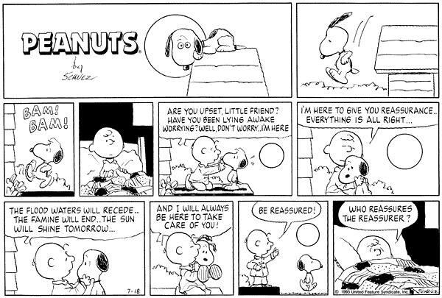
Compassion Fatigue Illustration
Notes:
Emotional exhaustion
Reduced sense of personal accomplishment
Mental exhaustion
Depersonalization
Decreased in sense of efficacy
Physical exhaustion
Connected to act of hearing/empathizing with traumatic stories
What protective factors does compassion fatigue attack?
sense of meaning and purpose, sense of efficacy

Slide 26
Compassion Fatigue
Emotional exhaustion
Reduced sense of personal accomplishment
Mental exhaustion
Depersonalization
Decreased in sense of efficacy
Physical exhaustion
Connected to act of hearing/empathizing with traumatic stories

Slide 27
Burnout Image

Slide 28
Burnout
Difficulty sleeping (particularly on Sundays)
Avoidance of work-urge to take a sick day
Difficulty concentrating and finishing tasks
Feeling overwhelmed by the workload
Sense of inadequacy to handle the tasks assigned
Withdrawing from colleagues
General irritation toward work
Connected to work related stress

Slide 29
What Is Healing?

Slide 30
Healing is…
A consistent process of efforts to create peace, balance, and justice.

Slide 31
Why Do We Need Healing???
Life is Hard
We all Face Challenges
There is no guarantee that things will be okay.

Slide 32
What is Work-Life Balance in a Virtual World!?!?

Slide 33
Understanding Our Wellness Domains
From the U of M Center for Spirituality and Healing Center

Slide 34
Wellbeing Wheel
- Wellbeing Wheel -
Dimensions:
Environment:
Personal Environment
Relationship with Nature
Global Environmental Health
Health:
Diet & Nutrition
Physical Activity
Sleep
Thoughts & Emotions
Stress Mastery
Relationships:
Personal Relationships
Security:
Safety
Facing Fear
Relationship to Money
Purpose:
Life Purpose
Spirituality
Community:
Community Wellbeing
Additional resources available at https://www.takingcharge.csh.umn.edu/what-wellbeing
created by Dr. Mary Jo Kreitzer, used with permission
From the U of M Center for Spirituality and Healing Center

Slide 35
Shifting from Self-Care to Sustainable Wellness

Slide 36
Sustainability
Sense of Social Support
Sense of Meaning and Purpose
Sense of Effectiveness
Ultimately, Sustaining ability is being Proactive in our self care.
Notes:
Leading protective factors for sustainability and well being.
Tell your neighbor why you originally chose to work in education? What brought you to this field and why are you still here?

Slide 37
Components of successful sustainability
Individual activities (physical activity, spirituality, mindfulness, meditation, therapy, humor, healthy eating,)
Activities with closest connections (fun, sharing, exploration, adventure, quality time)
Meaningful support at work (supervision, team building, ongoing assessments, accountability, learning opportunities)
Support within the field (professional development, connections for consult)
Notes:
Sustainability suggests more maintenance, less running all the way down to empty and then refilling.
The trap of self care:
Often think of self care as some activity to add what you are already doing: go to the gym, eat a healthier diet etc. We talk to ourselves about what we should do and feel guilt and failure when we cannot add these activities to our already busy lives. Sustainability suggests finding places/ways/opportunities for self care and replenishing that are available to us within the lifestyle we are living.
The Professional Greenhouse at Work-Slide
Professional Social Support
Being professional and playful
The “good enough professional”
Leadership that promotes balance between giving to others and caring for the self
NOTES
Cant wait for the rescue, for others to create a positive work environment. Do what you can do in your realm of the world. RELATIONSHIPS
Professional venting vs chronic complaining and negativity. Negativity weakens one’s ability to hopeful to students and collegues
Find ways to have fun and laugh with students, colleagues and yourself
Impossible to perform at the 100% level 100% of the time. The life of a school professional has no boundaries; there is always more to do

Slide 38
Sustainability is the best self care
Principles
Balance your work and leisure time
Prioritize the way in which you spend your time – do not allow others to waste it
Control interruptions
Allow time for thinking and the unexpected
Delegate work whenever it is appropriate
Be assertive – learn to say “no” both to unnecessary work and to taking on other people’s tasks
Put past mistakes behind you – do not dwell on them
Review significant problems and learn to manage them better – make realistic action plans

Slide 39
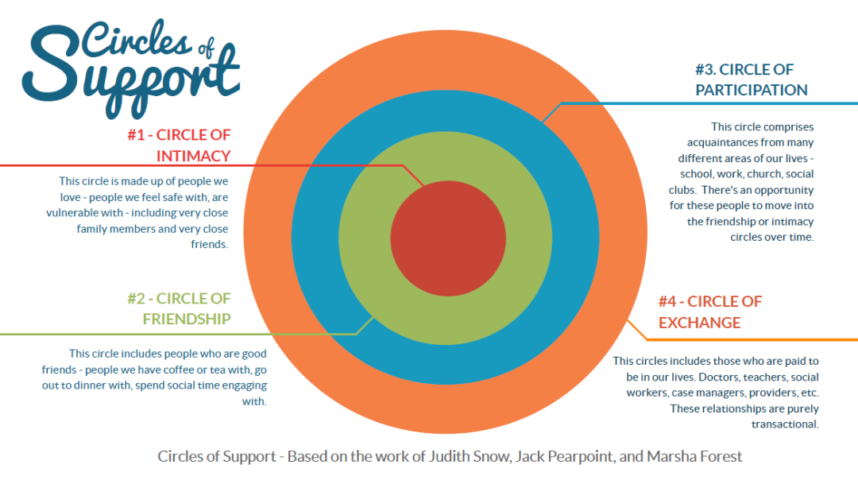
Circles of Support

Slide 40
Post Traumatic Growth
Where do we go from here?

Slide 41
PTG definition
Post-traumatic growth is positive psychological change experienced as a result of adversity and other challenges in order to rise to a higher level of functioning.
Ultimately, Post Traumatic Growth highlights the benefits of emotional growth, stronger relationship bonds, and a different perspective on life.

Slide 42
5 Domains of PTG

Slide 43
Personal Strength
Trauma often leads to Self-doubt
Recognizing your ability to handle challenges
Increase your sense of capacities to survive and prevail
We must believe in our possibilities

Slide 44
Healthy Relationships
Finding supports and networks to help you move forward
Set strong boundaries and let your expectations be known.
Being afraid of being vulnerable is a major obstacle

Slide 45
Appreciation and Purpose of Life
Understand what is important to you. What are the things you value and why?
Do things that lead to a purpose.
Small victories

Slide 46
Consecutive Constructive Choices
Do not be afraid of new experiences. Explore new information, spaces, people
Exposure and Consistency are key
Have some compassion for yourself

Slide 47
Personal Development
Do not be afraid of finding out who you truly are or who you want to be.
What are you investing in yourself?
Are you keeping it real with yourself?

Slide 48
Post Traumatic Growth Process
The process of post-traumatic growth can lead to improved relationships with others, more compassion, openness, appreciation for life, spiritual growth, personal strength, and a renewed sense of possibilities in the world.

Slide 49
Resiliency
RESILIENCY
Resiliency is a quality that can help you recover from early life experiences and deep emotional wounds.
The ability to “bounce back” or adapt in the face of adversity or major life stress.
Everyone has an ability to be resilient and to become even more resilient.
Notes:
Give out 24 signature strengths
Homework: to take the strengths finder and identify top 5 strengths
Consider a recent challenge and what resilient qualities you used to overcome this challenge- ask a friend, trusted adult, family member if you need some feedback.
Identify at least 2 supportive people you can call on and hap teachers and staff can turn to with your permission to help you accomplish your goals

Slide 50
Please Remember
Healing is a Journey!

Slide 51
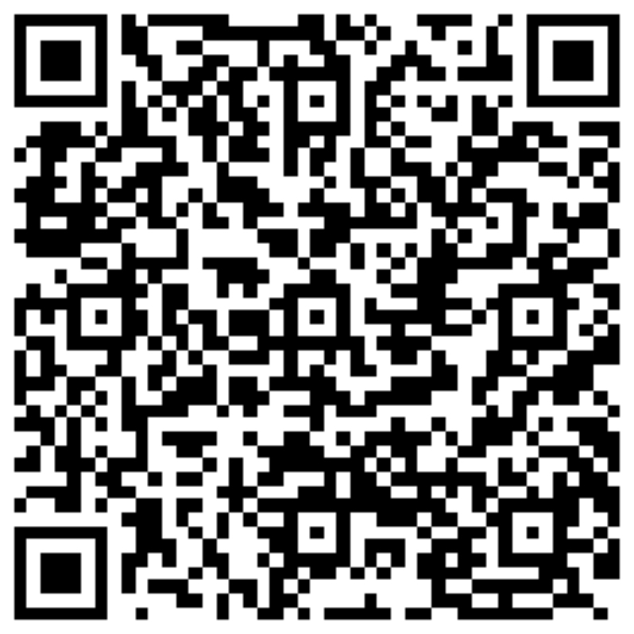
Contact Information
Brandon Jones, M.A.
Email: brandon@jegna.org
Website: www.Jegna.org

Slide 52
Citations
Brave Heart, M.Y.H. (2011). Welcome to Takini’s historical trauma. Historical Trauma. Retrieved from http://historicaltrauma.com/
Brislin, R.W. (2001). Understanding culture’s influence on behaviors (2nd ed.). Ft. Worth, TX: Harcourt.
Cutler, M. (n.d.). Multigenerational trauma: Behavior patterns in cultures [PowerPoint slides]. Retrieved from http://edweb.boisestate.edu/instituteforthestudyofaddiction/pp/Historical_Trauma_and_Grief.ppt
Child Welfare Information Gateway, Children’s Bureau, FRIENDS National Resource Center for Community-Based Child Abuse Prevention, and the Center for the Study of Social Policy- Strengthening Families. (2011). Strengthening families and communities: 2011 resource guide. Washington, DC: U.S. Department of Health and Human Services, Children’s Bureau. http://www.childwelfare.gov/preventing/preventionmonth/guide2011
Child Welfare Information Gateway (2015). Únderstanding the Effects of Maltreatment on Brain Development.” https://www.childwelfare.gov/pubPDFs/brain_development.pdf.
M. D. Madsen and N. Abell. “Trauma Resilience Scale: Validation of Protective Factors Associate with Adaptation Following Violence.” Research on Social Work Practice, 20, no. 2 (2010): 223-233
S. L. Bloom (2010). “Adverse Childhood Experiences Study and Allostatic Load.” http://www.sanctuaryweb.com/Portals/0/2010%20PDFs%20NEW/2010%20Bloom%20ACEs%20and%20Allostatic%20Load.pdf.
Stepleton, K., Mcintosh, J., & Corrington, B. (2010). Allied for better outcomes: Child welfare and early childhood. Center for the Study of Social Policy. http://www.strengtheningfamilies.net/images/uploads/images/(1.1)_Allied_for_Better_ Outcomes_(draft)_.pdf
Substance Abuse and Mental Health Services Administration-Health Resources and Services Administration Center for Integrated HealthSolutions. “Trauma.” Available at: http://www.integration.samhsa.gov/clinical-practice/trauma
https://www.cdc.gov/violenceprevention/acestudy Adapted by RYSE, 2016; updated, 2019
https://www.elsevier.com/connect/clinician-of-the-future

