Slide 1
2022 Minnesota PBIS Recognition Ceremony
June 16, 2022
11:35 am - 12:35 pm
Notes:
Welcome to the ceremony.
Today

Slide 2
Schedule of Events
Welcome and Opening Remarks
Message from the Minnesota Department of Education
History of Exemplar Schools and Districts - Eric Kloos, Janet Christensen
Presentation of 2022 Exemplar Schools & Districts - CELEBRATE!
Journey with St. Cloud Area School District
Closing Remarks - Erin Engness
Notes:
Today’s Agenda

Slide 3
Message from the Minnesota Department
of Education
Daron Korte

Slide 4
Assistant Director of Special Education Eric Kloos
Notes:
Janet introduces Eric Kloos

Slide 5
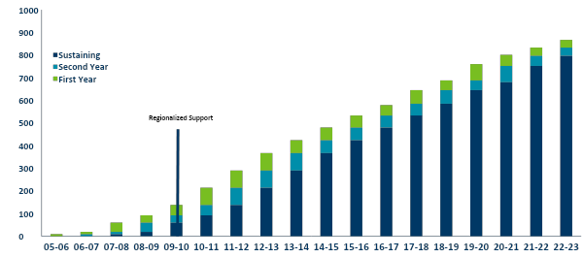
PBIS in Minnesota
2005-2022
867
Cohort 18
Recognition Music
Notes:
Eric Kloos continues and talks about exemplar districts - two categories
Fidelity measures and components

Slide 6
PBIS Exemplar Recognition
Exemplar Districts & Schools
Notes:
Eric Kloos continues and talks about exemplar districts - two categories
Fidelity measures and components

Slide 7
PBIS Exemplar School Recognition
Criteria for schools or programs:
Submitted application demonstrating sustained implementation of PBIS in the following areas:
Fidelity of Implementation
PBIS training
Leadership
Use of data in action planning
Collection Other work/outcomes
Sustainability practices
Giving back
Schools demonstrate fidelity of implementation as measured by the School-wide Evaluation Tool (SET), the Benchmarks of Quality (BoQ) or the Tiered Fidelity Inventory (TFI).
Overall SET score of 80 points or above
Overall BoQ score of 70 point or above
Overall TFI score of 70 points or above

Slide 8
District Recognition Criteria
There are two levels of recognition
at the district level
Districts that have demonstrated exemplar district capacity with over 60% of schools implementing SW-PBIS with fidelity as measured annually.
Districts that are in progress towards sustaining implementation and have multiple schools measuring fidelity annually.
District PBIS Recognition, districts demonstrate their capacity to support schools in their district to implement SW-PBIS
Coordination
Training
Coaching
Evaluation

Slide 9
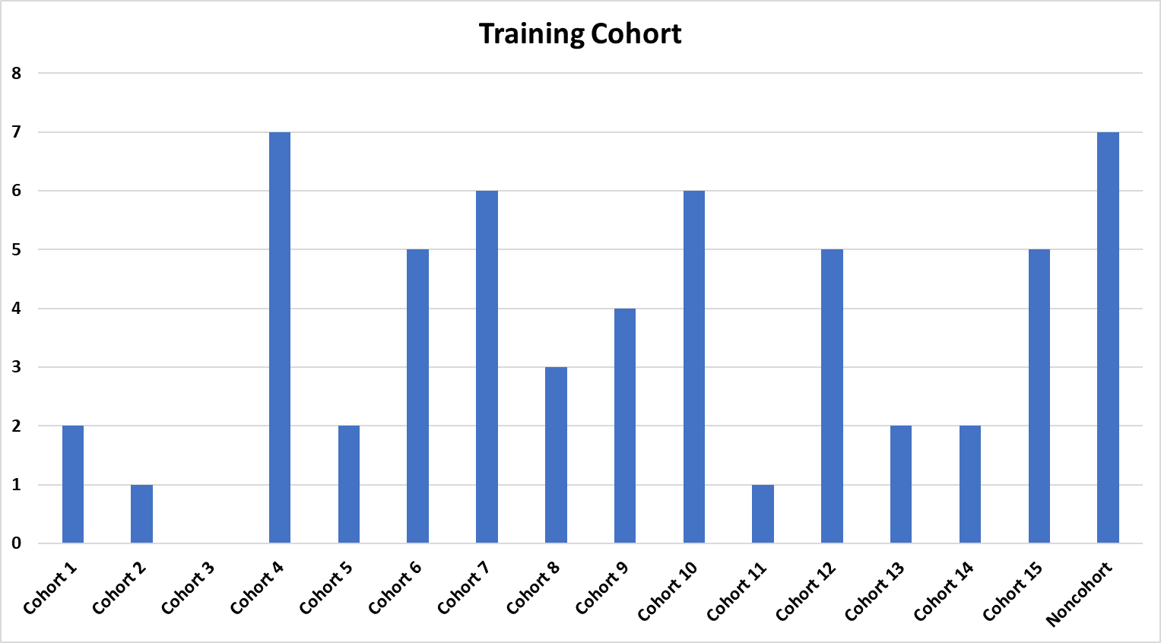
Minnesota PBIS Recognition Schools
Who are they?
Notes:
TJ updated
This is the exemplar schools - cohort and non-cohort breakdown-data in ceremony google folder
Eric will close out and hand over to Janet

Slide 10
2022 Minnesota PBIS Recognition
Districts and Schools
Districts
5 Districts Total Applied
3 Districts met criteria for exemplar status
2 District are Progressing toward
exemplar status
Schools
58 Total schools applied and met criteria for sustaining exemplar school recognition
North | Metro | South
2 | 1 | 0
North | Metro | South
0 | 1 | 1
North | Metro | South
22 | 26 | 10

Slide 11
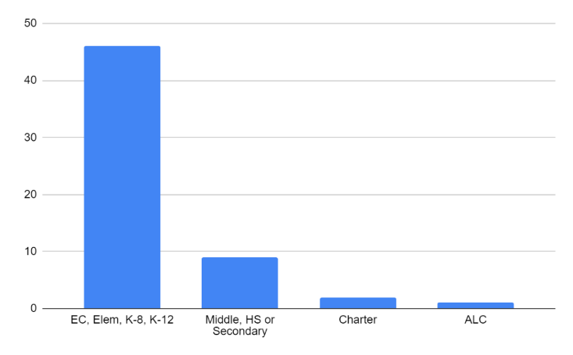
Exemplar School Classification
Schools: 58 schools or programs applied and met criteria (Cohort or Non-Cohort Coordinated District Training)
46 – Early Childhood, K-12 Elementary schools or programs
9 – Secondary-level schools Middle/Junior and/or High School
1 – State-Approved Alternative Programs
3 – Charter

Slide 12
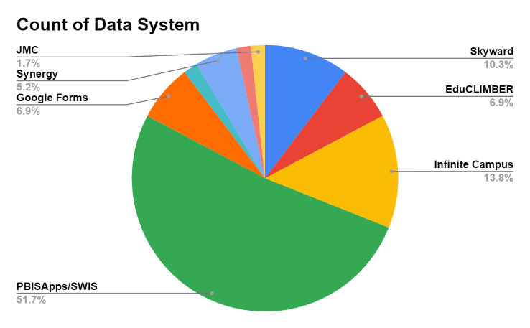
Data System used to Inform Decisions
How do they collect data?
Data for Decision-Making
PBIS Apps/SWIS
Infinite Campus
Skyward
Notes:
Campus and Infinite Campus as usually referred to the same system
SWIS and PBISapps are also likely referring to the same system

Slide 13
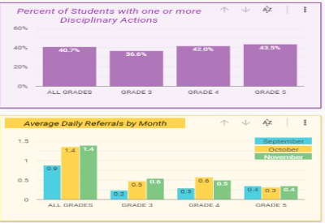
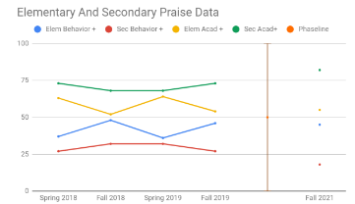
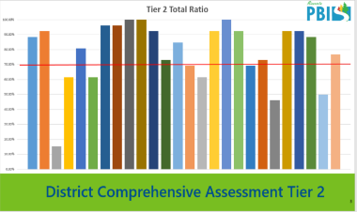
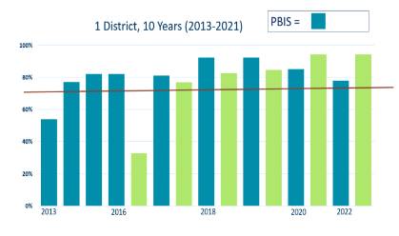
Outcomes and Improving Results
District building walkthroughs improving proactive engagement with students
Identified students multiple referrals implemented student support plans
24% of referrals take place in the hallway Implemented stronger Active supervision before & after school
and between classes
Goal: Lower Racial Disparities in ODRs
Climate & Culture Goal: Lower the disparities in behavioral data of Black and African American and 2 or more race
We will do this by: building relationships with community members, integrate restorative circles in Advisory time, focus on positive mindsets & improve responsiveness to racial harm situations
Measuring District PBIS Fidelity at Tier 2
Goal: improve student perception of feeling valued heard
Students reported: Not all students feel their teachers believe in them
1. Climate & Culture Goal: Increase percentage students who answered agreed or strongly agreed to the question
"Teachers in my school believe all students can learn and be successful” increase from 91% to 93%.

Slide 14
Exemplar Districts

Slide 15
Sustaining Exemplar
Three (3) districts are being recognized for Sustaining Exemplar District capacity:
Cambridge Isanti Schools, District 0911
Osseo Area Schools, District 279
St. Cloud Area School District 742
Two (2) districts are being recognized for Progressing Toward Sustaining Exemplar District Implementation:
Waterville-Elysian-Morristown School District 2143
Burnsville Public Schools, District 191

Slide 16
Cambridge - Isanti Schools
The District Team has participated in the District Capacity Assessment a number of times and have shown great growth from one assessment to the next. We have used the DCA results to further build our District and Building Level PBIS Teams.
Our DCA Results showed that we scored low on Coaching and the use of District Data for planning. As a result, our District PBIS Team spent the majority of the 21-22 SY developing a District Code of Conduct. We have also modified out Building Handbooks to include the new Code of Conduct expectations. This will allow us to have consistent data to view at our Distritric PBIS meetings. The District PBIS team is meeting in June to develop an implementation plan for training staff and to determine data recording plans for the 22-23 SY.
District: ISD #911
Cambridge - Isanti Schools
Region: North
Cambridge-Isanti Schools
Every Student, Every Day

Slide 17
Osseo Area Schools
The fidelity of implementation of tier 1 as evidenced by the recent TFI data across all schools is a reason to celebrate. Most of our schools are at or above the 70% implementation rate and continue to improve on fidelity of implementation at Tier 2 and 3 as well.
District: ISD #279
Osseo Area Schools
Region: Metro

Slide 18
St. Cloud Area School District 742
We are excited that we were able to train all of our coaches this year in our new data warehouse program Educlimber. All
coaches are able to look up their individual data, drill down, and filter results to plan with their building teams.
District: ISD #742
St. Cloud Area School District 742
Region: North

Slide 19
Burnsville - Eagan - Savage
School District 191
What we are most proud of is the fact that our buildings maintained their PBIS implementation throughout the past two years of Pandemic interruption.
We were able to reinstate our biannual building walkthroughs this school year and we found that many of
our data points were similar to the data points taken 2 years ago before the Pandemic. We were predicting that our data points would be lower due to these interruptions but we were pleasantly surprised to see that we didn't really lose much ground. We picked up right where we left off!
Many buildings were even able to grow in their PBIS implementation this school year. This shows the dedication of our staff to PBIS even when instructional methods were ever changing and when student behavioral concerns were rising as we all returned back to "traditional" school.
District: ISD #191
Burnsville - Eagan - Savage School District 191
Region: Metro

Slide 20
Waterville - Elysian - Morristown School District #2143
We are most proud of the reduction in behavioral referrals that have come from the newly implemented programs and
activities.
District: ISD #2143
Waterville - Elysian - Morristown School District
Region: South

Slide 21
Districts Recognized - Congratulations!
Burnsville-Eagan-Savage School District 191
Cambridge-Isanti Schools ISD 911
Osseo Area Schools 279
St. Cloud Area School District 742
Waterville-Elysian-Morristown School District #2143

Slide 22
Exemplar Schools - North
Notes:
Janet introduce Erin
Erin says a few words about the north

Slide 23
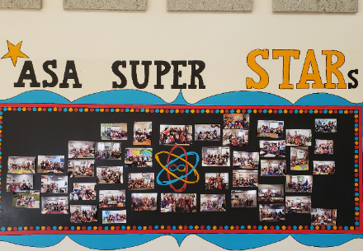
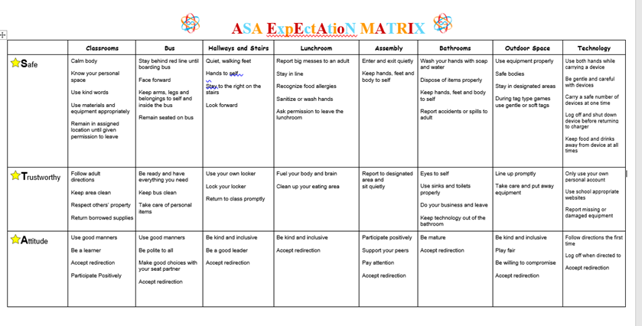
Art & Science Academy Elementary School
District: ISD #4227-07
Arts & Science Academy Elementary
Cohort: #15
Notes:
Janet will introduce the schools - read the names

Slide 24
Art & Science Academy Middle School
District: ISD #4227-07
Arts & Science Academy Middle School
Cohort: #15
Notes:
+

Slide 25
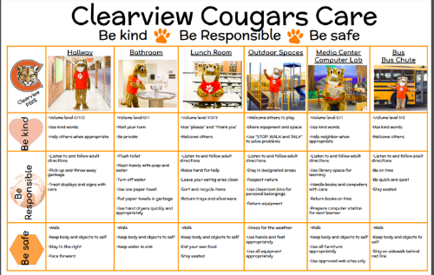
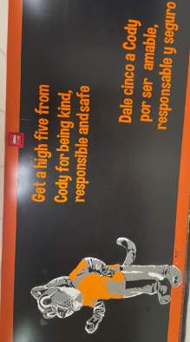
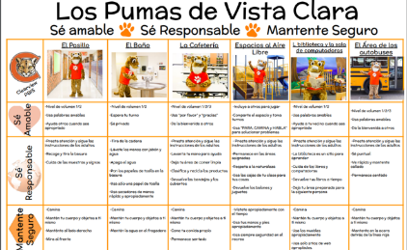
Clearview Elementary
District: ISD #742
St. Cloud Area School District 742
Cohort: #6
Notes:
+

Slide 26
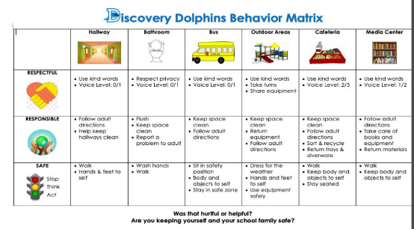
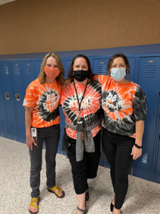
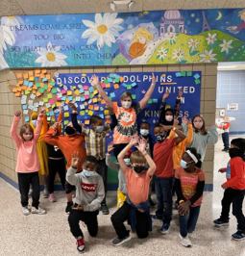
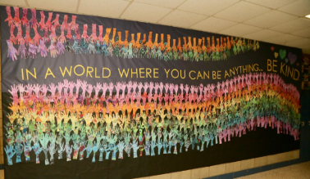
Discovery Community School
District: ISD #742
St. Cloud Area School District 742
Cohort: #4
Notes:
+

Slide 27
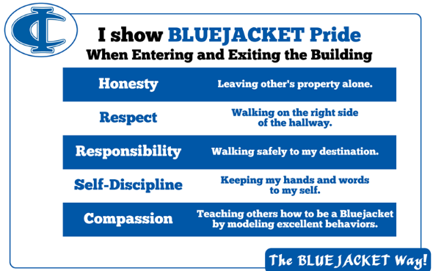
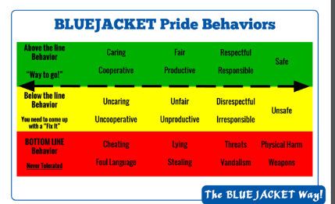
Isanti Intermediate School & School for All Seasons
District: ISD #911
Cambridge-Isanti Schools
Cohort: #6
Notes:
+

Slide 28
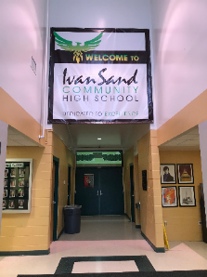
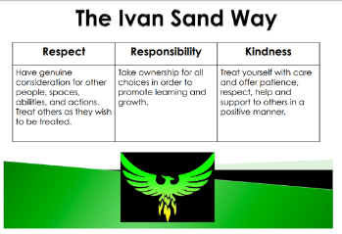
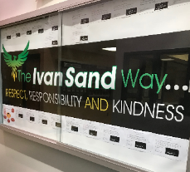
Ivan Sand Community High School
District: ISD #728
ISD 728 - Elk River, Otsego, Rogers, Zimmerman
Cohort: #7
Notes:
+

Slide 29
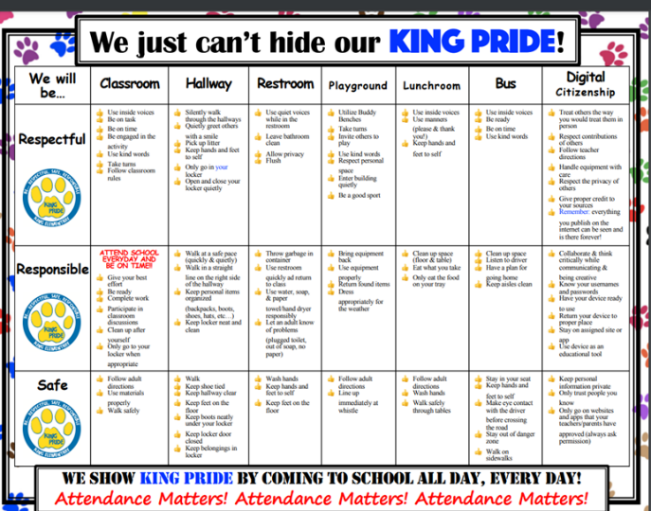
King Elementary School
District: ISD #317
Deer River Public School District
Cohort: #5
Notes:
+

Slide 30
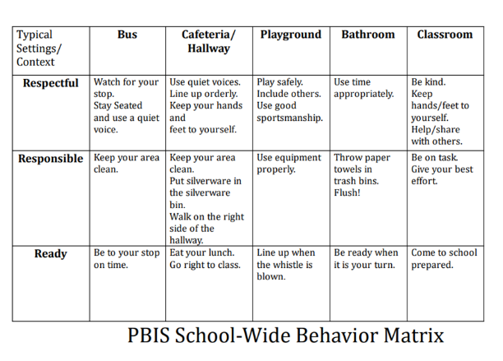
Lake Park Audubon Elementary
District: ISD #2889
Lake Park Audubon School District #2889
Cohort: #4
Notes:
+

Slide 31
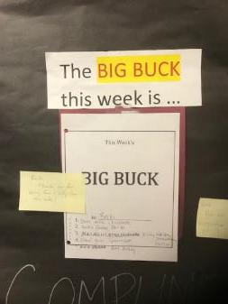
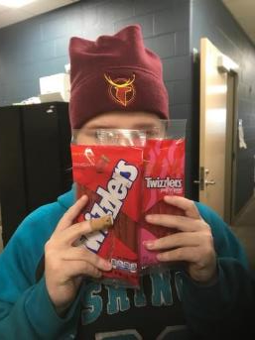
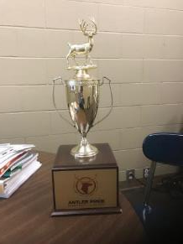
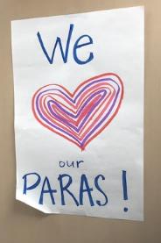
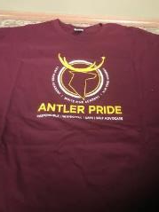
Leaf River/White Pine/Elm Tree Academies
District: ISD #6004
Freshwater Education District
Cohort: #7
Notes:
+

Slide 32
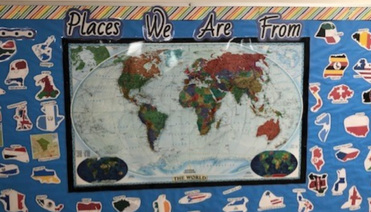
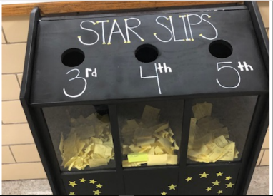
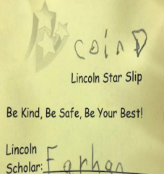
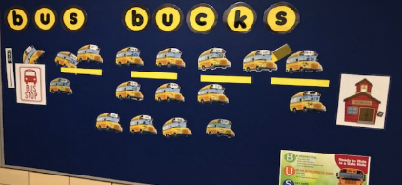
Lincoln Elementary School
District: ISD #742
St. Cloud Area School District 742
Cohort: #1
Notes:
+

Slide 33
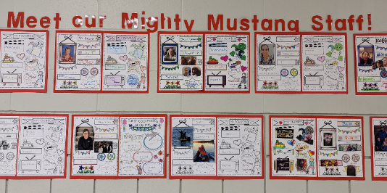
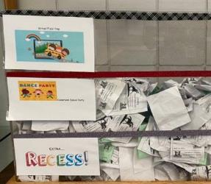
Meadowvale Elementary
District: ISD #728
ISD 728 Elk River-Otsego-Rogers-Zimmerman
Cohort: #10
Notes:
+

Slide 34
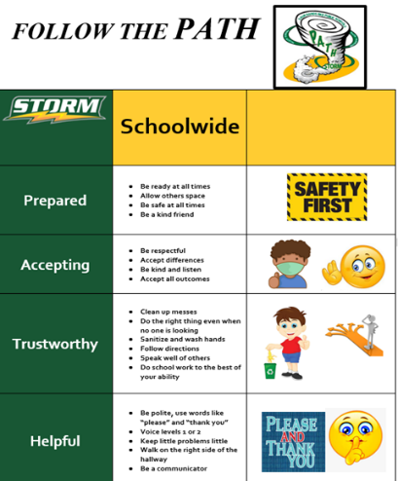
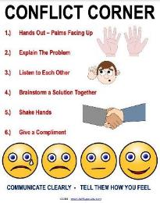
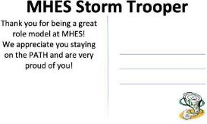
Mississippi Heights Elementary School
District: ISD #47
Sauk Rapids-Rice Public Schools
Cohort: #10
Notes:
+

Slide 35
North Junior High
District: ISD #742
St. Cloud Area School District 742
Cohort: #15
Notes:
+

Slide 36
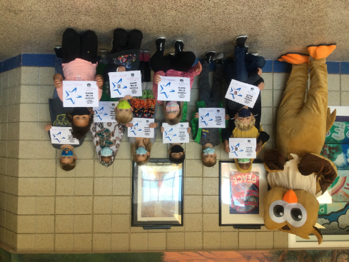
Oak Hill Community School
District: ISD #742
St. Cloud Area School District 742
Cohort: #2
Notes:
+

Slide 37
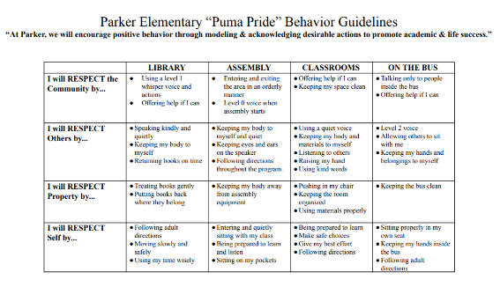
Parker Elementary School
District: ISD #728
ISD 728 - Elk River-Otsego- Rogers-Zimmerman
Cohort: #12
Notes:
+

Slide 38
Pine River-Backus Elementary School
District: ISD #2174
Pine River - Backus Public Schools
Cohort: #7
Notes:
+

Slide 39
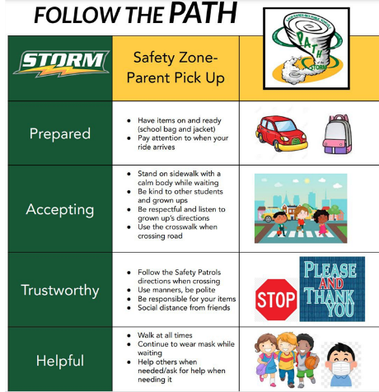
Rice Elementary School
District: ISD #47
Sauk Rapids - Rice Schools ISD 47
Cohort: #10
Notes:
+

Slide 40
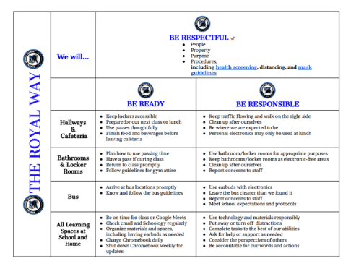
Rogers Middle School
District: ISD #728
ISD 728 - Elk River-Otsego-Rogers-Zimmerman
Cohort: #14
Notes:
+

Slide 41
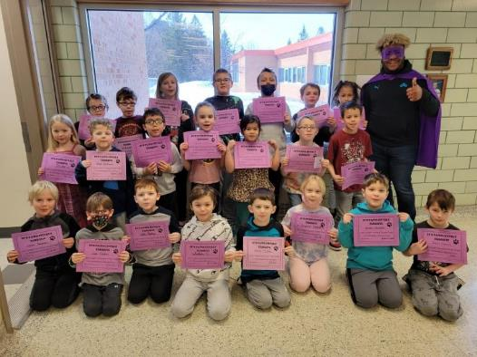
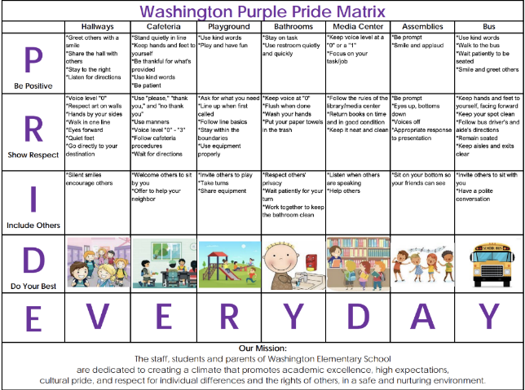
Washington Elementary
District: ISD #94
Cloquet Public Schools
Cohort: #9

Slide 42
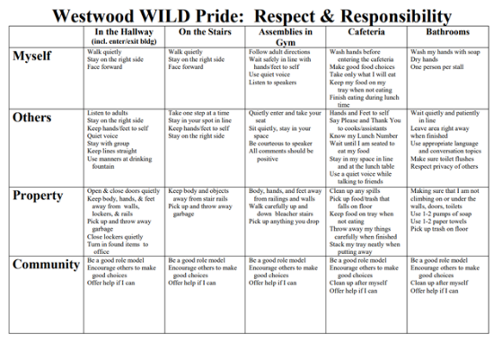
Westwood Elementary
District: ISD #728
ISD 728 - Elk River-Otsego-Rogers-Zimmerman
Cohort: #5
Notes:
+

Slide 43
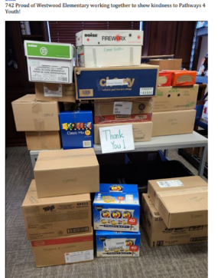
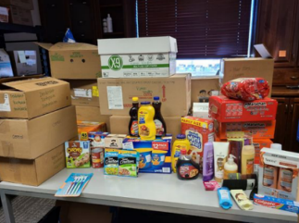
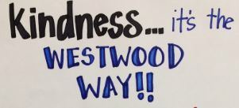
Westwood Elementary School
District: ISD #742
St. Cloud Area School District 742
Cohort: #1
Notes:
+

Slide 44
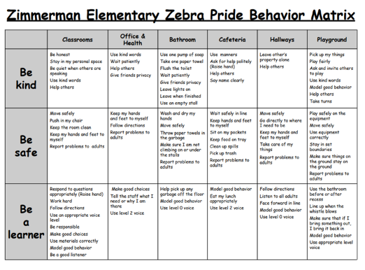
Zimmerman Elementary
District: ISD #728
ISD 728 - Elk River-Otsego-Rogers-Zimmerman
Cohort: #4
Notes:
+

Slide 45
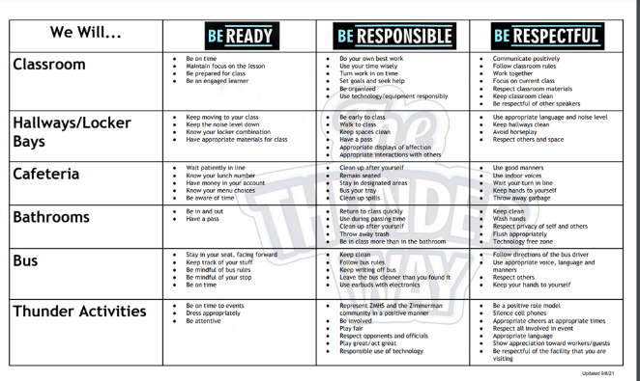
Zimmerman Middle/High School
District: ISD #728
ISD 728 - Elk River-Otsego-Rogers-Zimmerman
Cohort: #10
Notes:
+

Slide 46
Exemplar Schools - Metro
Notes:
Janet introduces Lauren
Lauren says a few things about the metro region

Slide 47
Basswood Elementary
District: ISD #279
Osseo Area Schools
Cohort: #9
Notes:
+

Slide 48
Benjamin E. Mays IB World School
District: ISD #625
Saint Paul Public School District
Non-Cohort
Notes:
+

Slide 49
Birch Grove Elementary School
District: ISD #279
Osseo Area Schools
Cohort: #6
District # 625
Metro Cohort # 6
Notes:
+

Slide 50
Bloomington Transition Center
District: ISD #271
Bloomington Public Schools
Cohort: #4
Notes:
+

Slide 51
Como Park Elementary School
District: ISD #625
Saint Paul Public Schools
Cohort: #6
District # 625
Metro Cohort # 6
Notes:
+

Slide 52
Chanhassen High School
District: ISD #112
Eastern Carver County
Cohort: #4
District # 625
Metro Cohort # 6

Slide 53
Dayton’s Bluff Achievement Plus Elementary
District: ISD #625
Saint Paul Public Schools
Non-Cohort
District # 625
Metro Cohort # 6
Notes:
+

Slide 54
Edinbrook Elementary
District: ISD #279
Osseo Area Schools
Cohort: #13
Notes:
+

Slide 55
Edward Neill Elementary
District: ISD #191
Burnsville - Eagan - Savage School District 191
Cohort: #7
District # 625
Notes:
+

Slide 56
Fair Oaks Elementary
Student | Sum of Total Time
Restorative Practices | 93:44
Work completion | 12:25
Breakfast | 24:35
Yellow Pass | 923:58
Green Pass | 423:06
recess detention | 7:02
study hall detention | 0:15
Grand Total | 1485:05
Student | Sum of Total Time
Restorative Practices | 62:57
Work completion | 2:48
Breakfast | 0:18
Yellow Pass | 329:23
Green Pass | 113:03
Recess detention | 1:20
Grand Total | 509:49
Scaled from 2018-2022
Fair Oaks Winter Olympics
District: #279
Osseo Area Schools
Cohort: Non Cohort School
Notes:
+

Slide 57
Hennepin Elementary School
District: Hennepin Schools
Cohort: #13
District # 625
Notes:
+

Slide 58
Hilltop Primary School
District: ISD #277
Westonka Public Schools
Cohort: #7
District # 625
Notes:
+

Slide 59
Laketown Elementary School
District: ISD #110
Waconia Public Schools
Cohort: #12
District # 110
Notes:
+

Slide 60
L’ Étoile du Nord French Immersion
District: ISD #625
Saint Paul Public Schools
Non-Cohort
District # 110
Notes:
+

Slide 61
Maxfield Elementary School
District: ISD #624
Saint Paul Public Schools
Non-Cohort
Notes:
+

Slide 62
North View Middle School
District: ISD #279
Osseo Area Schools
Non-Cohort

Slide 63
Oak Point Elementary
District: ISD #272
Eden Prairie Schools
Cohort: #11
Notes:
+

Slide 64
Oak View Elementary
District: ISD #279
Osseo Area Schools
Cohort: #10
Notes:
+

Slide 65
Osseo Area Learning Center
District: ISD #279
Osseo Area Schools
Non-Cohort
Notes:
+

Slide 66
Pioneer Ridge Middle School
District: ISD #112
Eastern Carver County Schools
Cohort: #4
Notes:
+

Slide 67
Prairie View Elementary
District: ISD #272
Eden Prairie Schools
Cohort: #12
Notes:
+

Slide 68
Rice Lake Elementary
District: ISD #12
Centennial School District
Cohort: #10
Notes:
+

Slide 69
Shirley Hills Primary
District: ISD #277
Westonka Public Schools
Cohort: #12
Notes:
+

Slide 70
Valley View Middle School
District: ISD #271
Bloomington Public Schools
Cohort: #4
Notes:
+

Slide 71
Vista View Elementary School
District: ISD #191
Burnsville - Eagan - Savage School District 191
Cohort: #7
Notes:
+

Slide 72
Woodland Elementary
District: ISD #279
Osseo Area Schools
Non-Cohort
Notes:
+

Slide 73
Exemplar Schools - South

Slide 74
Goodview Elementary School
District: ISD #861
Winona Area Public Schools
Cohort: #15
Notes:
+

Slide 75
I.J. Holton Intermediate School
District: ISD #492
Austin Public School District
Cohort: #14
Notes:
+

Slide 76
Jefferson Elementary School
District: ISD #861
Winona Area Public Schools
Cohort: #15
Notes:
+

Slide 77
Morristown 5-8
District: ISD #2143
Waterville-Elysian-Morristown Public Schools
Cohort: #8
Notes:
+

Slide 78
Sleepy Eye Elementary
District: ISD #84
Sleepy Eye Public School
Cohort: #6
Notes:
+

Slide 79
T.E.A.M. Academy Charter School
District: ISD #4127
TEAM Academy Charter School
Cohort: #9
Notes:
+

Slide 80
Tri-City United Le-Center K-8
District: ISD #2905
Tri-City United School District
Cohort: #6
Notes:
+

Slide 81
Washington-Kosciusko Elementary School
District: ISD #861
Winona Area Public Schools
Cohort: #15
Notes:
+

Slide 82
Waterville-Elysian-Morristown Elementary School
District: ISD #2143
Waterville-Elysian-Morristown Public Schools
Cohort: #8
Notes:
+

Slide 83
Woodson Kindergarten Center
District: ISD #492
Austin Public School District
Cohort: #7
Notes:
+

Slide 84
St. Cloud Area Schools
District

Slide 85
Congratulations to all our Exemplar Schools!

Slide 86
Recognition Schools - Congratulations!
Art and Science Academy Elementary and Middle School
Basswood Elementary
Benjamin E. Mays IB World School
Birch Grove Elementary
Bloomington Transition Center
Chanhassen High School
Clearview Elementary
Como Park Elementary School
Dayton’s Bluff Achievement Plus
Discovery Community School
Edinbrook Elementary
Edward Neill Elementary
Fair Oaks Elementary
Goodview Elementary School
Hilltop Primary
Hennepin Elementary
I.J. Holton Intermediate School
Isanti Intermediate School & School for All Seasons
Ivan Sand Community High School
Jefferson Elementary School
King Elementary School

Slide 87
Recognition Schools - Congratulations! 2
North Junior High
North View Middle School
Oak Hill Community School
Oak Point Elementary
Oak View Elementary
Osseo Area Learning Center
Parker Elementary School
Pine River-Backus Elementary School
Pioneer Ridge Middle School
Prairie View Elementary
L’Etoile du Nord French Immersion Elementary
Lake Park Audubon Elementary
Laketown Elementary
Leaf River/White Pine/Elm Tree Academies
Lincoln Elementary
Maxfield Elementary
Meadowvale Elementary
Mississippi Heights Elementary School
Morristown 5-8
Notes:
- TJ

Slide 88
Recognition Schools - Congratulations! 3
Rice Elementary School
Rice Lake Elementary
Rogers Middle School
Shirley Hills Primary
Sleepy Eye Elementary
TEAM Academy
Tri-City United Le Center K-8
Valley View Middle School
Vista View Elementary School
Washington Elementary
Washington-Kosciusko Elementary School
Waterville-Elysian-Morristown Elementary School
Westwood Elementary - Elk River School District
Westwood Elementary School - District 742 St. Cloud Area Schools
Woodland Elementary
Woodson Kindergarten Center
Zimmerman Elementary
Zimmerman Middle/High School
Notes:
- TJ

Slide 89
Regional Support
Contact Information
Metro Regional Implementation Project
Lauren Sparr MRIP Coordinator Lauren.Sparr@metroecsu.org
Debi Doran
Coaching and Evaluation Coordinator
PBIS.Debi@gmail.com
North Regional Implementation Project
Erin Engness NRIP Coordinator EEngness@resourcecoop-mn.gov
Charlie Eisenreich
External Coach
ceisenre@gmail.com
South Regional Implementation Project
Liz Deen
Lead SRIP Coordinator
Liz.Deen@swwc.org
Hazel Ashbeck
SRIP Coordinator
Hazel.Ashbeck@swwc.org
Sara McAdams
Data & SWIS Coordinator
Sara.McAdams@swwc.org
Amber Bruns Grant Administrator Amber.Bruns@swwc.org
Find other PBIS Minnesota contacts at: https://pbismn.org/contact-us.php
Notes:
RIP Coordinators introduce themselves - those in attendance

Slide 90
Congratulations to our Exemplar Districts

Slide 91
Districts Recognized - Congratulations! 4
Burnsville-Eagan-Savage School District 191
Cambridge-Isanti Schools ISD 911
Osseo Area Schools 279
St. Cloud Area School District 742
Waterville-Elysian-Morristown School District #2143

Slide 92
Do you want to be recognized as Sustaining Exemplar School or District in 2023?
Information will be posted on the MN PBIS Website:
www.pbismn.org
Also, be sure you’re following us on our social media sites!

Slide 93
Are you interested in getting involved in Minnesota PBIS as a trainer, coach, or other role?
pbismn/coaches/index.php

Slide 94
Thank you for joining
today and our annual
Summer Institute!

