Slide 1
PBIS Summer Institute 2023
Welcome and Opening – Day 1
Minnesota Department of Education | PBIS Management Team
June 14, 2023
Notes:
Relationship to the broader context of all students.
These Tier 1 supports that set a nice foundation and school-wide context for students who need additional, more individualized supports, such as a BIP, small group or individualized interventions in tier2 or tier 3, or mental health support.
"Right now, many districts are looking at their academic supports, but it's just as or more important to pay attention to social and emotional supports," - Kent McIntosh, co-director of the Center on Positive Behavioral Interventions and Supports
Schools in Minnesota have found ways to integrate positive behavior supports into distance learning practices.
"This is a really important time of transition, and [positive behavior supports] will really help students in that transition," - Eric Kloos, assistant director of special education for the Minnesota Department of Education
PBIS practices can help improve outcomes for all students and decrease disproportionality in discipline.

Slide 2
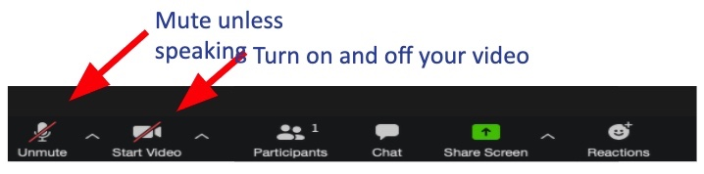
Zoom Reminders and Tips
You will be muted on entry
You can ask questions in the chat or at the end
Optional to use video
//surveygizmolibrary.s3.amazonaws.com/library/135041/SummerInstitute2023CertificateofAttendanceDay2.docx

Slide 3
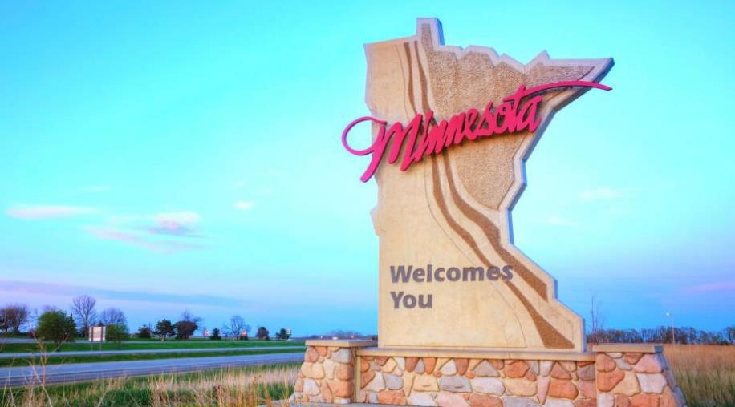
Welcome to Minnesota PBIS Summer Institute

Slide 4
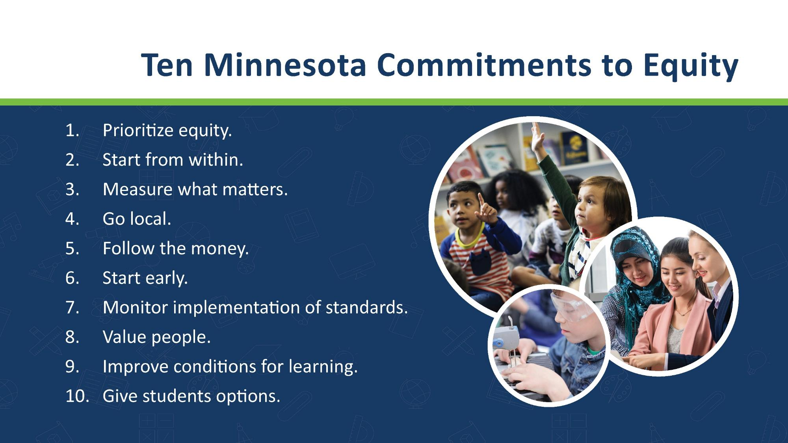
Ten Minnesota Commitments to Equity

Slide 5
Thank You
You made it through one of the toughest MN winters and the 2022-2023 school year!
We want to recognize your sustained efforts to improve outcomes for students and today most notably your PBIS work!
PBIS implementation takes intentional, sustained team effort over time. The non-linear fashion of implementation can be challenging. We would like to thank you for your PBIS work in your school and your presence today.

Slide 6
PBIS Growth in Minnesota

Slide 7
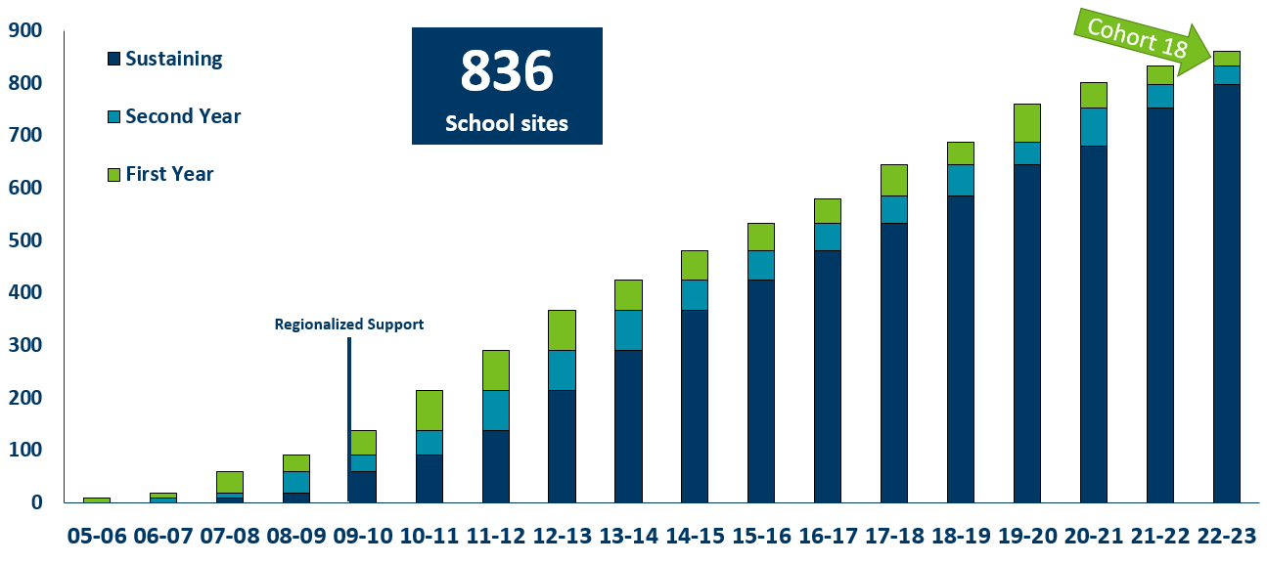
Growth of PBIS in Minnesota
2005-2023

Slide 8
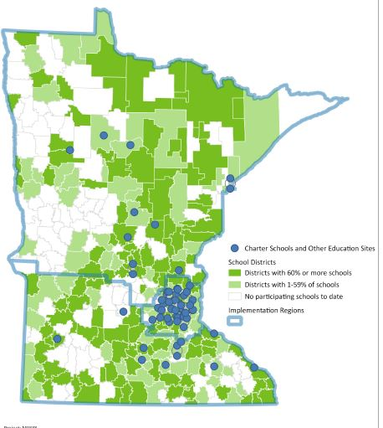
PBIS Scale-Up in Minnesota
As of 2023
288 districts/charters
  57% of districts/charters in MN
836 schools
  40% of schools in Minnesota
392,506 students
  45% of students in Minnesota

Slide 9
Stage-based Implementation
Statewide Cohorts 11-17 – 2015-2023

Slide 10

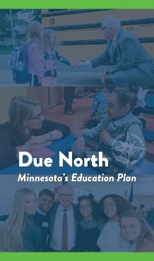
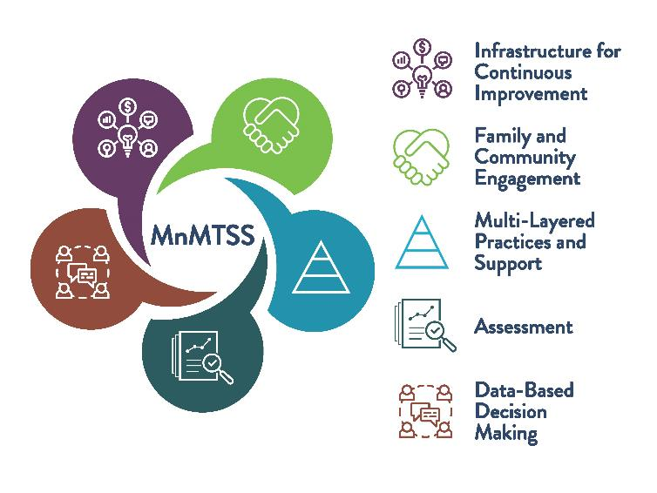
Minnesota Department of Education Priorities & Alignment
Notes:
Developed from a robust engagement effort with educators, school leaders, students, and families across the state, the Due North Education Plan is centered on ensuring every child in Minnesota receives a high-quality education, no matter their race or zip code. The Due North Education Plan is built from the voices and ideas of Minnesotans whom the Walz-Flanagan Administration engaged in their first two years in office, including the Governor’s Education Roundtable, the School Finance Working Group, the creation of the Minnesota Department of Education’s Strategic Plan, and conversations with educators, school leaders, education organizations, students and families.
The COVID-19 pandemic has exacerbated disparities in education across Minnesota, especially along racial and geographic lines. The Due North Education Plan will help students catch up on learning, while closing the opportunity gap and transforming our education system for years to come.
The plan includes actions to:
Support students during and after the COVID-19 pandemic
Reform our school finance system
Expand opportunities for students in Greater Minnesota
Build the most qualified and diverse teaching workforce in the nation
In addition, the plan would ensure academic standards address the modern needs of the workforce, are inclusive of ethnic studies, and are reflective of students of color and Indigenous students in order to close opportunity gaps and end disparities.
Detailed information about how the Due North Education Plan priorities were established and will be met are available in these documents:
A Roadmap for the Transformational Change in Minnesota Education, report from the Governor's Education Roundtable
80-20-10: Bringing Equity to Minnesota's School Finance System, report from the School Finance Working Group
Minnesota Department of Education Strategic Plan

Slide 11
2023 Minnesota PBIS Summer Institute Recordings Made Available
Presentations and links to recordings from June 14-15, 2023 will be available on the Summer Institute webpage (http://pbisMN.org/summer-institute)
Topics to view for sharing with others:
  Day 1 Keynote with PBIS Presenter Panel, Sustainable Stories: Perspectives on Leading Sustained Implementation
  Westonka Pyramid Model and PBIS
  Using Behavior Coaches for Behavior Management
  Roles and Responsibilities of a PBIS Coach/Educational Coaching
  PBIS Film Festival
  Day 2 Opening Session with Dan Torrez, Native Voices for PBIS
  Using the Principal Coach Relationship to Implement a Proactive Approach to Student Behavior
  The Importance of Emotional Intelligence Within School-Based Teams
  MN PBIS Sustaining Exemplar Ceremony

Slide 12
Congratulations to our Exemplar Schools and Districts
Notes:
Please join us on Day 2 for the Exemplar ceremony

Slide 13
Resources

Slide 14
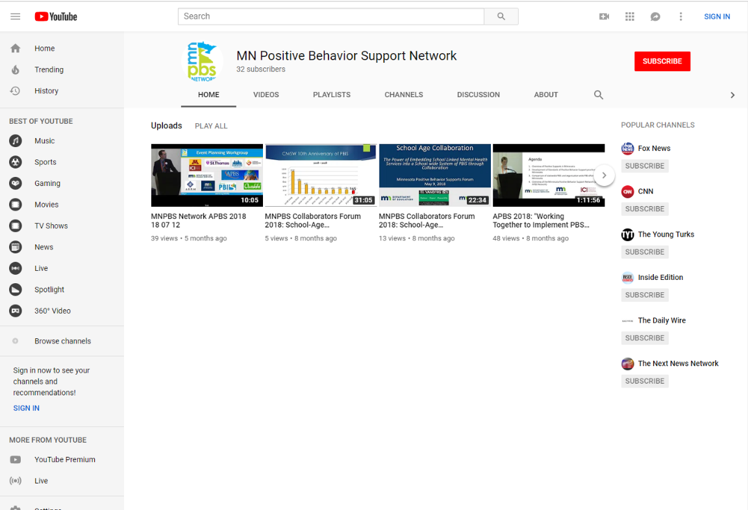
Recording Access: Subscribe on YouTube
“MN Positive Behavior Support Network” channel has:
  Home
  Videos
  Playlists
  Channels
  Discussion
  About
Click Subscribe button on top right next to channel icon

Slide 15
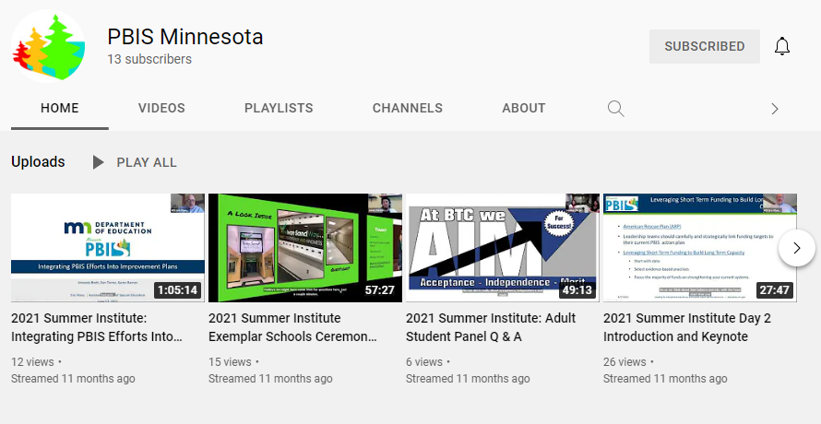
PBIS Minnesota YouTube Channel

Slide 16

New and Emerging Resources on PBIS.org
School Mental Health Integration: Lessons Learned from Implementation of the Interconnected Systems Framework across Two Local Education Agencies
Measuring Fidelity of Core Features of Tier 2 Systems and Practices in Schools
Supporting and Responding to Educators’ Classroom PBIS Implementation Needs: Guide to Classroom Systems and Data
Why Implement Tier 1 PBIS for Students with Disabilities? What Does Research Say?

Slide 17
Recorded Training Webinars
Positive Behavioral Interventions and Supports (PBIS) 101: An introduction to the framework, structures, and work that Minnesota schools are doing in PBIS and a multi-tiered system of support (MTSS) across the state.
Alternative Delivery of Special Education Services (ADSIS) 101: An introduction to ADSIS programming, local examples from implementing sites and updates on the application window for ADSIS funding.
Local Implementation Alignment - Integrating PBIS and School Linked Behavioral Health (SLBH) Services: Partnerships between public school districts and local mental health agencies to support PBIS
All accessible recordings and materials can be found at the MDE Special Education Training webpage (https://education.mn.gov/MDE/dse/sped/spedtrain)

Slide 18


Share your #pbisMN work!
facebook.com/pbisMN
twitter.com/pbisMN

Slide 19

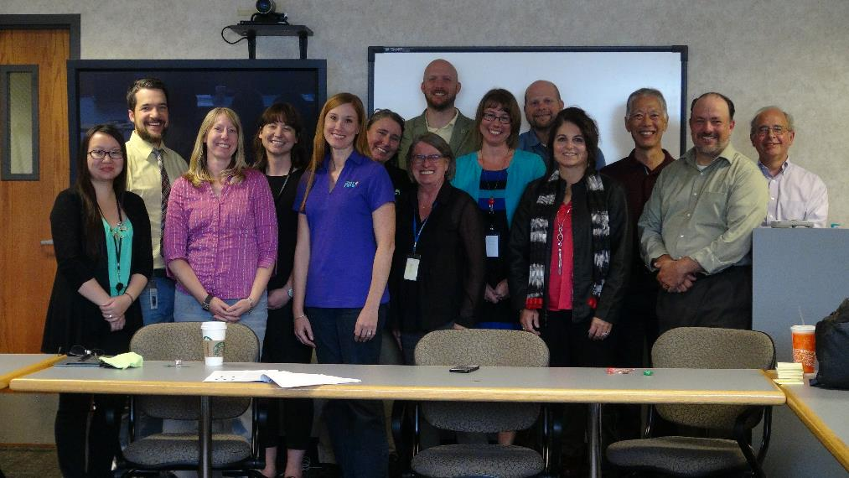
Honoring our Dear Friend and Colleague Becky Nies

Slide 20

Enjoy the Institute
Minnesota PBIS
Boundary Waters Canoe Area
Notes:
The Boundary Waters Canoe Area Wilderness - Over a million acres of pristine wilderness used primarily for canoeing and camping on the Minnesota-Canadian border.

