Slide 1
The Importance of Emotional Intelligence Within School-Based Teams
Cheryl Cook • Ellen Grossman • Michele Wackman

Slide 2
Our Session Objectives
Learn how team operating procedures set the foundation for developing your Team’s Emotional Intelligence (EI)
Review the history of EI
Explore ways to grow your EI
Explore ways to grow your school-based teams’ EI

Slide 3
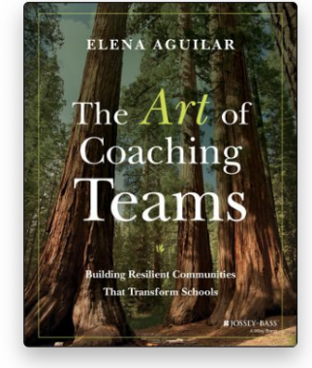
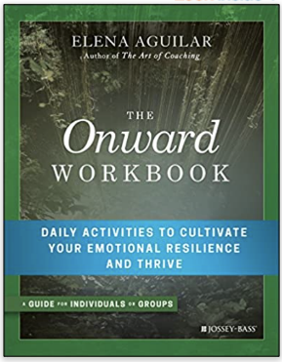
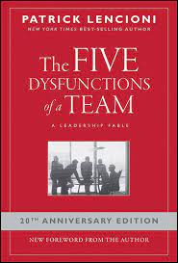
Resources
Bright Morning

Slide 4
To Go Together We Will Need…
Effective Team Operations
Notes:
Transition slide to Ellen’s Team Operations Slides

Slide 5
Set the Stage
Enhance…
Predictability
Use of time
Consistency
Professionalism
Distribution
Results
Reduce….
Unpredictability
Anxieties
Confusion
Inconsistencies
Spinning
Disproportionality
Notes:
Ellen- when these are reduced more likely to build trust and relationships

Slide 6
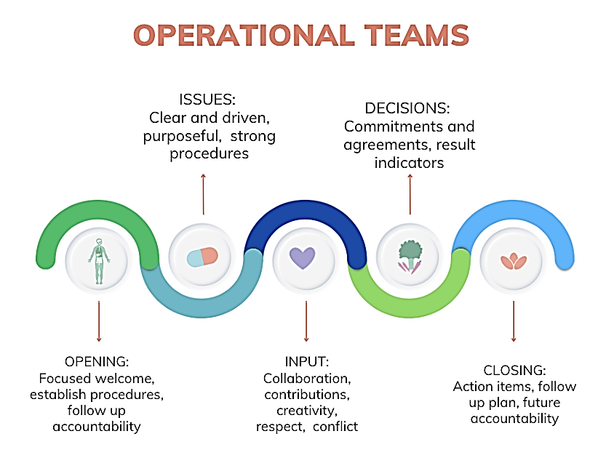
Team Operations
Notes:
Discussion and open to audience- welcoming routines (ellen share word/ number strategy), Discuss EOS system- check in, report back whip, quick headlines or framing, issues dig deep (majority), wrap up, score the meeting

Slide 7
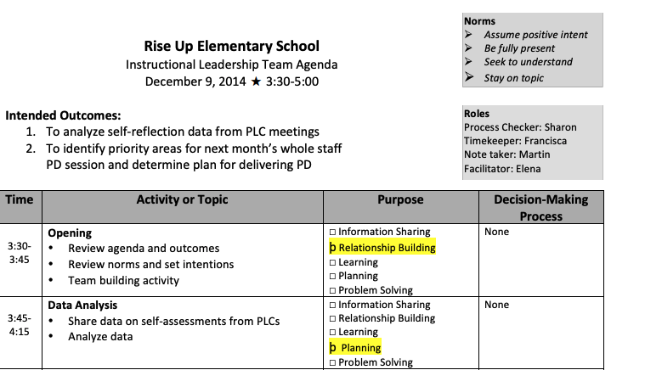
Team Example
Sample Agenda- Aguilar Clickable Example
Notes:
ellen working on this

Slide 8
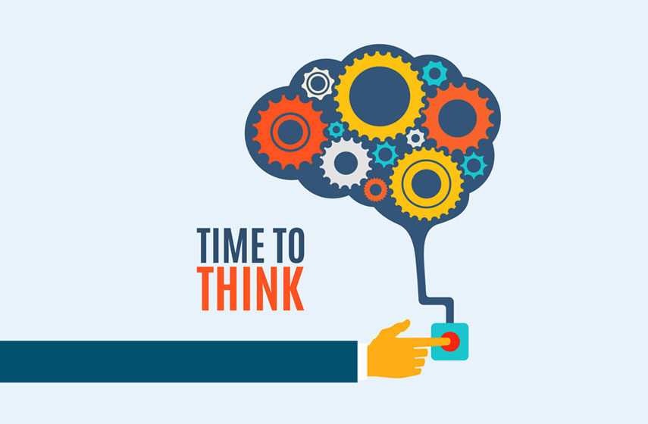
Team Effectiveness
Team Effectiveness
Notes:
Participant activity slide- show but don’t spend any time on it

Slide 9
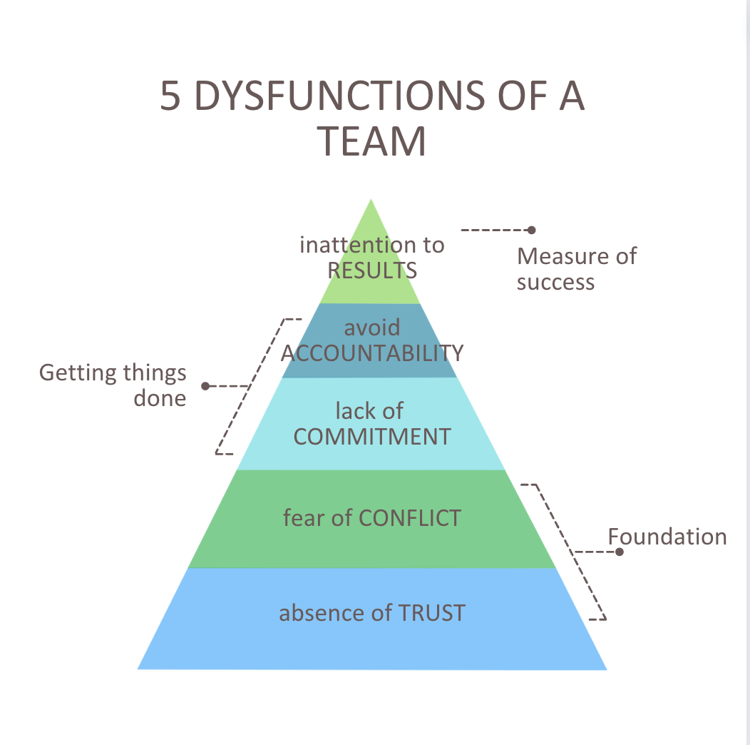
Indicators of an Effective Team
Notes:
Ellen

Slide 10
History of Emotional Intelligence
Date | Person | Topic
1920s | Edward Thorndike | Social Intelligence
1950s | Abraham Maslow | “Can build emotional strength”
1983 | Howard Garner | Multiple Intelligences
1990 | Mayer & Salovey | Emotional Intelligence published article
Notes:
Michelle 10-24

Slide 11
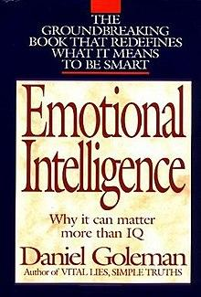
Launch of Emotional Intelligence
1995

Slide 12
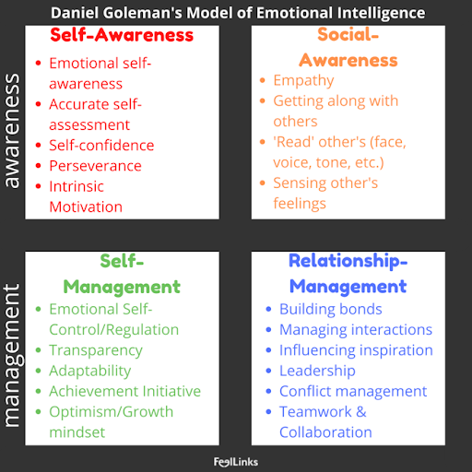
Goleman’s 4 Components

Slide 13
Goleman’s 4 Components (2)
Why does Goleman’s work look very familiar?

Slide 14
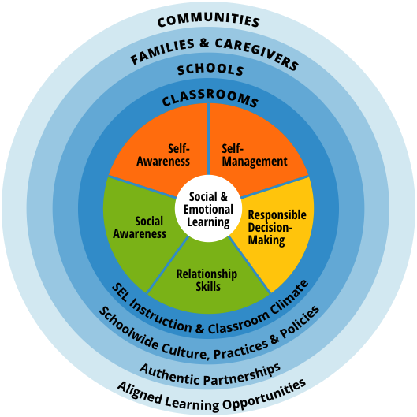
CASEL Framework
Notes:
Founded in 1994
Daniel Goleman was Co-Founder along with Eileen Rockefeller Growald

Slide 15
We can not teach what we can not do
“In order to create conditions for students to engage in SEL, adults need to feel empowered, supported, and valued. This calls on districts to foster a supportive staff community that promotes adults’ own SEL. This focus area helps districts strengthen staff expertise and skills to lead SEL initiatives, as well as cultivate adults’ social, emotional and cultural competencies.”
Strengthening Adult SEL=EI

Slide 16
EI = SEL
What adults need are the same skills we are teaching to kids….
MDE Grade Level SEL BENCHMARKS – using CASEL framework
Notes:
*The construct of EI or SEL has been around for over 3 decades but just starting getting traction and attention in the schools more recently.
*Go in and show the grade level strands (quick walk through)

Slide 17
Emotionally Intelligent Individuals
Need 2 Sets of Skills:
Awareness (Self & Social)
Management (Self & Relationships)

Slide 18
Energy Check-In
Energy Check-In
Notes:
Show but don’t have them do. This is a more global check in of all your energy. Then take a deeper dive into one of the four domains…EMOTIONS.

Slide 19
Why Do We Have Emotions?
Understanding the Emotional Guidance System
Emotions are our guiding signals.
Emotions can motivate us to take action
Emotions help us survive, thrive, and avoid danger
Emotions can help us make decisions
Emotions allow other people to understand us
Emotions allow us to understand others
What if
Notes:
what if from very little we had someone like this incredible mama teaching us about emotions…this little one already knows what emotions are-most of us never had a conversation like this with our caregivers about emotions-this little guy knows more than many adults

Slide 20
Mindful Daily “Bookending”
Morning
Set an intention for the day (one word or phrase)
Flexible
Strong
Curious
Peaceful
Rooted
Open-minded
Grounded
Evening
Check-in about the day
What went well?
What didn’t go well?
What did I learn & how will I be smarter tomorrow?
Who Am I grateful for?

Slide 21
Cycle of Emotions Activity and Reflection Questions
Cycle of Emotions Activity and Reflection Questions
Notes:
Participant activity slide

Slide 22
Getting Curious…
Where in the Emotion Cycle can you most easily intervene?

Slide 23
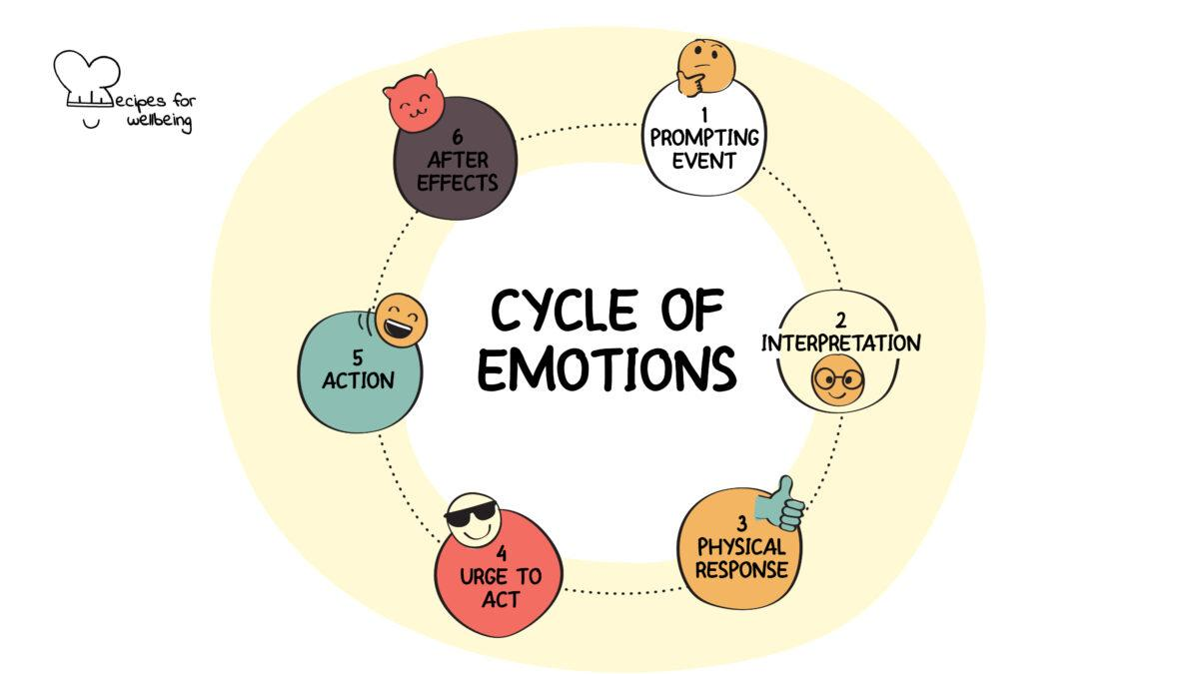
Cycles of Emotions

Slide 24
Interpretation Stage
Recognizing Cognitive Distortions
All or Nothing Thinking
Overgeneralizing
Catastrophizing
Magical Thinking
Personalizing
Jumping to Conclusions (Mind Reading or Fortune Telling)
Disqualifying the Positive
Magnifying or Minimizing
“Should” Statements therapistaid.com
Notes:
All cognitive distortions are: Michelle
Tendencies or patterns of thinking or believing;
That are false or inaccurate;
And have the potential to cause psychological damage.
Add slide w/ Chart: Cognitive distortion–Definition-Example

Slide 25
Does Emotion Impact How We Behave?
culture = behavior
climate = feel
Notes:
Cheryl 25-35

Slide 26
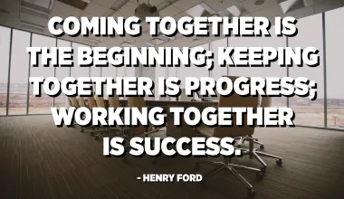
From Here to Where We Want to Be
Temperature Check
Notes:
Do the temperature check activity at MACMH

Slide 27
Reflection Tool
Reflection Tool
Notes:
Participant activity slide- dimensions of a great team - MACMH have them look at reflection tool not complete it

Slide 28
Emotionally Intelligent Teams
Leader Needs:
Ability to hold SPACE for feelings
Ability to MANAGE them in a group
Team Needs:
Norms & Routines that support healthy behavior
A facilitator who encourages behavior to respond constructively to emotionally uncomfortable situations

Slide 29
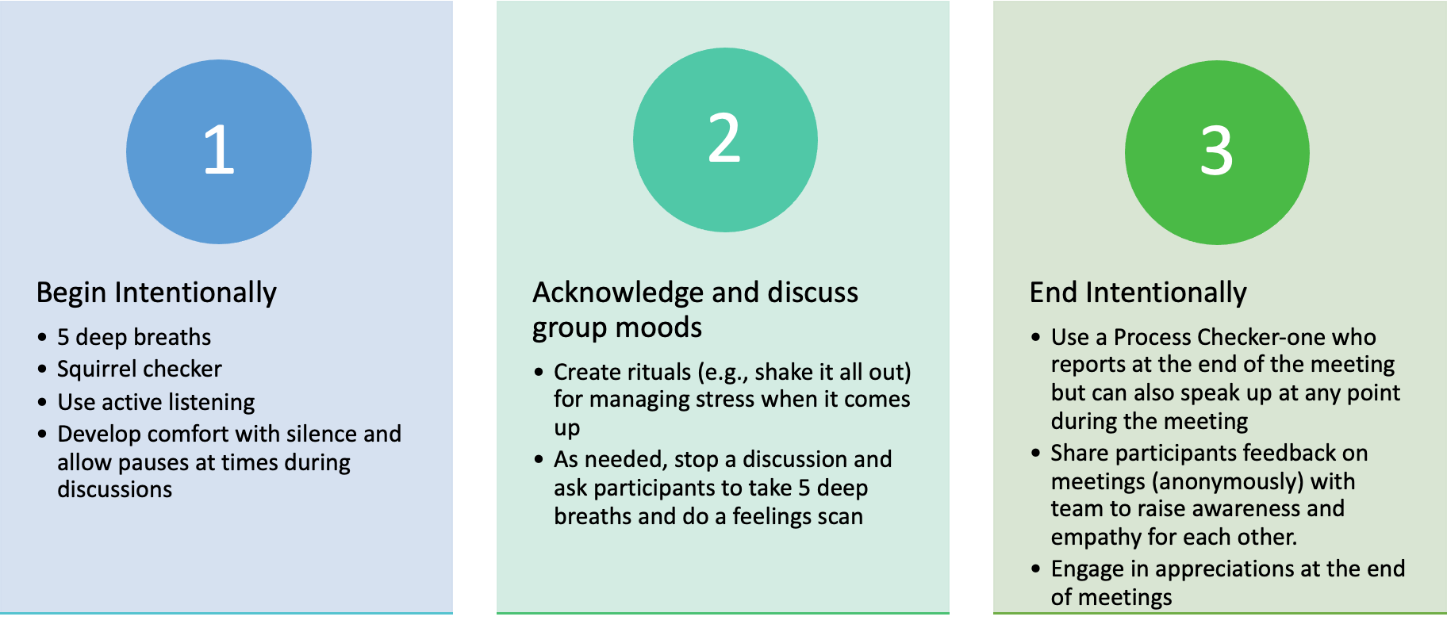
To Create Team Awareness of Feelings
Adapted from: Exhibit 6.2 © Elena Aguilar, The Art of Coaching Teams: Building Resilient Communities that Transform Schools. Jossey-Bass, 2016.
44 Ways to Build Your Team’s EI

Slide 30
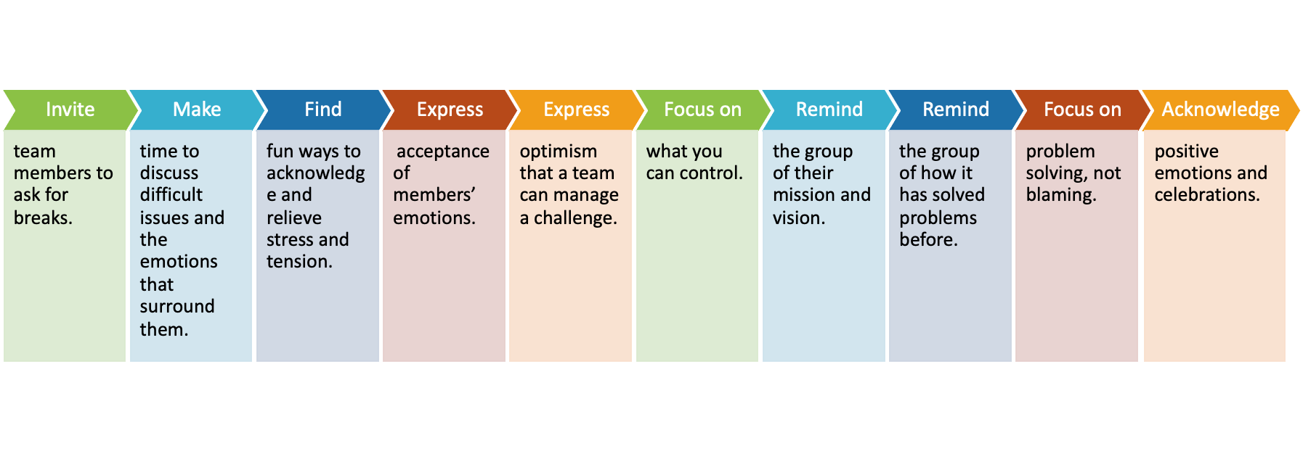
To Help A Team Manage Feelings
Adapted from: Exhibit 6.2 © Elena Aguilar, The Art of Coaching Teams: Building Resilient Communities that Transform Schools. Jossey-Bass, 2016.
44 Ways to Build Your Team’s EI

Slide 31
Indicators of a Team’s EI
Indicators of a Team’s EI
Notes:
MACMH- spend time on having teams look at these indicators and how it connects to a team they sit on
–Transition to Ellen—

Slide 32
Healthy vs. Unhealthy Conflict
“Healthy conflict brings the brings group members closer to each other and contributes to strengthening the work or product they’re focused on”
“Unhealthy conflict does the opposite. It erodes trust among teammates and distracts the group from their goals and objectives.”

Slide 33
Healthy Conflict
Acknowledge that navigating conflict is not easy and commit to managing it in healthy ways.
Understand that healthy conflict is predicated on trust and quality of relationship
Proactive Planning for Conflict:
Understand each member’s relationship with conflict
Discuss a process for navigating conflict
Practice when there is no conflict

Slide 34
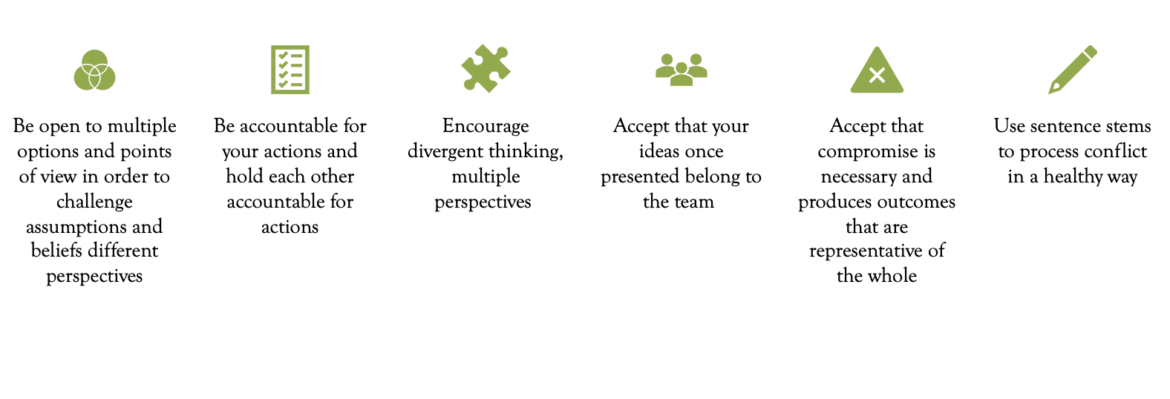
Navigating Conflict
Want to Learn More…Podcast 3 Tips for Navigating Conflict

Slide 35
Navigating Conflict
Active Listening Stems
What I’m hearing...Is that correct?
I hear you saying that…
Clarifying Stems
Let me see if I understand…
I’d be interested in hearing about…
I’m curious to know more about…
Non-judgmental Responses
I noticed…
You seem upset…
Is the anything I can do to help…
What’s on your mind right now…
Probing Stems
What would it look like if…
What sort of impact do you think…
What do you think/feel/believe about…
How did you decide...
Sentence Stems for Managing Conflict

Slide 36
Closing…
1 • 2 • 3 Activity
In reflection or on sticky notes, please capture………
1 way you can expand your EI
1 way you can apply your growth to the teams you serve
1 way this will impact the effectiveness of your team
We Wish You Well!

