Slide 1

PBIS and Behavior Coaches
5 years of Behavior Coaches and PBIS

Slide 2
Who We Are
Matt Lambaere- PBIS Lead of IJ Holton
David Brown- Behavior Coach, IJ Holton
Blake Henely- Associate Principal, IJ Holton

Slide 3
Background
During the 2017-2018 school year, IJ Holton was a school in crisis.
  Staff members were frustrated and living under the “SIG Grant” debacle, as well as having administration that was simply a bad fit for Holton.
  Poor student behavior was at an unimaginable high (2420 documented major behaviors).
In the fall of 2018, Mr. Schara and Mr. Henely were hired as new principal and assistant principal at IJ Holton.
  After spending a significant amount of time speaking with teachers before the school year began, Mr. Schara knew that not only did something major have to be done, but teachers were frustrated enough that they would be willing to accept something that was completely different.

Slide 4
Behavior Coaches
One of the first decisions made by Mr. Schara was to implement and hire Behavior Interventionists.
To pay for the position, the school removed its Reading and Math Interventionists. The belief was that if behaviors were brought under control, scores would increase naturally.
Mrs. Gunderson and Mr. Brown were hired for this position; both possessed Admin Licenses. By being licensed, this allowed them to make decisions and work with students AND staff in a way that might not have otherwise been accepted.
Title changed to “Behavior Coaches”. Change made to show they were there to teach and assist with ways to help improve behaviors for both students and staff.

Slide 5
Benefits of a Behavior Coach
Frees administration up to deal with other “administrative duties”.
Deal with Tier 1 and Tier 2 (and occasionally Tier 3) behaviors.
Not another administrator
Manage behavior data and SWIS
A designated person to set up and implement building wide expectations -Create expectations for “Hot Spots” and other out of the ordinary situations -One or two people can teach all students specific expectations- not mixed messages

Slide 6
Year 1 (2018-2019) Changes
“Officially” began using PBIS.
Attended PBIS Cohort trainings in Mankato
Invested in PBIS SWIS data collection
Established hierarchy of who deals with specific behaviors based on PBIS Pyramid
  Assistant Principal/Principal will deal with Tier 3 behaviors
  Behavior Coaches/Instructional Facilitator and Dean of Students/Continuing Improvement Specialist and Dean of Students will handle Tier 2 behaviors
  Behavior Coaches/Teachers will address Tier 1 behaviors

Slide 7
2018-2019 (cont’d)
Created School-wide Behavior Matrix
Created Behavior Flowchart
Created expectation presentations for previously known “hot spots” (i.e. cafeteria, bathrooms, locker bays, hallways, Movement Break area, and assemblies).
Assigned staff members to various supervision location.
Allocated Funds to be used for PBIS Incentives and supplies
Used SIG monies to hire two additional support staff for the Academic Recovery Room
Outdoor and Indoor Movement Break activities planned
Mrs. Gunderson created “Zones of Regulation” groups
Behavior Coaches began visiting teams during Team Time.

Slide 8
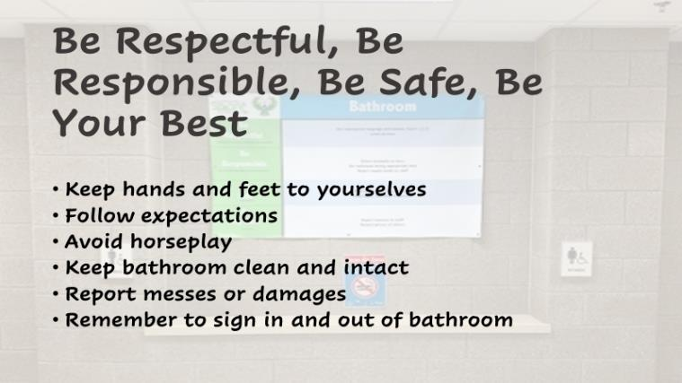

Presentations

Slide 9
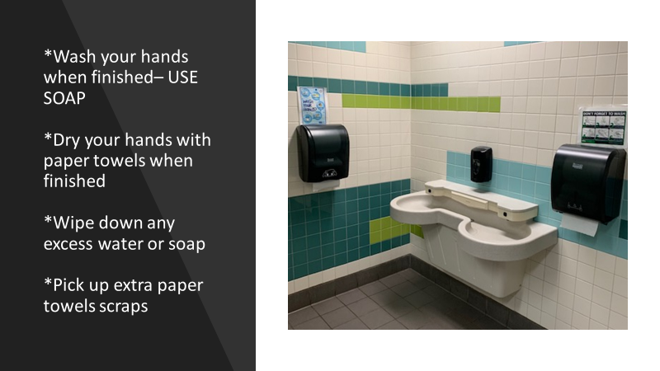
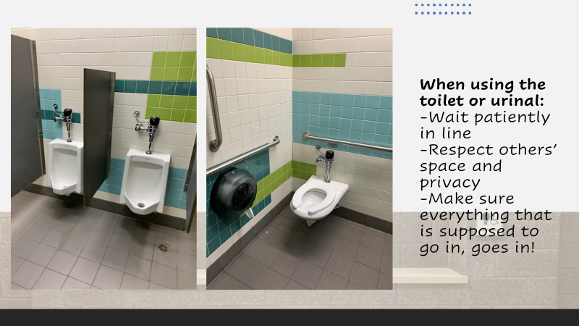

Slide 10
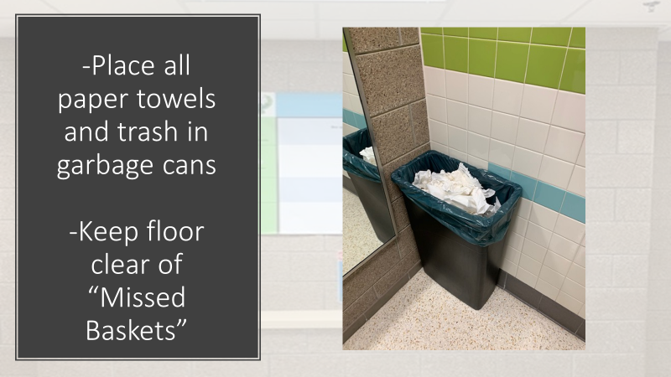
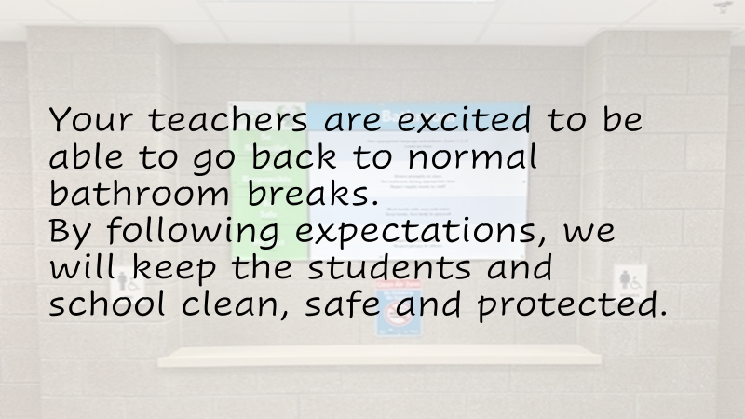

Slide 13
Year 1 (2018-2019)Data vs 2017-2018
(Major Behaviors Only)*
Location 2017-2018 2018-2019
Classroom Behaviors 1526 --------------------- 938
Locker 31------------------------- 21
Other Indoor Areas 235------------------------157
Outdoor Area (MB) 193------------------------126
Cafeteria 205------------------------22
*Infinite Campus Behavior Extracts

Slide 14
Year 1 (2018-2019)Data SWIS
(Minor Behaviors Only)*
1510 Documentations
*PBIS SWIS Data

Slide 15
Year 2 (2019-2020)
Creation of Tier II Committee
Created “Office vs Classroom Managed Behaviors” document
Formally created and began using RADs (Restorative Alternatives to Discipline)
Expectation videos and PowerPoints created to share with students
Additional equipment for Movement Break added
Assistant Principal and Behavior Coaches attended several workshops on behavior
Used documentation from Year 1 to address areas that still needed attention
Behavior Coaches began attending SAT Meetings.
Dean of Students and Continuing Improvement Specialist Positions Dropped
** March of 2020-- COVID 19 ended the school year as we knew it (Distance Learning).

Slide 20
Year 1(18-19) Data vs Year 2 (19-20)
(Major Behaviors Only)*
Location 2018-2019 2019-2020
Classroom Behaviors 938 --------------------- 396
Locker 21-------------------------12
Other Indoor Areas 157------------------------126
Outdoor Area (MB) 126------------------------91
Cafeteria 22--------------------------7
*Infinite Campus Behavior Extracts

Slide 21
Year 2 (2019-2020)Data SWIS
(Minor Behaviors Only)*
851 Documentations
*PBIS SWIS Data

Slide 22
Year 3 (2020-2021)
**COVID 19 Year**
*No Wednesdays and Multiple Distance Learning Days
Movement Break began year as large walking path only
Lunch and Movement Break in Rooms schedules and Supervisions
Breakfast in Rooms
Scheduled Bathroom Breaks
Scheduled Doors to exit the building at the end of the day
Established Masking and Building Cleaning Protocols
New Behavior Coach hired in October after one of the originals accepted an administrative position

Slide 23
Year 2(19-20) Data vs Year 3 (20-21)
(Major Behaviors Only)*
Location 2019-2020 2020-2021
Classroom Behaviors 396 --------------------- 129
Locker 12-------------------------(No Lockers used)
Other Indoor Areas 126-----------------------25
Outdoor Area (MB) 91------------------------38
Cafeteria 7--------------------------2 (Moved to Lunch in Classrooms)
*Infinite Campus Behavior Extracts

Slide 24
Year 3 (2020-2021)Data SWIS
(Minor Behaviors Only)*
296 Documentations
*PBIS SWIS Data

Slide 25
Year 4 (2021-2022)
Scheduled bathroom breaks
Reintroduction of Outdoor Movement Break activities
Review and Modifications made for return to “normal”
Scheduled building exits
Reintroduction of large group activities/Celebrations
Updated “Office vs Classroom” Matrix
Single Person Academic Recovery Room Coverage

Slide 26
2021-2022 (cont’d)
Single Person Academic Recovery Room Coverage
Usage of SWIS and Minor Documentations pushed and encouraged.
Some Tier 3 Behaviors began being handled by Behavior Coaches

Slide 27
Year 3(20-21) Data vs Year 4 (21-22)
(Major Behaviors Only)*
Location 2020-2021 2021-2022
Classroom Behaviors 129--------------------- 369
Locker N/A---------------------2
Other Indoor Areas 25-----------------------49
Outdoor Area (MB) 38------------------------80
Cafeteria 2--------------------------26
*Infinite Campus Behavior Extracts

Slide 28
Year 4 (2021-2022)Data SWIS
(Minor Behaviors Only)*
1515 Documentations
*PBIS SWIS Data

Slide 29
Year 5 (2022-2023)
Staff coverage in Academic Recovery/ Staff hallway coverage
Heavy Emphasis on Minor Referrals handled by teachers
Almost all Tier 2 and 3 Behavior Referrals handled by Behavior Coaches
Scheduled supervision locations for staff before and after school
New Behavior Coach hired in November after previous retired

Slide 31
Year 4(21-22) Data vs Year 5 (8/27-11/30)
(Major Behaviors Only)*
Location 2021-2022 2022-2023
Classroom Behaviors 369--------------------- 106
Locker 2-------------------------2
Other Indoor Areas 49-----------------------13
Outdoor Area (MB) 80------------------------28
Cafeteria 26--------------------------5
*Infinite Campus Behavior Extracts

Slide 32
Year 5 (2022-2023)Data SWIS
(Minor Behaviors Only)*
8/27-12/31
577 Documentations
*PBIS SWIS Data

Slide 33
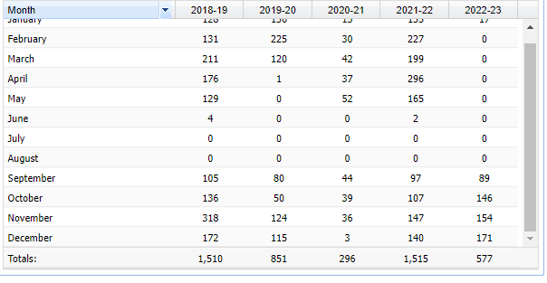

Slide 34
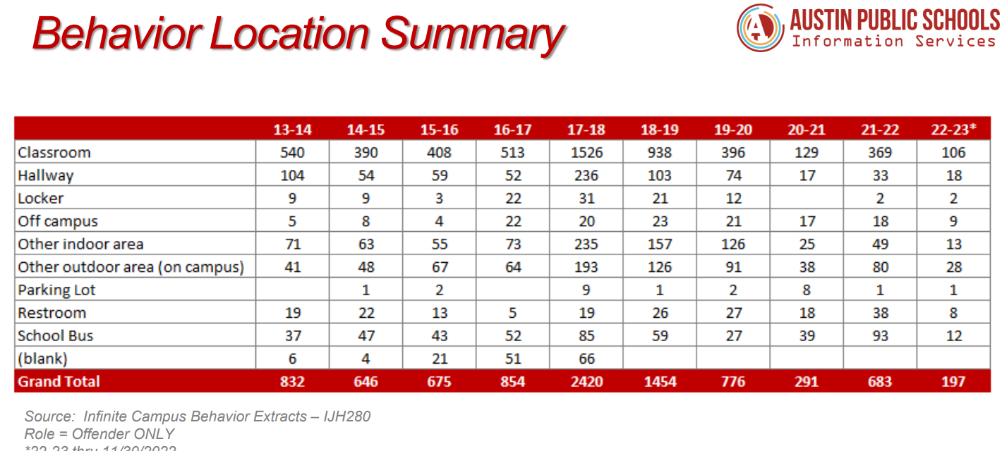

Slide 36
Questions??

